Slide 1

Mission Connection 特會分享

Slide 2
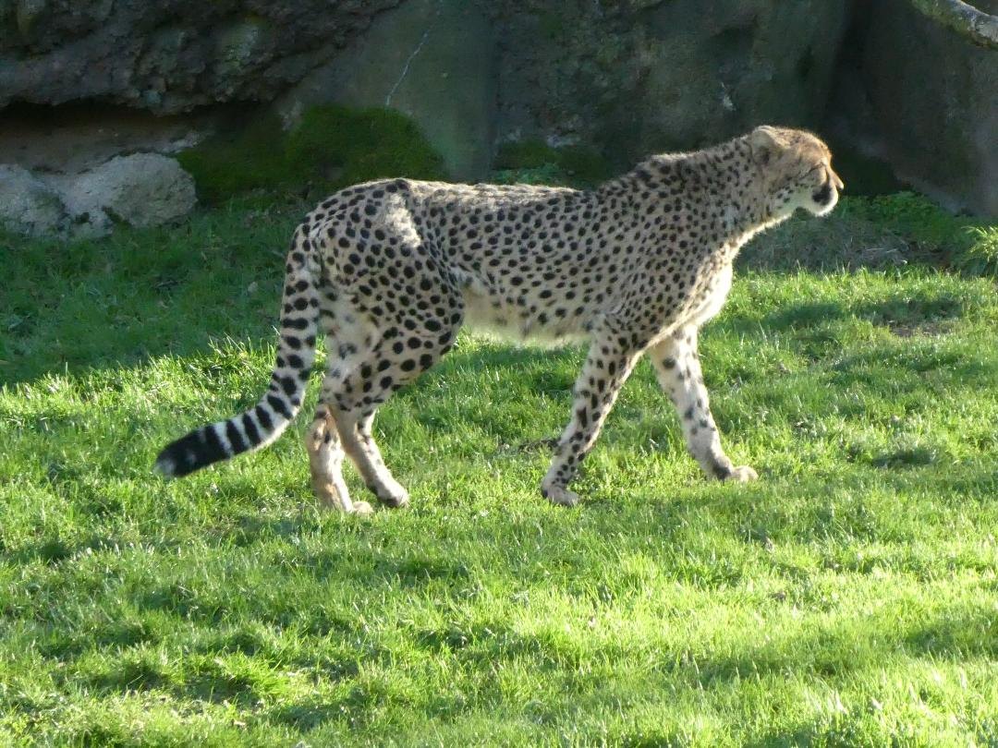

Slide 3
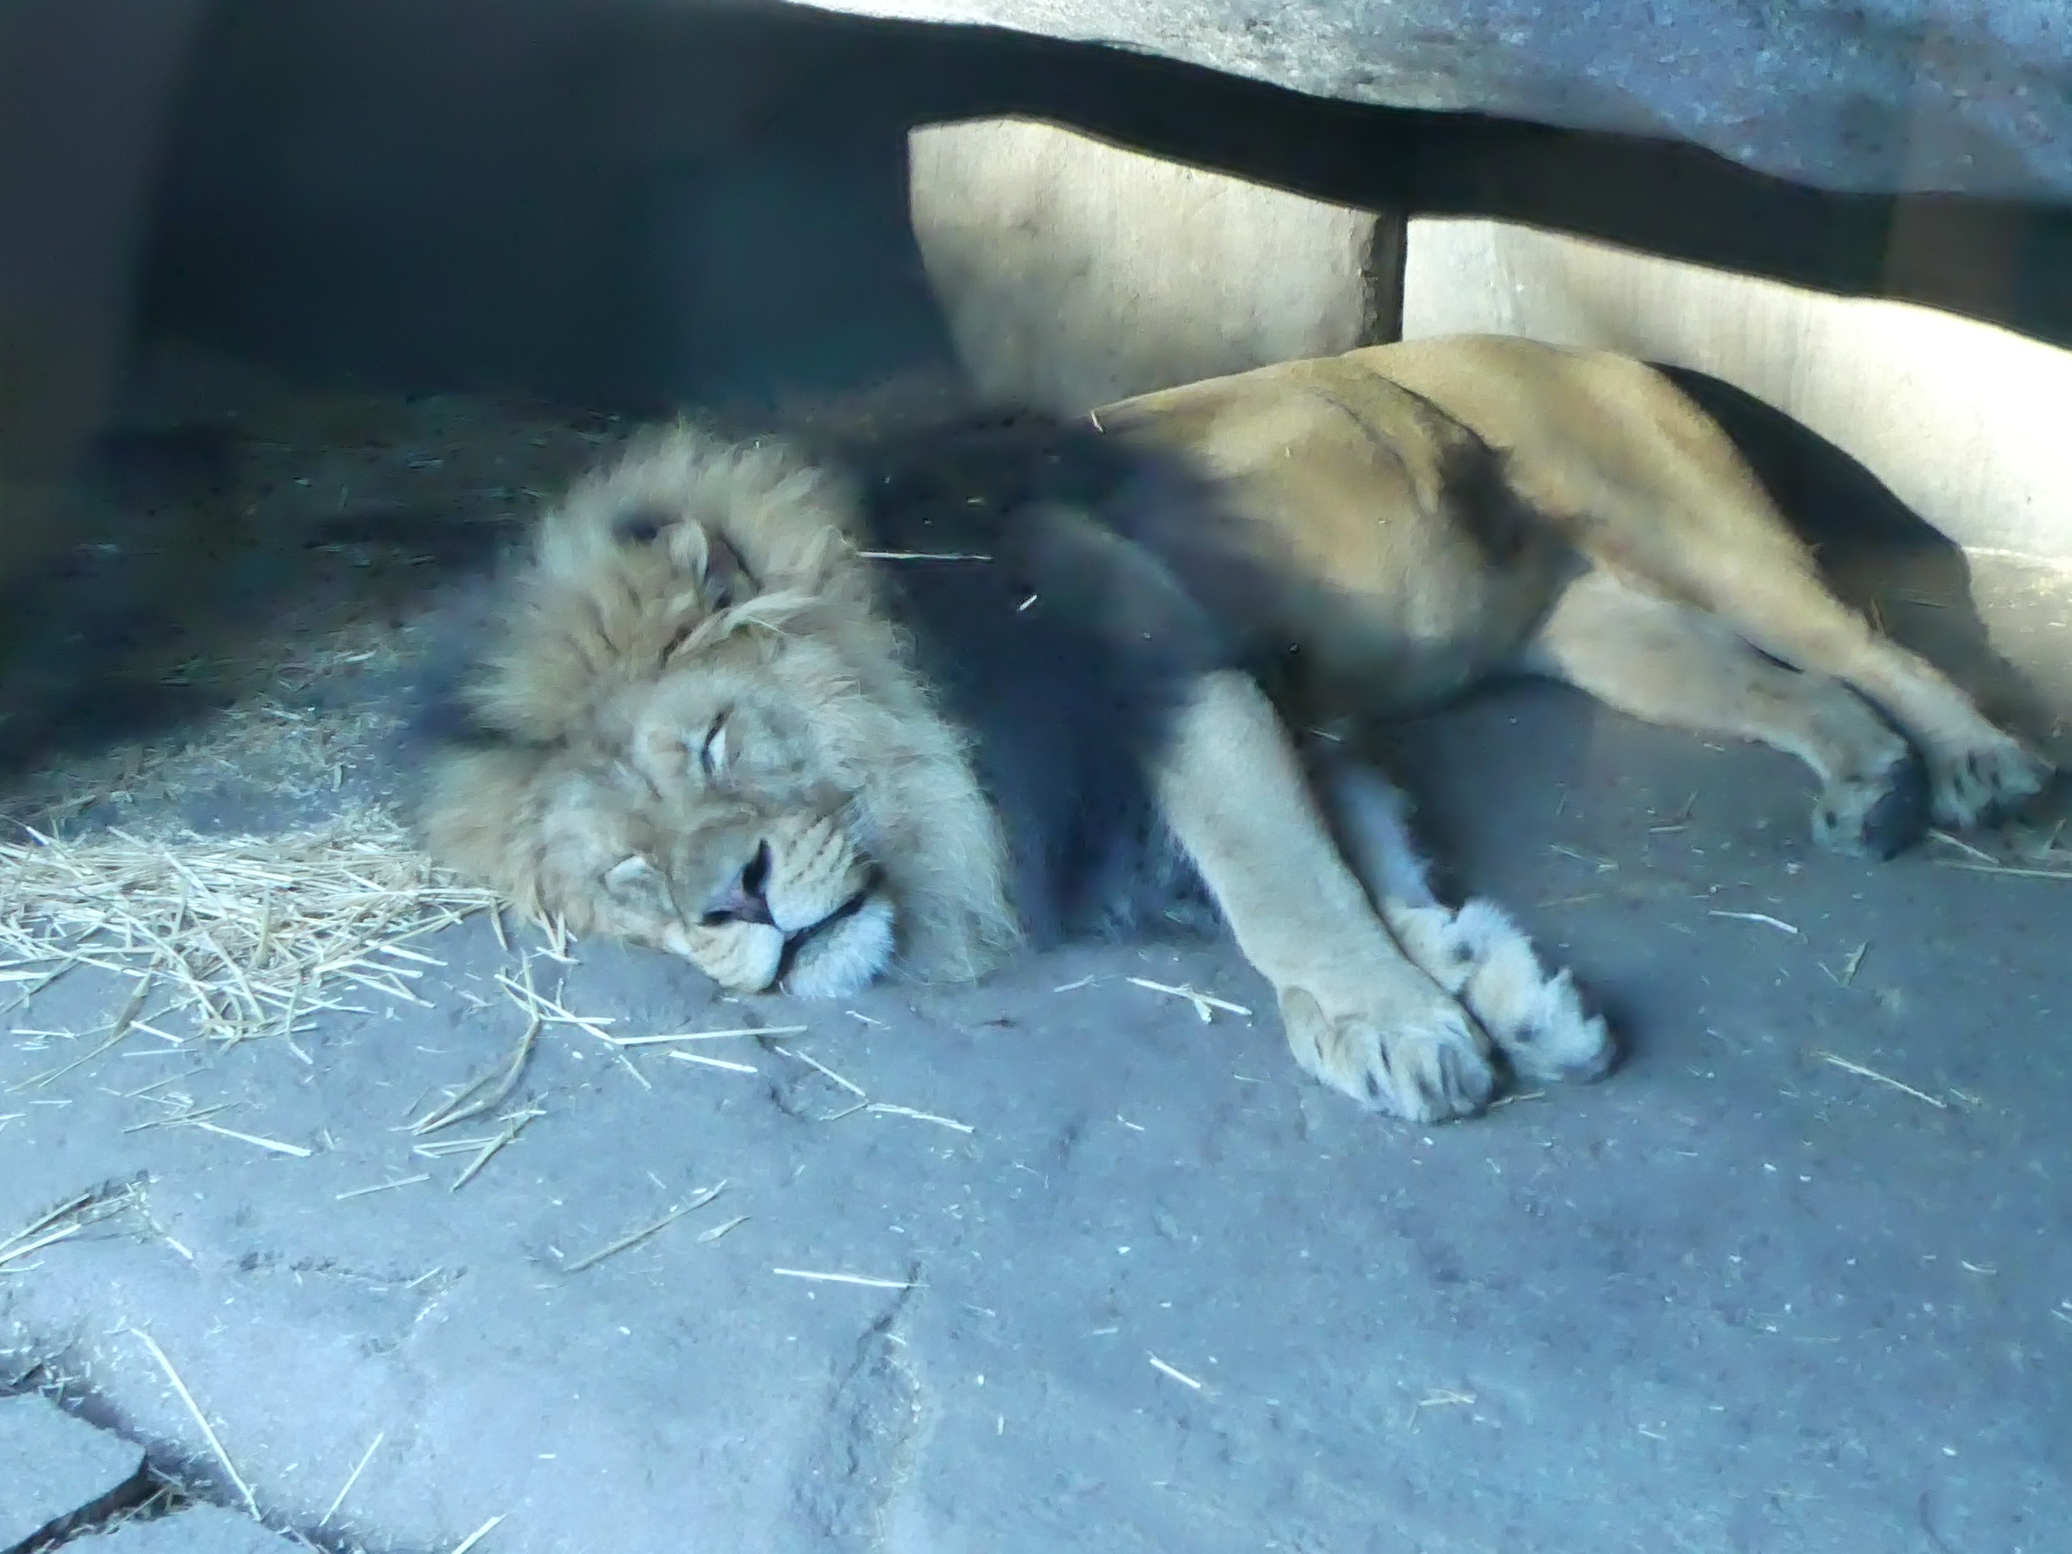

Slide 4

思念上面的事
Set Our Minds on Things Above
波特蘭靈糧堂
January 21, 2018

Slide 5
所以，你們若真與基督一同復活，就當求在上面的事；那裡有基督坐在 神的右邊。 你們要思念上面的事，不要思念地上的事。 (歌羅西書 Colossians 3:1-2)
Since, then, you have been raised with Christ, set your hearts on things above, where Christ is, seated at the right hand of God. Set your minds on things above, not on earthly things

Slide 6
因為你們已經死了，你們的生命與基督一同藏在 神裡面。基督是我們的生命，他顯現的時候，你們也要與他一同顯現在榮耀裡。 (歌羅西書 Colossians 3:3-4)
For you died, and your life is now hidden with Christ in God. When Christ, who is your life, appears, then you also will appear with him in glory.

Slide 7
抱怨、懷疑 ─ It’s all about me?

Slide 8
負面思考
逃避問題
不敢期待
提不起勁
暴躁易怒
自艾自憐
容易沉迷
閒言閒語

Slide 9
讚美、感恩 ─ It’s all about Him!

Slide 10
聖靈不是一種能力，而是一個真實可以與他親近相愛的 Person.
“Good morning Holy Spirit!”

Slide 11
求他按著他豐盛的榮耀，藉著他的靈，叫你們心裡的力量剛強起來，使基督因你們的信，住在你們心裡，叫你們的愛心有根有基，(以弗所書 Ephesians 3:16-17)
I pray that out of his glorious riches he may strengthen you with power through his Spirit in your inner being, so that Christ may dwell in your hearts through faith. And I pray that you, being rooted and established in love,

Slide 12
能以和眾聖徒一同明白基督的愛是何等長闊高深，並知道這愛是過於人所能測度的，便叫 神一切所充滿的，充滿了你們。 (以弗所書 Ephesians 3:18-19)
may have power, together with all the Lord’s holy people, to grasp how wide and long and high and deep is the love of Christ, and to know this love that surpasses knowledge—that you may be filled to the measure of all the fullness of God.

Slide 13
便叫 神一切所充滿的，充滿了你們。
so that you may have the richest experience of God’s presence in your lives, completely filled and flooded with God Himself.

Slide 14
神能照著運行在我們心裡的大力充充足足地成就一切，超過我們所求所想的。 (以弗所書 Ephesians 3:20)
Now to him who is able to do immeasurably more than all we ask or imagine, according to his power that is at work within us,

Slide 15
人非有信，就不能得 神的喜悅；因為到 神面前來的人必須信有 神，且信他賞賜那尋求他的人。
(希伯來書 Hebrews 11:6)
And without faith it is impossible to please God, because anyone who comes to him must believe that he exists and that he rewards those who earnestly seek him.

Slide 16
抱怨、懷疑 ─ It’s all about me?
讚美、感恩 ─ It’s all about Him!

Slide 17
即使我們心中最擔憂和掛念的情况看起來岌岌可危，毫無起色；即使我們十分沮喪正準備放棄；我們仍然要每天求主聖靈幫助和提醒我們思念上面的事，賜給我們一個新的信心的視界，用心去期待事情會漸入佳境。 讓我們常常回到 神強烈豐盛的愛中來做這樣信心的禱告：

Slide 18
感謝愛我的主！ 我相信也宣告今天會是一個美好的日子；我對今天充滿了期待！ 我將更真實的經歷 神強烈而豐盛的愛; 讓我在信心中開始看見自己喜樂、健康而剛強。 感謝 神掌管我生命的一切！即使一切看起來都不可能，我知道今天會是讓事情翻轉的日子；今天會是祢拯救我婚姻的日子；今天會是祢讓我的孩子回轉的日子；今天會是祢讓我的事業開始成長的日子。 這是一個我將看見神蹟的日子。 奉主耶穌的名禱告，阿們！

