Slide 1

為父的心
Father’s Heart
波特蘭靈糧堂
January 28, 2018

Slide 2

為父的心

Slide 3
你們學基督的，師傅雖有一萬，為父的卻是不多，因我在基督耶穌裡用福音生了你們。 所以，我求你們效法我。 (哥林多前書 1 Corinthians 4:15-16)
Even if you had ten thousand guardians in Christ, you do not have many fathers, for in Christ Jesus I became your father through the gospel. Therefore I urge you to imitate me.

Slide 4
師傅與為父的差別
「尊敬屬於師傅，愛卻是為父的標誌。」

Slide 5
師傅與為父的分別
師傅和你是知識和道理上的關係，父親則是生命和盟約上的關係。師傅是一個職業，是把一個東西交給你，他的責任就完了；父親是看著你成長，看著你成熟，看著你成為一個健康的人。當我們來服事主的時候，我們要有一個為父的心。你不是去作工，你是把自己的生命投資在弟兄姊妹的身上，這就是作師傅和作父親的分別。

Slide 6
為父的心 ─ 有恩典有真理
道成了肉身，住在我們中間，充充滿滿地有恩典有真理。 我們也見過他的榮光，正是父獨生子的榮光。
(約翰福音 John 1:14)
The Word became flesh and made his dwelling among us. We have seen his glory, the glory of the one and only Son, who came from the Father, full of grace and truth.

Slide 7
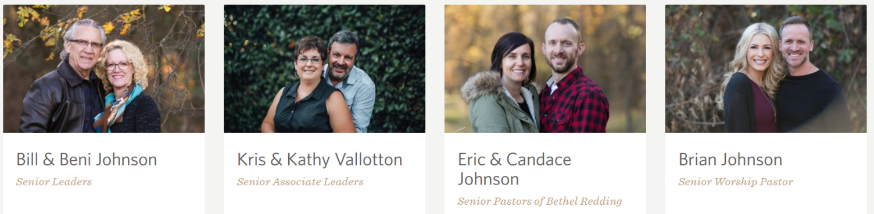
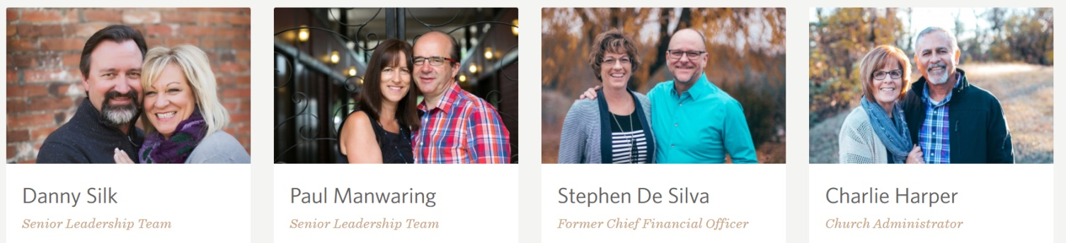
恩典 ─ 盟約的愛
伯特利使徒團隊合一的盟約

Slide 8
我小子啊，我為你們再受生產之苦，直等到基督成形在你們心裡。 我巴不得現今在你們那裡，改換口氣，因我為你們心裡作難。
(加拉太書 Galatians 4:19-20)
My dear children, for whom I am again in the pains of childbirth until Christ is formed in you, how I wish I could be with you now and change my tone, because I am perplexed about you!

Slide 9
只在你們中間存心溫柔，如同母親乳養自己的孩子。 我們既是這樣愛你們，不但願意將 神的福音給你們，連自己的性命也願意給你們，因你們是我們所疼愛的。 (帖撒羅尼迦前書 1 Thess. 2:7-8)
Instead, we were gentle among you. Just as a nursing mother cares for her children, so we cared for you. Because we loved you so much, we were delighted to share with you not only the gospel of God but our lives as well.

Slide 10
真理 ─ 智慧的勸戒
我們傳揚他，是用諸般的智慧，勸戒各人，教導各人，要把各人在基督裡完完全全地引到 神面前。
(歌羅西書 Colossians 1:28)
He is the one we proclaim, admonishing and teaching everyone with all wisdom, so that we may present everyone fully mature in Christ.

Slide 11
你們也曉得，我們怎樣勸勉你們，安慰你們，囑咐你們各人，好像父親待自己的兒女一樣，要叫你們行事對得起那召你們進他國、得他榮耀的 神。
(帖撒羅尼迦前書 1 Thessalonians 2:11-12)
For you know that we dealt with each of you as a father deals with his own children, encouraging, comforting and urging you to live lives worthy of God, who calls you into his kingdom and glory.

Slide 12
你們也知道，凡與你們有益的，我沒有一樣避諱不說的，或在眾人面前，或在各人家裡，我都教導你們；
(使徒行傳 Acts 20:20)
You know that I have not hesitated to preach anything that would be helpful to you but have taught you publicly and from house to house.

Slide 13
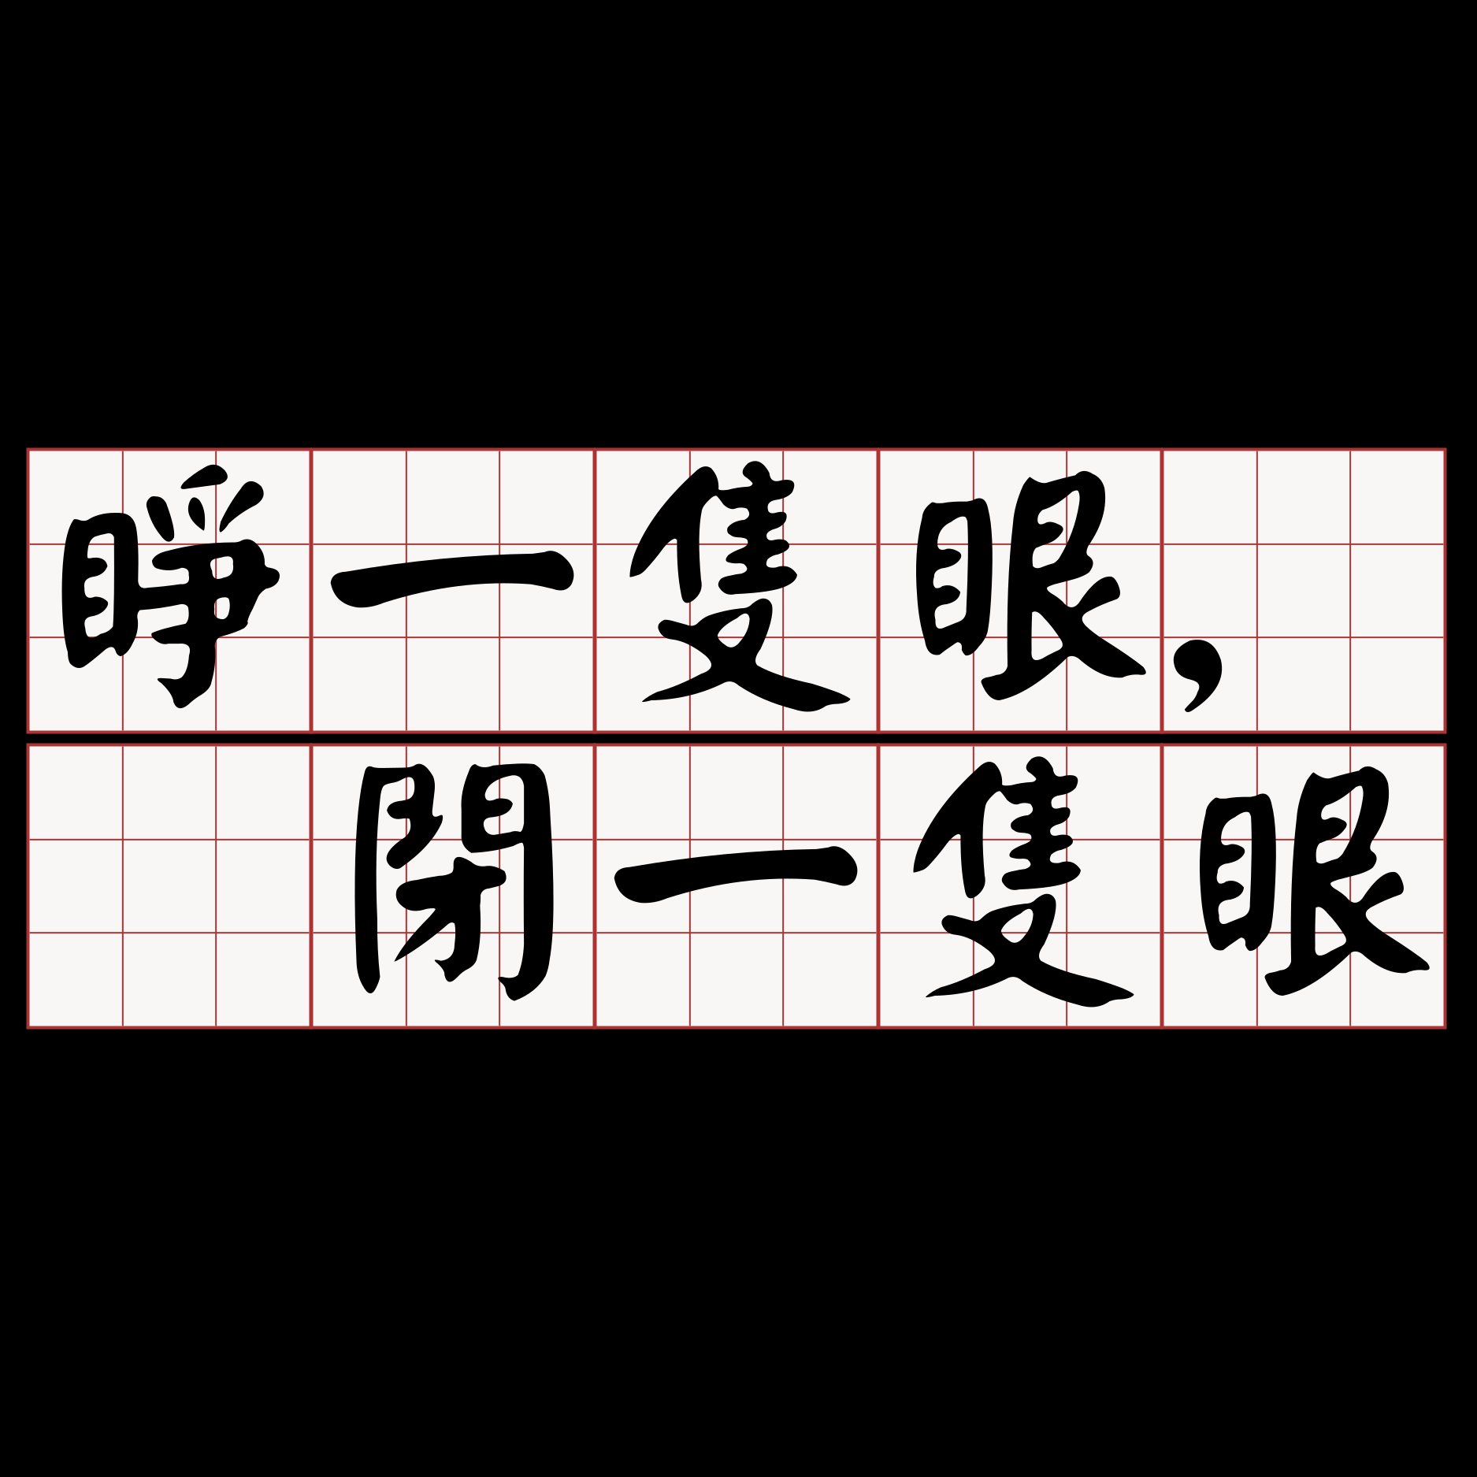


Slide 14
為父的心 ─ 生命的投資
我們的盼望和喜樂，並所誇的冠冕是甚麼呢？ 豈不是我們主耶穌來的時候、你們在他面前站立得住嗎？ 因為你們就是我們的榮耀，我們的喜樂。(帖前 1 Thess. 2:19-20)
20 Indeed, you are our glory and joy.

Slide 15
─ 操練用為父的心彼此祝福

