Slide 1
主日信息

Slide 2

照亮世界
Ignite the World
Mike Macsimowicz
January 20, 2019

Slide 3
耶穌是世界的光
耶穌又對眾人說：「我是世界的光。跟從我的，就不在黑暗裡走，必要得著生命的光。」
(約翰福音 John 8:12)
he said, “I am the light of the world. Whoever follows me will never walk in darkness, but will have the light of life.”

Slide 4
興起，發光！ 因為你的光已經來到！耶和華的榮耀發現照耀你。 看哪，黑暗遮蓋大地，幽暗遮蓋萬民，耶和華卻要顯現照耀你；他的榮耀要現在你身上。 萬國要來就你的光；君王要來就你發現的光輝。
(以賽亞書 Isaiah 60:1-3)

Slide 5
Arise, shine, for your light has come, and the glory of the Lord rises upon you. See, darkness covers the earth and thick darkness is over the peoples, but the Lord rises upon you and his glory appears over you. Nations will come to your light, and kings to the brightness of your dawn. (以賽亞書 Isaiah 60:1-3)

Slide 6

Ignite The World Ministries
“I am the light of the world. Whoever follows me will never walk in
darkness, but will have the light of life.” John 8:12

Slide 7
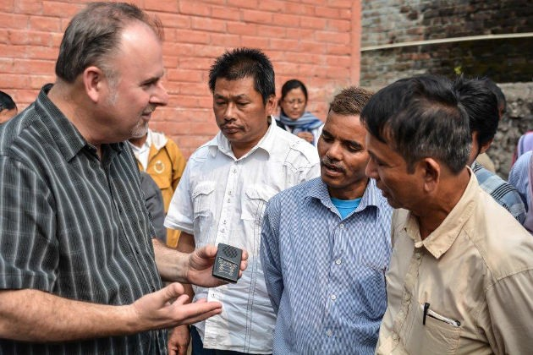
Who we are
◆ We are a team of committed Christians dedicated to change the world for Jesus Christ with the supernatural power of the Gospel.
◆ Our mission... is to bring hope to the nations through the transforming power of Jesus Christ by way of evangelism, evangelism training and missionary church planting, compassion relief projects and the ministry of prayer.
◆ CORE VALUES
◆ Honoring God
◆ Demonstrating Integrity
◆ Loving People
◆ Forming Partnerships
◆ Changing Societies

Slide 8

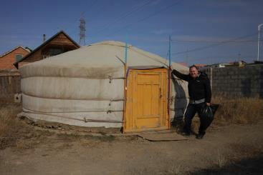
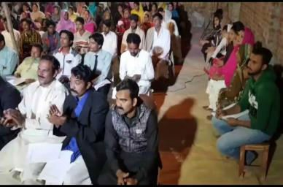

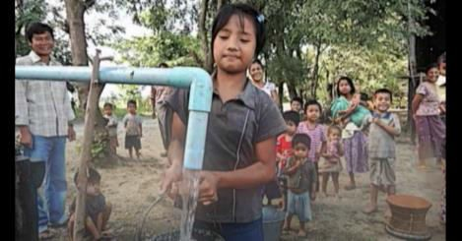
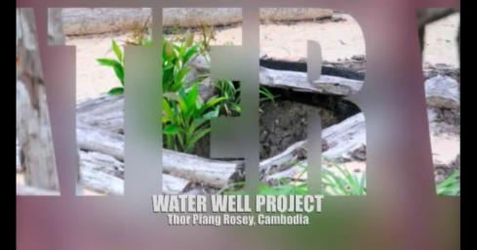
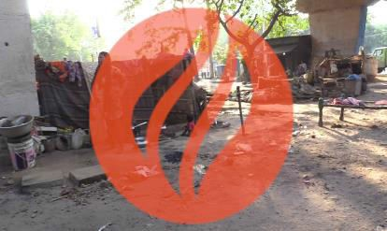
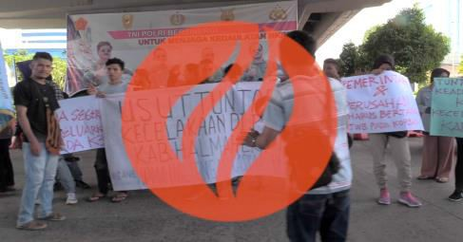
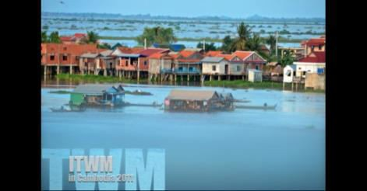
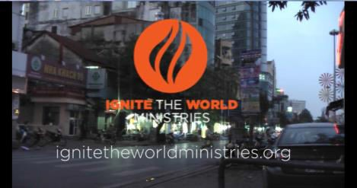

Videos
Overview
Mongolia
Pakistan
Central Asia
Myanmar Well
Cambodia Well
Kolkata/Indo
Outpouring
2011 SE Asia
Borneo
October 18

Slide 9
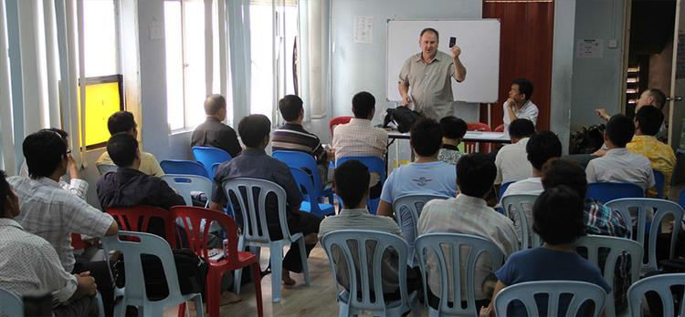
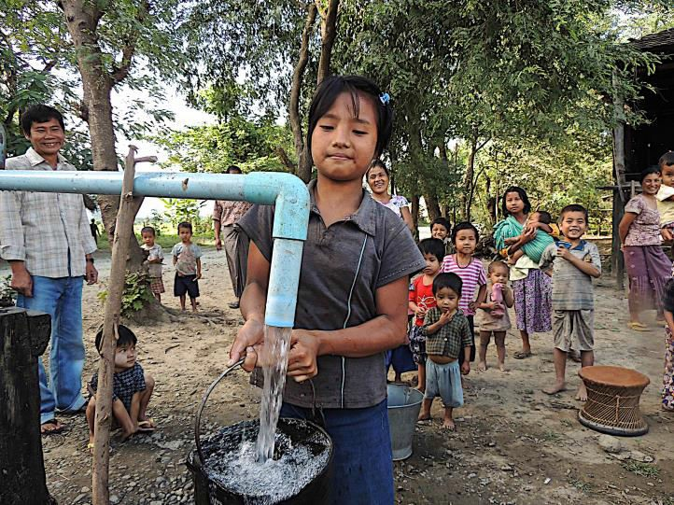
What we do
◆ Evangelism
◆ Training/Equipping Evangelists
◆ Compassion Relief

Slide 10





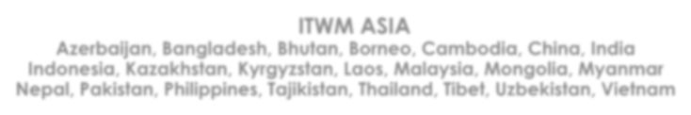











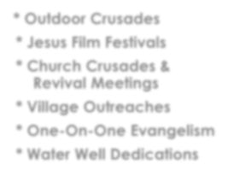



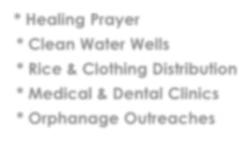

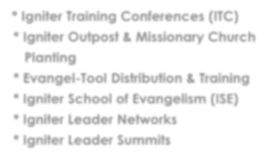
Ignite the World Ministries
ITWM USA
ITWM ASIA
Azerbaijan, Bangladesh, Bhutan, Borneo, Cambodia, China, India Indonesia, Kazakhstan, Kyrgyzstan, Laos, Malaysia, Mongolia, Myanmar Nepal, Pakistan, Philippines, Tajikistan, Thailand, Tibet, Uzbekistan, Vietnam
EVANGELISM
TRAINING & EQUIPPING EVANGELISTS
(IGNITERS)
COMPASSION RELIEF
Outdoor Crusades
Jesus Film Festivals
Church Crusades & Revival Meetings
Village Outreaches
One-On-One Evangelism
Water Well Dedications
Healing Prayer
Clean Water Wells
Rice & Clothing Distribution
Medical & Dental Clinics
Orphanage Outreaches
Igniter Training Conferences (ITC)
Igniter Outpost & Missionary Church Planting
Evangel-Tool Distribution & Training
Igniter School of Evangelism (ISE)
Igniter Leader Networks
Igniter Leader Summits

Slide 11

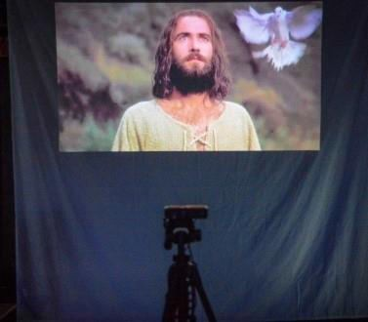
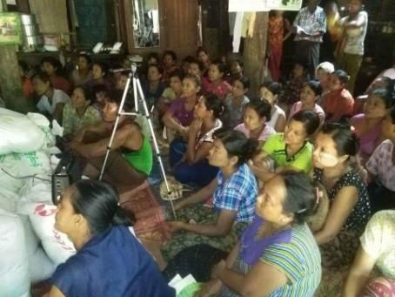
EVANGEL-TOOLS
◆ Solar-Powered Video Projection System:
“Movie Theater in a Backpack”

Slide 12
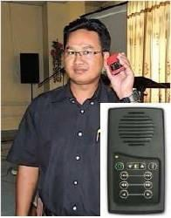
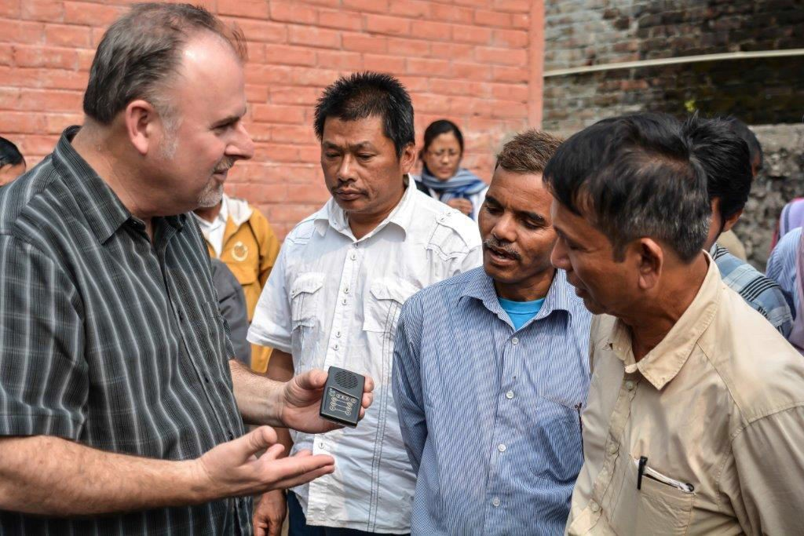
EVANGEL-TOOLS
◆ Solar Audio Bibles:

Slide 13
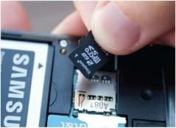
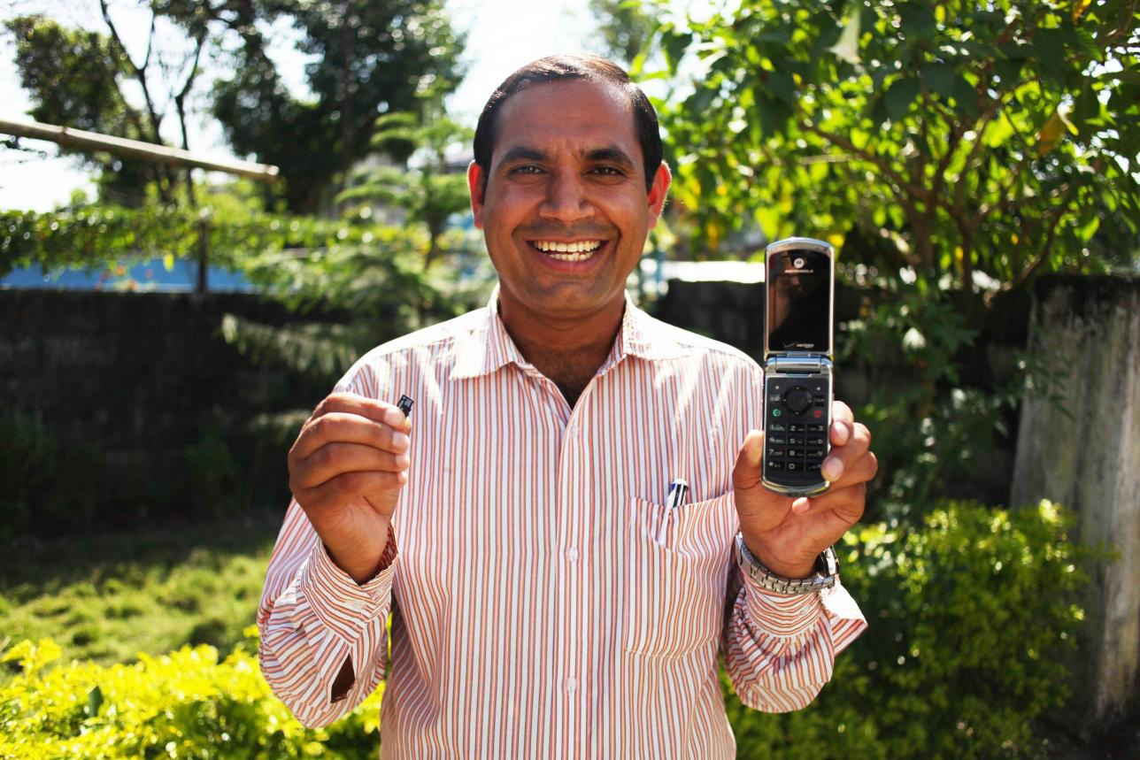
EVANGEL-TOOLS
◆ SD Memory Cards for Cell Phones:
“Gospel Chips”

Slide 14
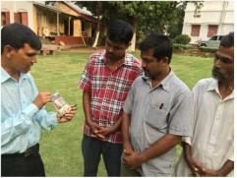
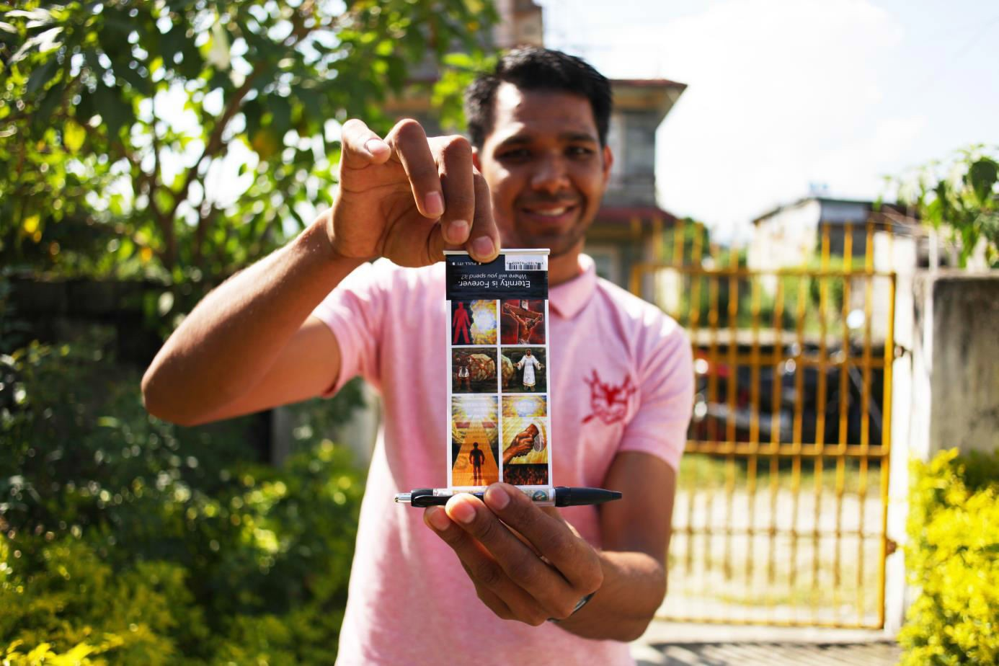
EVANGEL-TOOLS
◆ Evangel-Pens:

Slide 15
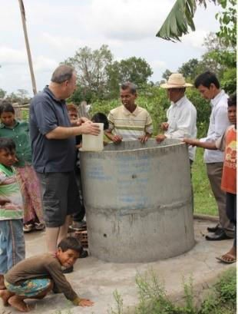
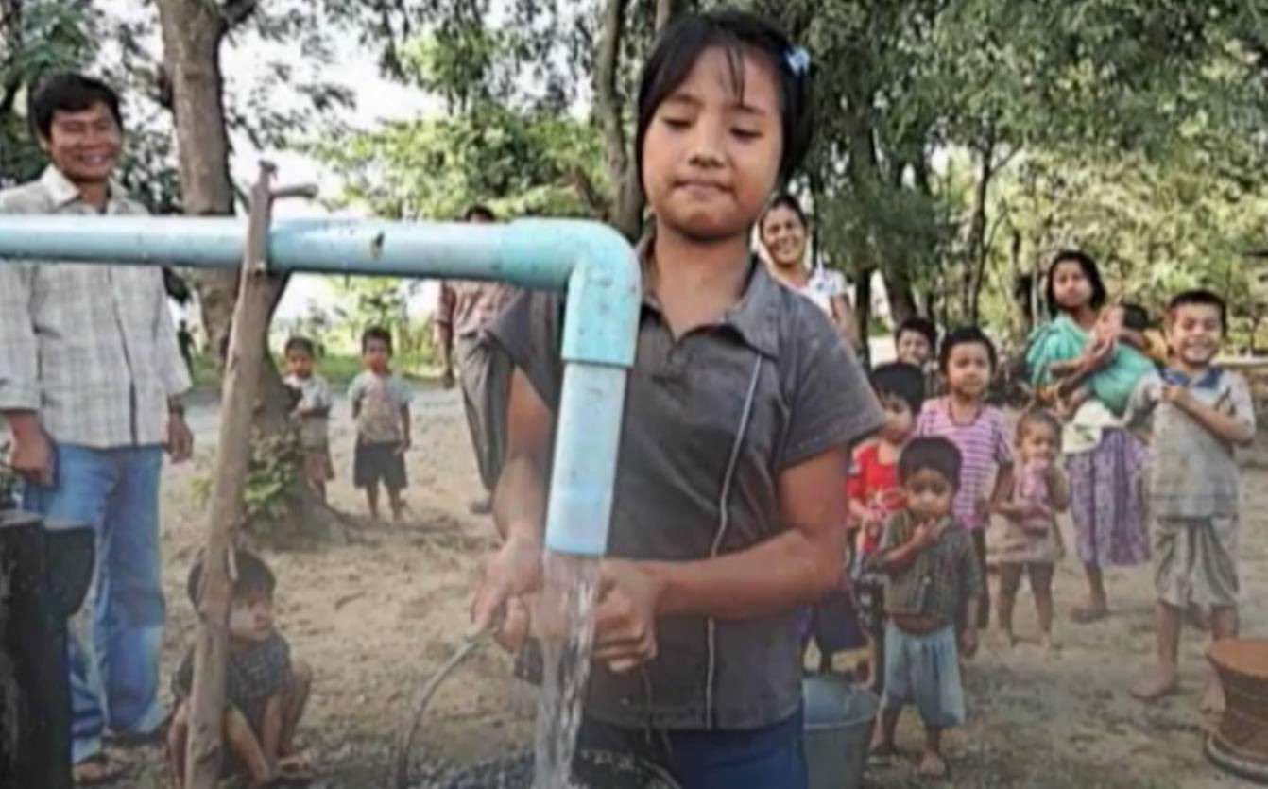
EVANGEL-TOOLS
◆ Clean Water Wells:
“The 3-in-1 Well”

Slide 16
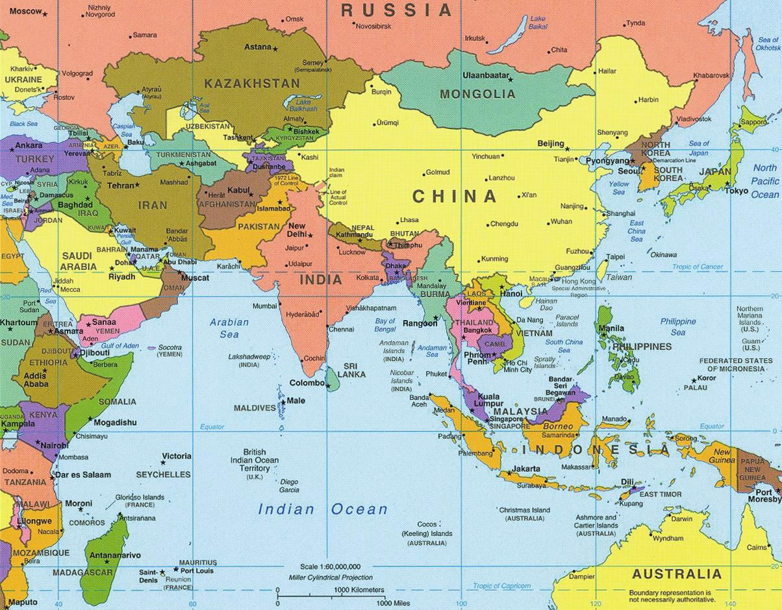
Where we go
◆ Azerbaijan
◆ Bangladesh
◆ Bhutan
◆ Borneo
◆ Cambodia
◆ China
◆ India
◆ Indonesia
◆ Kazakhstan
◆ Kyrgyzstan
◆ Laos
◆ Malaysia
◆ Mongolia
◆ Myanmar
◆ Nepal
◆ Pakistan
◆ Philippines
◆ Tajikistan
◆ Thailand
◆ Tibet
◆ Uzbekistan
◆ Vietnam

Slide 17
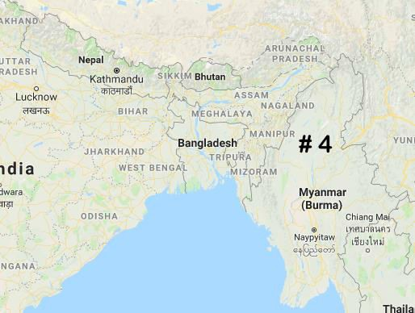
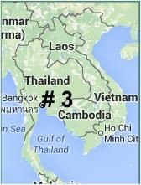
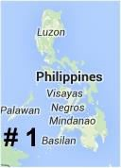
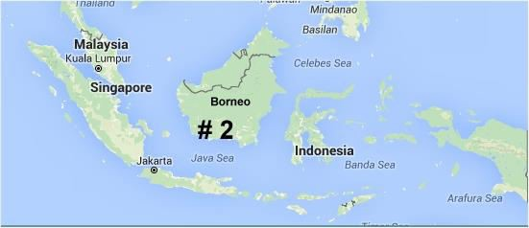
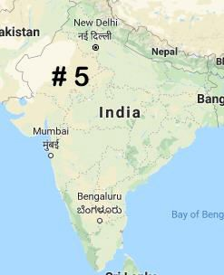
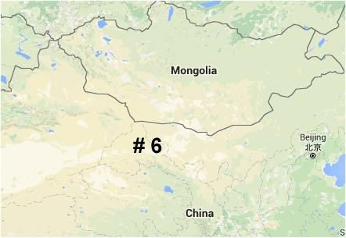
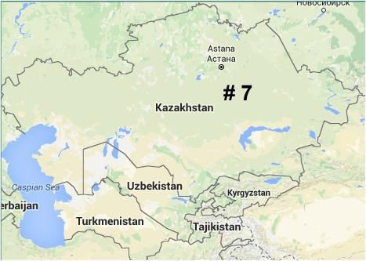
7 Unreached Regions of SE &
CENTRAL ASIA

Slide 18
