Slide 1
主日信息

Slide 2

靠聖靈行事
Keeping in Step with the Spirit
波特蘭靈糧堂
February 17, 2019

Slide 3
我們若是靠聖靈得生，就當靠聖靈行事。
(加拉太書 Galatians 5:24-25)
Since we live by the Spirit, let us keep in step with the Spirit.

Slide 4
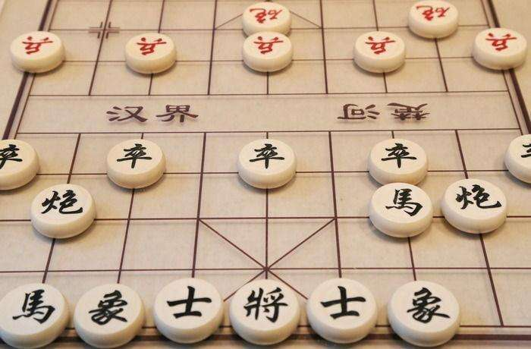
人生如棋局

Slide 5
提防生命中的「盜賊」
盜賊來，無非要偷竊，殺害，毀壞；我來了，是要叫羊（或譯：人）得生命，並且得的更豐盛。 我是好牧人；好牧人為羊捨命。
(約翰福音 John 10:10-11)
The thief comes only to steal and kill and destroy; I have come that they may have life, and have it to the full.

Slide 6
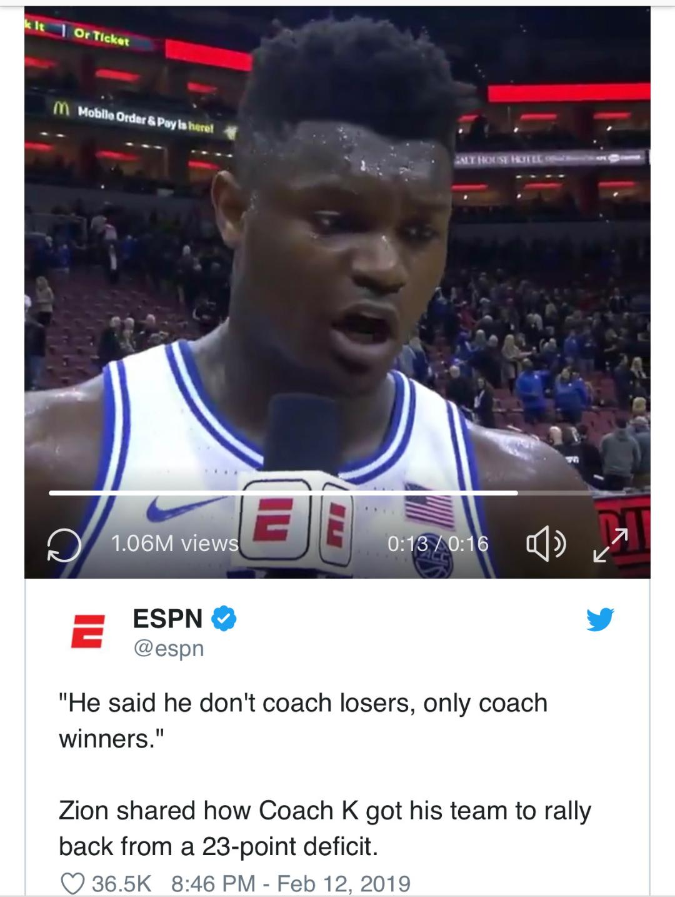
Coach K only coaches winners.

Slide 7
成為基督耶穌的精兵
我兒啊，你要在基督耶穌的恩典上剛強起來。你在許多見證人面前聽見我所教訓的，也要交託那忠心能教導別人的人。你要和我同受苦難，好像基督耶穌的精兵。
(提摩太後書 2 Timothy 2:1-3)
3 Join with me in suffering, like a good soldier of Christ Jesus.

Slide 8
神設立爭戰得勝的規則
人若在場上比武，非按規矩，就不能得冠冕。
(提摩太後書 2 Timothy 2:5)
Similarly, anyone who competes as an athlete does not receive the victor’s crown except by competing according to the rules.

Slide 9
「吉甲」的屬靈涵義
抬耶和華約櫃的祭司從約旦河裡上來，腳掌剛落旱地，約旦河的水就流到原處，仍舊漲過兩岸。
正月初十日，百姓從約旦河裡上來，就在吉甲，在耶利哥的東邊安營。 (約書亞記 Joshua 5:8-9)

Slide 10
割禮從生命中滾去羞辱
國民都受完了割禮，就住在營中自己的地方，等到痊癒了。
耶和華對約書亞說：「我今日將埃及的羞辱從你們身上滾去了。」因此，那地方名叫吉甲（就是滾的意思），直到今日。
(約書亞記 Joshua 5:8-9)

Slide 11
基督的割禮脫去肉體情慾
你們在他裡面也受了不是人手所行的割禮，乃是基督使你們脫去肉體情慾的割禮。
(歌羅西書 Colossians 2:11)
In him you were also circumcised with a circumcision not performed by human hands. Your whole self ruled by the flesh was put off when you were circumcised by Christ,

Slide 12
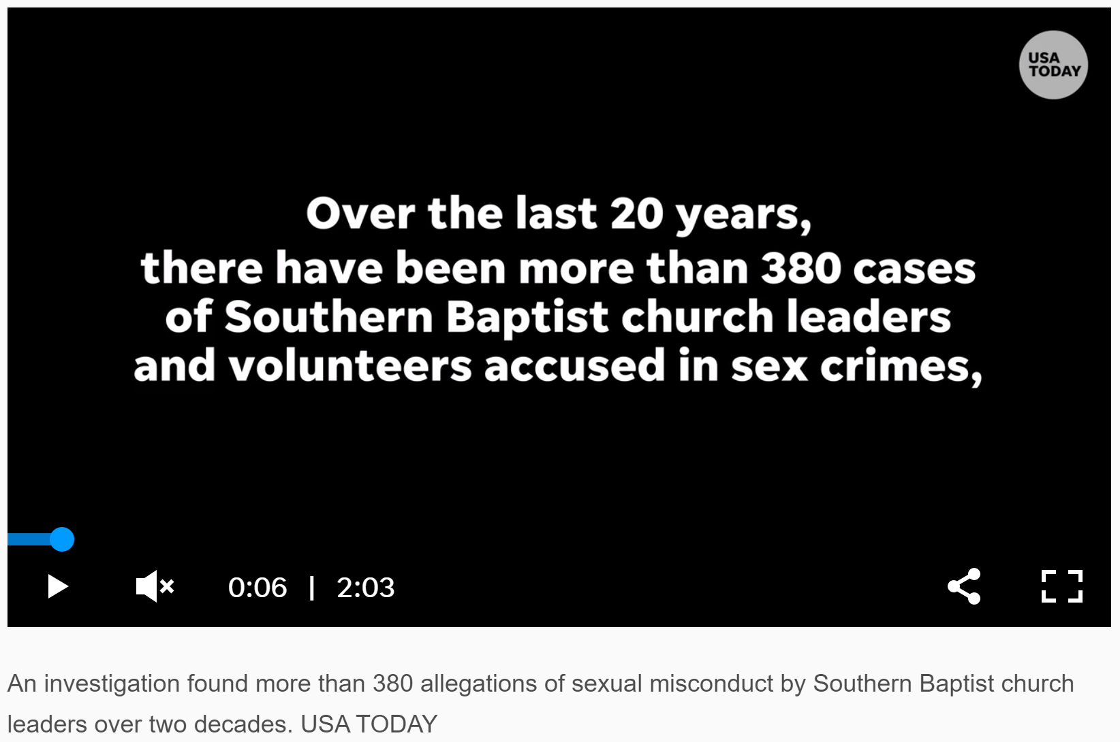
美南浸信會最哀傷的一天

Slide 13
我是罪人中的罪魁 ???
「基督耶穌降世，為要拯救罪人。」這話是可信的，是十分可佩服的。 在罪人中我是個罪魁。
然而，我蒙了憐憫，是因耶穌基督要在我這罪魁身上顯明他一切的忍耐，給後來信他得永生的人作榜樣。 (提前 1 Tim 1:15-16)

Slide 14
I am the worst sinner ???
Here is a trustworthy saying that deserves full acceptance: Christ Jesus came into the world to save sinners—of whom I am the worst. But for that very reason I was shown mercy so that in me, the worst of sinners, Christ Jesus might display his immense patience as an example for those who would believe in him and receive eternal life.

Slide 15
我也要賜給你們一個新心，將新靈放在你們裡面，又從你們的肉體中除掉石心，賜給你們肉心。 (以西結書 Ezekiel 36:26)
I will give you a new heart and put a new spirit in you; I will remove from you your heart of stone and give you a heart of flesh.

Slide 16
凡屬基督耶穌的人，是已經把肉體連肉體的邪情私慾同釘在十字架上了。 我們若是靠聖靈得生，就當靠聖靈行事。
(加拉太書 Galatians 5:24-25)
Those who belong to Christ Jesus have crucified the flesh with its passions and desires. Since we live by the Spirit, let us keep in step with the Spirit.

Slide 17
回應詩歌

Slide 18
「照我本相」
“Just as I am”

Slide 19
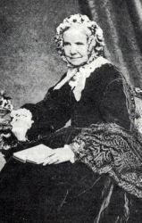
Charlotte Elliott, 1789-1871

Slide 20
Play mp3 audio
“Just as I am”

Slide 21
Just As I Am 照我本相
Just as I am without one plea,
照我本相，無善可陳
but that Thy blood was shed for me;
惟你寶血 為我而流
And that Thou biddst me come to Thee,
呼召我前來 就祢得生
Oh Lamb of God, I come, I come.
真神羔羊 我來 我來

Slide 22
Just As I Am 照我本相
Just as I am, though tossed about
照我本相，焦慮 翻騰
With many a conflict, many a doubt;
多有矛盾 衝擊 疑慮
Fightings and fears within without,
內有懼怕 外有爭戰
O Lamb of God, I come, I come!
真神羔羊 我來 我來

Slide 23
Just As I Am 照我本相
Just as I am, poor, wretched, blind;
照我本相，貧困 破碎 盲目
Sight, riches, healing of the mind;
求使重見光明 心得醫治
Yea, all I need, in Thee to find,
凡我所需 祢確能滿足
O Lamb of God, I come, I come!
真神羔羊 我來 我來

Slide 24
Just As I Am 照我本相
Just as I am, Thou wilt receive,
照我本相，祢肯包容
Wilt welcome, pardon, cleanse, relieve;
悅納 赦免 潔淨 釋放
Because Thy promise I believe,
因我深信 祢所應許
O Lamb of God, I come, I come.
真神羔羊 我來 我來

Slide 25
Play mp3 audio
“Just as I am”

