Slide 1
主日信息

Slide 2
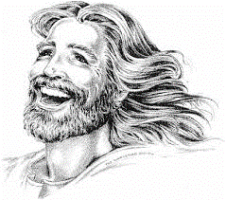

Slide 3

Thanksgiving
Never the Same Again
不再一樣的感恩
Mary Lu Konkel
Bethel Church, Redding
March 3, 2019

Slide 4
如經上所記： 神為愛他的人所預備的是眼睛未曾看見，耳朵未曾聽見，人心也未曾想到的。
(哥林多前書 1 Corinthians 2:9)
However, as it is written: “What no eye has seen, what no ear has heard, and what no human mind has conceived”— the things God has prepared for those who love him

