Slide 1
主日信息
Sunday Sermon

Slide 2

YOUR STORY, GOD’S GLORY
你的故事， 神的榮耀
Pastor Joshua Jen
May 19, 2019

Slide 3
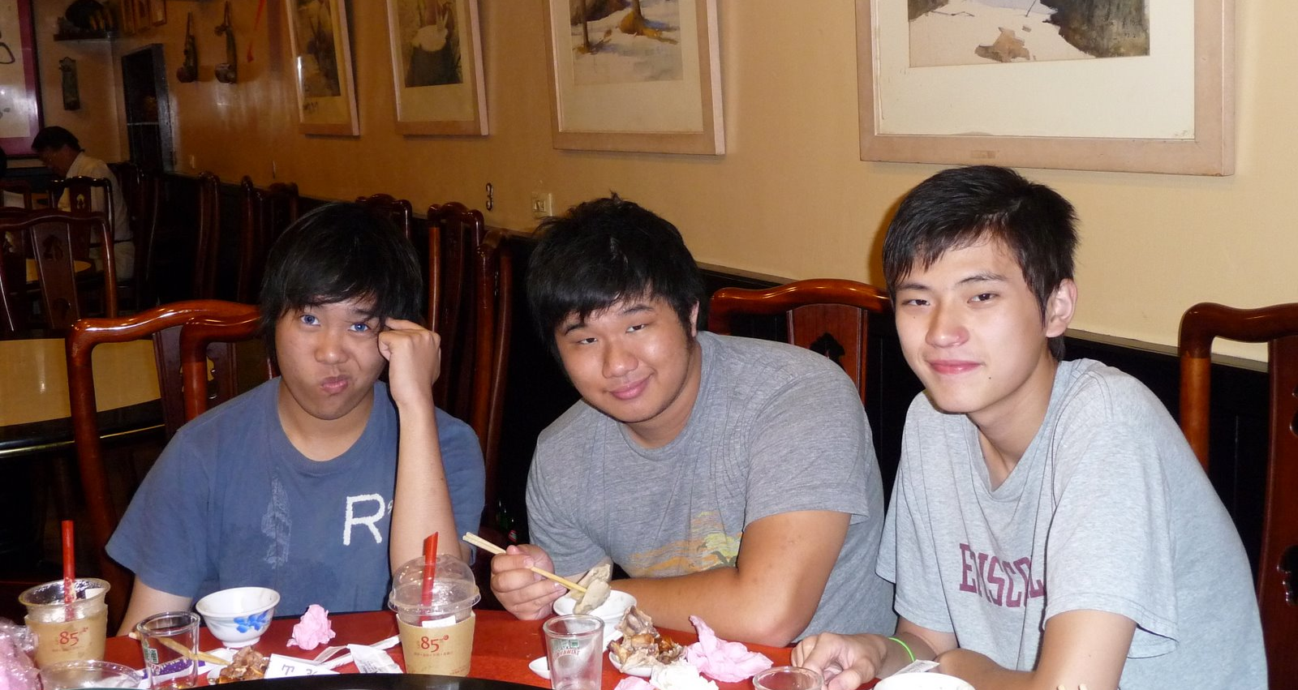
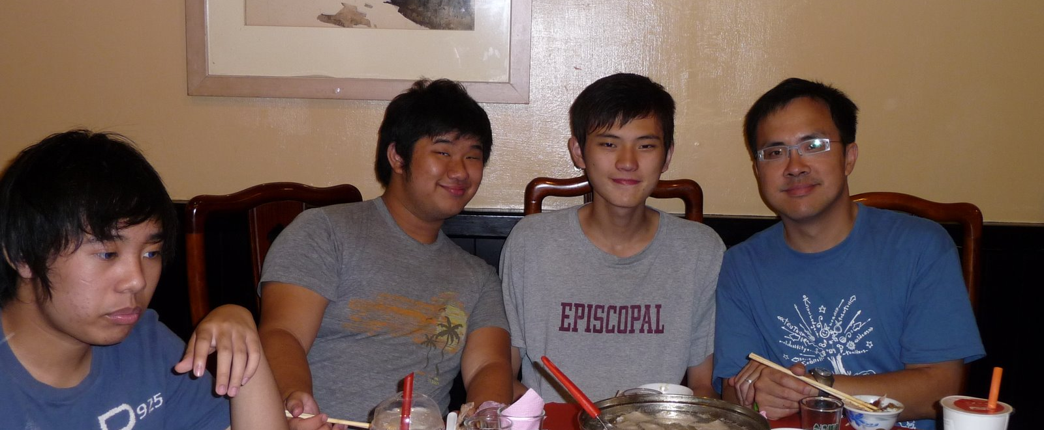
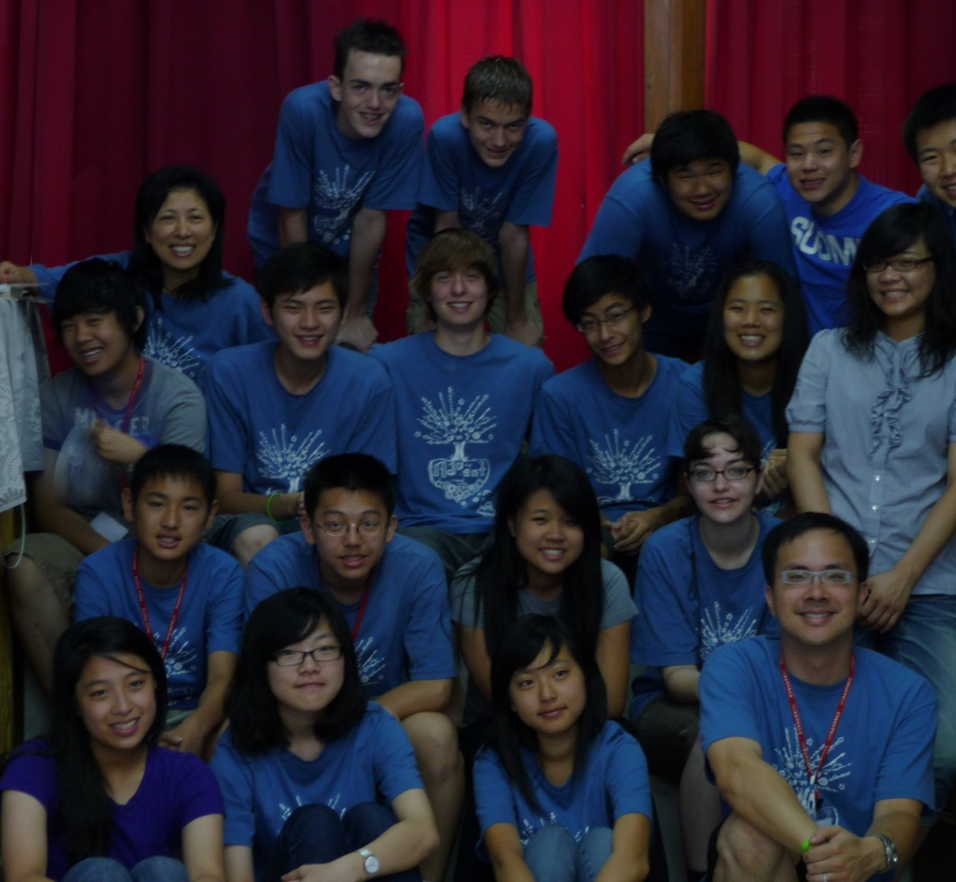
Pastor Josh Jen
RockPoint Church, Newberg
When he went on Advent 2009

Slide 4
God’s Glory
Your Story

Slide 5
1 Corinthians 1:26 -31
your story, God’s glory
26 Brothers and sisters, think of what you were when you were called. Not many of you were wise by human standards; not many were influential; not many were of noble birth. 27 But God chose the foolish things of the world to shame the wise; God chose the weak things of the world to shame the strong. 28 God chose the lowly things of this world and the despised things—and the things that are not—to nullify the things that are, 29 so that no one may boast before him. 30 It is because of him that you are in Christ Jesus, who has become for us wisdom from God—that is, our righteousness, holiness and redemption. 31 Therefore, as it is written: “Let the one who boasts boast in the Lord.”

Slide 6
26 弟兄們哪，可見你們蒙召的，按著肉體有智慧的不多，有能力的不多，有尊貴的也不多。 27 神卻揀選了世上愚拙的，叫有智慧的羞愧；又揀選了世上軟弱的，叫那強壯的羞愧。 28 神也揀選了世上卑賤的，被人厭惡的，以及那無有的，為要廢掉那有的， 29 使一切有血氣的，在 神面前一個也不能自誇。 30 但你們得在基督耶穌裡是本乎 神， 神又使他成為我們的智慧、公義、聖潔、救贖。 31 如經上所記：「誇口的，當指著主誇口。」 (林前 1:26-31)

Slide 7
God does not need you
your story, God’s glory
1 Corinthians 1:26
26 Brothers and sisters, think of what you were when you were called. Not many of you were wise by human standards; not many were influential; not many were of noble birth.
26 弟兄們哪，可見你們蒙召的，按著肉體有智慧的不多，有能力的不多，有尊貴的也不多。 」 (林前 1:26)

Slide 8
God Wants you
your story, God’s glory
1 Corinthians 1:27-28
27 But God chose the foolish things of the world to shame the wise; God chose the weak things of the world to shame the strong. 28 God chose the lowly things of this world and the despised things—and the things that are not—to nullify the things that are,
27 神卻揀選了世上愚拙的，叫有智慧的羞愧；又揀選了世上軟弱的，叫那強壯的羞愧。 28 神也揀選了世上卑賤的，被人厭惡的，以及那無有的，為要廢掉那有的，

Slide 9
God fills your lack
your story, God’s glory
1 Corinthians 1:29-30
29 so that no one may boast before him. 30 It is because of him that you are in Christ Jesus, who has become for us wisdom from God—that is, our righteousness, holiness and redemption.
29 使一切有血氣的，在 神面前一個也不能自誇。 30 但你們得在基督耶穌裡是本乎 神， 神又使他成為我們的智慧、公義、聖潔、救贖。

Slide 10
your story, God’s glory
your story, God’s glory
1 Corinthians 1:29-30
31 Therefore, as it is written: “Let the one who boasts boast in the Lord.”
31 如經上所記：「誇口的，當指著主誇口。」 (林前 1:26-31)

