Slide 1
主日信息
Sunday Sermon

Slide 2

連於葡萄樹
Remain in the Vine
波特蘭靈糧堂
May 26, 2019

Slide 3
我們有這寶貝放在瓦器裡，要顯明這莫大的能力是出於 神，不是出於我們。 我們四面受敵，卻不被困住；心裡作難，卻不至失望； 遭逼迫，卻不被丟棄；打倒了，卻不至死亡。(哥林多後書 2 Corinthians 4:7-9)
7 But we have this treasure in jars of clay to show that this all-surpassing power is from God and not from us.

Slide 4
禱告的著眼點 Prayer Focus
狀況 ─ Condition
地位 ─ Position

Slide 5
耶穌素來愛馬大和她妹子並拉撒路。 聽見拉撒路病了，就在所居之地仍住了兩天。 然後對門徒說：「我們再往猶太去吧。」
(約翰福音 John 11:5-7)
Now Jesus loved Martha and her sister and Lazarus. So when he heard that Lazarus was sick, he stayed where he was two more days, and then he said to his disciples, “Let us go back to Judea.”

Slide 6
馬大對耶穌說：「主啊，你若早在這裡，我兄弟必不死。 就是現在，我也知道，你無論向 神求甚麼， 神也必賜給你。」 耶穌說：「你兄弟必然復活。」 馬大說：「我知道在末日復活的時候，他必復活。」
(約翰福音 John 11:21-24)
21 “Lord,” Martha said to Jesus, “if you had been here, my brother would not have died.

Slide 7
馬利亞到了耶穌那裡，看見他，就俯伏在他腳前，說：「主啊，你若早在這裡，我兄弟必不死。」
(約翰福音 John 11:32)
When Mary reached the place where Jesus was and saw him, she fell at his feet and said, “Lord, if you had been here, my brother would not have died.”

Slide 8
耶穌到了管會堂的家裡，看見有吹手，又有許多人亂嚷，就說：「退去吧！這閨女不是死了，是睡著了。」 他們就嗤笑他。 眾人既被攆出，耶穌就進去，拉著閨女的手，閨女便起來了。(馬太福音 Matt 9:23-25)
25 After the crowd had been put outside, he went in and took the girl by the hand, and she got up.

Slide 9
禱告的著眼點 Prayer Focus
狀況 ─ Condition
地位 ─ Position

Slide 10
我是葡萄樹，你們是枝子。 常在我裡面的，我也常在他裡面，這人就多結果子；因為離了我，你們就不能做甚麼。 (約翰福音 John 15:5)
I am the vine; you are the branches. If you remain in me and I in you, you will bear much fruit; apart from me you can do nothing.

Slide 11
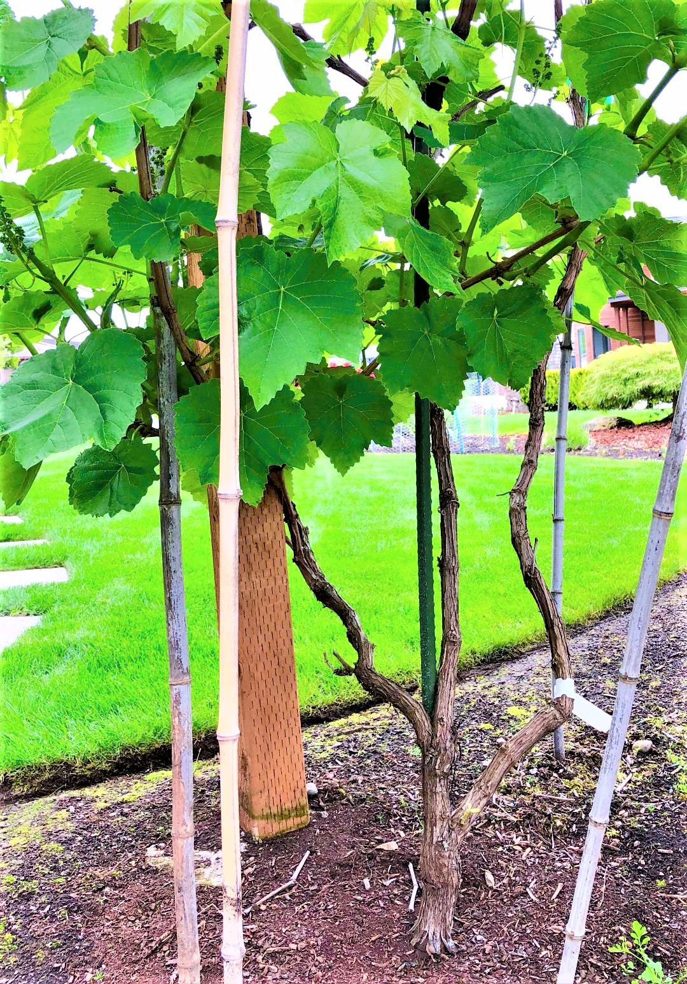
(約翰福音 John 15:5)

Slide 12
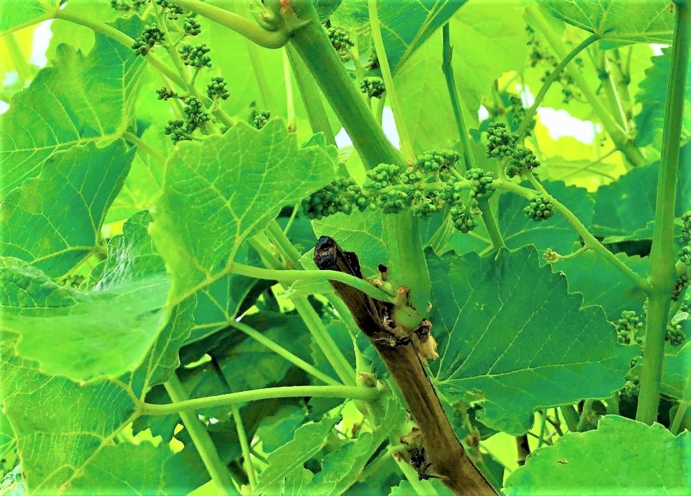
我是葡萄樹，你們是枝子。

Slide 13
我實實在在地告訴你們，我所做的事，信我的人也要做，並且要做比這更大的事，因為我往父那裡去。 (約翰福音 John 14:12)
Very truly I tell you, whoever believes in me will do the works I have been doing, and they will do even greater things than these, because I am going to the Father.

Slide 14
回應詩歌

Slide 15
Play video
「住在祢裡面」

