Slide 1
主日信息
Sunday Sermon

Slide 2

主賜平安
The God of Peace
波特蘭靈糧堂
March 1, 2020

Slide 3
我留下平安給你們；我將我的平安賜給你們。 我所賜的，不像世人所賜的。你們心裡不要憂愁，也不要膽怯。
(約翰福音 John 14:27)
Peace I leave with you; my peace I give you. I do not give to you as the world gives. Do not let your hearts be troubled and do not be afraid.

Slide 4
我不以福音為恥；這福音本是 神的大能，要救 (σωτηρία) 一切相信 (πιστεύω)的，先是猶太人，後是希臘人。 (羅馬書 Romans 1:16)
For I am not ashamed of the gospel, for it is the power of God for salvation to everyone who believes, to the Jew first and also to the Greek.

Slide 5
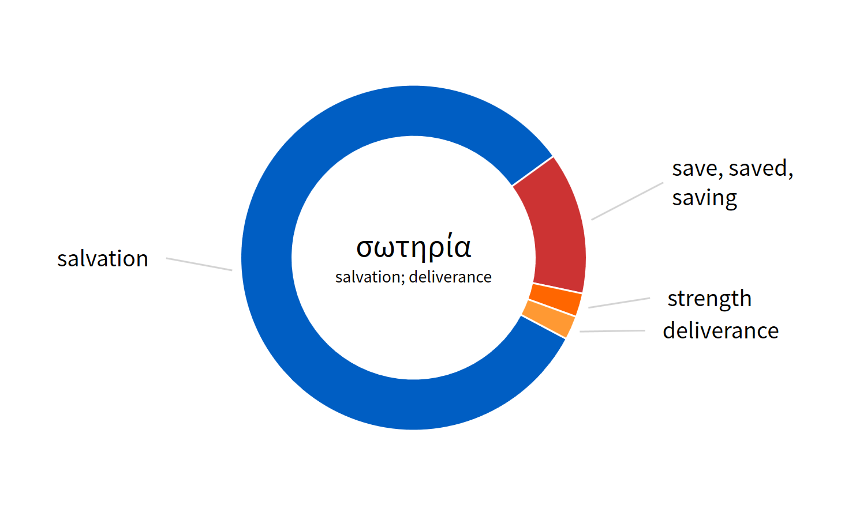
救 (σωτηρία) ─
Salvation / Deliverance

Slide 6
他誠然擔當我們的憂患，背負我們的痛苦；我們卻以為他受責罰，被 神擊打苦待了。
(以賽亞書 Isaiah 53:4-5)
Surely our sicknesses he hath borne, And our pains -- he hath carried them, And we -- we have esteemed him plagued, Smitten of God, and afflicted.

Slide 7
他誠然擔當我們的憂患(חֳלִי)，背負我們的痛苦(מַכְאֹב)；我們卻以為他受責罰，被 神擊打苦待了。 (以賽亞書 Isaiah 53:4-5)
憂患 (חֳלִי) ─ sickness, disease
痛苦 (מַכְאֹב) ─ pain, sorrow

Slide 8
哪知他為我們的過犯受害，為我們的罪孽壓傷。 因他受的刑罰，我們得平安 ( שָׁלוֹם )；因他受的鞭傷，我們得醫治。
(以賽亞書 Isaiah 53:5)
But He was pierced through for our transgressions, He was crushed for our iniquities; The chastening for our well-being fell upon Him, And by His scourging we are healed.

Slide 9
兒女既同有血肉之體，他也照樣親自成了血肉之體，特要藉著死敗壞那掌死權的，就是魔鬼，並要釋放那些一生因怕死而為奴僕的人。
(希伯來書 Hebrews 2:14-15)
Since the children have flesh and blood, he too shared in their humanity so that by his death he might break the power of him who holds the power of death

Slide 10
耶和華說：我知道我向你們所懷的意念是賜平安 ( שָׁלוֹם ) 的意念，不是降災禍的意念，要叫你們末後有指望。 (耶利米書 Jeremiah 29:11)
For I know the plans that I have for you,’ declares the Lord, ‘plans for welfare and not for calamity to give you a future and a hope.

Slide 11
回應詩歌
「平安 Peace」

Slide 12
Play video
「平安 Peace」

