Slide 1
主日信息
Sunday Sermon

Slide 2

巴蘭的驢子
Balaam’s Donkey
波特蘭靈糧堂
July 5, 2020

Slide 3
我們的心若責備我們， 神比我們的心大，一切事沒有不知道的。
親愛的弟兄啊，我們的心若不責備我們，就可以向 神坦然無懼了。 (約翰一書 1 John 3:20-21)
If our hearts condemn us, we know that God is greater than our hearts, and he knows everything. Dear friends, if our hearts do not condemn us, we have confidence before God

Slide 4
山窮水盡疑無路
柳暗花明又一村

Slide 5
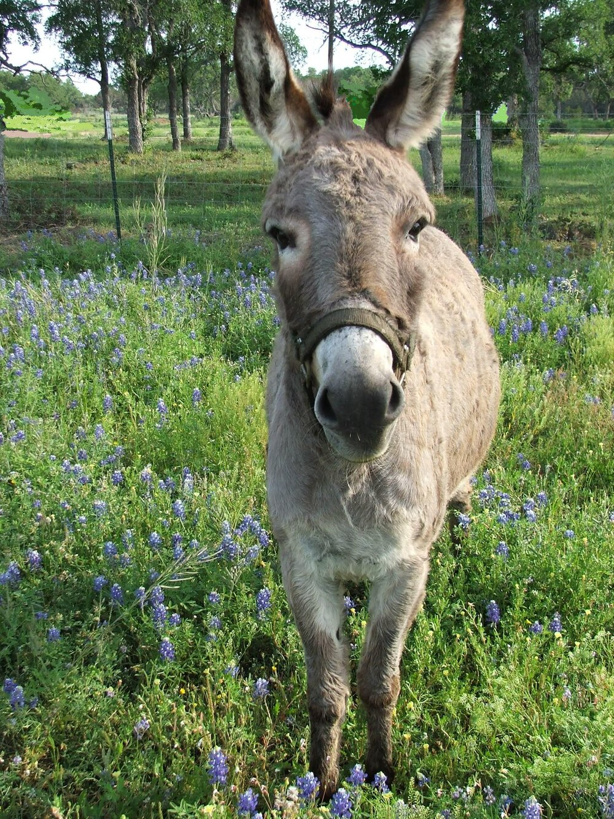

Slide 6
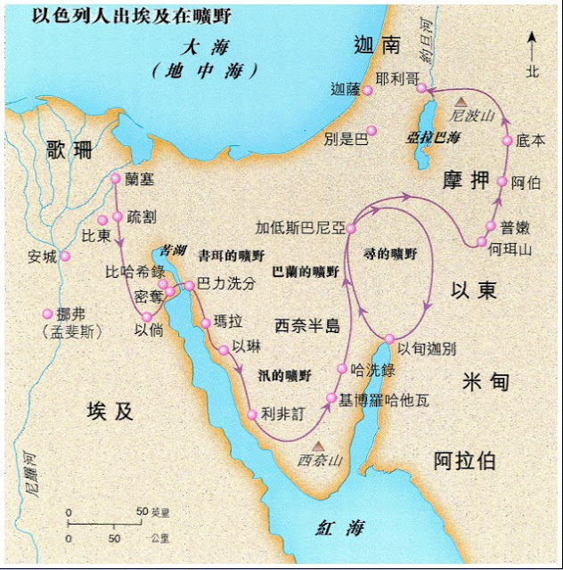

Slide 7
神因他去就發了怒；耶和華的使者站在路上敵擋他。 他騎著驢，有兩個僕人跟隨他。 驢看見耶和華的使者站在路上，手裡有拔出來的刀，就從路上跨進田間，巴蘭便打驢，要叫牠回轉上路。
(民數記 Numbers 22:22-23)
22 But God was very angry when he went, and the angel of the Lord stood in the road to oppose him. Balaam was riding on his donkey, and his two servants were with him.

Slide 8
耶和華的使者就站在葡萄園的窄路上；這邊有牆，那邊也有牆。 驢看見耶和華的使者，就貼靠牆，將巴蘭的腳擠傷了；巴蘭又打驢。 耶和華的使者又往前去，站在狹窄之處，左右都沒有轉折的地方。 驢看見耶和華的使者，就臥在巴蘭底下，巴蘭發怒，用杖打驢。
(民數記 Numbers 22:24-27)
24 Then the angel of the Lord stood in a narrow path through the vineyards, with walls on both sides.

Slide 9
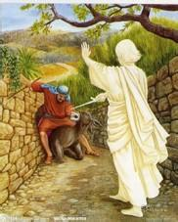

Slide 10
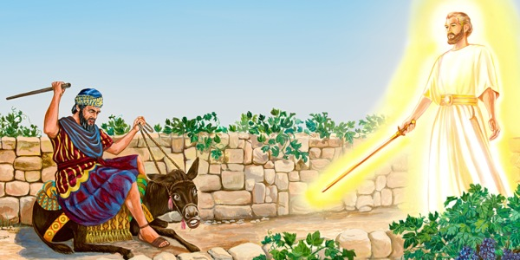

Slide 11
耶和華叫驢開口，對巴蘭說：「我向你行了甚麼，你竟打我這三次呢？」 巴蘭對驢說：「因為你戲弄我，我恨不能手中有刀，把你殺了。」 驢對巴蘭說：「我不是你從小時直到今日所騎的驢嗎？我素常向你這樣行過嗎？」巴蘭說：「沒有。」 (民數記 Numbers 22:28-30)
28 Then the Lord opened the donkey’s mouth, and it said to Balaam, “What have I done to you to make you beat me these three times?”

Slide 12
當時，耶和華使巴蘭的眼目明亮，他就看見耶和華的使者站在路上，手裡有拔出來的刀，巴蘭便低頭俯伏在地。 耶和華的使者對他說：「你為何這三次打你的驢呢？我出來敵擋你，因你所行的，在我面前偏僻。 驢看見我就三次從我面前偏過去；驢若沒有偏過去，我早把你殺了，留牠存活。」
(民數記 Numbers 22:31-33)
32 I have come here to oppose you because your path is a reckless one before me.

Slide 13
神的敵擋和管教
God’s Opposition & Dealing

Slide 14
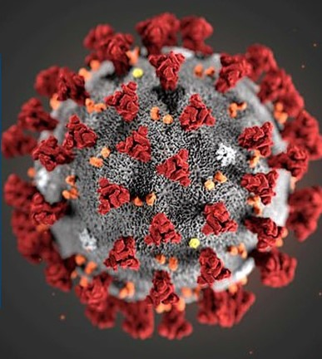
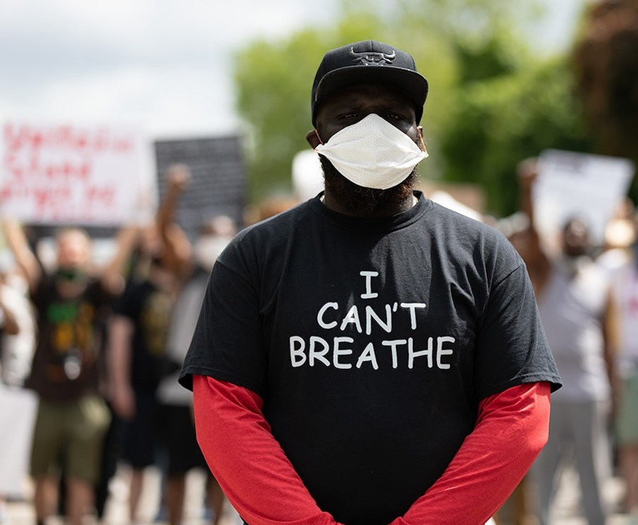

Slide 15
但他賜更多的恩典，所以經上說： 神阻擋驕傲的人，賜恩給謙卑的人。 (雅各書 James 4:6)
But he gives more grace. Therefore it says, “God opposes the proud but gives grace to the humble.”

Slide 16
我兒，你不可輕看耶和華的管教（或譯：懲治），也不可厭煩他的責備；因為耶和華所愛的，他必責備，正如父親責備所喜愛的兒子。 (箴言 Proverbs 3:11-12)
My son, do not despise the Lord’s discipline, and do not resent his rebuke, because the Lord disciplines those he loves, as a father the son he delights in.

Slide 17
你們又忘了那勸你們如同勸兒子的話，說：我兒，你不可輕看主的管教，被他責備的時候也不可灰心；因為主所愛的，他必管教，又鞭打凡所收納的兒子。
(希伯來書 Hebrews 12:5-6)
5 “My son, do not make light of the Lord’s discipline, and do not lose heart when he rebukes you,

Slide 18
生身的父都是暫隨己意管教我們；惟有萬靈的父管教我們，是要我們得益處，使我們在他的聖潔上有分。(希伯來書 Hebrews 12:10)
They disciplined us for a little while as they thought best; but God disciplines us for our good, in order that we may share in his holiness.

Slide 19
凡管教的事，當時不覺得快樂，反覺得愁苦；後來卻為那經練過的人結出平安的果子，就是義。
(希伯來書 Hebrews 12:11)
No discipline seems pleasant at the time, but painful. Later on, however, it produces a harvest of righteousness and peace for those who have been trained by it.

Slide 20
凡我所疼愛的，我就責備管教他；所以你要發熱心，也要悔改。
(啟示錄 Revelation 3:19)
Those whom I love I rebuke and discipline. So be earnest and repent.

Slide 21
你所喜愛的是內裡誠實；你在我隱密處，必使我得智慧。
(詩篇 Psalm 51:6)
Behold, You desire truth in the innermost being, And in the hidden part You will make me know wisdom.

Slide 22
誠實省察自己：
長久以來聖靈的責備
參雜和悖逆的心思意念

Slide 23

同領聖餐 Holy Communion

Slide 24
主耶穌被賣的那一夜，拿起餅來， 祝謝了，就擘開，說：「這是我的身體，為你們捨的，你們應當如此行，為的是記念我。」
(哥林多前書 1 Corinthians 11:23-24)
The Lord Jesus, on the night he was betrayed, took bread, and when he had given thanks, he broke it and said, “This is my body, which is for you; do this in remembrance of me.”

Slide 25
飯後，也照樣拿起杯來，說：「這杯是用我的血所立的新約，你們每逢喝的時候，要如此行，為的是記念我。」
(哥林多前書 1 Corinthians 11:25)
In the same way, after supper he took the cup, saying, “This cup is the new covenant in my blood; do this, whenever you drink it, in remembrance of me.”

Slide 26
你們每逢吃這餅，喝這杯，是表明主的死，直等到他來。
(哥林多前書 1 Corinthians 11:26)
For whenever you eat this bread and drink this cup, you proclaim the Lord’s death until he comes.

Slide 27
人應當自己省察，然後吃這餅、喝這杯。
(哥林多前書 1 Corinthians 11:28)
Everyone ought to examine themselves before they eat of the bread and drink from the cup.

Slide 28
回應詩歌
「照我本相」
“Just As I Am”

Slide 29
同心禱告

Slide 30
哪知他為我們的過犯受害，為我們的罪孽壓傷。因他受的刑罰，我們得平安；因他受的鞭傷，我們得醫治。 (以賽亞書 Isaiah 53:5)
But he was pierced for our transgressions, he was crushed for our iniquities; the punishment that brought us peace was on him, and by his wounds we are healed.

