Slide 1
主日信息
Sunday Sermon

Slide 2

健康的活力與界線
Healthy Energy and Boundaries
波特蘭靈糧堂
November 15, 2020

Slide 3
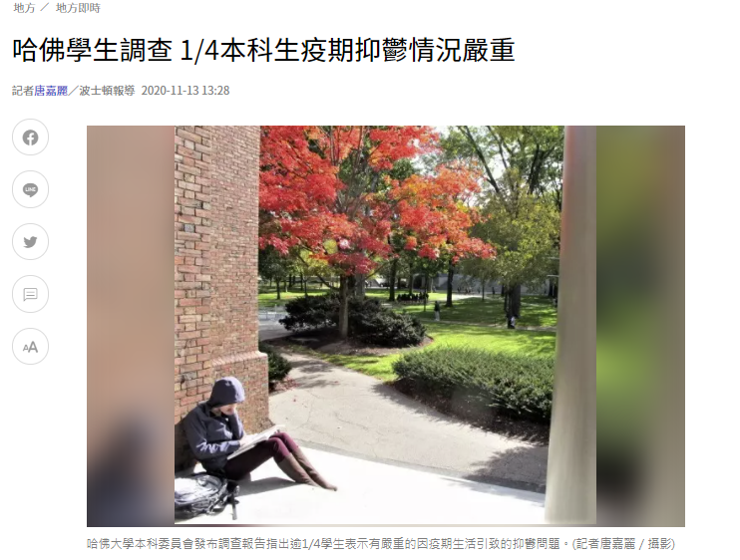

Slide 4
疲乏的，他賜能力；軟弱的，他加力量。 就是少年人也要疲乏困倦；強壯的也必全然跌倒。 但那等候耶和華的必重新得力。 他們必如鷹展翅上騰；他們奔跑卻不困倦，行走卻不疲乏。(以賽亞書 Isaiah 40:29-31)
31 but those who hope in the Lord will renew their strength. They will soar on wings like eagles; they will run and not grow weary, they will walk and not be faint.

Slide 5
健康的活力
活力的本質
活力的分類
活力與界限

Slide 6
健康的活力
活力的本質
活力的分類
活力與界限

Slide 7
健康的活力
活力的本質
活力的分類
活力與界限

Slide 8
如何設定界線保持活力?
認識你的呼召
學習取捨放下
神的上升氣流

Slide 9
A vocation (from Latin vocātiō ‘a call, summons’) 職業、使命感
is an occupation to which a person is especially drawn or for which they are suited, trained, or qualified. Though now often used in non-religious contexts, the meanings of the term originated in Christianity.

Slide 10
如何設定界線保持活力?
認識你的呼召
學習取捨放下
神的上升氣流

Slide 11
如何設定界線保持活力?
認識你的呼召
學習取捨放下
神的上升氣流

Slide 12
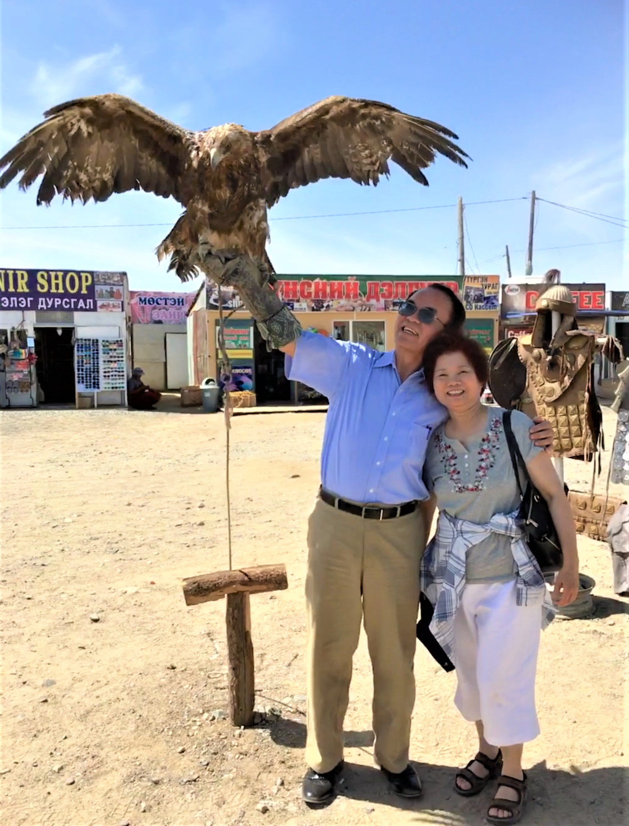

Slide 13
Achievement 成就 ─ 10% 快樂
Fulfilment 心靈的滿足 ─ 90% 快樂

Slide 14
你們要先求他的國和他的義，這些東西都要加給你們了。
(馬太福音 Matthew 6:33)
But seek first his kingdom and his righteousness, and all these things will be given to you as well.

Slide 15
同心禱告

