Slide 1
主日信息
Sunday Sermon

Slide 2

天上與地上
In Heaven and On Earth
波特蘭靈糧堂
November 29, 2020

Slide 3
願你的國降臨；願你的旨意行在地上，如同行在天上。
(馬太福音 Matthew 6:10)
Your kingdom come.
Your will be done,
On earth as it is in heaven.

Slide 4
所以，你們若真與基督一同復活，就當求在上面的事；那裡有基督坐在 神的右邊。 你們要思念上面的事，不要思念地上的事。因為你們已經死了，你們的生命與基督一同藏在 神裡面。 (歌羅西書 Col. 3:1-3)
2 Set your minds on things above, not on earthly things. 3 For you died, and your life is now hidden with Christ in God.

Slide 5
主耶和華的靈在我身上；因為耶和華用膏膏我，叫我傳好信息給謙卑的人（傳福音給貧窮的人），差遣我醫好傷心的人，報告被擄的得釋放，被囚的出監牢；
(以賽亞書 Isaiah 61:1)
The Spirit of the Sovereign Lord is on me, because the Lord has anointed me to proclaim good news to the poor. He has sent me to bind up the brokenhearted, to proclaim freedom for the captives
and release from darkness for the prisoners,

Slide 6
賜華冠與錫安悲哀的人，代替灰塵；喜樂油代替悲哀；讚美衣代替憂傷之靈；使他們稱為「公義樹」，是耶和華所栽的，叫他得榮耀。
(以賽亞書 Isaiah 61:3)
To grant those who mourn in Zion, Giving them a garland instead of ashes, The oil of gladness instead of mourning, The cloak of praise instead of a disheartened spirit. So they will be called oaks of righteousness, The planting of the Lord, that He may be glorified.

Slide 7
他們必修造已久的荒場，建立先前淒涼之處，重修歷代荒涼之城。
(以賽亞書 Isaiah 61:3)
Then they will rebuild the ancient ruins,
They will raise up the former devastations;
And they will repair the ruined cities,
The desolations of many generations.

Slide 8
我實實在在地告訴你們，我所做的事，信我的人也要做，並且要做比這更大的事，因為我往父那裡去。 (約翰福音 John 14:12)
Truly, truly I say to you, the one who believes in Me, the works that I do, he will do also; and greater works than these he will do; because I am going to the Father.

Slide 9
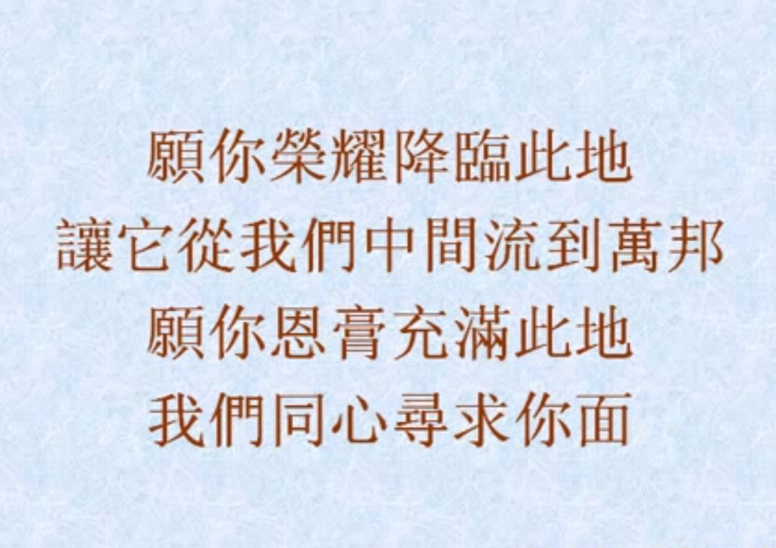
LET YOUR GLORY FALL IN THIS ROOM

Slide 10
同心禱告

