Slide 1
主日信息
Sunday Sermon

Slide 2

聖靈的修正
Corrections by the Spirit
波特蘭靈糧堂
January 31, 2021

Slide 3
如經上所記： 神為愛他的人所預備的是眼睛未曾看見，耳朵未曾聽見，人心也未曾想到的。 只有 神藉著聖靈向我們顯明了，因為聖靈參透萬事，就是 神深奧的事也參透了。
(哥林多前書 1 Corinthians 2:9-10)
10 these are the things God has revealed to us by his Spirit. The Spirit searches all things, even the deep things of God.

Slide 4
你們從主所受的恩膏常存在你們心裡，並不用人教訓你們，自有主的恩膏在凡事上教訓你們。 這恩膏是真的，不是假的；你們要按這恩膏的教訓住在主裡面。
(約翰一書 1 John 2:27)
As for you, the anointing you received from him remains in you, and you do not need anyone to teach you. But as his anointing teaches you about all things and as that anointing is real, not counterfeit—just as it has taught you, remain in him.

Slide 5
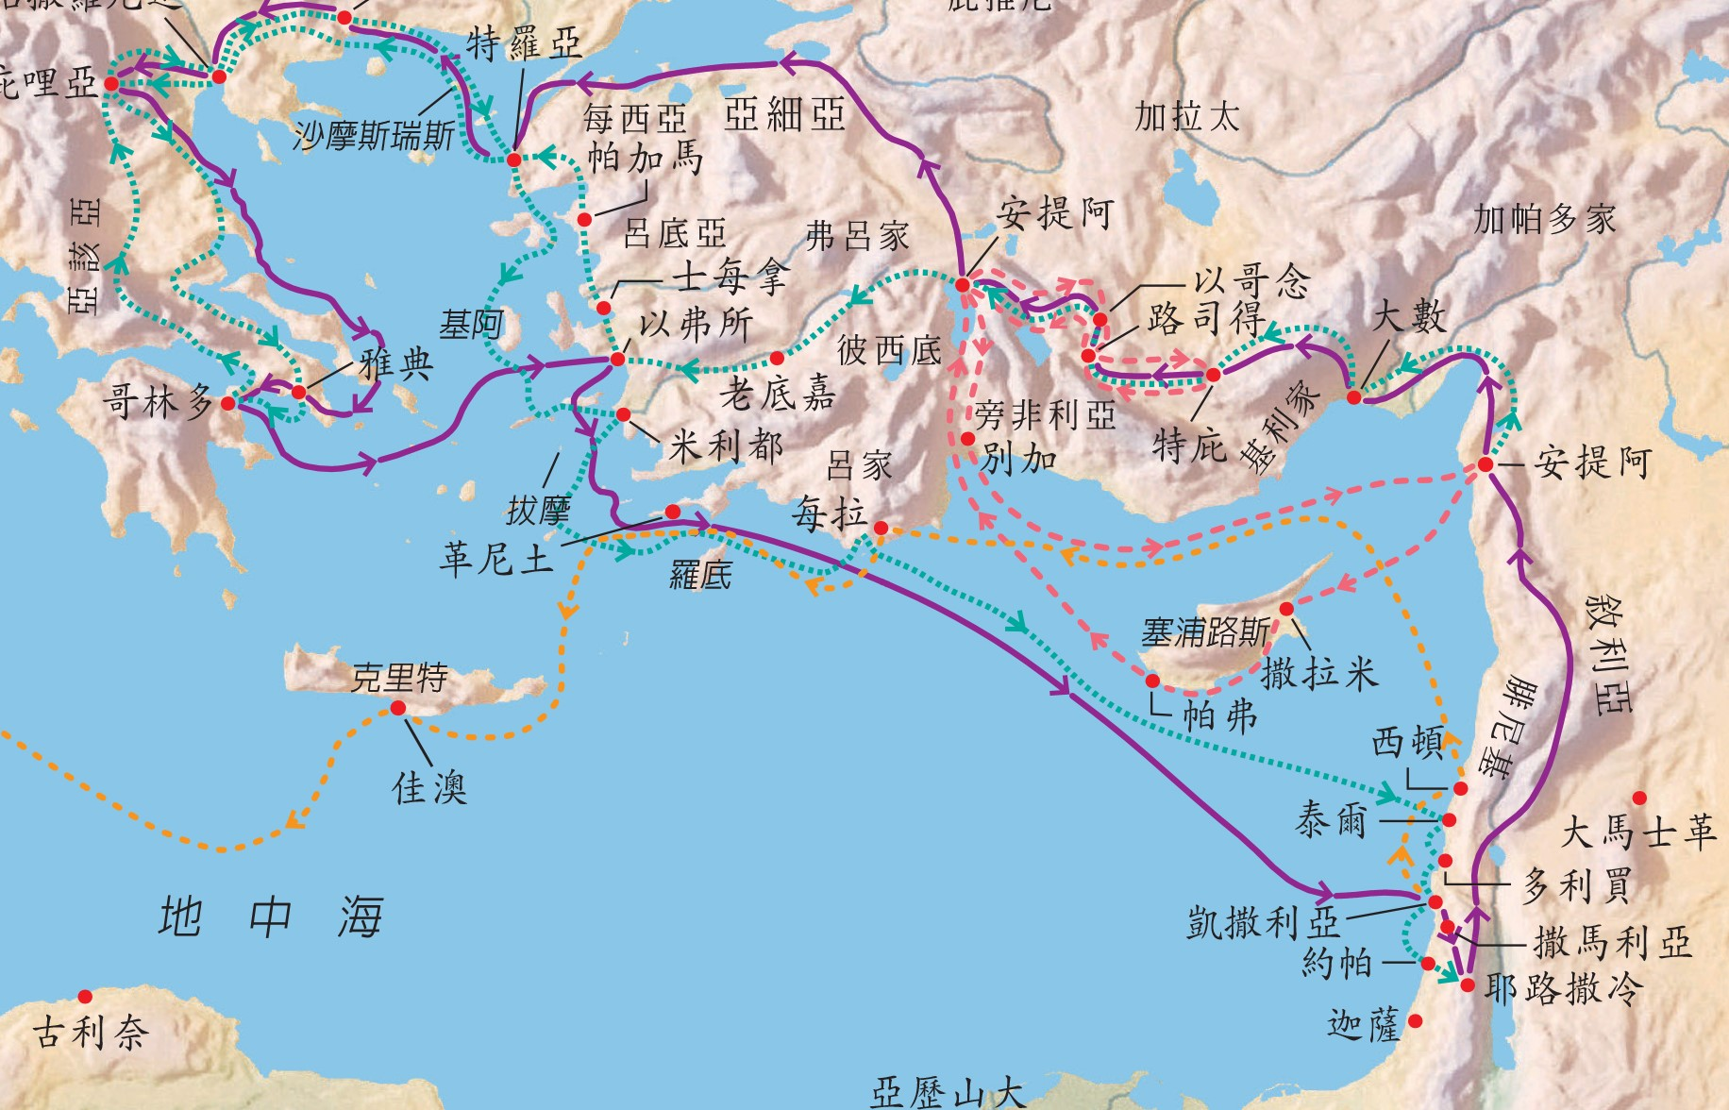
保羅第一次宣教旅程中聖靈的指示

Slide 6
他們敬拜主、禁食的時候，聖靈說：「要為我分派巴拿巴和掃羅，去做我召他們所做的工。」 於是禁食禱告，按手在他們頭上，就打發他們去了。 他們既被聖靈差遣，就下到西流基，從那裡坐船往塞浦路斯去。
(使徒行傳 Acts 13:2-4)
While they were worshiping the Lord and fasting, the Holy Spirit said, “Set apart for me Barnabas and Saul for the work to which I have called them.” So after they had fasted and prayed, they placed their hands on them and sent them off.

Slide 7
聖靈既然禁止他們在亞細亞講道，他們就經過弗呂家、加拉太一帶地方。 到了每西亞的邊界，他們想要往庇推尼去，耶穌的靈卻不許。 他們就越過每西亞，下到特羅亞去。 (使徒行傳 Acts 16:6-8)
Paul and his companions traveled throughout the region of Phrygia and Galatia, having been kept by the Holy Spirit from preaching the word in the province of Asia. When they came to the border of Mysia, they tried to enter Bithynia, but the Spirit of Jesus would not allow them to. So they passed by Mysia and went down to Troas.

Slide 8
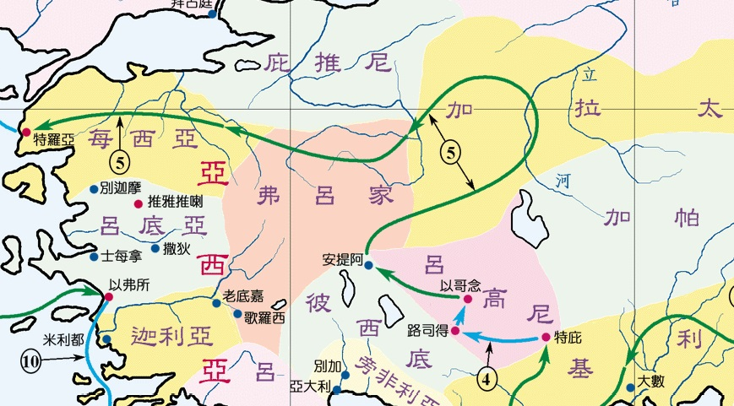
保羅第二次宣教旅程中聖靈的修正

Slide 9
聖靈「禁止」和「不許」的方式
藉著環境的攔阻
聖經的啟示
藉著異夢、異象
靈裏覺得不平安
先知明確的預言
缺乏共識的印證

Slide 10
大衛住在自己宮中，對先知拿單說：「看哪，我住在香柏木的宮中，耶和華的約櫃反在幔子裡。」拿單對大衛說：「你可以照你的心意而行，因為 神與你同在。」當夜， 神的話臨到拿單，說：「你去告訴我僕人大衛，說耶和華如此說：『你不可建造殿宇給我居住。 (歷代志上 1 Chronicles 17:1-4)
2 Nathan replied to David, “Whatever you have in mind, do it, for God is with you.” But that night the word of God came to Nathan, saying:

Slide 11
聖靈『為何』禁止呢？

Slide 12
重啟（實體）聚會後，你發現沒有在教會看到某些人的身影嗎？他們是誰？為何他們不再上教會？
後疫情時代，20-30% 的會友不再到教會聚會!? 湯姆．雷納（Thom S. Rainer）牧師歸納出是 5 種人

Slide 13
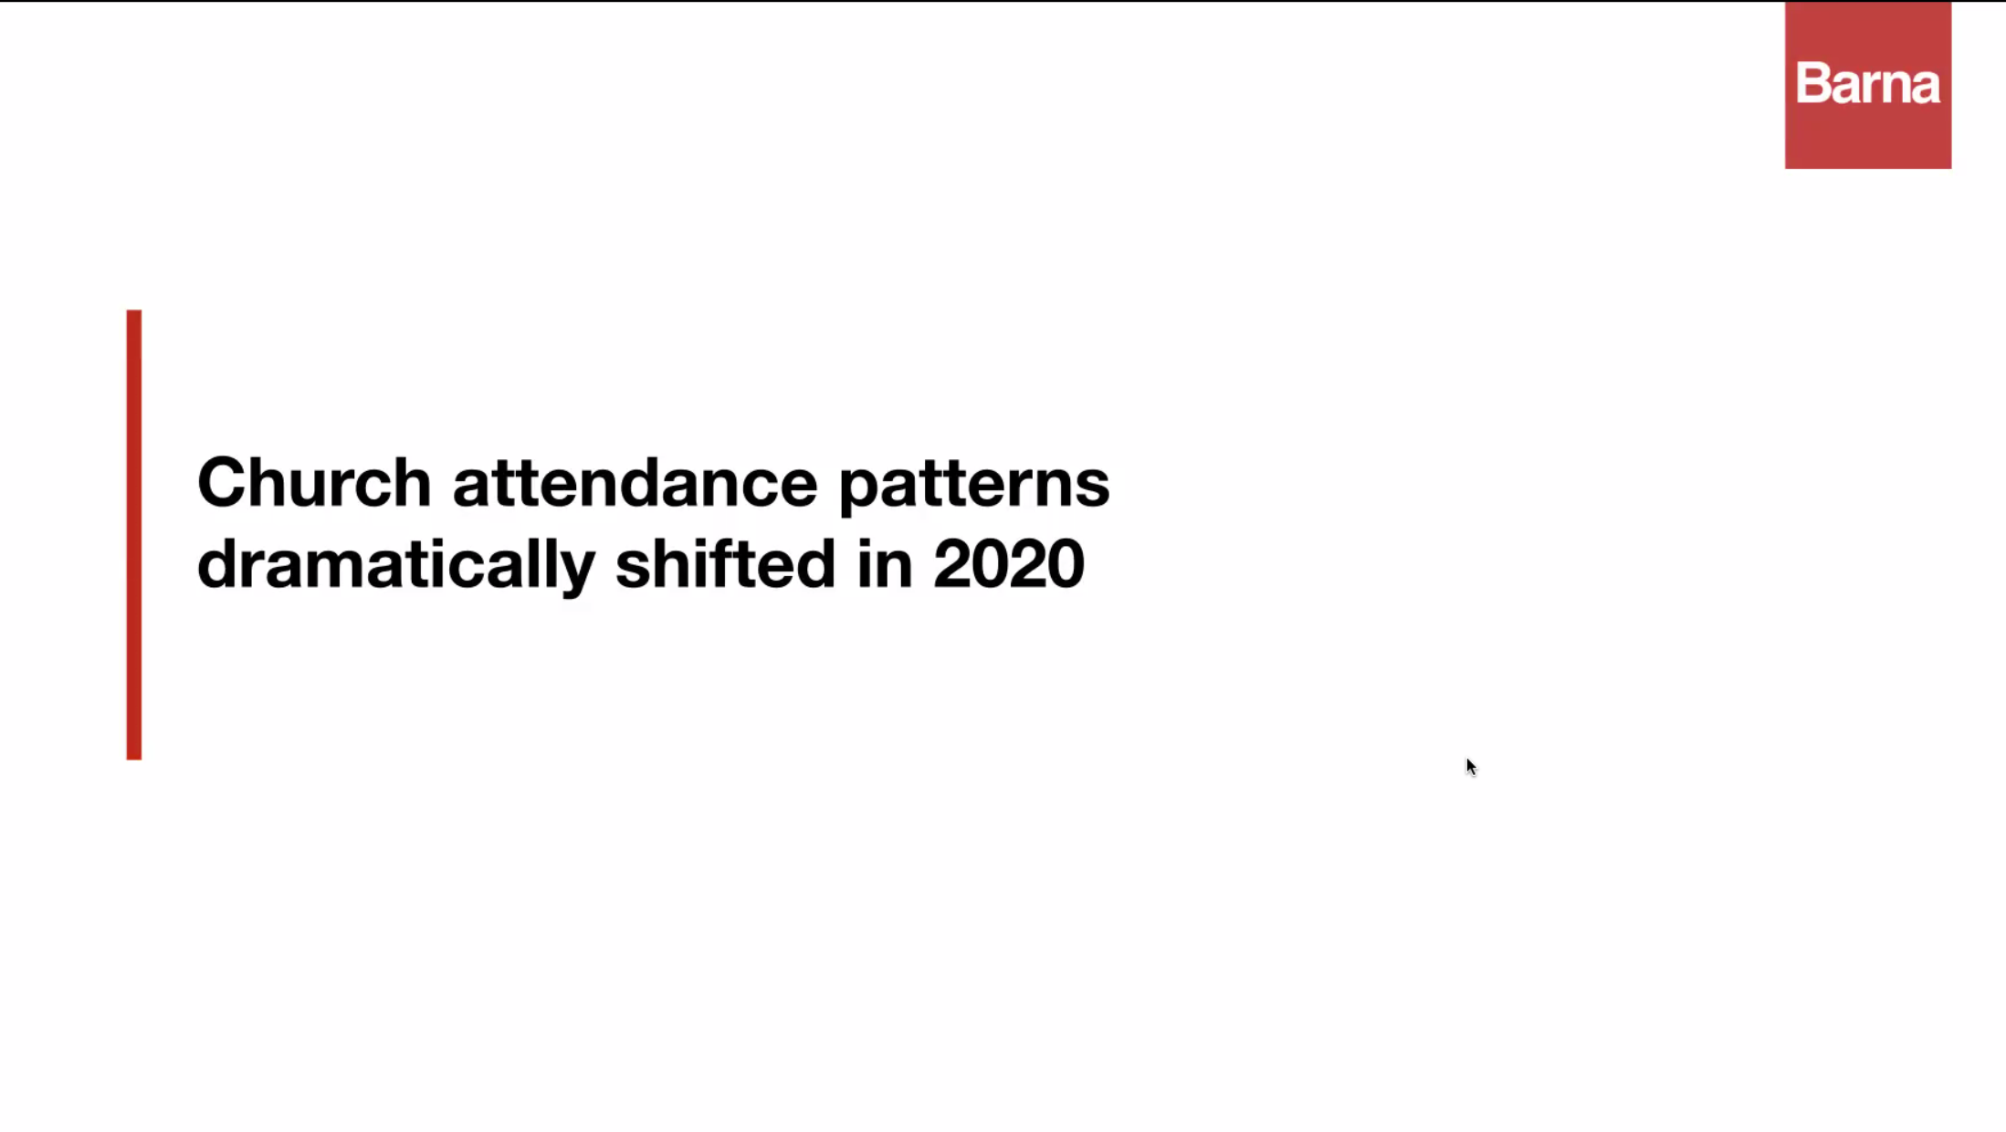

Slide 14
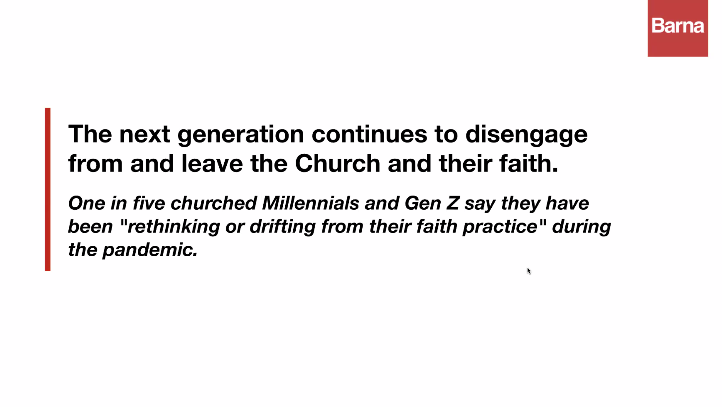

Slide 15
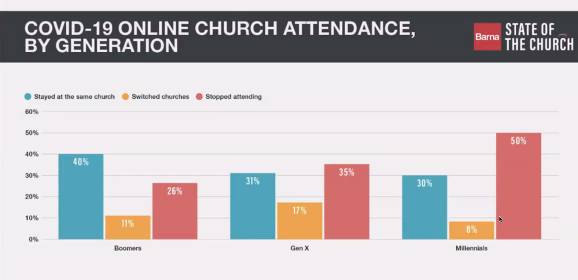
1946-1964
1965-1980
1981-1996

Slide 16
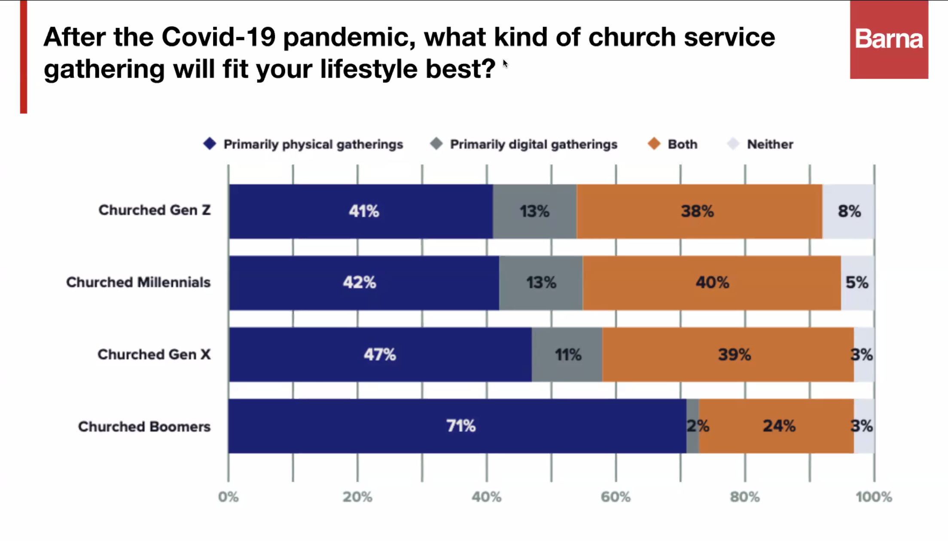
1997-2014
1981-1996
1965-1980
1946-1964

Slide 17
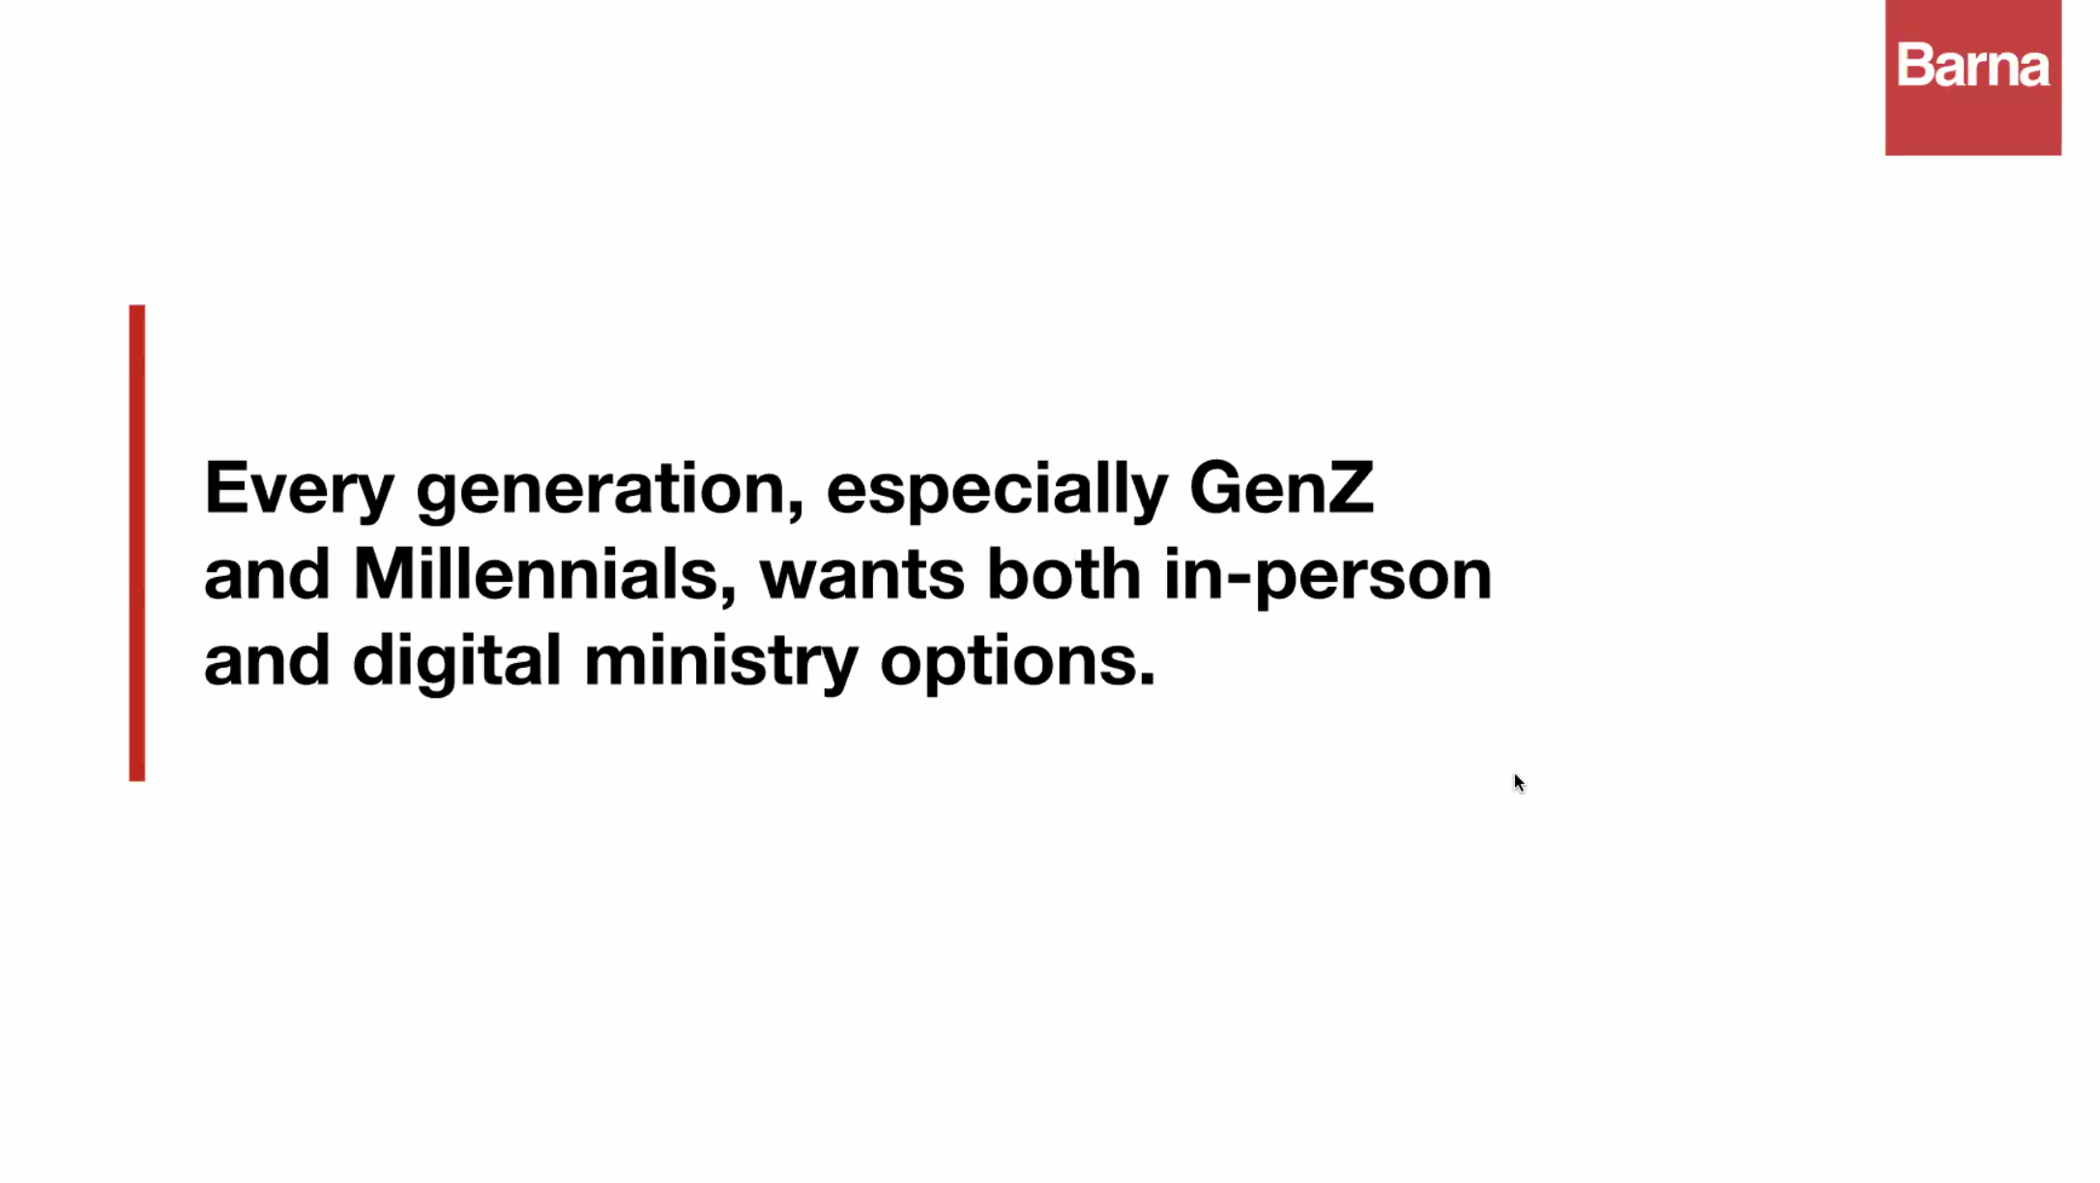
*** 較年青的族群多半期望教會提供 Hybrid 混合進行的聚會方式

Slide 18
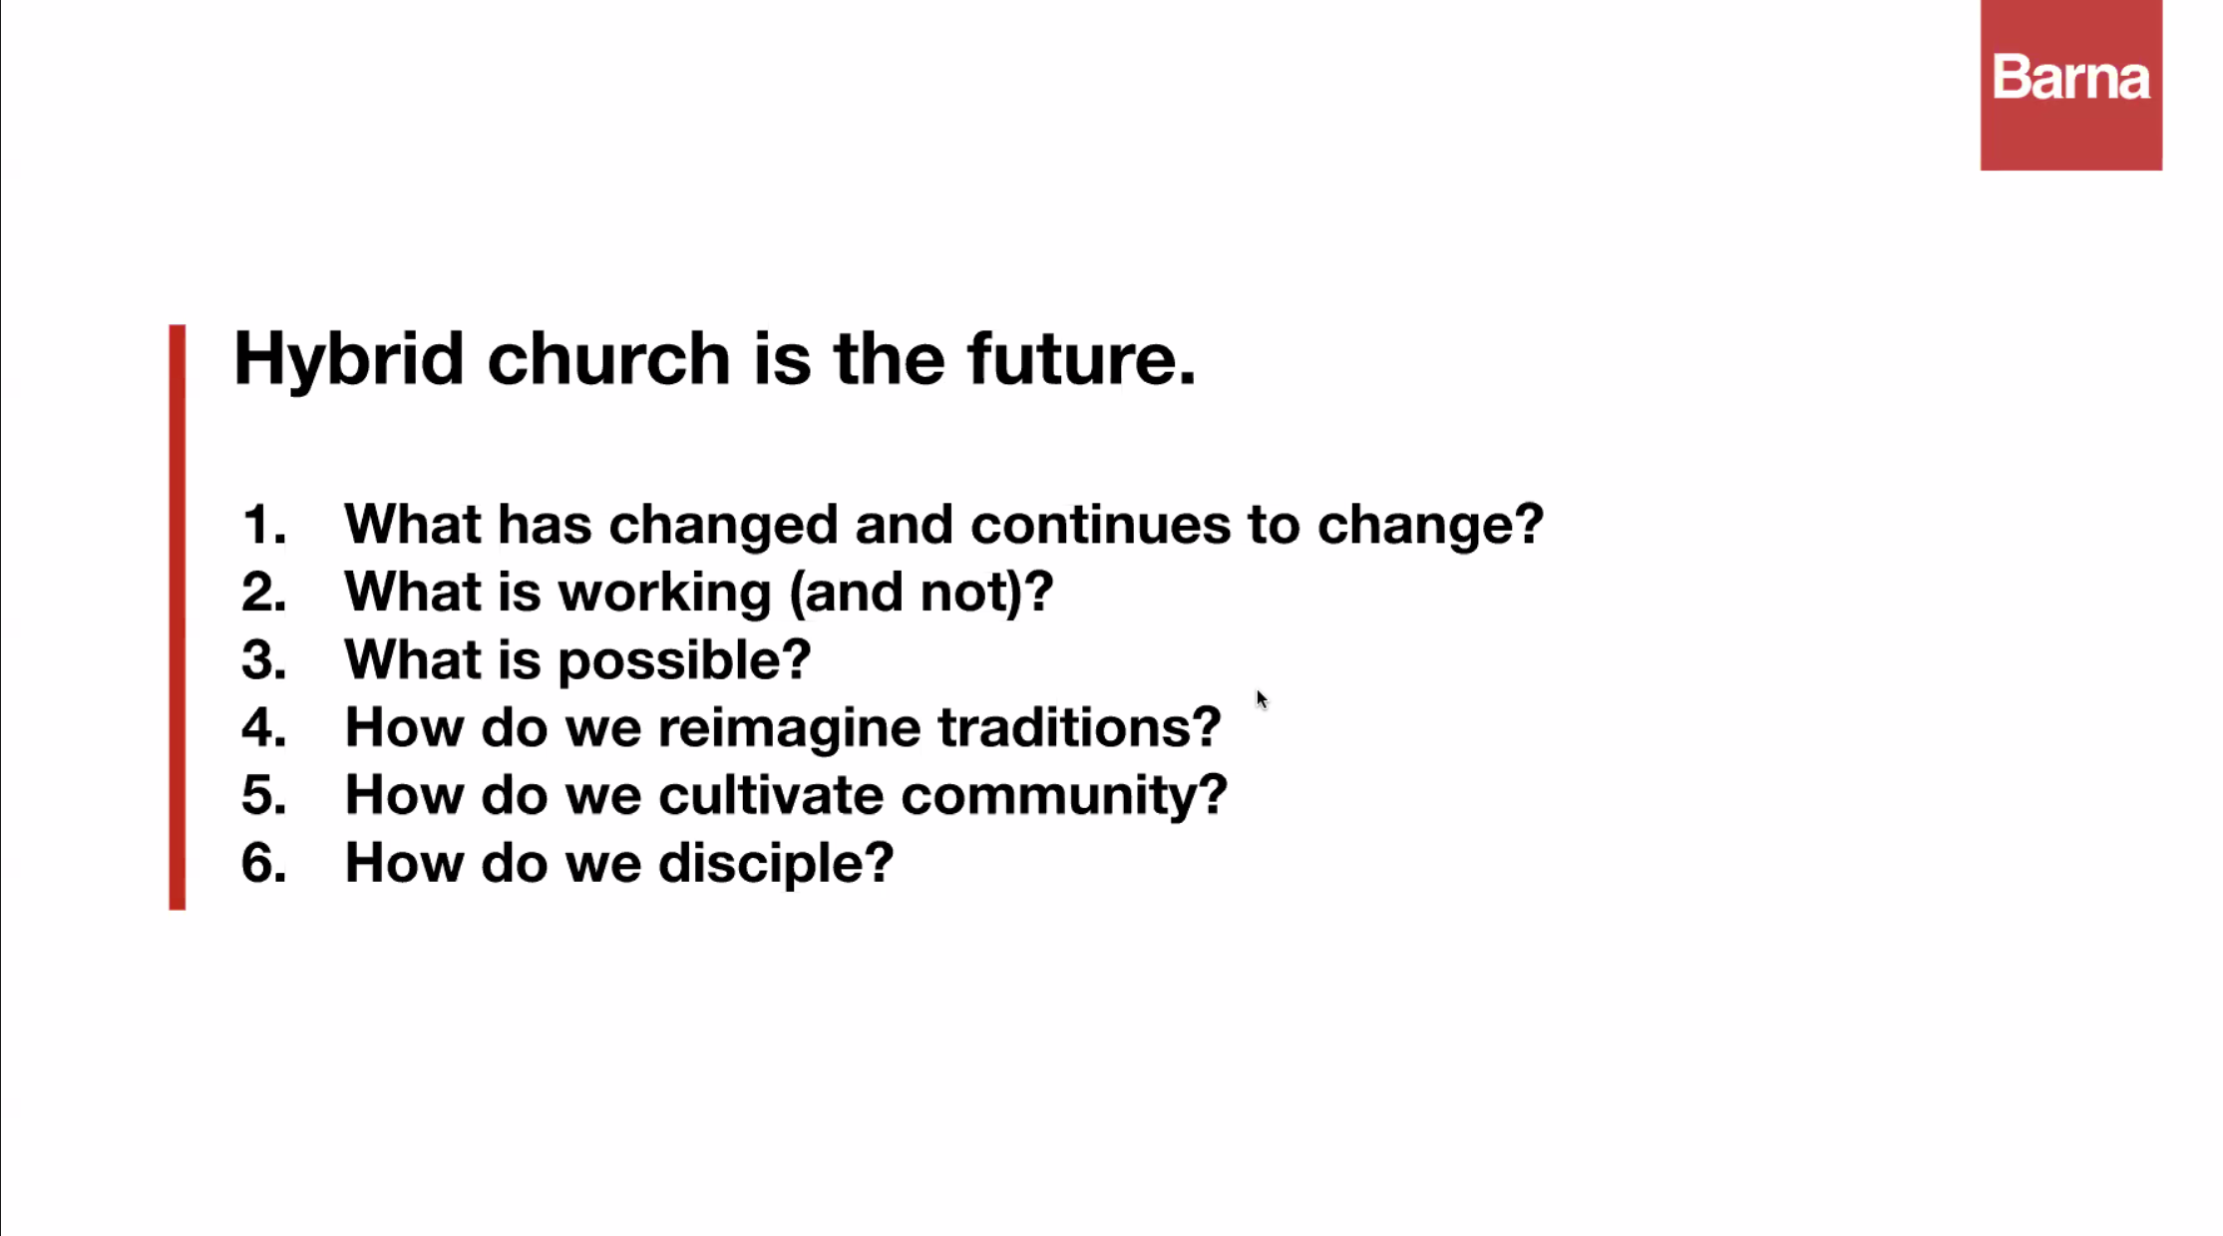

Slide 19
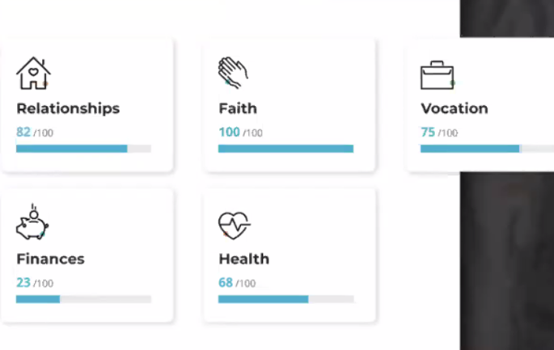
1.人際關係 2.信仰 3.工作 4.財務 5.健康

Slide 20
與教牧團、劉牧師、理事會諮商、交通、禱告、尋求之後，對於取消西區植堂事工的決定和考量
目前累計西區植堂基金: $64,886.58
將歸入 「宣教基金」 中的 「植堂」 專款
Mission Fund – Church Planting

Slide 21

愛心奉獻 Offering
為教會未來植堂奉獻，請在支票或是 Zelle 網上奉獻給帳號 bolip.donation@gmail.com 並註明 “Mission – Church Planting” 或是 「宣教 ─ 植堂」。

Slide 22
要常常喜樂，不住地禱告，凡事謝恩；因為這是 神在基督耶穌裡向你們所定的旨意。 不要消滅聖靈的感動； 不要藐視先知的講論。但要凡事察驗；善美的要持守，
(帖撒羅尼迦前書 1 Thess. 5:14-20)
Rejoice always, pray continually, give thanks in all circumstances; for this is God’s will for you in Christ Jesus. Do not quench the Spirit. Do not treat prophecies with contempt but test them all; hold on to what is good,

Slide 23
同心禱告

