Slide 1

同領聖餐 Holy Communion

Slide 2
凡事都不可虧欠人，惟有彼此相愛要常以為虧欠，因為愛人的就完全了律法。 (羅馬書 Romans 13:8)
Let no debt remain outstanding, except the continuing debt to love one another, for whoever loves others has fulfilled the law.

Slide 3
主耶穌被賣的那一夜，拿起餅來， 祝謝了，就擘開，說：「這是我的身體，為你們捨的，你們應當如此行，為的是記念我。」
(哥林多前書 1 Corinthians 11:23-24)
The Lord Jesus, on the night he was betrayed, took bread, and when he had given thanks, he broke it and said, “This is my body, which is for you; do this in remembrance of me.”

Slide 4
飯後，也照樣拿起杯來，說：「這杯是用我的血所立的新約，你們每逢喝的時候，要如此行，為的是記念我。」
(哥林多前書 1 Corinthians 11:25)
In the same way, after supper he took the cup, saying, “This cup is the new covenant in my blood; do this, whenever you drink it, in remembrance of me.”

Slide 5
你們每逢吃這餅，喝這杯，是表明主的死，直等到他來。
(哥林多前書 1 Corinthians 11:26)
For whenever you eat this bread and drink this cup, you proclaim the Lord’s death until he comes.

Slide 6
人應當自己省察，然後吃這餅、喝這杯。 (哥林多前書 1 Cor. 11:28)
Everyone ought to examine themselves before they eat of the bread and drink from the cup.

Slide 7
主日信息
Sunday Sermon

Slide 8

Reaching the Unreached of the World 2021
2021 年世界未得之地的外展
Ignite the World Ministries
Mike Maksimowicz
February 7, 2021

Slide 9
我們不仗著別人所勞碌的，分外誇口；但指望你們信心增長的時候，所量給我們的界限，就可以因著你們更加開展， 得以將福音傳到你們以外的地方；並不是在別人界限之內，藉著他現成的事誇口。 (哥林多後書 2 Corinthians 10:15-16)
Neither do we go beyond our limits by boasting of work done by others. Our hope is that, as your faith continues to grow, our sphere of activity among you will greatly expand, so that we can preach the gospel in the regions beyond you. For we do not want to boast about work already done in someone else’s territory.

Slide 10
Ignite the World Ministries video

Slide 11
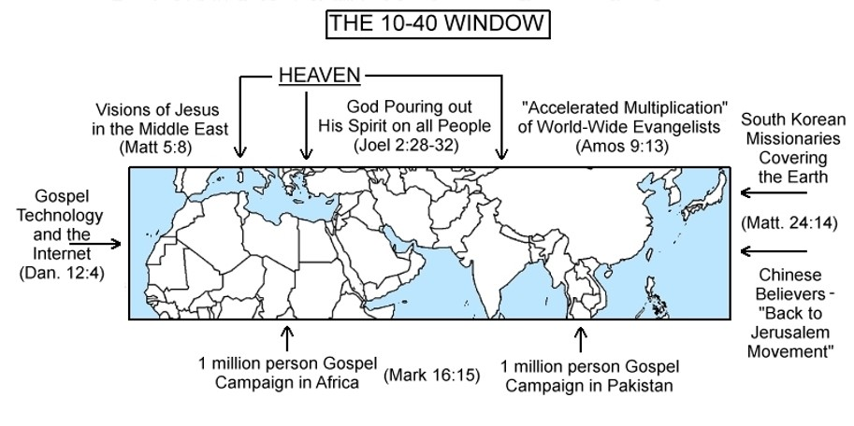

Slide 12
