Slide 1


Slide 2
凡事都不可虧欠人，惟有彼此相愛要常以為虧欠，因為愛人的就完全了律法。 (羅馬書 Romans 13:8)
Let no debt remain outstanding, except the continuing debt to love one another, for whoever loves others has fulfilled the law.

Slide 3
主日信息
Sunday Sermon

Slide 4

培養敏銳的靈
Cultivating Keen Spirit
波特蘭靈糧堂
February 14, 2021

Slide 5
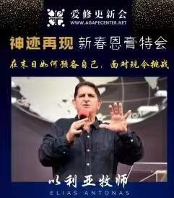
「在末日如何預備自己，面對現今挑戰」

Slide 6
約伯記的啟示
缺乏分辨諸靈能力的世代

Slide 7
你且伸手毀他一切所有的；他必當面棄掉你。」 耶和華對撒但說：「凡他所有的都在你手中；只是不可伸手加害於他。」於是撒但從耶和華面前退去。 (約伯記 Job 1:11-12)
12 “Very well, then, everything he has is in your power, but on the man himself do not lay a finger.” Then Satan went out from the presence of the Lord.

Slide 8
三個污穢的靈 Three unclean spirits
龍 the dragon (古蛇、魔鬼、撒但) {啟示錄 12:9; 16:13; 20:1-3}
海出來的獸 ─ 敵基督 the antichrist (大罪人、沉淪之子) {啟示錄 13:1-8; 帖後 2:3-4; 馬太 24:15; 但以理 9:27}
地出來的獸 ─ 假先知 the false prophet {啟示錄 13:11-12; 16:13; 19:20}

Slide 9
我又看見三個污穢的靈，好像青蛙，從龍口、獸口並假先知的口中出來。 他們本是鬼魔的靈，施行奇事，出去到普天下眾王那裡，叫他們在 神全能者的大日聚集爭戰。
(啟示錄 Revelation 16:13-14)
Then I saw three impure spirits that looked like frogs; they came out of the mouth of the dragon, out of the mouth of the beast and out of the mouth of the false prophet.

Slide 10
敵基督彰顯的三個方式
(那) 敵基督者 the antichrists
敵基督 the antichrist
敵基督者的靈 the spirit of the antichrist

Slide 11
小子們哪，如今是末時了。 你們曾聽見說，那敵基督的要來；現在已經有好些敵基督的出來了，從此我們就知道如今是末時了。
(約翰一書 1 John 2:18)
Dear children, this is the last hour; and as you have heard that the antichrist is coming, even now many antichrists have come. This is how we know it is the last hour.

Slide 12
誰是說謊話的呢？ 不是那不認耶穌為基督的嗎？ 不認父與子的，這就是敵基督的。 (約翰一書 1 John 2:22)
Who is the liar? It is whoever denies that Jesus is the Christ. Such a person is the antichrist—denying the Father and the Son.

Slide 13
凡靈認耶穌基督是成了肉身來的，就是出於 神的；從此你們可以認出 神的靈來。 凡靈不認耶穌，就不是出於 神，這是那敵基督者的靈。 你們從前聽見他要來，現在已經在世上了。 (約翰一書 1 John 4:2-3)
3 but every spirit that does not acknowledge Jesus is not from God. This is the spirit of the antichrist, which you have heard is coming and even now is already in the world.

Slide 14
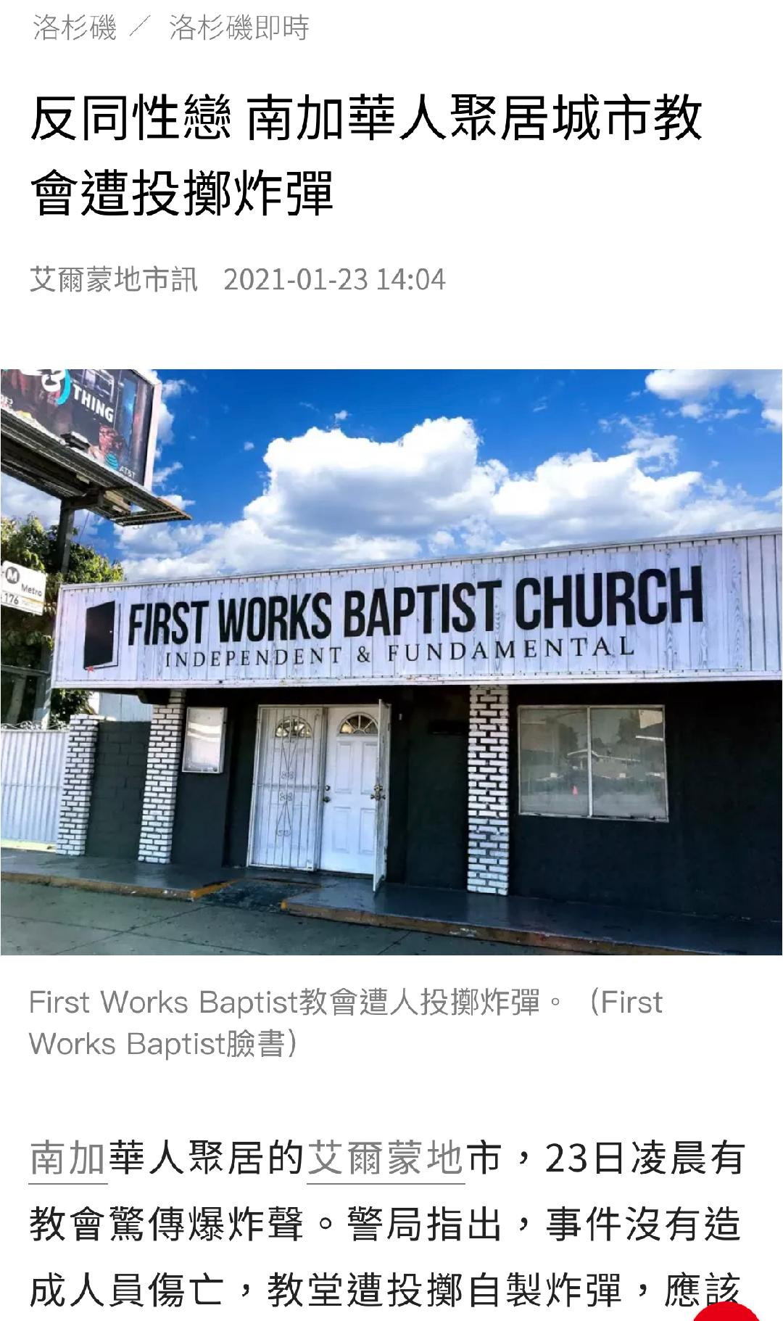

Slide 15
小子們哪，你們是屬 神的，並且勝了他們；因為那在你們裡面的，比那在世界上的更大。 他們是屬世界的，所以論世界的事，世人也聽從他們。 (約翰一書 1 John 4:4-5)
You, dear children, are from God and have overcome them, because the one who is in you is greater than the one who is in the world. They are from the world and therefore speak from the viewpoint of the world, and the world listens to them.

Slide 16
你們從主所受的恩膏常存在你們心裡，並不用人教訓你們，自有主的恩膏在凡事上教訓你們。 這恩膏是真的，不是假的；你們要按這恩膏的教訓住在主裡面。
(約翰一書 1 John 2:27)
As for you, the anointing you received from him remains in you, and you do not need anyone to teach you. But as his anointing teaches you about all things and as that anointing is real, not counterfeit—just as it has taught you, remain in him.

Slide 17
辨別諸靈但不是唯靈論

Slide 18
因為，隨從肉體的人體貼肉體的事；隨從聖靈的人體貼聖靈的事。 體貼肉體的，就是死；體貼聖靈的，乃是生命、平安。(羅馬書 Romans 8:5-6)
Those who live according to the flesh have their minds set on what the flesh desires; but those who live in accordance with the Spirit have their minds set on what the Spirit desires. The mind governed by the flesh is death, but the mind governed by the Spirit is life and peace.

Slide 19
生活當中，每件事都會牽動著靈界勢力。 夫妻吵架、失意沮喪、懼怕、突來的誘惑或攻擊等，可能都有靈界勢力參與或是撒旦攪擾，而不是單純的事。多讀聖經，順從聖靈的引領，養成查驗每件事背後可能的靈界意圖的習慣，能幫助提高我們辨別諸靈的能力，培養敏銳的靈。

Slide 20
同心禱告

