Slide 1
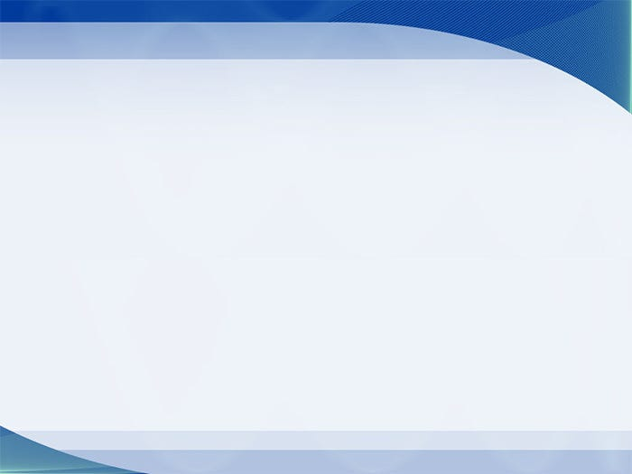
主日信息
Sunday Sermon

Slide 2
耶和華對摩西說：「耶和華的膀臂豈是縮短了嗎？ 現在要看我的話向你應驗不應驗。」
(民數記 Numbers 11:23)
The Lord answered Moses, “Is the Lord’s arm too short? Now you will see whether or not what I say will come true for you.”

Slide 3

神說
God Says
波特蘭靈糧堂
April 11, 2021

Slide 4
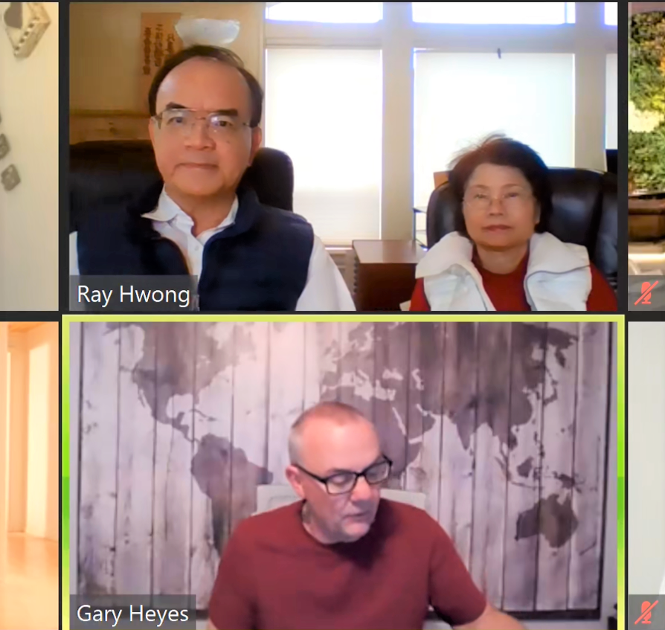
3/27 先知課程「聆聽神的聲音」

Slide 5
但作先知講道的，是對人說，要造就、安慰、勸勉人。 說方言的，是造就自己；作先知講道的，乃是造就教會。(哥林多前書 1 Corinthians 14:3)
But the one who prophesies speaks to people for their strengthening, encouraging and comfort. Anyone who speaks in a tongue edifies themselves, but the one who prophesies edifies the church.

Slide 6
太起初， 神創造天地。 地是空虛混沌，淵面黑暗； 神的靈運行在水面上。 神說：「要有光」，就有了光。 (創世記 Genesis 1:1-3)
In the beginning God created the heavens and the earth. Now the earth was formless and empty, darkness was over the surface of the deep, and the Spirit of God was hovering over the waters. And God said, “Let there be light,” and there was light.

Slide 7
神用祂的話創造 ──「神說」
(創世紀 Gen. 1: 3, 6, 9, 14, 20, 24, 26)
第一日 ─ 分別光暗
第二日 ─ 分別上下，造出穹蒼
第三日 ─ 分別水地，造出植物
第四日 ─ 派置天上日、月、星等光體
第五日 ─ 造出水中和空中各樣動物
第六日 ─ 造出地上各樣動物和人

Slide 8
太初有道 (λόγος)，道與 神同在，道就是 神。 這道太初與 神同在。 萬物是藉著他造的；凡被造的，沒有一樣不是藉著他造的。
(約翰福音 John 1:1-4)
In the beginning was the Word, and the Word was with God, and the Word was God. He was with God in the beginning. Through him all things were made; without him nothing was made that has been made.

Slide 9
道 λόγος (logos) Word
說 λέγω (lego) speak

Slide 10
可見，信道是從聽道來的，聽道是從基督的話 (ῥῆμα) 來的。
(羅馬書 Romans 10:17)
So faith comes from hearing, and hearing by the word of Christ. (NASB)

Slide 11
耶穌卻回答說：「經上記著說：人活著，不是單靠食物，乃是靠 神口裡所出的一切話 (ῥῆμα)。」
(馬太福音 Matthew 4:4)
Jesus answered, “It is written: ‘Man shall not live on bread alone, but on every word that comes from the mouth of God.’

Slide 12
如何「聽」基督的「話」？
How do we listen to word of Christ?
進入主的同在 His presence
求主賜下話語 His word ῥῆμα
謙卑降服遵行 surrender

Slide 13
然而直到今日，每逢誦讀摩西書的時候，帕子還在他們心上。 但他們的心幾時歸向主，帕子就幾時除去了。 主就是那靈；主的靈在哪裡，那裡就得以自由。 (哥林多後書 2 Cor. 3:15-17)
Even to this day when Moses is read, a veil covers their hearts. But whenever anyone turns to the Lord, the veil is taken away. Now the Lord is the Spirit, and where the Spirit of the Lord is, there is freedom.

Slide 14
回應詩歌
「新的親密」

Slide 15
同心禱告

