Slide 1
你們要為耶路撒冷求平安！耶路撒冷啊，愛你的人必然興旺！ 願你城中平安！ 願你宮內興旺！ (Psalm 122:6-7)
Pray for the peace of Jerusalem:
May they prosper who love you.
May peace be within your walls,
And prosperity within your palaces.

Slide 2
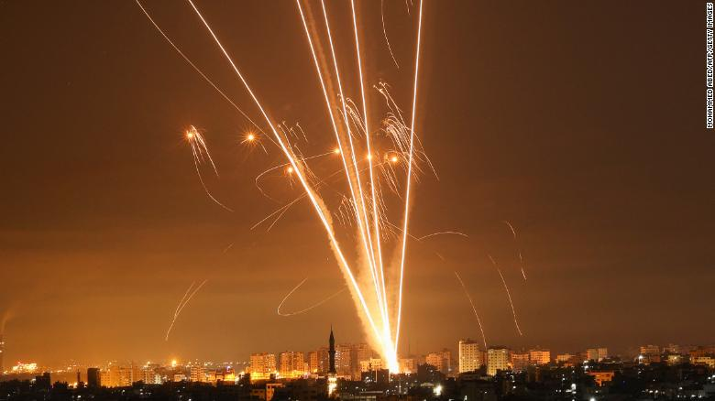

Slide 3
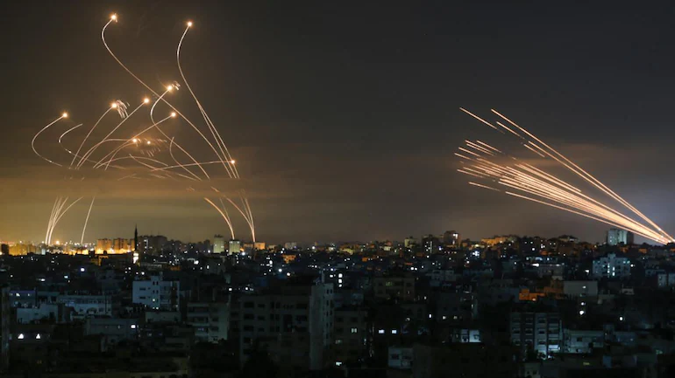

Slide 4
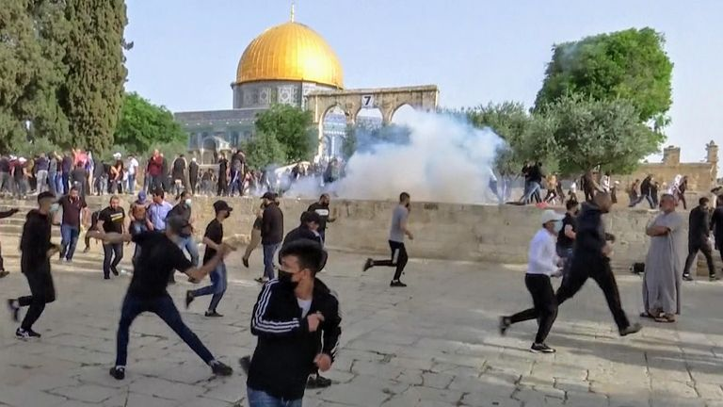

Slide 5

主日信息
Sunday Sermon

Slide 6

羨慕一個更美的家鄉
Desire a Better Country
波特蘭靈糧堂
May 16, 2021

Slide 7
他們若想念所離開的家鄉，還有可以回去的機會。 他們卻羨慕一個更美的家鄉，就是在天上的。 所以 神被稱為他們的 神，並不以為恥，因為他已經給他們預備了一座城。
(希伯來書 Hebrews 11:15-16)
16 Instead, they were longing for a better country—a heavenly one. Therefore God is not ashamed to be called their God, for he has prepared a city for them.

Slide 8
** 撒但起來攻擊以色列人，激動大衛數點他們。大衛就吩咐約押和民中的首領說：「你們去數點以色列人，從別是巴直到但，回來告訴我，我好知道他們的數目。」約押說：「願耶和華使他的百姓比現在加增百倍。我主我王啊，他們不都是你的僕人嗎？我主為何吩咐行這事，為何使以色列人陷在罪裡呢？」 (歷代志上 1 Chronicles 21:1-3)
1 Then Satan stood up against Israel and moved David to number Israel.

Slide 9
至於我，我凡事平順便說：我永不動搖。 耶和華啊，你曾施恩，叫我的江山穩固；你掩了面，我就驚惶。
(詩篇 Psalm 30:6-7)
Now as for me, I said in my prosperity,
“I will never be moved.” O Lord, by Your favor You have made my mountain to stand strong;
You hid Your face, I was dismayed.

Slide 10
因為，凡要救自己生命的，必喪掉生命；凡為我和福音喪掉生命的，必救了生命。 人就是賺得全世界，賠上自己的生命，有甚麼益處呢？人還能拿甚麼換生命呢？
(馬可福音 Mark 8:35-37)
36 What good is it for someone to gain the whole world, yet forfeit their soul? Or what can anyone give in exchange for their soul?

Slide 11
同心禱告

