Slide 1

主日信息
Sunday Sermon

Slide 2

父親怎樣憐恤他的兒女，耶和華也怎樣憐恤敬畏他的人！ (詩篇 Psalm 103:13)

Slide 3

父親節見證分享
Father’s Day Testimony Sharing
Karson Yang 楊家駿 弟兄
波特蘭靈糧堂
June 20, 2021

Slide 4
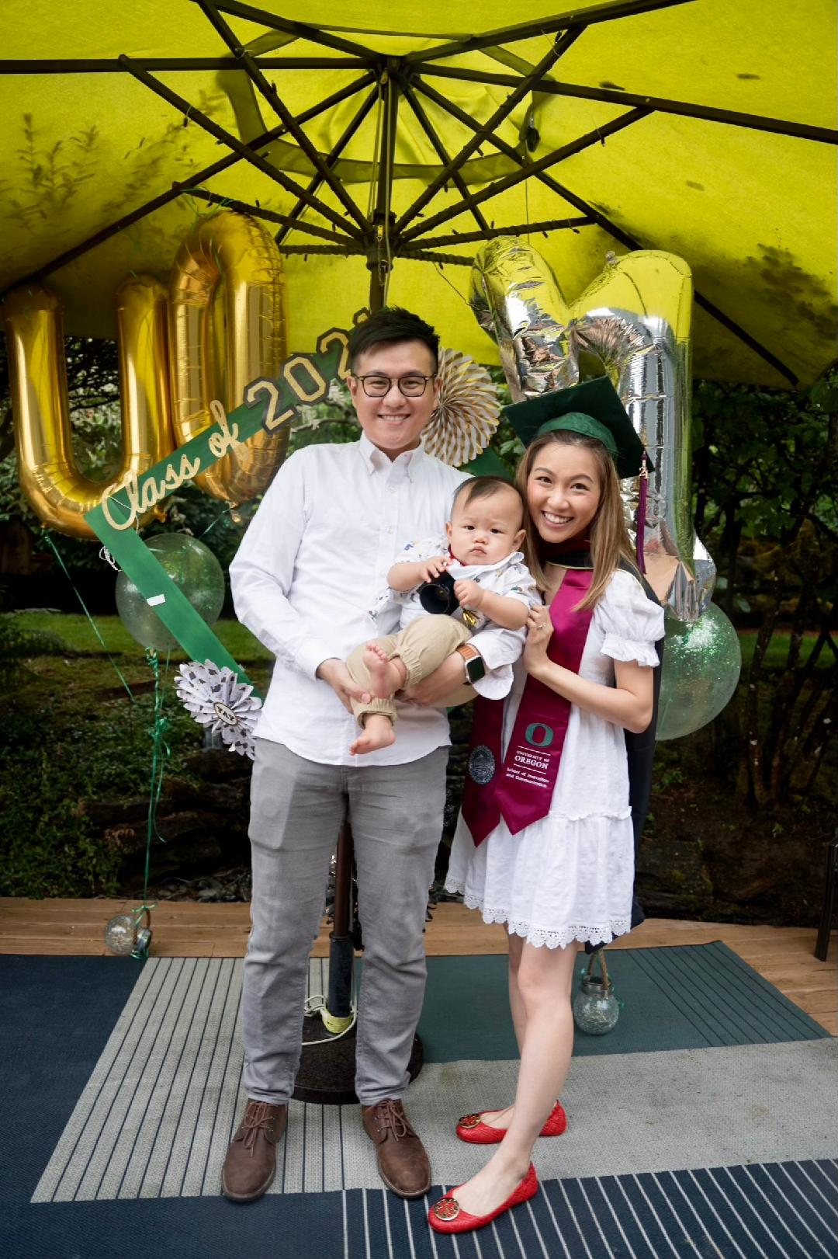
Karson, Rachel, Lucas Yang

Slide 5
我來了，是要叫羊（或譯：人）得生命，並且得的更豐盛。
(約翰福音 John 10:10)
The thief comes only to steal and kill and destroy; I have come that they may have life, and have it to the full.

Slide 6
父親節見證分享
Father’s Day Testimony Sharing
Xiaoting Gu 顧晓汀 弟兄
波特蘭靈糧堂
June 20, 2021

Slide 7
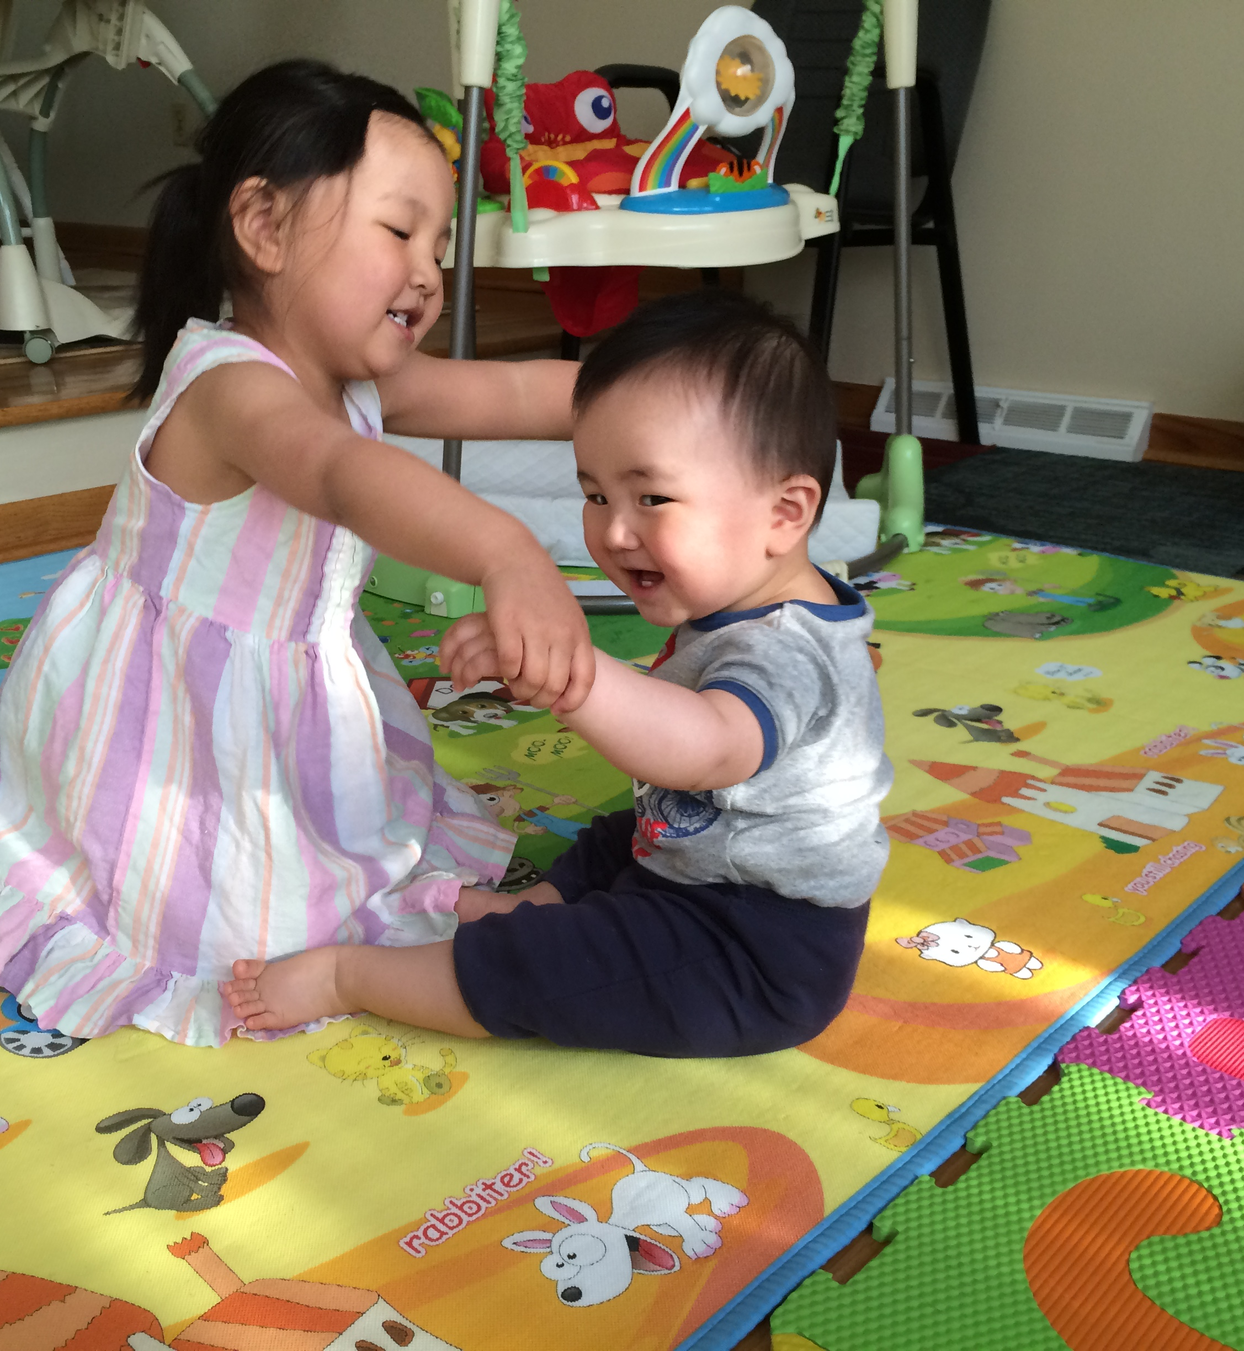
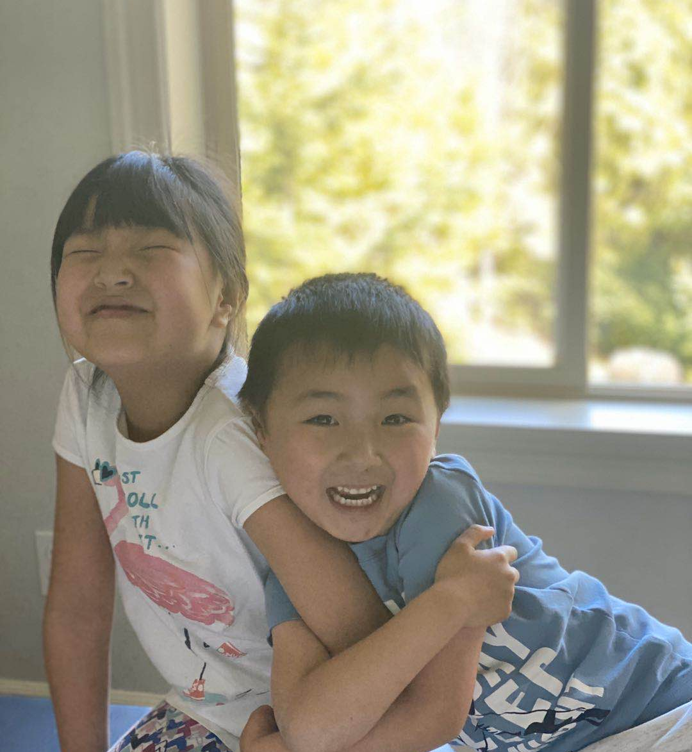
2015
2020

Slide 8

当我感受不到爱的时候，
你说你一直爱我。
当我觉得软弱的时候，
你说我很强大。
当我有所缺乏的时候，
你说你会伸手托起我。
当我找不到归属的时候，
你说我属于你。

Slide 9
原來我們不是顧念所見的，乃是顧念所不見的；因為所見的是暫時的，所不見的是永遠的。
(哥林多後書 2 Corinthians 4:18)
So we fix our eyes not on what is seen, but on what is unseen, since what is seen is temporary, but what is unseen is eternal.

Slide 10
父親節見證分享
Father’s Day Testimony Sharing
Pastor Phil Yien 顏百輝 傳道
波特蘭靈糧堂
June 20, 2021

Slide 11
耶和華在他面前宣告說：「耶和華，耶和華，是有憐憫有恩典的 神，不輕易發怒，並有豐盛的慈愛和誠實
(出埃及記 Exodus 34:6)
“The LORD! The LORD! a God who is compassionate and merciful, very patient, full of great loyalty and faithfulness”
“The LORD, the LORD, a God merciful and gracious, slow to anger, and abounding in steadfast love and faithfulness

Slide 12
兩代之間的醫治
Healing Between Two Generations
波特蘭靈糧堂
June 20, 2021

Slide 13
看哪，耶和華大而可畏之日未到以前，我必差遣先知以利亞到你們那裡去。 他必使父親的心轉向兒女，兒女的心轉向父親，免得我來咒詛遍地。
(瑪拉基書 Malachi 4:5-6)
Behold, I am going to send you Elijah the prophet before the coming of the great and terrible day of the Lord. He will restore the hearts of the fathers to their children and the hearts of the children to their fathers, so that I will not come and smite the land with a curse.

Slide 14
他要使許多以色列人回轉，歸於主─他們的 神。 他必有以利亞的心志能力，行在主的前面，叫為父的心轉向兒女，叫悖逆的人轉從義人的智慧，又為主預備合用的百姓。 (路加福音 Luke 1:16-17)
And he will turn many of the sons of Israel back to the Lord their God. It is he who will go as a forerunner before Him in the spirit and power of Elijah, to turn the hearts of the fathers back to the children, and the disobedient to the attitude of the righteous, so as to make ready a people prepared for the Lord.

Slide 15
同心禱告

