Slide 1
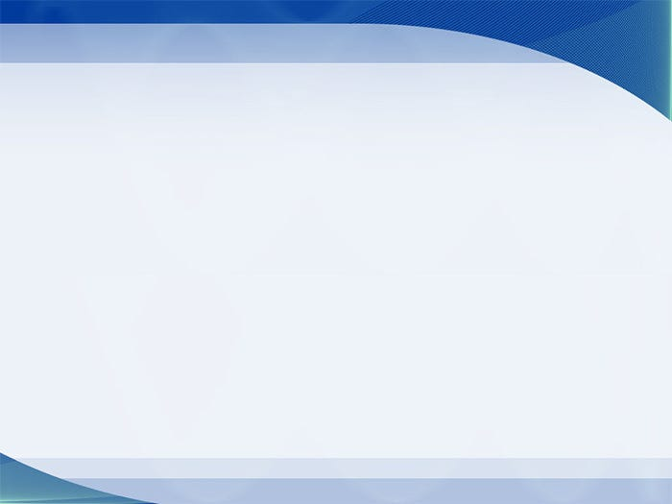
主日信息
Sunday Sermon

Slide 2

從懷疑到相信
From Doubt to Belief
波特蘭靈糧堂
July 4, 2021

Slide 3
十一個門徒往加利利去，到了耶穌約定的山上。 他們見了耶穌就拜他，然而還有人疑惑。(馬太福音 Matthew 28:16-17)
Then the eleven disciples went to Galilee, to the mountain where Jesus had told them to go. When they saw him, they worshiped him; but some doubted.

Slide 4
約翰在監裡聽見基督所做的事，就打發兩個門徒去，問他說：「那將要來的是你嗎？ 還是我們等候別人呢？」
(馬太福音 Matthew 11:2-3)
When John, who was in prison, heard about the deeds of the Messiah, he sent his disciples to ask him, “Are you the one who is to come, or should we expect someone else?”

Slide 5
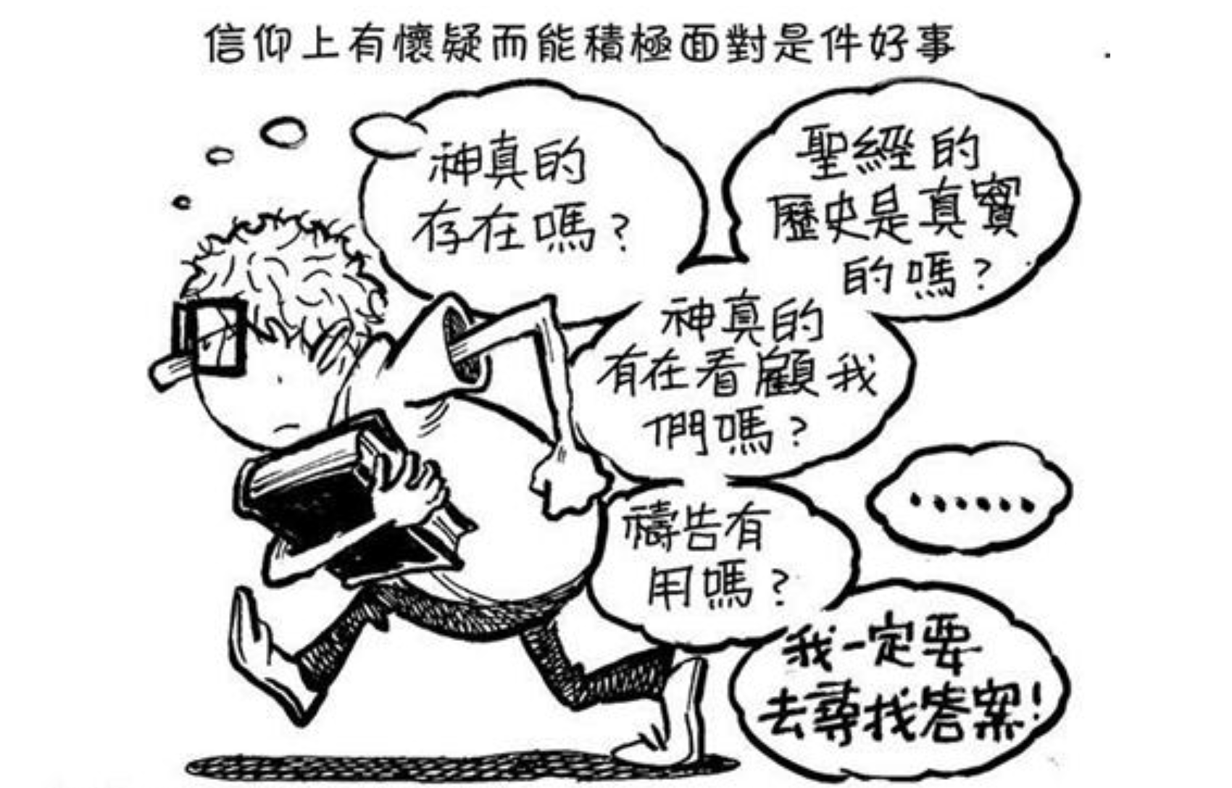

Slide 6
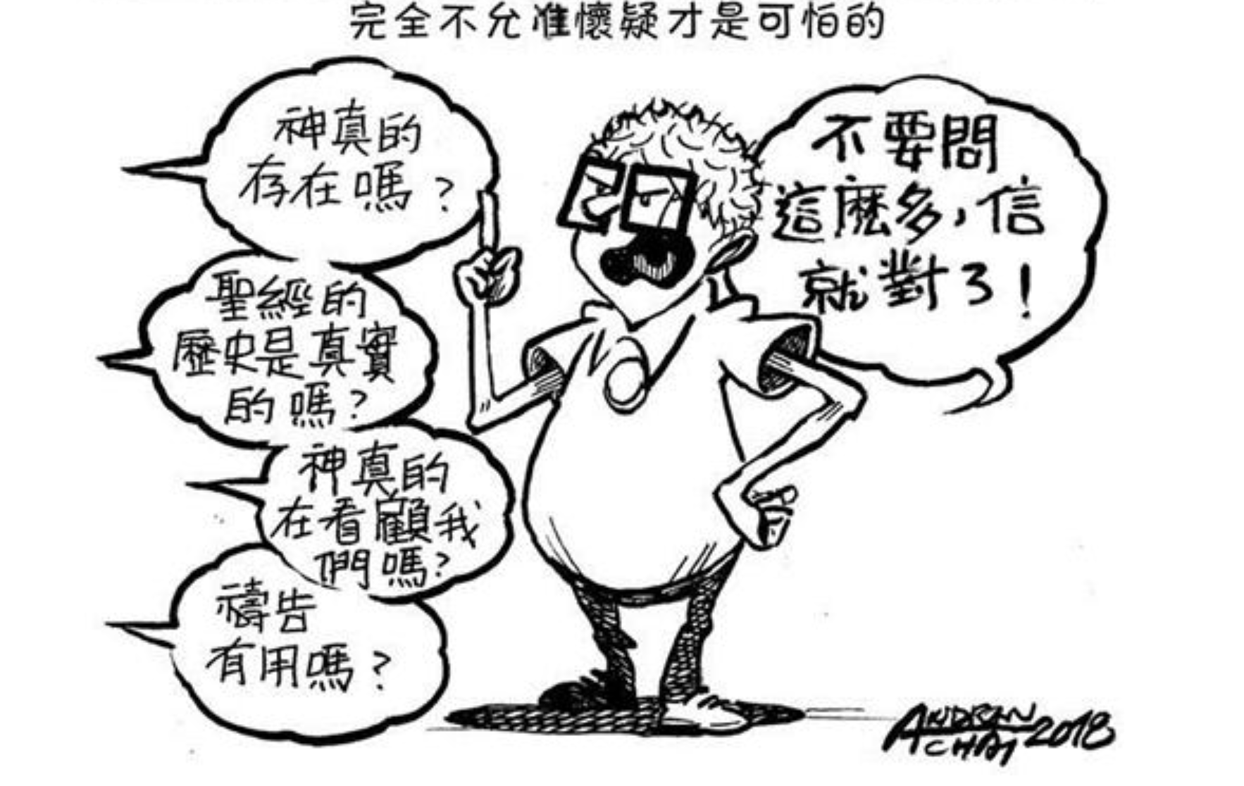

Slide 7
Timothy Keller 提姆‧凱勒牧師說：「沒有懷疑的信仰，就像一個身體內沒有抗體的人……如果一個人未能耐心地傾聽自己內心的懷疑，他的信心可能在一夜間崩潰……」
─ [我為什麼相信？]
“The Reason for God”

Slide 8
面對「懷疑」
試著忽略你的懷疑並不會讓它們消失
很多人其實跟你一樣有懷疑
誠實分享你的信仰經歷（包含懷疑）可以幫助其他人

Slide 9
所以，你們當聽這撒種的比喻。 凡聽見天國道理不明白的，那惡者就來，把所撒在他心裡的奪了去；這就是撒在路旁的了。 (馬太福音 Matthew 13:18-19)
“Listen then to what the parable of the sower means: When anyone hears the message about the kingdom and does not understand it, the evil one comes and snatches away what was sown in their heart. This is the seed sown along the path.

Slide 10
撒在石頭地上的，就是人聽了道，當下歡喜領受，只因心裡沒有根，不過是暫時的，及至為道遭了患難，或是受了逼迫，立刻就跌倒了。
(馬太福音 Matthew 13:20-21)
The seed falling on rocky ground refers to someone who hears the word and at once receives it with joy. But since they have no root, they last only a short time. When trouble or persecution comes because of the word, they quickly fall away.

Slide 11
撒在荊棘裡的，就是人聽了道，後來有世上的思慮、錢財的迷惑把道擠住了，不能結實。 (馬太福音 Matthew 13:22)
The seed falling among the thorns refers to someone who hears the word, but the worries of this life and the deceitfulness of wealth choke the word, making it unfruitful.

Slide 12
撒在好地上的，就是人聽道明白了，後來結實，有一百倍的，有六十倍的，有三十倍的。」 (馬太福音 Matthew 13:23)
But the seed falling on good soil refers to someone who hears the word and understands it. This is the one who produces a crop, yielding a hundred, sixty or thirty times what was sown.”

Slide 13
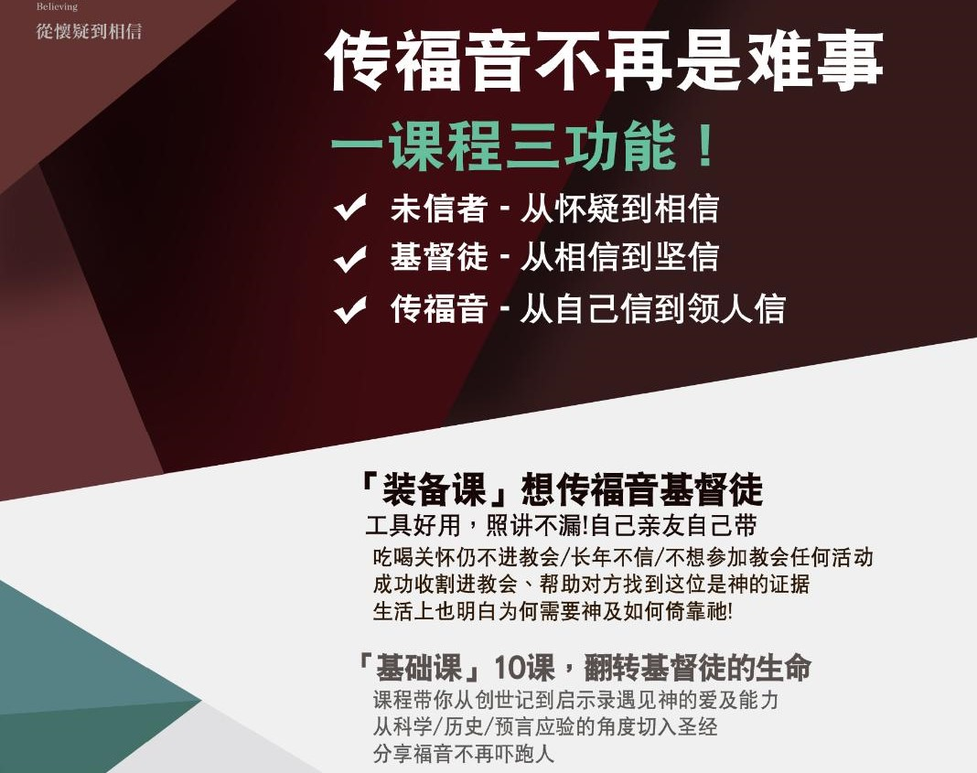

Slide 14
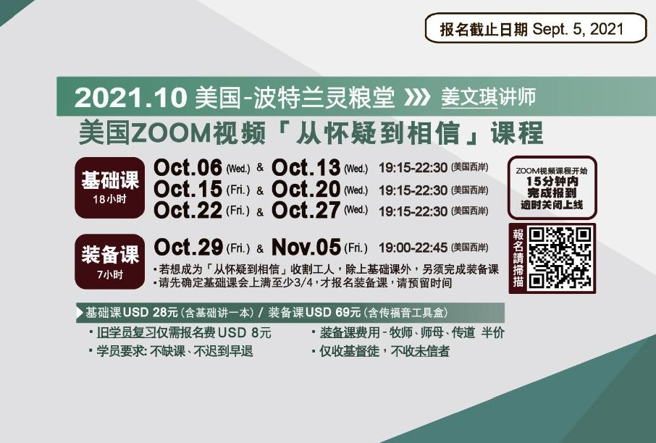

Slide 15
同心禱告

