Slide 1

主日信息
Sunday Sermon

Slide 2
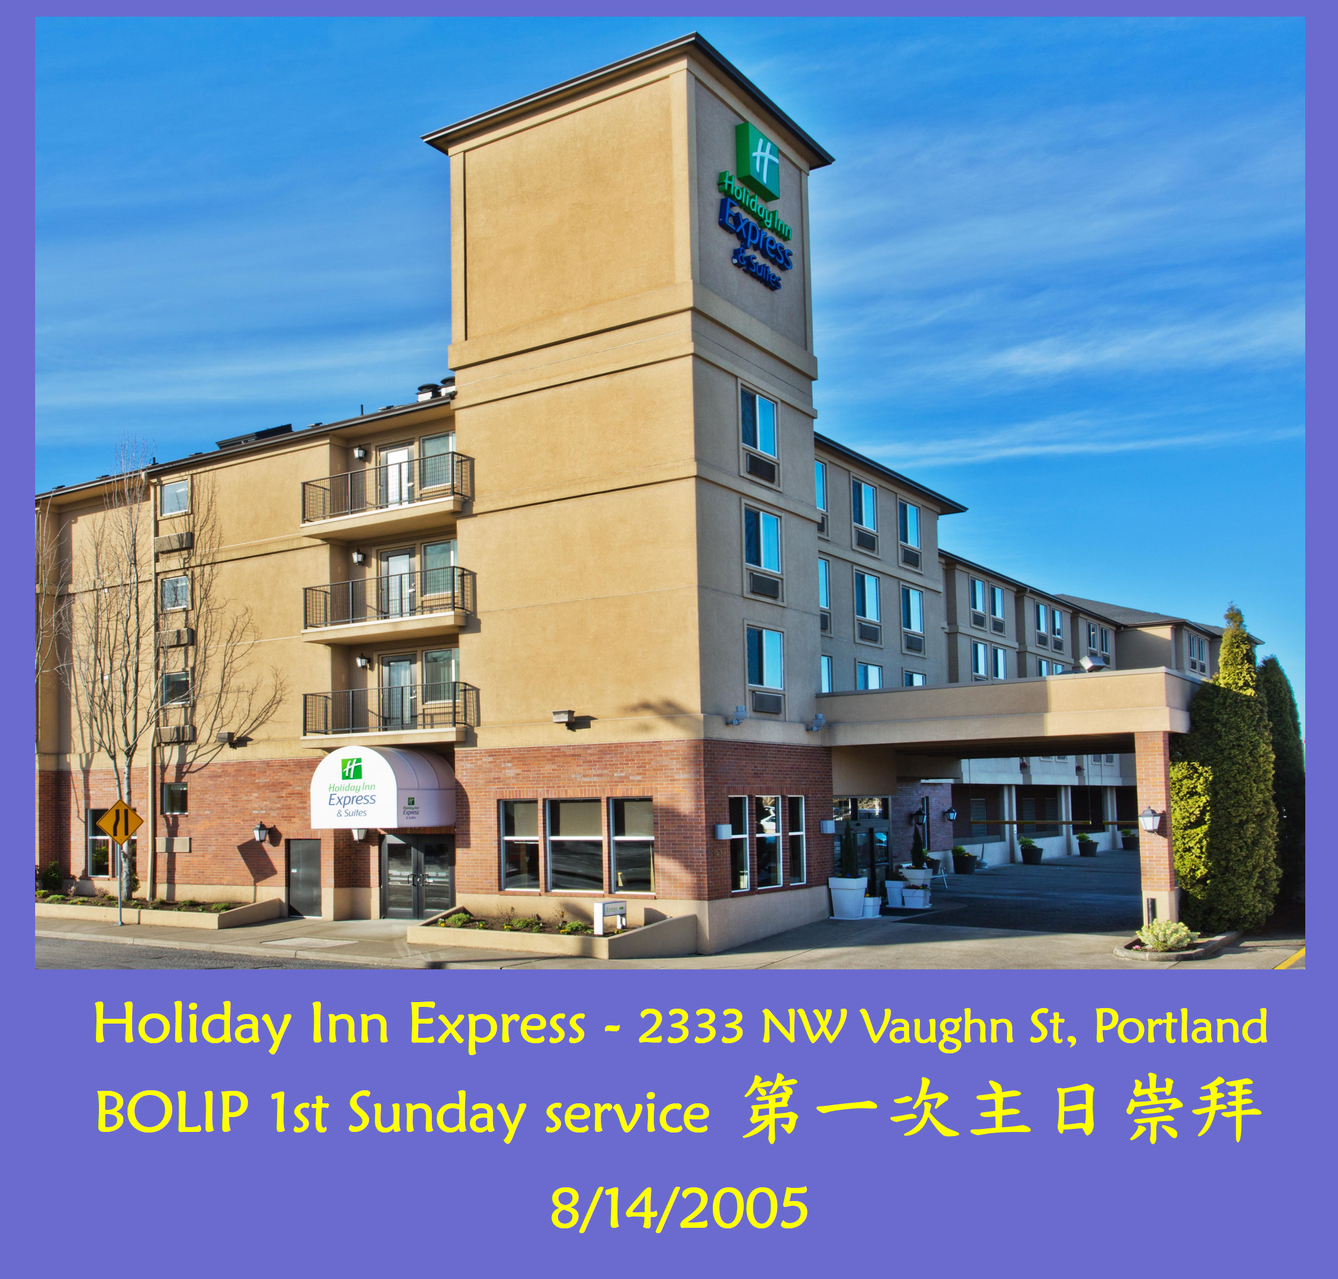

Slide 3
你們要依從那些引導你們的，且要順服；因他們為你們的靈魂時刻警醒，好像那將來交帳的人。 你們要使他們交的時候有快樂，不致憂愁；若憂愁就與你們無益了。 (希伯來書 Hebrews 13:17)
Have confidence in your leaders and submit to their authority, because they keep watch over you as those who must give an account. Do this so that their work will be a joy, not a burden, for that would be of no benefit to you.

Slide 4
***
主，我們感謝你，賜給我們那樣好的教會、同工和弟兄姊妹。 讓我們在天路上一同奔跑，彼此扶持，榮耀你的名，求賜給我們感恩的心，面對每天的生活。感謝禱告奉耶穌得勝的名祈求，阿們！

Slide 5

UNITING THE GENERATIONS
世代之間的合一
Stephen Oh 胡恩瀚
August 15, 2021

Slide 6
The purpose of unity is to grow in understanding with each other so that we can encourage each other to deepen our relationship with God and in sharing the gospel with the world.

Slide 7
1 Corinthians 1:10 I appeal to you, brothers and sisters, in the name of our Lord Jesus Christ, that all of you agree with one another in what you say and that there be no divisions among you, but that you be perfectly united in mind and thought.
弟兄們，我藉我們主耶穌基督的名勸你們都說一樣的話。 你們中間也不可分黨，只要一心一意，彼此相合。 (林前 1:10)

Slide 8
Philippians 2:1-2 Therefore if you have any encouragement from being united with Christ, if any comfort from his love, if any common sharing in the Spirit, if any tenderness and compassion, 2 then make my joy complete by being like-minded, having the same love, being one in spirit and of one mind.
1 所以，在基督裡若有甚麼勸勉，愛心有甚麼安慰，聖靈有甚麼交通，心中有甚麼慈悲憐憫， 2 你們就要意念相同，愛心相同，有一樣的心思，有一樣的意念，使我的喜樂可以滿足。
(腓立比書 2:1-2)

Slide 9
The purpose of unity is to grow in understanding with each other so that we can encourage each other to deepen our relationship with God and in sharing the gospel with the world.

Slide 10
No one is going to want to listen to what you have to say until they know that you care.

Slide 11
James 2:16 If one of you says to them, “Go in peace; keep warm and well fed,” but does nothing about their physical needs, what good is it?
你們中間有人對他們說：「平平安安地去吧！願你們穿得暖，吃得飽」，卻不給他們身體所需用的，這有甚麼益處呢？
(雅各書 2:11)

Slide 12
The purpose of unity is to grow in understanding with each other so that we can encourage each other to deepen our relationship with God and in sharing the gospel with the world.

Slide 13
Romans 5: 8 But God demonstrates his own love for us in this: While we were still sinners, Christ died for us.
惟有基督在我們還作罪人的時候為我們死， 神的愛就在此向我們顯明了。
(羅馬書 5:8)

Slide 14
A relationship requires both people to want have to want it. But one person needs to reach out first.

Slide 16
祢一直都在
Your Ever Presence
Jessica 林嘉琦
August 15, 2021

Slide 17
一. 神的選召是沒有後悔的:
*詩篇 139:13 我的肺腑是你所造的. 我在母腹中, 你已覆庇我.
*羅馬書 11:29 因為 神的恩賜和選召, 是沒有後悔的.

Slide 18
二. 我們的一生都在主手中:
*創世記 18:14 耶和華豈有難成的事麼．到了日期、明年這時候、我必回到你這裡、撒拉必生一個兒子。
*以賽亞書 43:19 看哪，我要做一件新事；如今要發現，你們豈不知道嗎？ 我必在曠野開道路，在沙漠開江河。

Slide 19
三. 教會要興起發光:
*以賽亞書60:1 興起發光. 因為你的光已經來到, 耶和華的榮耀發現照耀你.
A: 禱告：
*歷代志下 7:14 這稱為我名下的子民, 若是自卑, 禱告, 尋求我的面, 轉離他們的惡行. 我必從天上垂聽, 赦免他們的罪醫治他們的地.

Slide 20
*馬太福音 21:22 你們禱告, 無論求甚麼, 只要信, 就必得著.
*馬可福音 11:24 所以我告訴你們, 凡你們禱告祈求的, 無論是甚麼,只要信是得著的, 就必得著.
*羅馬書 12:12 在指望中要喜樂. 在患難中要忍耐. 禱告要恆切.
*腓立比書 4:6 應當一無挂慮, 只要凡事藉著禱告, 祈求, 和感謝, 將你們所要的告訴 神.

Slide 21
B. 服事：
*羅馬書 12:11 殷勤不可懶惰. 要心裡火熱. 常常服事主.
*以弗所書 6:7 甘心事奉, 好像服事主, 不像服事人.
*彼得前書 4:10 各人要照所得的恩賜彼此服事, 作 神百般恩賜的好管家.

Slide 22
C. 復興：
*啟示錄 14:15-16
15 又有一位天使從殿中出來, 向那坐在雲上的大聲喊著說, 伸出你的鐮刀來收割. 因為收割的時候已經到了, 地上的莊稼已經熟透了. 16 那坐在雲上的, 就把鐮刀扔在地上. 地上的莊稼就被收割了.

Slide 23
獻詩
「帶我進水深處」

