Slide 1

主日信息
Sunday Sermon

Slide 2

釋放神的恩慈的禱告
Prayer That Releases God’s Goodness
波特蘭靈糧堂
November 28, 2021

Slide 3
摩西說：「求你顯出你的榮耀給我看。」
耶和華說：「我要顯我一切的恩慈，在你面前經過，宣告我的名。我要恩待誰就恩待誰；要憐憫誰就憐憫誰」；
(出埃及記 Exodus 33:18-19）
And he said, “I will make all my goodness pass before you and will proclaim before you my name ‘The LORD.’ And I will be gracious to whom I will be gracious, and will show mercy on whom I will show mercy.

Slide 4
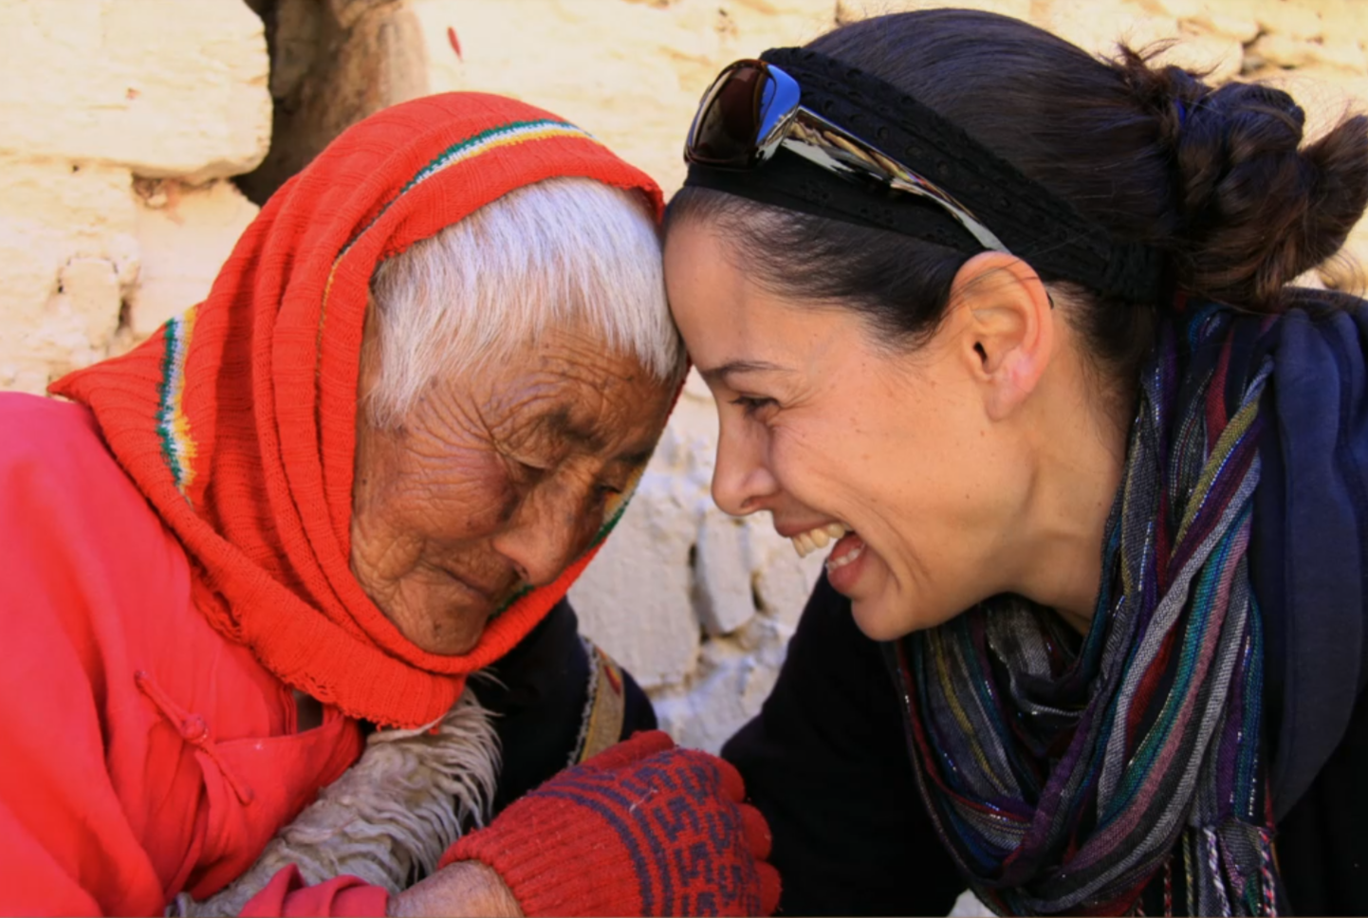

Slide 5
你們要恆切禱告，在此警醒感恩。 也要為我們禱告，求 神給我們開傳道的門，能以講基督的奧祕（我為此被捆鎖），叫我按著所該說的話將這奧祕發明出來。
(歌羅西書 Colossians 4:2-4）
Devote yourselves to prayer, being watchful and thankful. And pray for us, too, that God may open a door for our message, so that we may proclaim the mystery of Christ, for which I am in chains. Pray that I may proclaim it clearly, as I should.

Slide 6
同心禱告

Slide 7
回應詩歌
「禱告等候」

