Slide 1

主日信息
Sunday Sermon

Slide 2
講員介紹 Speaker Introduction
Josh is a currently the Spiritual Formation, Discipleship, and Integration pastor at Rock Point Church, in Newberg. He has been a part of that church since 2000. He has a Bachelors of Theology from Portland Bible College, a Masters of Divinity from Western Seminary, and is finishing up a Masters in Biblical History and Geography from Jerusalem University College. He is a native to the Pacific Northwest and enjoys hiking, games, coffee, cooking, and watching movies with his new wife (just married in August).

Slide 3
God First 神第一優先
Pastor Josh Jen

Slide 4
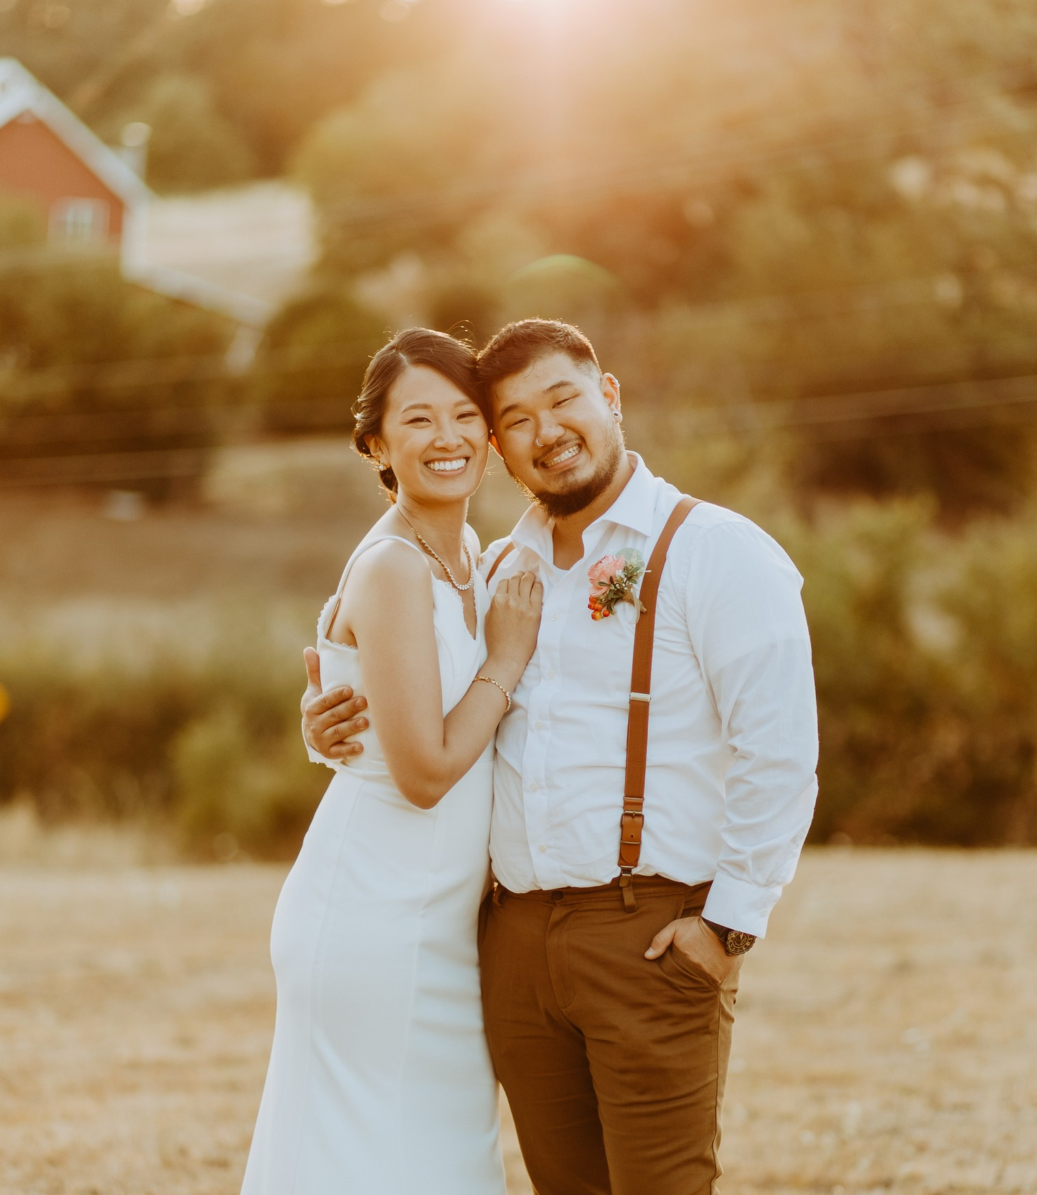
My Journey so far...
我目前為止的人生旅程...

Slide 5
One simple thing. My life is for God.
一件簡單的事。 我的生命屬於神。
How did I end up in ministry?
我是如何成為一個傳道人的？
My life was to serve God anyway He saw fit.
我的生命就是要照著神認為合適的方式來服事祂。

Slide 6
1.
1 Peter 2:9
But you are a chosen race, a royal priesthood, a holy nation, a people for his own possession, that you may proclaim the excellencies of him who called you out of darkness into his marvelous light.
God wants all of us in full-time ministry.
Ephesians 4:11-12
11 And he gave the apostles, the prophets, the evangelists, the shepherds and teachers, 12 to equip the saints for the work of ministry, for building up the body of Christ,

Slide 7
1.
惟有你們是被揀選的族類，是有君尊的祭司，是聖潔的國度，是屬 神的子民，要叫你們宣揚那召你們出黑暗入奇妙光明者的美德。 (彼得前書 2:9)
他所賜的，有使徒，有先知，有傳福音的，有牧師和教師， 為要成全聖徒，各盡其職，建立基督的身體，
(以弗所書 4:11-12)
God wants all of us in full-time ministry.
神要我們所有的人都全時間的服事祂

Slide 8
2.
God has made us intentionally, uniquely, and prepared us for ministry
神按著祂的美意獨特的製作了我們，並且預備我們來服事祂
Ephesians 2:10
For we are his workmanship, created in Christ Jesus for good works, which God prepared beforehand, that we should walk in them.
我們原是他的工作，在基督耶穌裡造成的，為要叫我們行善，就是 神所預備叫我們行的。 (以弗所書 2:10)

Slide 9

You are a handcrafted masterpiece of God, made to be in Christ and the Church, for a purpose that God already has planned and prepared for us.
你是神在基督與教會裡親手製作的傑作，為的是神已經為我們計劃好和預備好的目的
Your life was made for this but you must choose to walk in it.
你的生命乃是為此而受造，但你必須自己選擇走在這道路上

Slide 10
3.
We were made to make God first
Conviction leads to → Action
If we really believe something, that belief affects how we live.
Matthew 6:33
But seek first the kingdom of God and his righteousness, and all these things will be added to you.

Slide 11
3.
Conviction leads to → Action If we really believe something, that belief affects how we live.
信念帶來行動。 如果我們真的相信某一件事，這信心會影響我們活出怎樣的生命
Matthew 6:33
But seek first the kingdom of God and his righteousness, and all these things will be added to you.
你們要先求他的國和他的義，這些東西都要加給你們了。 (馬太福音 6:33)
We were made to make God first
我們受造是為了把神放在第一優先

Slide 12

What is most honoring to God?
什麼是最尊榮神的？
There are bad things in life. But what could be worse are not bad things but good things that keep you from the best things.
生命中會有壞的事情。 但是更壞的事並不是這些壞事，而是那些使你無法得到最好的事的好事。

Slide 13
This is how we understood what was most honoring to God.
我們如此的理解什麼是最尊榮神的
If something needed to be sacrificed, it wasn’t time with God.
如果實在需要犧牲某一件事的話，不可以犧牲給神的時間

Slide 14
Are there good things that we hold above the best?
有哪些我們緊緊抓住的好的東西是高過於那最好的東西的？
Do you need it?
你需要它嗎？
There are bad things in life. But what could be worse are not bad things but good things that keep you from the best things.
生命中會有壞的事情。 但是更壞的事並不是這些壞事，而是那些使你無法得到最好的事的好事。
Be willing to remove, redesign, or re-organize anything to put God first.
讓我們情願除去、重新計畫、或是重整任何一件事情而把神放在第一優先

Slide 15

馬太福音 Matthew 13:44-46
44 “The kingdom of heaven is like treasure hidden in a field, which a man found and covered up. Then in his joy he goes and sells all that he has and buys that field. 45 “Again, the kingdom of heaven is like a merchant in search of fine pearls, 46 who, on finding one pearl of great value, went and sold all that he had and bought it.
44 天國好像寶貝藏在地裡，人遇見了就把它藏起來，歡歡喜喜地去變賣一切所有的，買這塊地。 45 天國又好像買賣人尋找好珠子， 46 遇見一顆重價的珠子，就去變賣他一切所有的，買了這顆珠子。

