Slide 1

同領聖餐 Holy Communion

Slide 2
主耶穌被賣的那一夜，拿起餅來， 祝謝了，就擘開，說：「這是我的身體，為你們捨的，你們應當如此行，為的是記念我。」
(哥林多前書 1 Corinthians 11:23-24)
The Lord Jesus, on the night he was betrayed, took bread, and when he had given thanks, he broke it and said, “This is my body, which is for you; do this in remembrance of me.”

Slide 3
飯後，也照樣拿起杯來，說：「這杯是用我的血所立的新約，你們每逢喝的時候，要如此行，為的是記念我。」
(哥林多前書 1 Corinthians 11:25)
In the same way, after supper he took the cup, saying, “This cup is the new covenant in my blood; do this, whenever you drink it, in remembrance of me.”

Slide 4
你們每逢吃這餅，喝這杯，是表明主的死，直等到他來。
(哥林多前書 1 Corinthians 11:26)
For whenever you eat this bread and drink this cup, you proclaim the Lord’s death until he comes.

Slide 5
人應當自己省察，然後吃這餅、喝這杯。 (哥林多前書 1 Cor. 11:28)
Everyone ought to examine themselves before they eat of the bread and drink from the cup.

Slide 6
所以，你們既是 神的選民，聖潔蒙愛的人，就要存（原文是穿）憐憫、恩慈、謙虛、溫柔、忍耐的心。 倘若這人與那人有嫌隙，總要彼此包容，彼此饒恕；主怎樣饒恕了你們，你們也要怎樣饒恕人。 (歌羅西書 Colossians 3:12-13)
13 bearing with one another and, if one has a complaint against another, forgiving each other; as the Lord has forgiven you, so you also must forgive.

Slide 7

主日信息
Sunday Sermon

Slide 8
新年目標 New Year Resolutions：
1 + 1 = 2 傳福音
加入 RPG 復興禱告小組

Slide 9
你一生一世必得安穩─有豐盛的救恩，並智慧和知識；你以敬畏耶和華為至寶。 (以賽亞書 Isaiah 33:6）
and he will be the stability of your times,
abundance of salvation, wisdom, and knowledge;
the fear of the Lord is Zion's treasure. (ESV)

Slide 10

行走水面的禱告
Prayer to Walk on the Water
波特蘭靈糧堂
January 2, 2022

Slide 11
Play Video
「耶穌在水面行走」

Slide 12
耶穌連忙對他們說：「你們放心，是我，不要怕！」彼得說：「主，如果是你，請叫我從水面上走到你那裡去。」耶穌說：「你來吧。」彼得就從船上下去，在水面上走，要到耶穌那裡去；只因見風甚大，就害怕，將要沉下去，便喊著說：「主啊，救我！」
耶穌趕緊伸手拉住他，說：「你這小信的人哪，為甚麼疑惑呢？」 他們上了船，風就住了。 在船上的人都拜他，說：「你真是 神的兒子了。」 (馬太福音 Matthew 14:27-33）

Slide 13
盜賊來，無非要偷竊，殺害，毀壞；我來了，是要叫羊（或譯：人）得生命，並且得的更豐盛。 (約翰福音 John 10:10）
The thief comes only to steal and kill and destroy. I came that they may have life and have it abundantly.

Slide 14
使徒對百姓說話的時候，祭司們和守殿官，並撒都該人忽然來了。 因他們教訓百姓，本著耶穌，傳說死人復活，就很煩惱，於是下手拿住他們；因為天已經晚了，就把他們押到第二天。 但聽道之人有許多信的，男丁數目約到五千。 (使徒行傳 Acts 4:1-4）
2 They were greatly disturbed because the apostles were teaching the people, proclaiming in Jesus the resurrection of the dead. They seized Peter and John and, because it was evening, they put them in jail until the next day.

Slide 15
彼得、約翰說：「聽從你們，不聽從神，這在 神面前合理不合理，你們自己酌量吧！ 我們所看見所聽見的，不能不說。」 官長為百姓的緣故，想不出法子刑罰他們，又恐嚇一番，把他們釋放了。這是因眾人為所行的奇事都歸榮耀與 神。
(使徒行傳 Acts 4:19-21）
19 But Peter and John replied, “Which is right in God’s eyes: to listen to you, or to him? You be the judges! As for us, we cannot help speaking about what we have seen and heard.”

Slide 16
他們聽見了，就同心合意地高聲向 神說：「主啊！你是造天、地、海，和其中萬物的，
(使徒行傳 Acts 4:24）
When they heard this, they raised their voices together in prayer to God. “Sovereign Lord,” they said, “you made the heavens and the earth and the sea, and everything in them.

Slide 17
你曾藉著聖靈，託你僕人─我們祖宗大衛的口，說：外邦為甚麼爭鬧？ 萬民為甚麼謀算虛妄的事？ 世上的君王一齊起來，臣宰也聚集，要敵擋主，並主的受膏者。
(使徒行傳 Acts 4:25-26）
You spoke by the Holy Spirit through the mouth of your servant, our father David: “‘Why do the nations rage and the peoples plot in vain? The kings of the earth rise up and the rulers band together against the Lord and against his anointed one.

Slide 18
希律和本丟•彼拉多，外邦人和以色列民，果然在這城裡聚集，要攻打你所膏的聖僕耶穌，成就你手和你意旨所預定必有的事。
(使徒行傳 Acts 4:27-28）
Indeed Herod and Pontius Pilate met together with the Gentiles and the people of Israel in this city to conspire against your holy servant Jesus, whom you anointed. They did what your power and will had decided beforehand should happen.

Slide 19
他們恐嚇我們，現在求主鑒察，一面叫你僕人大放膽量講你的道，一面伸出你的手來醫治疾病，並且使神蹟奇事因著你聖僕耶穌的名行出來。」 (使徒行傳 Acts 4:29-30）
Now, Lord, consider their threats and enable your servants to speak your word with great boldness. Stretch out your hand to heal and perform signs and wonders through the name of your holy servant Jesus.

Slide 20
禱告完了，聚會的地方震動，他們就都被聖靈充滿，放膽講論 神的道。
(使徒行傳 Acts 4:31）
After they prayed, the place where they were meeting was shaken. And they were all filled with the Holy Spirit and spoke the word of God boldly.

Slide 21
神為愛他的人所預備的是眼睛未曾看見，耳朵未曾聽見，人心也未曾想到的。
(哥林多前書 1 Corinthians 2:9）
What no eye has seen, nor ear heard,
nor the heart of man imagined,
what God has prepared for those who love him

Slide 22
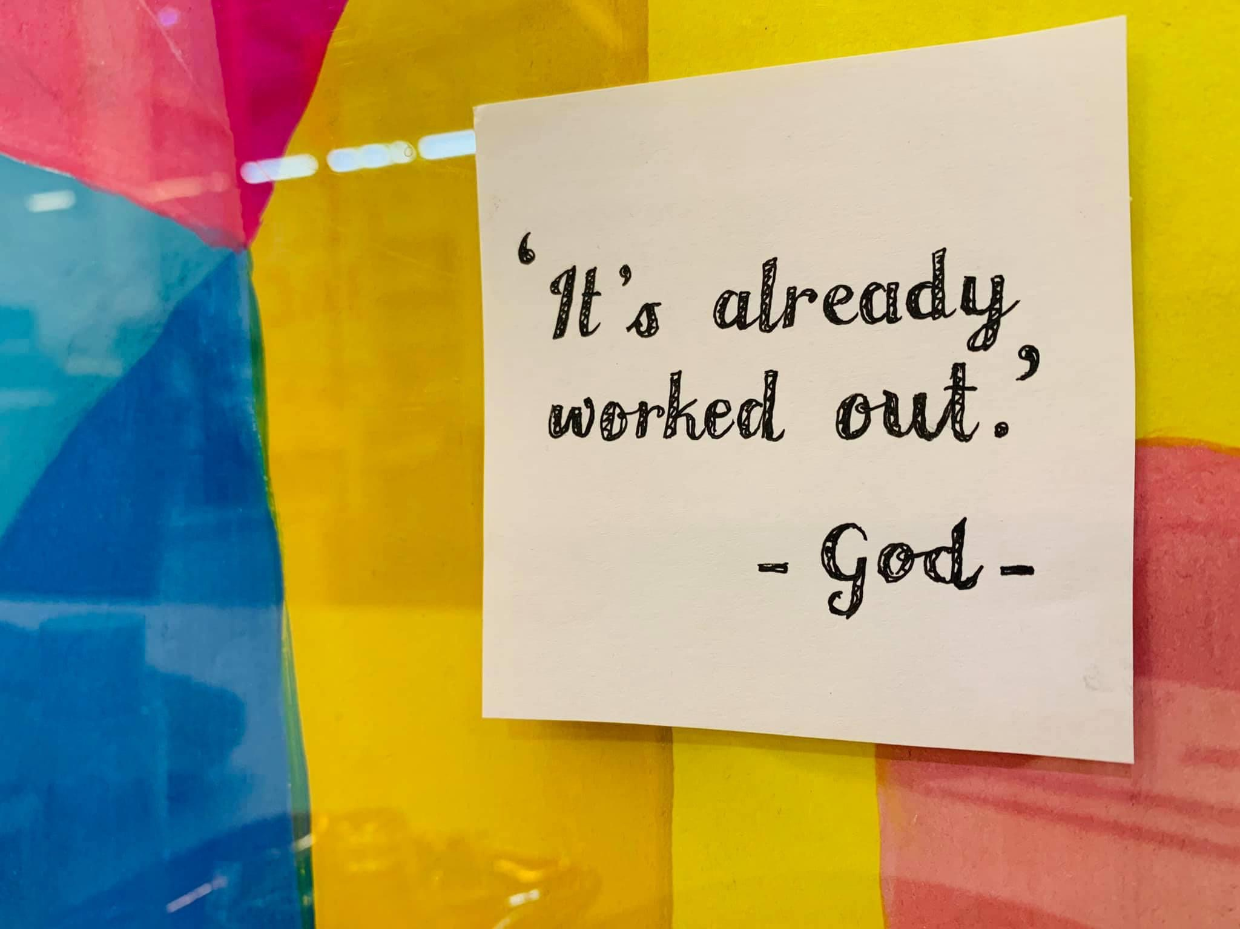

Slide 23
神能照著運行在我們心裡的大力充充足足地成就一切，超過我們所求所想的。
(以弗所書 Ephesians 3:20）
Now to him who is able to do far more abundantly than all that we ask or think, according to the power at work within us,

Slide 24
同心禱告

Slide 25
回應詩歌
「戰勝巨人的恩膏」

