Slide 1

主日信息
Sunday Sermon

Slide 2

Ignite The World Ministries
“I am the light of the world. Whoever follows me will never walk in darkness, but will have the light of life.” John 8:12

Slide 3
這福音傳到你們那裡，也傳到普天之下，並且結果，增長，如同在你們中間，自從你們聽見福音，真知道 神恩惠的日子一樣。 (歌羅西書 Colossians 1:6)
All over the world this Gospel is bearing fruit and growing—as it also does among you, since the day you heard it and understood the grace of God in truth,

Slide 4
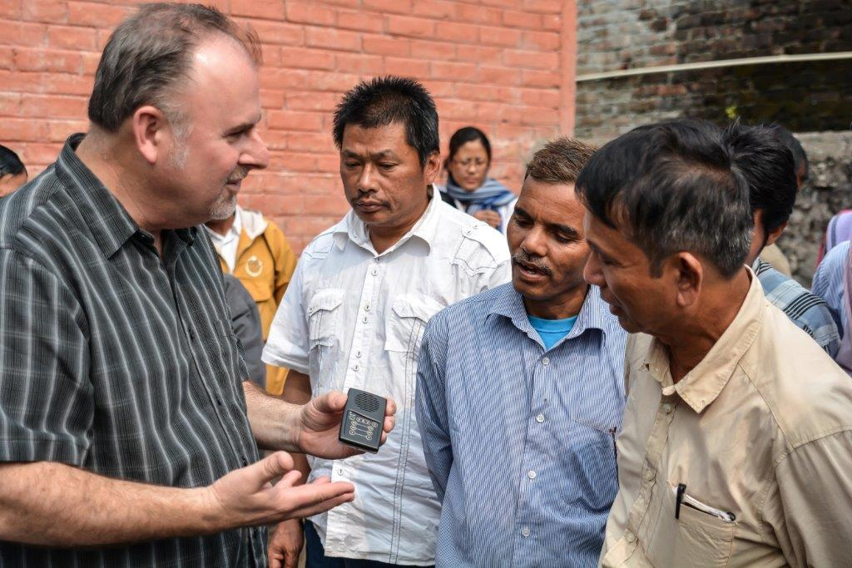
Who we are
We are a team of committed Christians dedicated to change the world for Jesus Christ with the supernatural power of the Gospel.
Our mission... is to bring hope to the nations through the transforming power of Jesus Christ by way of evangelism, evangelism training and missionary church planting, compassion relief projects and the ministry of prayer.
CORE VALUES
Honoring God
Demonstrating Integrity
Loving People
Forming Partnerships
Changing Societies

Slide 5
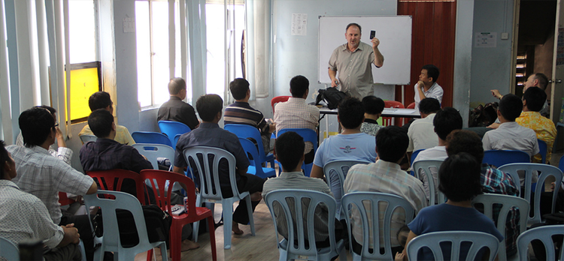

What we do
Evangelism
Training/Equipping Evangelists
Compassion Relief

Slide 6

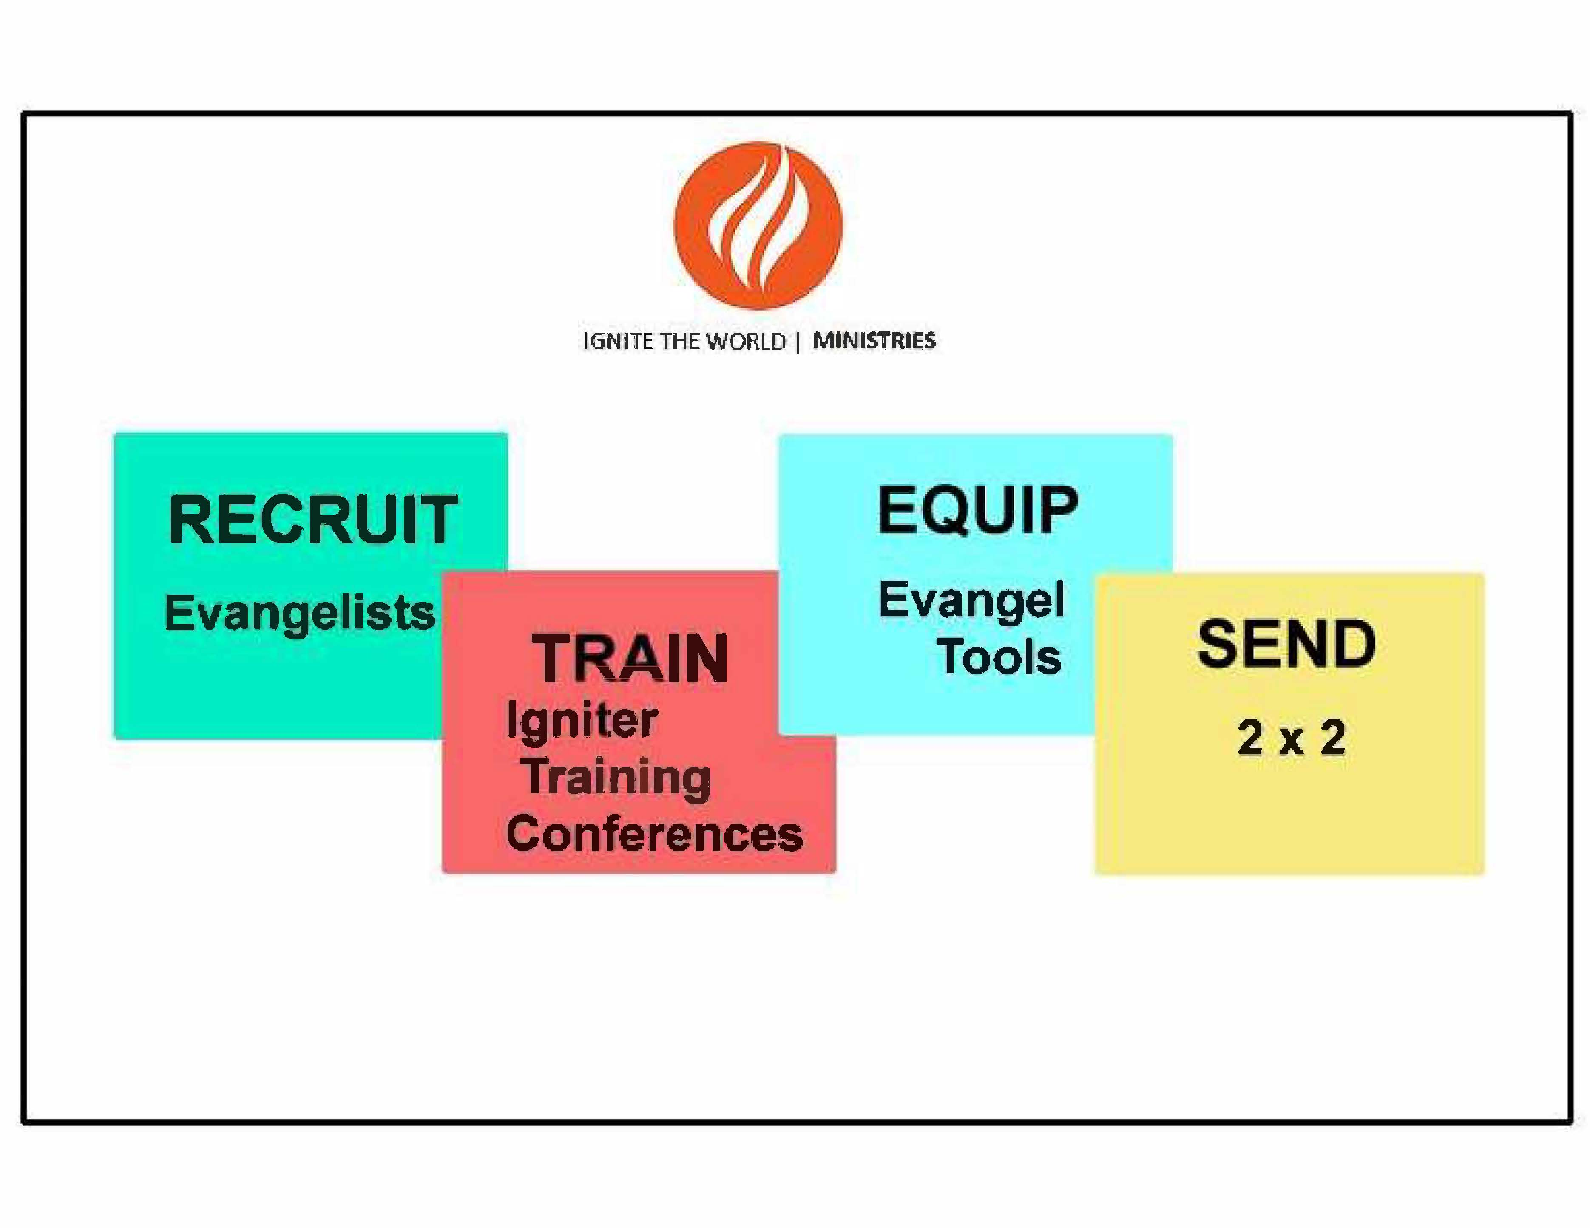
4-step evangelism strategy

Slide 7
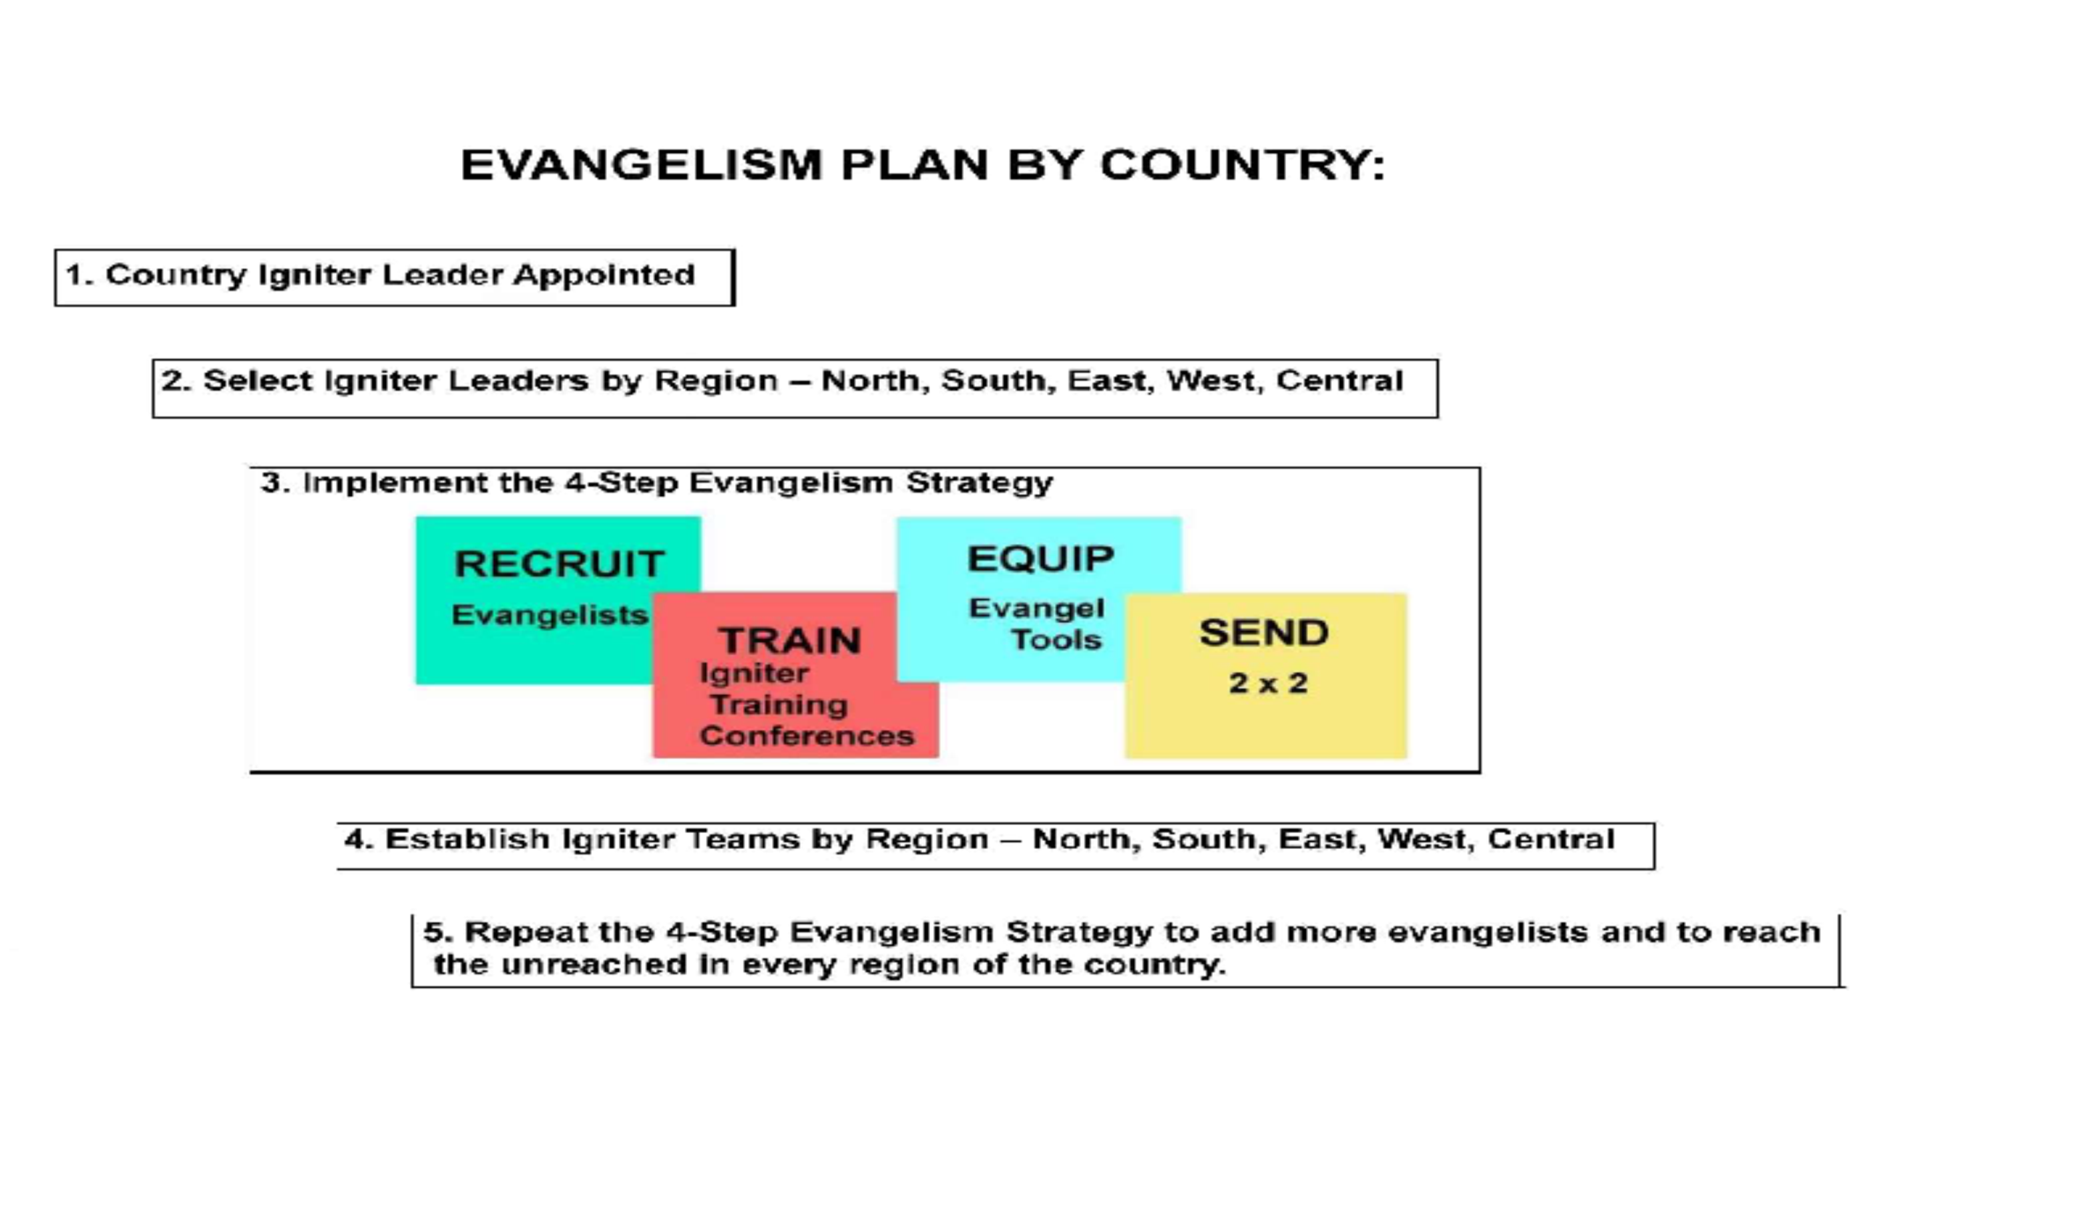
Evangelism Plan by Country

Slide 8

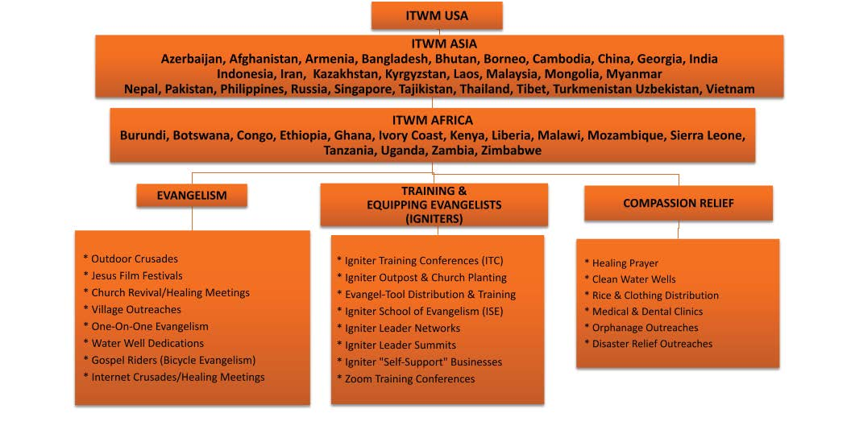




Slide 9


Slide 10


Slide 11

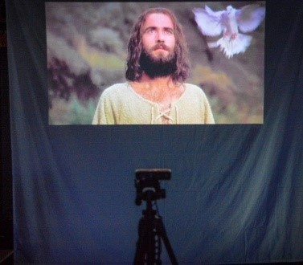
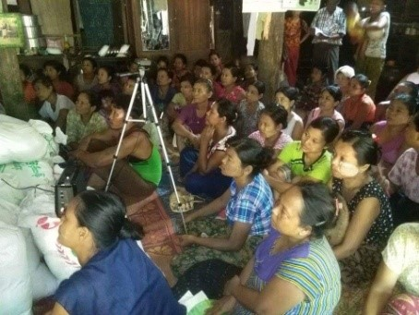
EVANGEL-TOOLS
Solar-Powered Video Projection System:
“Movie Theater in a Backpack”

Slide 12
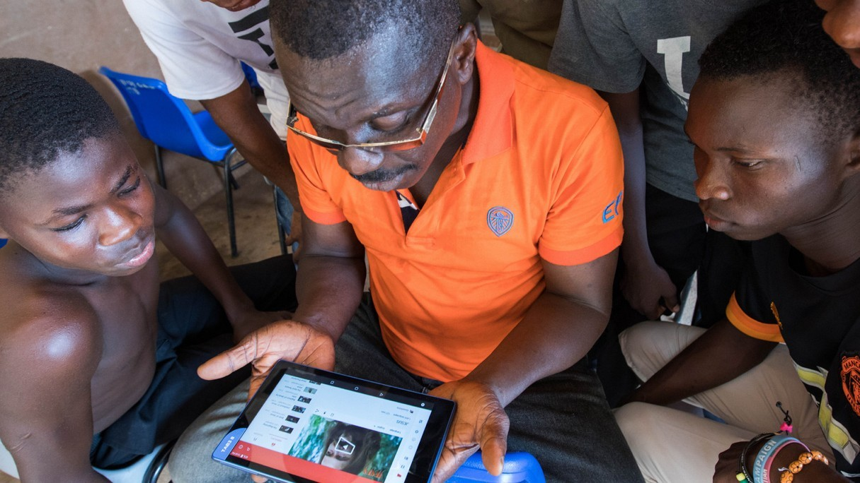
The Jesus Film Video Tablet
EVANGEL-TOOLS
Sharing The Jesus Film to 5-20 people at a time.

Slide 13

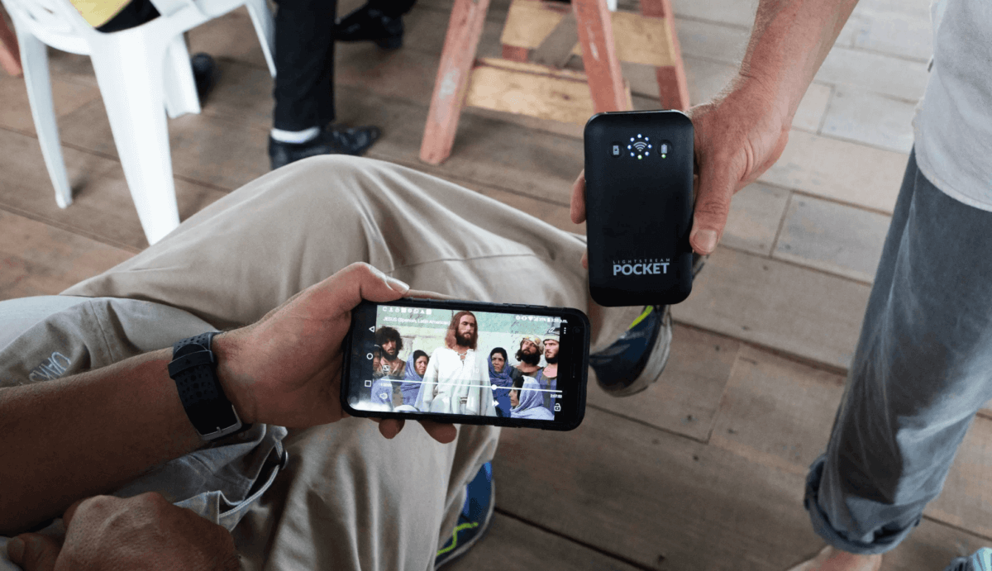
EVANGEL-TOOLS
WIFI Hotspot for Sharing Jesus Film

Slide 14
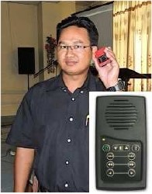
EVANGEL-TOOLS
Solar Audio Bibles:

Slide 15

EVANGEL-TOOLS
SD Memory Cards for Cell Phones:
“Gospel Chips”

Slide 16
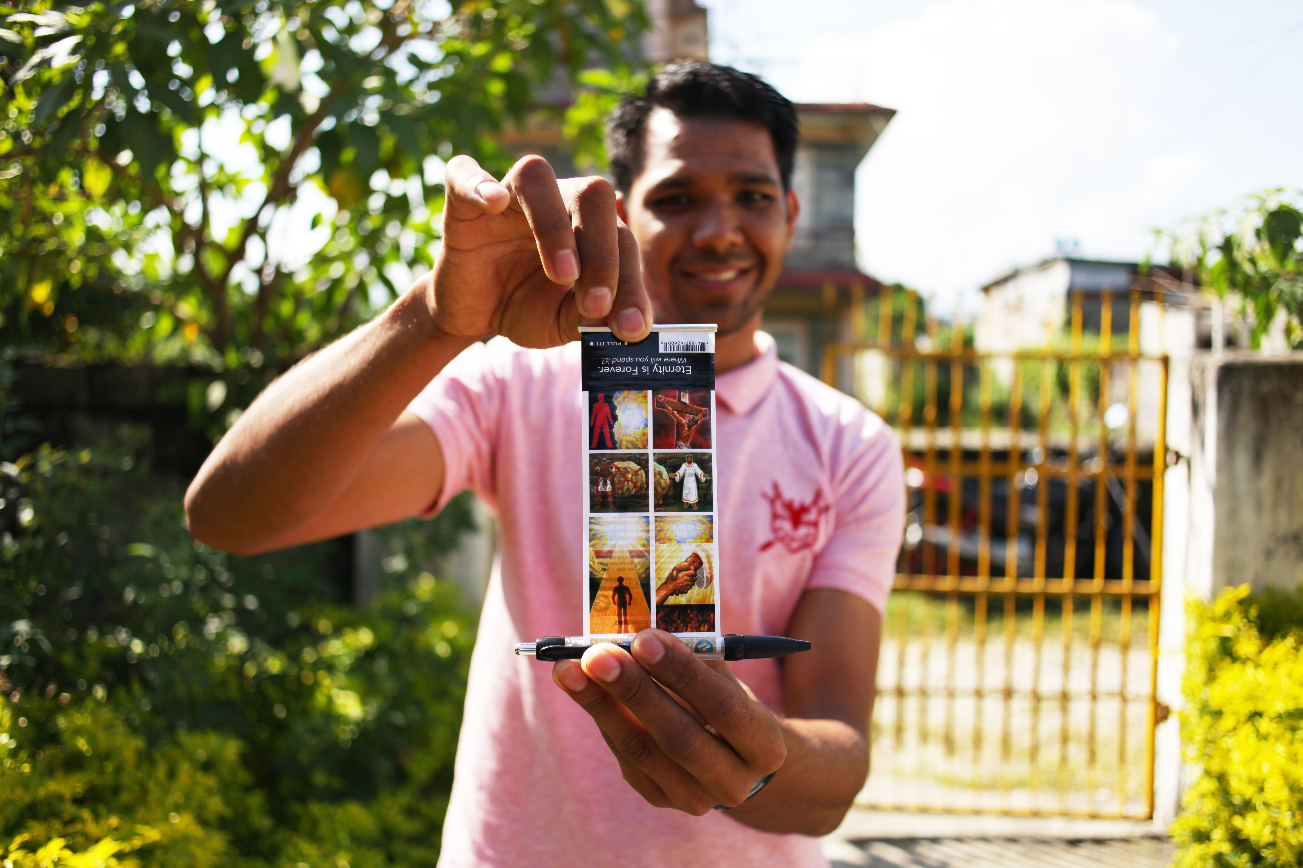
EVANGEL-TOOLS
Evangel-Pens:

Slide 17
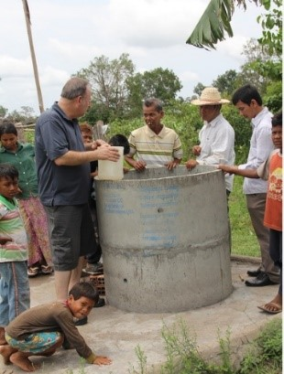
EVANGEL-TOOLS
Clean Water Wells:
“The 3-in-1 Well”

Slide 18

Where we go
Azerbaijan
Bangladesh
Bhutan
Borneo
Cambodia
China
India
Indonesia
Kazakhstan
Kyrgyzstan
Laos
Malaysia
Mongolia
Myanmar
Nepal
Pakistan
Philippines
Tajikistan
Thailand
Tibet
Uzbekistan
Vietnam

Slide 19


Slide 20
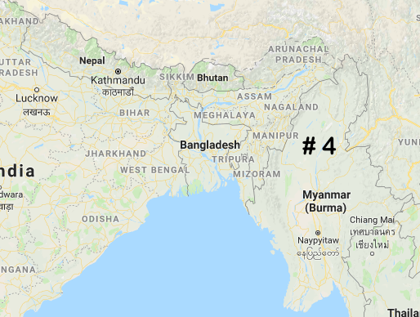
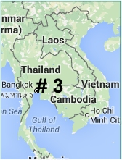

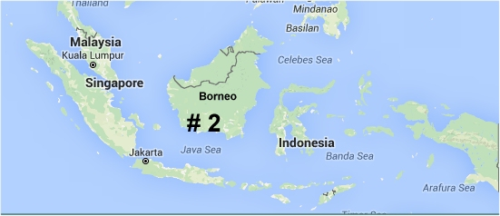
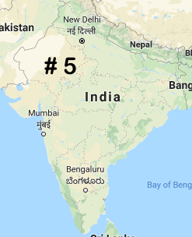
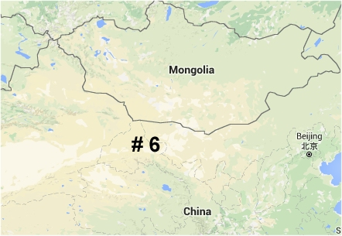
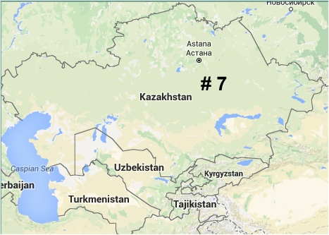
7 Unreached Regions of SE & CENTRAL ASIA

Slide 21
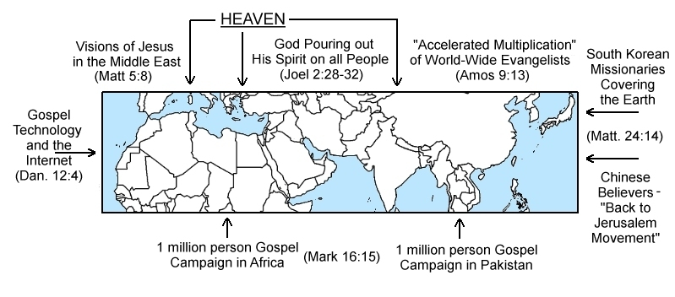
The 10-40 Window

Slide 22
How you can help
Travel on a mission with us
Financially support & pray for us
Sponsor a project

