Slide 1

「懷疑到相信」D2B 課程
領人歸主見證分享
敏良弟兄 & 素月牧師

Slide 2

主日信息
Sunday Sermon

Slide 3
全新的你
A New You
波特蘭靈糧堂
February 6, 2022

Slide 4
亞伯拉罕的後裔，大衛的子孫（後裔），耶穌基督的家譜：亞伯拉罕生以撒；以撒生雅各；雅各生猶大和他的弟兄；
(馬太福音 Matthew 1:1-2）
This is the genealogy of Jesus the Messiah the son of David, the son of Abraham: Abraham was the father of Isaac, Isaac the father of Jacob, Jacob the father of Judah and his brothers,

Slide 5
猶大從她瑪氏生法勒斯和謝拉；法勒斯生希斯崙；希斯崙生亞蘭； (馬太福音 Matthew 1:3）
and Judah the father of Perez and Zerah by Tamar, and Perez the father of Hezron, and Hezron the father of Ram,

Slide 6
撒門從喇合氏生波阿斯；波阿斯從路得氏生俄備得；俄備得生耶西；耶西生大衛王。 大衛從烏利亞的妻子生所羅門；
(馬太福音 Matthew 1:5-6）
Salmon the father of Boaz, whose mother was Rahab,
Boaz the father of Obed, whose mother was Ruth,
Obed the father of Jesse, and Jesse the father of King David. David was the father of Solomon, whose mother had been Uriah’s wife,

Slide 7
你所喜愛的是內裡誠實；你在我隱密處，必使我得智慧。 (詩篇 Psalm 51:6）
Behold, you delight in truth in the inward being,
and you teach me wisdom in the secret heart.

Slide 8
你們必曉得真理，真理必叫你們得以自由。 (約翰福音 John 8:32）
and you will know the truth, and the truth will set you free.

Slide 9
所以，我們從今以後，不憑著外貌（肉體）認人了。 雖然憑著外貌認過基督，如今卻不再這樣認他了。 若有人在基督裡，他就是新造的人，舊事已過，都變成新的了。
(哥林多後書 2 Corinthians 5:16-17）
From now on, therefore, we regard no one according to the flesh. Even though we once regarded Christ according to the flesh, we regard him thus no longer. Therefore, if anyone is in Christ, he is a new creation. The old has passed away; behold, the new has come.

Slide 10
舊事已過 The Old Has Passed Away
  誠實面對
  真心饒恕
  認罪悔改

Slide 11
遮掩自己罪過的，必不亨通；承認離棄罪過的，必蒙憐恤。 (箴言 Proverbs 28:13）
Whoever conceals his transgressions will not prosper, but he who confesses and forsakes them will obtain mercy.

Slide 12
並且照明你們心中的眼睛，使你們知道他的恩召有何等指望，他在聖徒中得的基業有何等豐盛的榮耀；並知道他向我們這信的人所顯的能力是何等浩大， (以弗所書 Ephesians 1:18-19）
I pray that the eyes of your heart may be enlightened in order that you may know the hope to which he has called you, the riches of his glorious inheritance in his holy people, and his incomparably great power for us who believe.

Slide 13
新造的人 A New Creation
眼光 Enlightened eyes
盼望的呼召 Calling of Hope
榮耀的基業 Glorious Inheritance (Joyce Meyer)
超自然的能力 Supernatural Power (呂代豪、 Joyce Meyer)

Slide 14
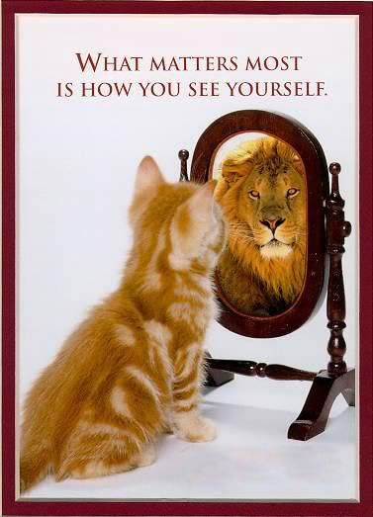

Slide 15
新造的人 A New Creation
屬神的眼光 Enlightened eyes
呼召的盼望 Calling of Hope
榮耀的基業 Glorious Inheritance
超自然的能力 Supernatural Power

Slide 16
同心禱告

Slide 17

同領聖餐 Holy Communion

Slide 18
主耶穌被賣的那一夜，拿起餅來， 祝謝了，就擘開，說：「這是我的身體，為你們捨的，你們應當如此行，為的是記念我。」
(哥林多前書 1 Corinthians 11:23-24)
The Lord Jesus, on the night he was betrayed, took bread, and when he had given thanks, he broke it and said, “This is my body, which is for you; do this in remembrance of me.”

Slide 19
飯後，也照樣拿起杯來，說：「這杯是用我的血所立的新約，你們每逢喝的時候，要如此行，為的是記念我。」
(哥林多前書 1 Corinthians 11:25)
In the same way, after supper he took the cup, saying, “This cup is the new covenant in my blood; do this, whenever you drink it, in remembrance of me.”

Slide 20
你們每逢吃這餅，喝這杯，是表明主的死，直等到他來。
(哥林多前書 1 Corinthians 11:26)
For whenever you eat this bread and drink this cup, you proclaim the Lord’s death until he comes.

Slide 21
人應當自己省察，然後吃這餅、喝這杯。 (哥林多前書 1 Cor. 11:28)
Everyone ought to examine themselves before they eat of the bread and drink from the cup.

