Slide 1

主日信息
Sunday Sermon

Slide 2

在恩典與真理中成長
Growing Up in Grace and Truth
波特蘭靈糧堂
March 6, 2022

Slide 3
道成了肉身，住在我們中間，充充滿滿地有恩典有真理。 我們也見過他的榮光，正是父獨生子的榮光。
(約翰福音 John 1:14）
The Word became flesh and made his dwelling among us. We have seen his glory, the glory of the one and only Son, who came from the Father, full of grace and truth.

Slide 4
從他豐滿的恩典裡，我們都領受了，而且恩上加恩。 律法本是藉著摩西傳的；恩典和真理都是由耶穌基督來的。
(約翰福音 John 1:16-17）
Out of his fullness we have all received grace in place of grace already given. For the law was given through Moses; grace and truth came through Jesus Christ.

Slide 5
律法 (The Law）與 真理 (Truth）

Slide 6
耶穌對信他的猶太人說：「你們若常常遵守我的道，就真是我的門徒；你們必曉得真理，真理必叫你們得以自由。」
(約翰福音 John 8:31-32）
So Jesus said to the Jews who had believed him, “If you abide in my word, you are truly my disciples, and you will know the truth, and the truth will set you free.”

Slide 7
耶穌說：「我就是道路、真理、生命；若不藉著我，沒有人能到父那裡去。」
(約翰福音 John 14:6）
Jesus said to him, “I am the way, and the truth, and the life. No one comes to the Father except through me.

Slide 8
聖靈 (The Spirit）與 真理 (Truth）

Slide 9
只等真理的聖靈來了，他要引導你們明白（原文是進入）一切的真理；因為他不是憑自己說的，乃是把他所聽見的都說出來，並要把將來的事告訴你們。
(約翰福音 John 16:13）
When the Spirit of truth comes, he will guide you into all the truth, for he will not speak on his own authority, but whatever he hears he will speak, and he will declare to you the things that are to come.

Slide 10
誠實 (Truth）與 恩典 (Grace）

Slide 11
神是（個）靈，所以拜他的必須用心靈和誠實拜他。
(約翰福音 John 4:23-24）
God is spirit, and those who worship him must worship in spirit and truth.”

Slide 12
他對我說：「我的恩典夠你用的，因為我的能力是在人的軟弱上顯得完全。」所以，我更喜歡誇自己的軟弱，好叫基督的能力覆庇我。
(哥林多後書 2 Corinthians 12:9）
But he said to me, “My grace is sufficient for you, for my power is made perfect in weakness.” Therefore I will boast all the more gladly of my weaknesses, so that the power of Christ may rest upon me.

Slide 13
耶穌聽見，就對他們說：「康健的人用不著醫生，有病的人才用得著。 我來本不是召義人，乃是召罪人。」
(馬可福音 Mark 2:17）
And when Jesus heard it, he said to them, “Those who are well have no need of a physician, but those who are sick. I came not to call the righteous, but sinners.”

Slide 14
The 4 Absolutes in AA meetings
    Honesty 誠實
    Unselfishness 不自私
    Purity 純潔
    Love 愛

Slide 15
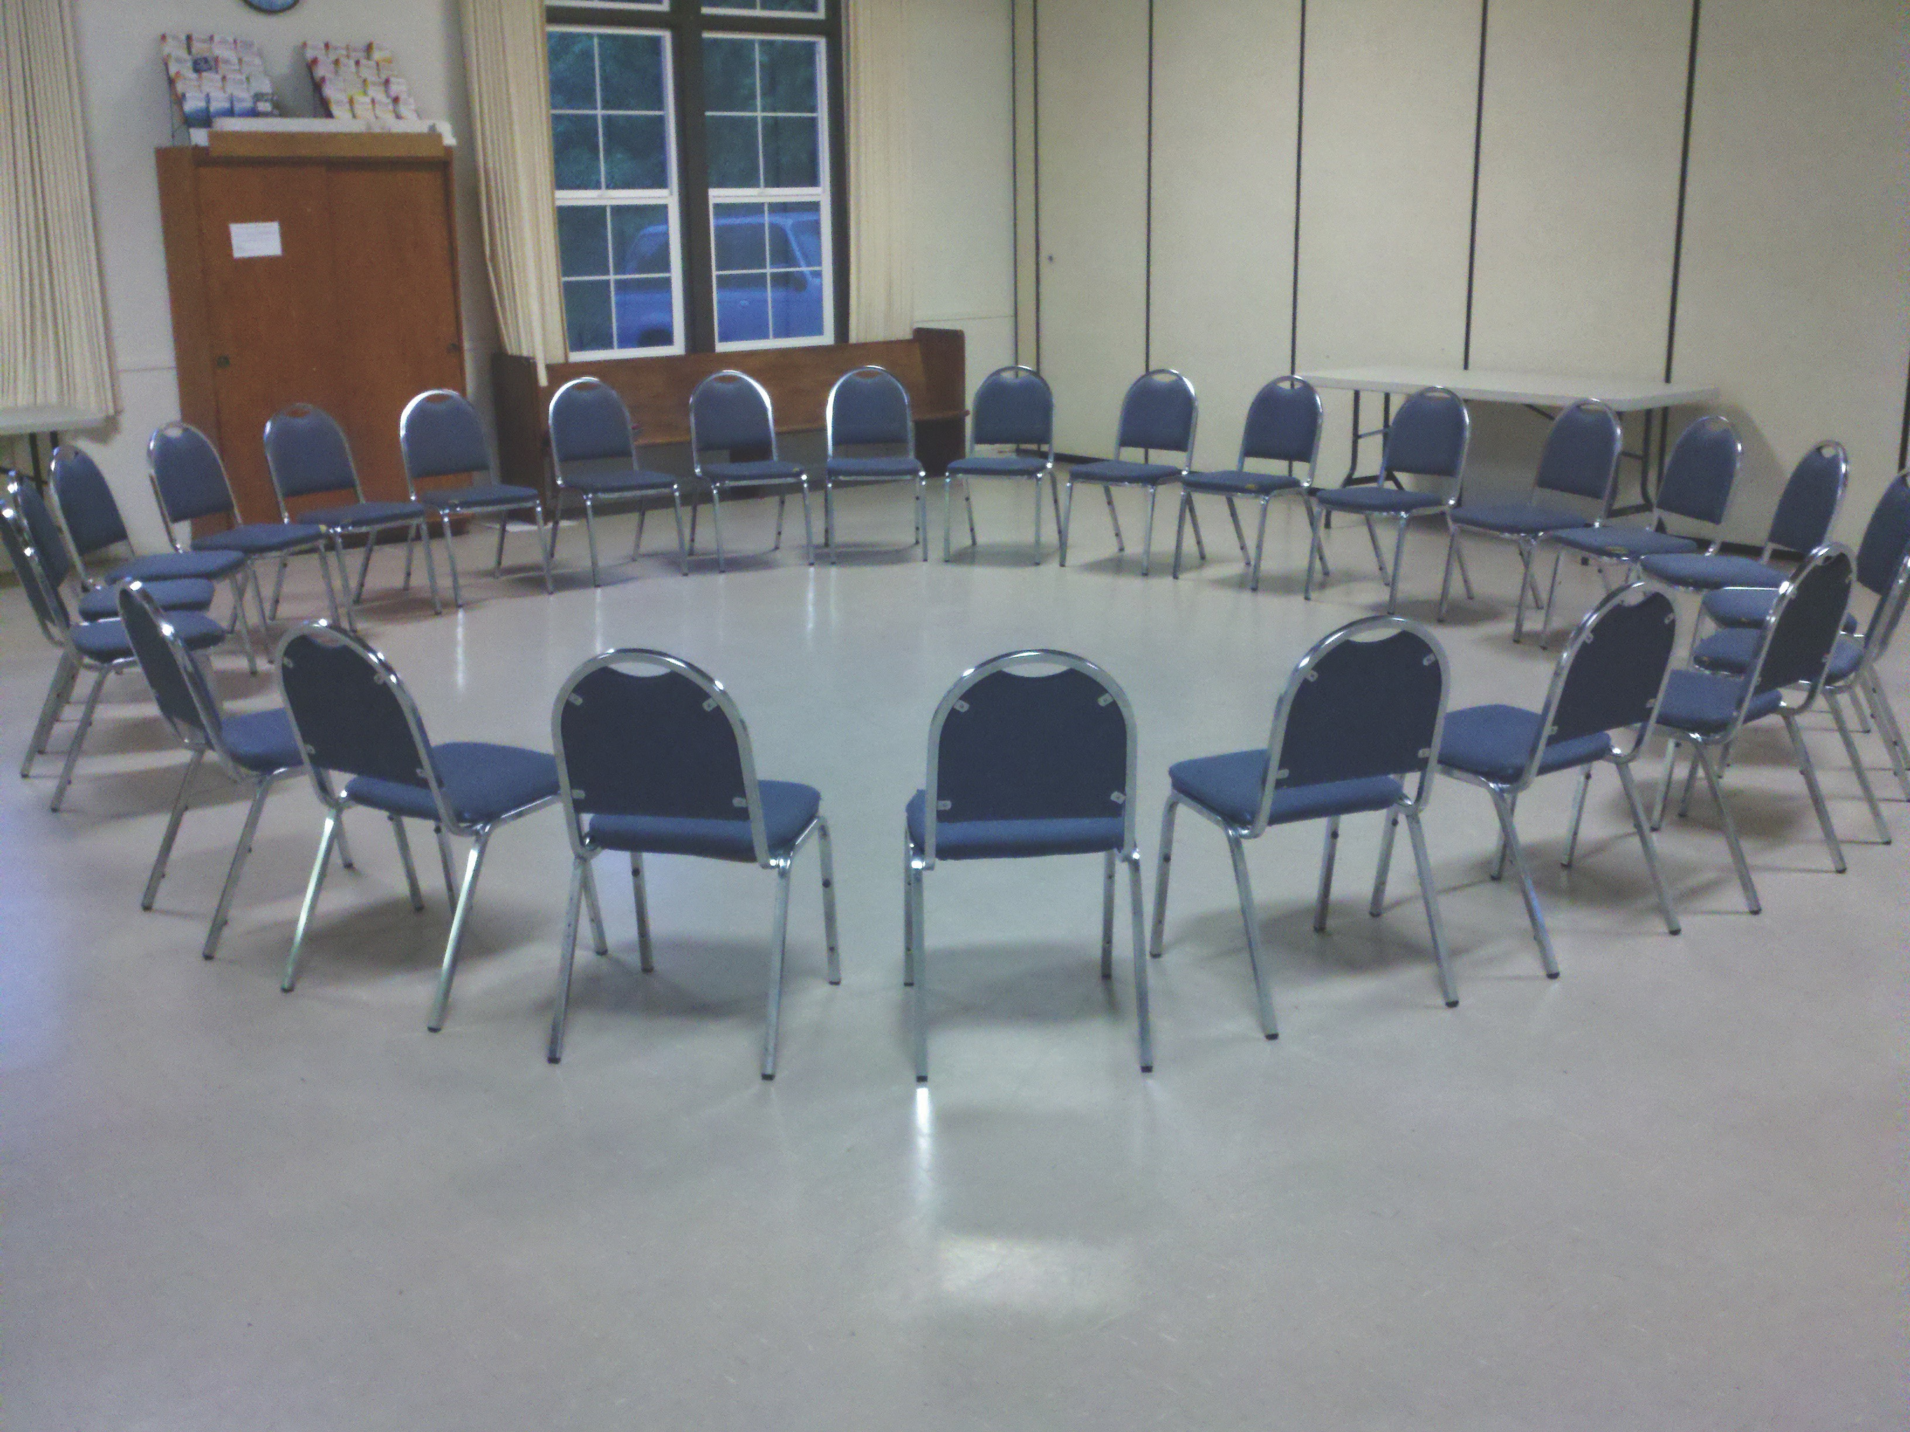

Slide 16
恩典＋真理＋時間
Grace + Truth + Time
<改變帶來醫治>
<Changes That Heal>
- Henry Cloud

Slide 17
神的國如同人把種撒在地上。 黑夜睡覺，白日起來，這種就發芽漸長，那人卻不曉得如何這樣。 (馬可福音 Mark 4:26-27）
The kingdom of God is as if a man should scatter seed on the ground. He sleeps and rises night and day, and the seed sprouts and grows; he knows not how.

Slide 18
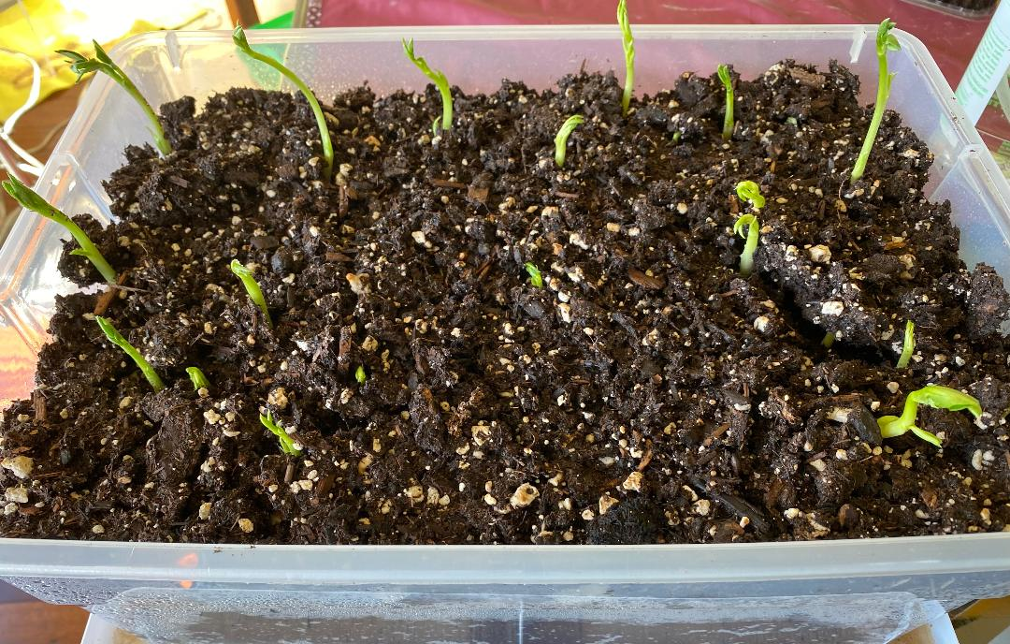

Slide 19
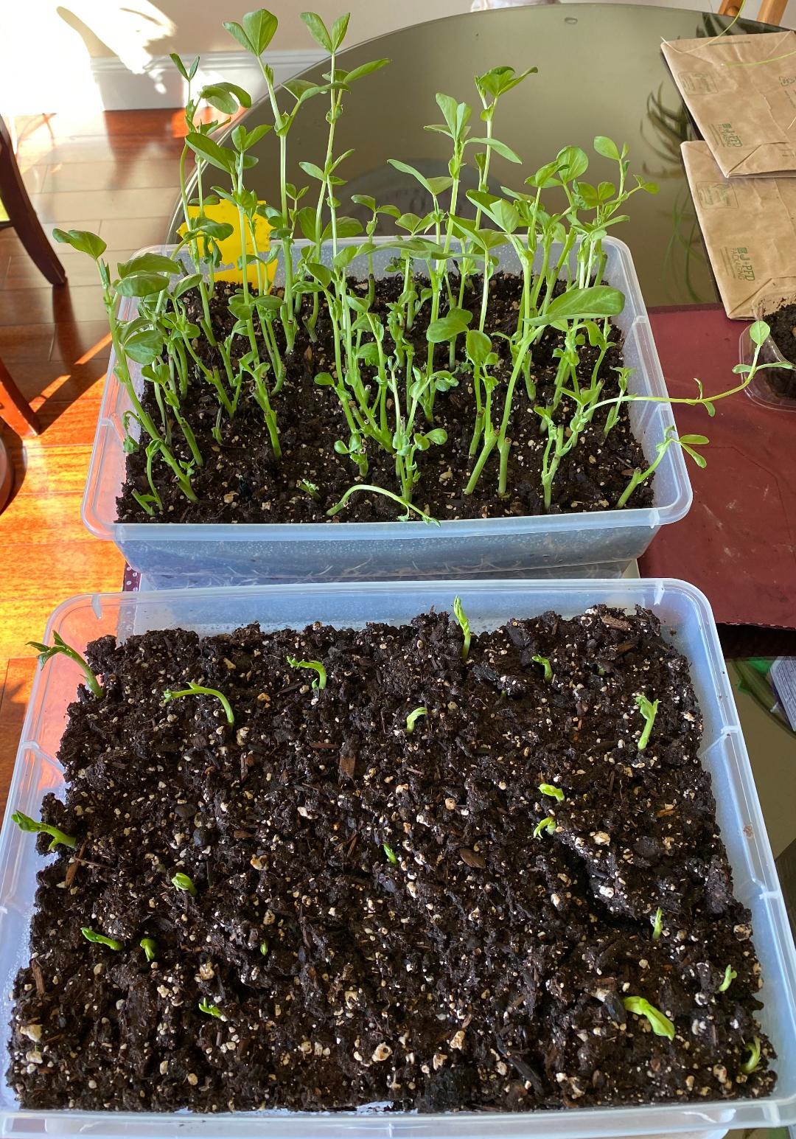

Slide 20
各（全）房靠他聯絡得合式，漸漸成為主的聖殿。 你們也靠他同被建造，成為 神藉著聖靈居住的所在。
(以弗所書 Ephesians 2:21-22）
in whom the whole structure, being joined together, grows into a holy temple in the Lord. And in him you too are being built together to become a dwelling in which God lives by his Spirit.

Slide 21
回應詩歌
「照我本相 Just as I am」

Slide 22

同領聖餐 Holy Communion

Slide 23
主耶穌被賣的那一夜，拿起餅來， 祝謝了，就擘開，說：「這是我的身體，為你們捨的，你們應當如此行，為的是記念我。」 (哥林多前書 1 Corinthians 11:23-24)
The Lord Jesus, on the night he was betrayed, took bread, and when he had given thanks, he broke it and said, “This is my body, which is for you; do this in remembrance of me.”

Slide 24
飯後，也照樣拿起杯來，說：「這杯是用我的血所立的新約，你們每逢喝的時候，要如此行，為的是記念我。」
(哥林多前書 1 Corinthians 11:25)
In the same way, after supper he took the cup, saying, “This cup is the new covenant in my blood; do this, whenever you drink it, in remembrance of me.”

Slide 25
你們每逢吃這餅，喝這杯，是表明主的死，直等到他來。
(哥林多前書 1 Corinthians 11:26)
For whenever you eat this bread and drink this cup, you proclaim the Lord’s death until he comes.
人應當自己省察，然後吃這餅、喝這杯。 (哥林多前書 1 Cor. 11:28)
Everyone ought to examine themselves before they eat of the bread and drink from the cup.

