Slide 1

主日信息
Sunday Sermon

Slide 2

神聖的驚喜
Divine Surprises
波特蘭靈糧堂
March 20, 2022

Slide 3
如經上所記： 神為愛他的人所預備的是眼睛未曾看見，耳朵未曾聽見，人心也未曾想到的。 只有 神藉著聖靈向我們顯明了，因為聖靈參透萬事，就是 神深奧的事也參透了。 (哥林多前書 1 Cor. 2:9-10）
However, as it is written: “What no eye has seen, what no ear has heard, and what no human mind has conceived”—the things God has prepared for those who love him—these are the things God has revealed to us by his Spirit. The Spirit searches all things, even the deep things of God.

Slide 4
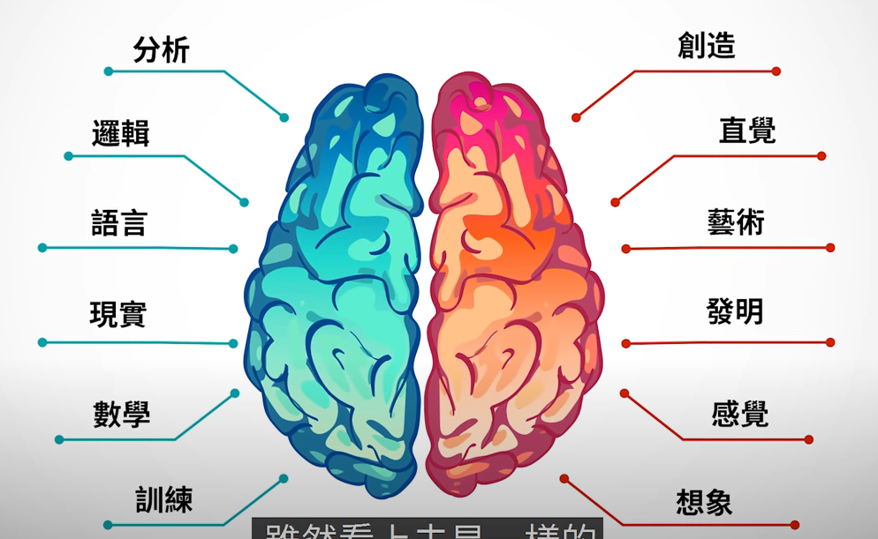
左腦 右腦

Slide 5
Good enough vs 上好的福分

Slide 6

我要拿金子代替銅，拿銀子代替鐵，拿銅代替木頭，拿鐵代替石頭；並要以和平為你的官長，以公義為你的監督。
(以賽亞書 Isaiah 60:17）
Instead of bronze I will bring you gold,
and silver in place of iron.
Instead of wood I will bring you bronze,
and iron in place of stones.
I will make peace your governor
and well-being your ruler.

Slide 7
我又告訴你們，你們祈求，就給你們；尋找，就尋見；叩門，就給你們開門。
因為，凡祈求的，就得著；尋找的，就尋見；叩門的，就給他開門。
(路加福音 Luke 11:9-10）
“So I say to you: Ask and it will be given to you; seek and you will find; knock and the door will be opened to you. For everyone who asks receives; the one who seeks finds; and to the one who knocks, the door will be opened.

Slide 8
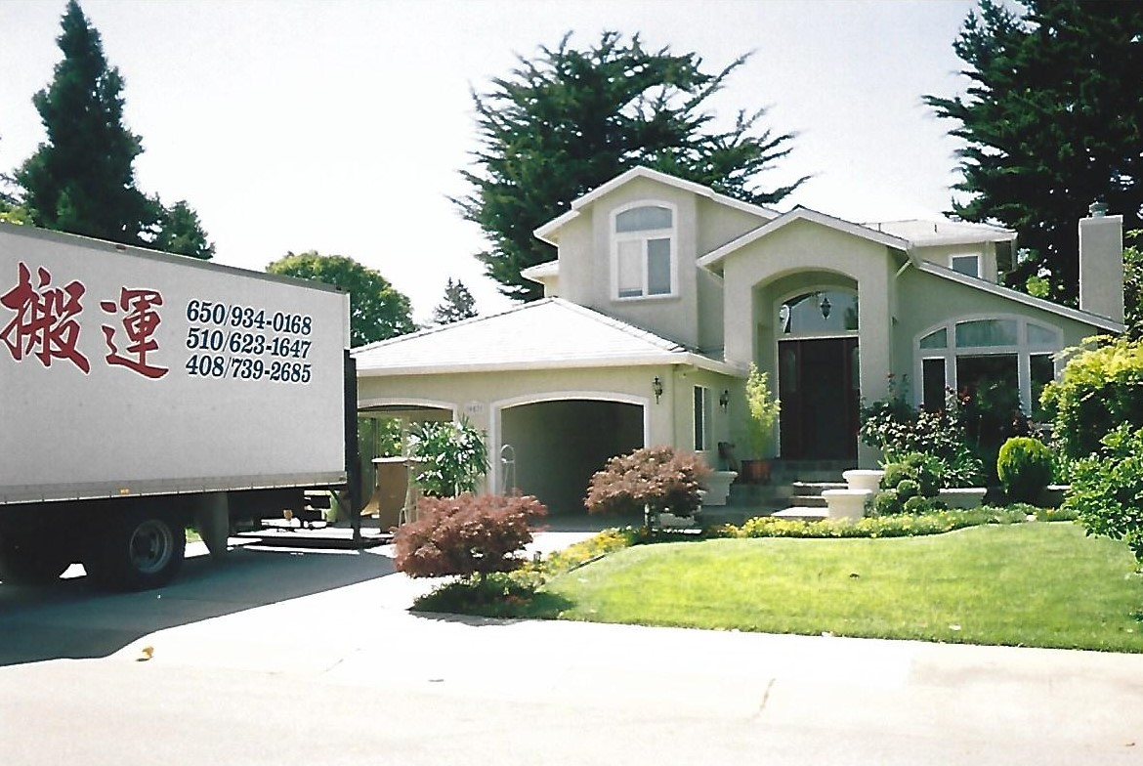

Slide 9
你們要先求他的國和他的義，這些東西都要加給你們了。 (馬太福音 Matthew 6:33）
But seek first his kingdom and his righteousness, and all these things will be given to you as well.

Slide 10
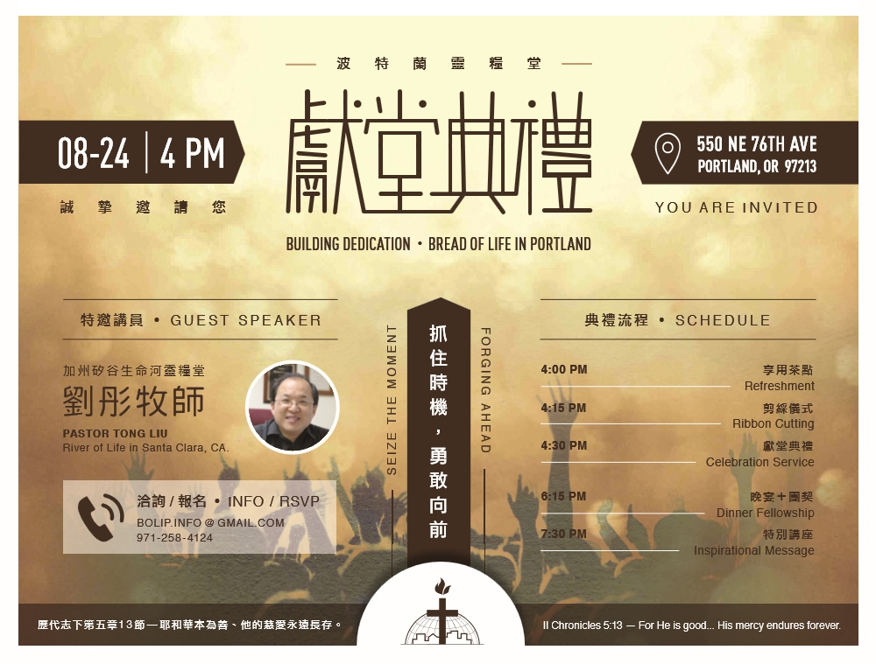

Slide 11
我們滿口喜笑、滿舌歡呼的時候，外邦中就有人說：耶和華為他們行了大事！ 耶和華果然為我們行了大事，我們就歡喜。 (詩篇 Psalm 126:2-3）
Our mouths were filled with laughter,
our tongues with songs of joy.
Then it was said among the nations,
“The Lord has done great things for them.”
The Lord has done great things for us,
and we are filled with joy.

Slide 12
你們祈求，就給你們；尋找，就尋見；叩門，就給你們開門。 因為凡祈求的，就得著；尋找的，就尋見；叩門的，就給他開門。 (馬太福音 Matthew 7:7-8）
Ask, and it will be given to you; seek, and you will find; knock, and it will be opened to you. For everyone who asks receives, and he who seeks finds, and to him who knocks it will be opened.

Slide 13
耶和華說：我的意念非同你們的意念；我的道路非同你們的道路。
(以賽亞書 Isaiah 55:6-8）
“For my thoughts are not your thoughts,
neither are your ways my ways,” declares the Lord.

Slide 14
為何有時禱告會吃閉門羹？

Slide 15
祂的旨意？ 我的想法？

Slide 16
我們若照他的旨意求甚麼，他就聽我們，這是我們向他所存坦然無懼的心。 既然知道他聽我們一切所求的，就知道我們所求於他的，無不得著。
(約翰一書 1 John 5:14-15）
This is the confidence we have in approaching God: that if we ask anything according to his will, he hears us. And if we know that he hears us—whatever we ask—we know that we have what we asked of him.

Slide 17
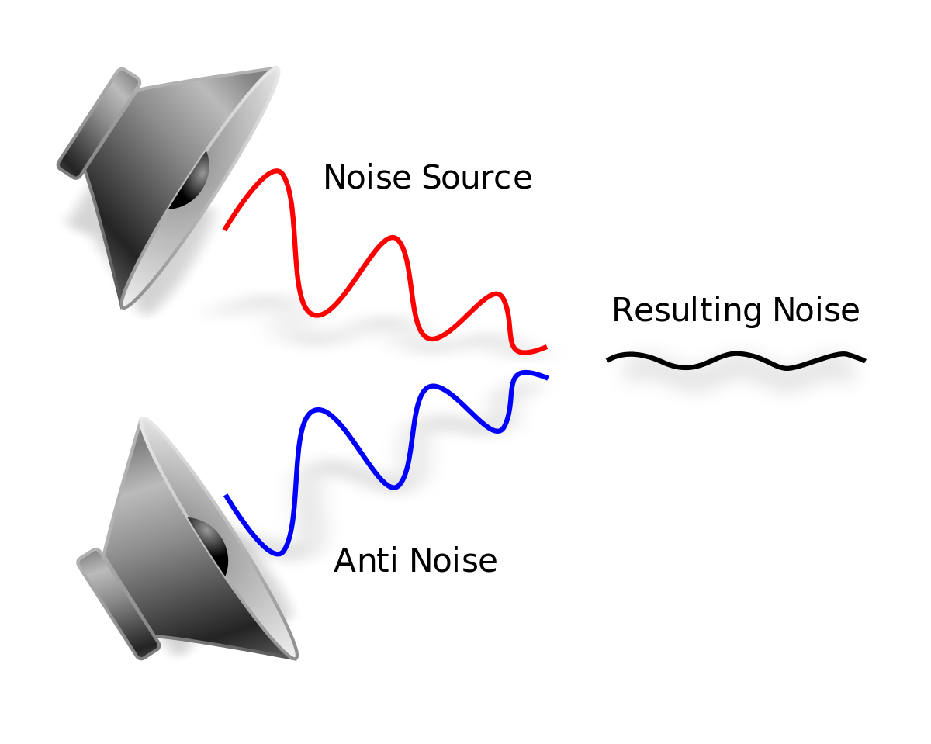


抗噪耳機 noise cancelling headphones

Slide 18
你們求也得不著，是因為你們妄求，要浪費在你們的宴樂中。
(雅各書 James 4:3）
When you ask, you do not receive, because you ask with wrong motives, that you may spend what you get on your pleasures.

Slide 19
主所應許的尚未成就，有人以為他是耽延，其實不是耽延，乃是寬容你們，不願有一人沉淪，乃願人人都悔改。
(彼得後書 2 Peter 3:9）
The Lord is not slow in keeping his promise, as some understand slowness. Instead he is patient with you, not wanting anyone to perish, but everyone to come to repentance.

Slide 20
不是你們揀選了我，是我揀選了你們，並且分派你們去結果子，叫你們的果子常存，使你們奉我的名，無論向父求甚麼，他就賜給你們。
(約翰福音 John 15:16）
You did not choose me, but I chose you and appointed you so that you might go and bear fruit—fruit that will last—and so that whatever you ask in my name the Father will give you.

Slide 21

禱告的堅持商數
P.Q. (Persistence Quotient)

Slide 22
回應詩歌
「帶我飛，聖靈 」

Slide 23
同心禱告

