Slide 1

主日信息
Sunday Sermon

Slide 2

禁食禱告的大能
Power of Fasting Prayer
波特蘭靈糧堂
May 1, 2022

Slide 3
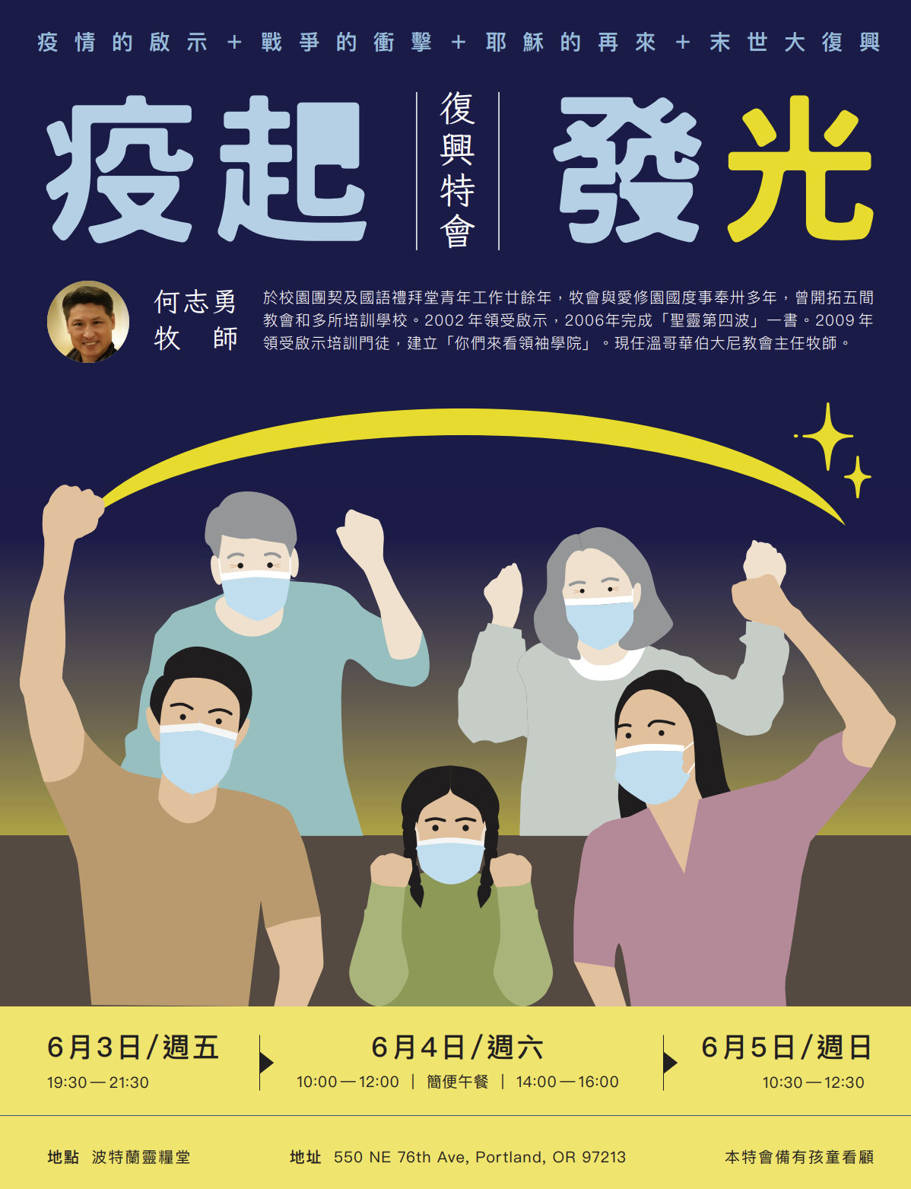

Slide 4
禁食的意義 Significance of Fasting
捨己、謙卑在神的面前 Humble before God
煉淨內在生命 Cleansing Inner Life
爭戰得勝 Victorious over enemy

Slide 5
禁食的分類 Types of Fasting
標準禁食 ─ 不吃任何食物但可以喝水
  主耶穌
完全禁食 ─ 不吃不喝
  摩西、以斯拉、以斯帖、掃羅
部分禁食 ─ 禁戒吃某些食物
  但以理 (蔬菜、水)
集體禁食
  以斯拉、以斯帖、約沙法

Slide 6
禁食禱告的大能 The Power of Fasting Prayer
靈裡的復興 Spiritual Revival
從罪中得潔淨 Cleansing of sins
危難中得解救 Delivery from crisis
尋求神的指引 God’s revelation & guidance

Slide 7
約珥書 Joel 1:14-15
你們要分定禁食的日子，宣告嚴肅會，招聚長老和國中的一切居民到耶和華─你們 神的殿，向耶和華哀求。 哀哉！耶和華的日子臨近了。這日來到，好像毀滅從全能者來到。
Consecrate a fast, Proclaim a solemn assembly;
Gather the elders And all the inhabitants of the land
To the house of the Lord your God, And cry out to the Lord. Alas for the day! For the day of the Lord is near,
And it will come as destruction from the Almighty.

Slide 8
以賽亞書 Isaiah 58:8
這樣，你的光就必發現如早晨的光；你所得的醫治要速速發明。 你的公義必在你前面行；耶和華的榮光必作你的後盾。
Then your light will break out like the dawn,
And your recovery will speedily spring forth;
And your righteousness will go before you;
The glory of the Lord will be your rear guard.

Slide 9
以賽亞書 Isaiah 58:12
那些出於你的人必修造久已荒廢之處；你要建立拆毀累代的根基。 你必稱為補破口的，和重修路徑與人居住的。
Those from among you will rebuild the ancient ruins;
You will raise up the age-old foundations;
And you will be called the repairer of the breach,
The restorer of the streets in which to dwell.

Slide 10
路加福音 Luke 4:1-2
耶穌被聖靈充滿，從約旦河回來，聖靈將他引到曠野，四十天受魔鬼的試探。 那些日子沒有吃甚麼；日子滿了，他就餓了。
Jesus, full of the Holy Spirit, returned from the Jordan and was led around by the Spirit in the wilderness for forty days, being tempted by the devil. And He ate nothing during those days, and when they had ended, He became hungry.

Slide 11
路加福音 Luke 4:13
魔鬼用完了各樣的試探，就暫時離開耶穌。 耶穌滿有聖靈的能力，回到加利利；他的名聲就傳遍了四方。
When the devil had finished every temptation, he left Him until an opportune time. And Jesus returned to Galilee in the power of the Spirit, and news about Him spread through all the surrounding district.

Slide 12
馬太福音 Matthew 17:21
至於這一類的鬼，若不禱告、禁食，他就不出來（或譯：不能趕他出來）。
But this kind does not go out except by prayer and fasting.

Slide 13
禁食禱告的大能 The Power of Fasting Prayer
靈裡的復興 Spiritual Revival
從罪中得潔淨 Cleansing of sins
危難中得解救 Delivery from crisis
尋求神的指引 God’s revelation & guidance

Slide 14
以賽亞書 Isaiah 58:3b-5a
看哪，你們禁食的日子仍求利益，勒逼人為你們做苦工。 你們禁食，卻互相爭競，以凶惡的拳頭打人。 你們今日禁食，不得使你們的聲音聽聞於上。 這樣禁食豈是我所揀選、使人刻苦己心的日子嗎？
5 “Is it a fast like this which I choose, a day for a man to humble himself?

Slide 15
以賽亞書 Isaiah 58:7
不是要把你的餅分給飢餓的人，將飄流的窮人接到你家中，見赤身的給他衣服遮體，顧恤自己的骨肉而不掩藏嗎？
Is it not to divide your bread with the hungry
And bring the homeless poor into the house;
When you see the naked, to cover him;
And not to hide yourself from your own flesh?

Slide 16
以賽亞書 Isaiah 58:9-10
那時你求告，耶和華必應允；你呼求，他必說：我在這裡。 你若從你中間除掉重軛和指摘人的指頭，並發惡言的事，你心若向飢餓的人發憐憫，使困苦的人得滿足，你的光就必在黑暗中發現；你的幽暗必變如正午。
Then you will call, and the Lord will answer; You will cry, and He will say, ‘Here I am.’ If you remove the yoke from your midst, The pointing of the finger and speaking wickedness,
And if you give yourself to the hungry, And satisfy the desire of the afflicted, Then your light will rise in darkness, And your gloom will become like midday.

Slide 17
但以理書 Daniel 9:3-6
我便禁食，披麻蒙灰，定意向主 神祈禱懇求。 我向耶和華─我的 神祈禱、認罪，說：「主啊，大而可畏的 神，向愛主、守主誡命的人守約施慈愛。 我們犯罪作孽，行惡叛逆，偏離你的誡命典章，沒有聽從你僕人眾先知奉你名向我們君王、首領、列祖，和國中一切百姓所說的話。
3 So I gave my attention to the Lord God to seek Him by prayer and supplications, with fasting, sackcloth and ashes. 4 I prayed to the Lord my God and confessed and said,

Slide 18
禁食禱告的大能 The Power of Fasting Prayer
靈裡的復興 Spiritual Revival
從罪中得潔淨 Cleansing of sins
危難中得解救 Delivery from crisis
尋求神的指引 God’s revelation & guidance

Slide 19
以賽亞書 Isaiah 58:6
我所揀選的禁食不是要鬆開凶惡的繩，解下軛上的索，使被欺壓的得自由，折斷一切的軛嗎？
Is this not the fast which I choose,
To loosen the bonds of wickedness,
To undo the bands of the yoke,
And to let the oppressed go free
And break every yoke?

Slide 20
歷代志下 2 Chronicles 20:1-3
此後，摩押人和亞捫人，又有米烏尼人，一同來攻擊約沙法。 有人來報告約沙法說：「從海外亞蘭那邊有大軍來攻擊你，如今他們在哈洗遜‧他瑪，就是隱‧基底。」 約沙法便懼怕，定意尋求耶和華，在猶大全地宣告禁食。
3 Jehoshaphat was afraid and turned his attention to seek the Lord, and proclaimed a fast throughout all Judah.

Slide 21
以斯帖記 Esther 4:15-16
以斯帖就吩咐人回報末底改說：「你當去招聚書珊城所有的猶大人，為我禁食三晝三夜，不吃不喝；我和我的宮女也要這樣禁食。 然後我違例進去見王，我若死就死吧！」。
Then Esther told them to reply to Mordecai, “Go, assemble all the Jews who are found in Susa, and fast for me; do not eat or drink for three days, night or day. I and my maidens also will fast in the same way. And thus I will go in to the king, which is not according to the law; and if I perish, I perish.”

Slide 22
禁食禱告的大能 The Power of Fasting Prayer
靈裡的復興 Spiritual Revival
從罪中得潔淨 Cleansing of sins
危難中得解救 Delivery from crisis
尋求神的指引 God’s revelation & guidance

Slide 23
以賽亞書 Isaiah 58:11
耶和華也必時常引導你，在乾旱之地使你心滿意足，骨頭強壯。 你必像澆灌的園子，又像水流不絕的泉源。
And the Lord will continually guide you,
And satisfy your desire in scorched places,
And give strength to your bones;
And you will be like a watered garden,
And like a spring of water whose waters do not fail.

Slide 24
但以理書 Daniel 9:3, 21-23
3 我便禁食，披麻蒙灰，定意向主 神祈禱懇求。
21 我正禱告的時候，先前在異象中所見的那位加百列，奉命迅速飛來，約在獻晚祭的時候，按手在我身上。 他指教我說：「但以理啊，現在我出來要使你有智慧，有聰明。 你初懇求的時候，就發出命令，我來告訴你，因你大蒙眷愛；所以你要思想明白這以下的事和異象。
3 So I turned to the Lord God and pleaded with him in prayer and petition, in fasting, and in sackcloth and ashes.

Slide 25
以斯拉記 Ezra 8:21, 23
21 那時，我在亞哈瓦河邊宣告禁食，為要在我們 神面前克苦己心，求他使我們和婦人孩子，並一切所有的，都得平坦的道路。
23 所以我們禁食祈求我們的 神，他就應允了我們。
21 Then I proclaimed a fast there at the river of Ahava, that we might humble ourselves before our God to seek from Him a safe journey for us, our little ones, and all our possessions.
23 So we fasted and sought our God concerning this matter, and He listened to our entreaty.

Slide 26
使徒行傳 Acts 13:2-3
他們事奉主、禁食的時候，聖靈說：「要為我分派巴拿巴和掃羅，去做我召他們所做的工。」
於是禁食禱告，按手在他們頭上，就打發他們去了。
While they were ministering to the Lord and fasting, the Holy Spirit said, “Set apart for Me Barnabas and Saul for the work to which I have called them.” Then, when they had fasted and prayed and laid their hands on them, they sent them away.

Slide 27
禁食禱告的注意事項 Precautions
心的預備
設立目標
身體的預備
停止禁食須知

Slide 28
為復興特會禁食禱告 Praying for the Conference
為自己以及所有參加復興特會的弟兄 姊妹禱告
為大會禱告
為講員何牧師及服事的同工禱告

Slide 29
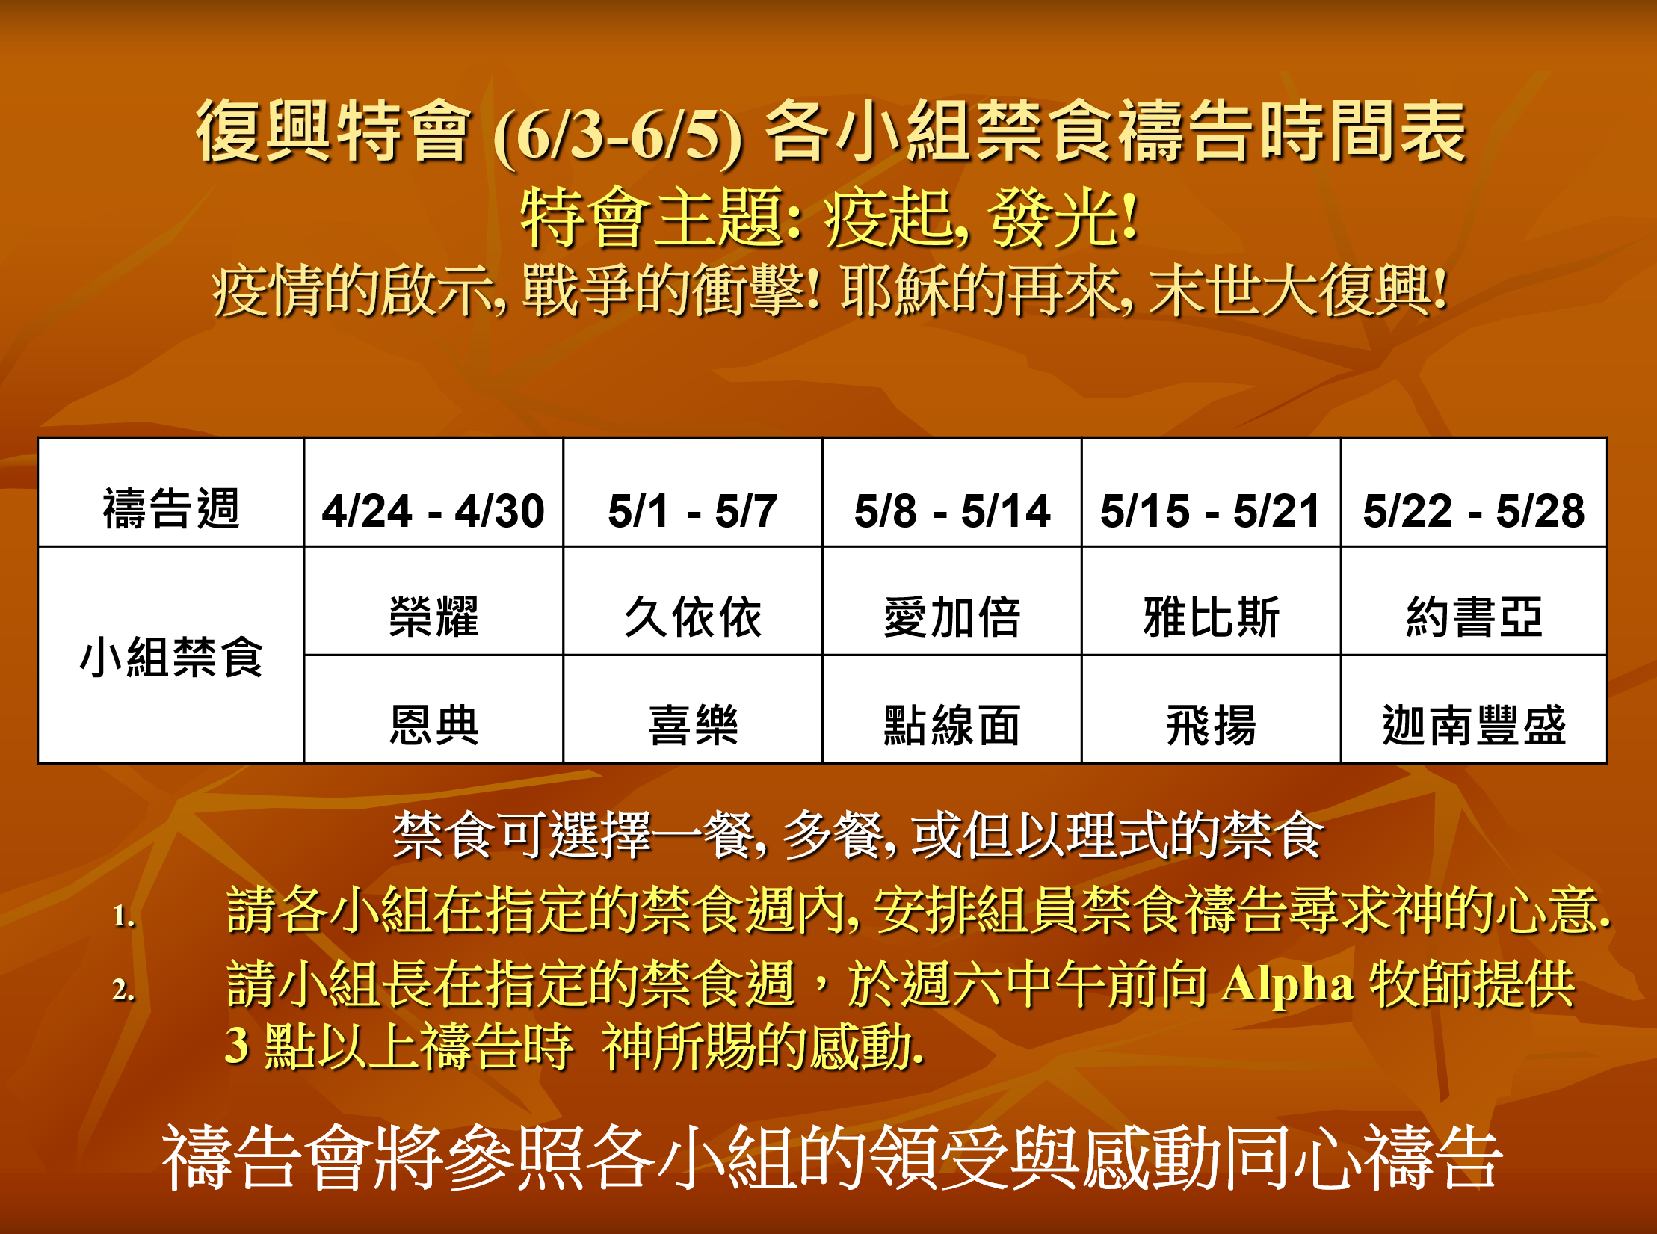

Slide 30
禁食禱告的感動 Inspirations sharing
我們要靠着主，倚賴他的大能大力作剛強的人；要穿戴神所賜的全副軍裝。
求圣灵赐下突破的恩膏和心志，重启生命的动力，使弟兄姐妹用信心和凯歌征服自己经过多次失败没有攻克的高山。
主的靈要釋放我們，救拔我們脱離一切捆綁，剛強壯膽去傳福音，釋放被擄者得醫治，得自由。

Slide 31
耶利米書 Jeremiah 29:12-13
你們要呼求我，禱告我，我就應允你們。 你們尋求我，若專心尋求我，就必尋見。
Then you will call upon Me and come and pray to Me, and I will listen to you. You will seek Me and find Me when you search for Me with all your heart.

Slide 32
回應詩歌
「我以禱告來到你跟前」

Slide 33
同心禱告

