Slide 1

主日信息
Sunday Sermon

Slide 2

領受 神的啟示
Receiving Revelation from God
波特蘭靈糧堂
May 22, 2022

Slide 3
神啟示的方式 Two Categories of Revelation
普通 (自然界) 啟示 Natural Revelation
特殊 (超自然) 啟示 Special Revelation

Slide 4
馬太福音 Matthew 6:9-10
我們在天上的父：願人都尊你的名為聖。
願你的國降臨；願你的旨意行在地上，如同行在天上。
“This, then, is how you should pray:
“‘Our Father in heaven,
hallowed be your name,
your kingdom come,
your will be done,
on earth as it is in heaven.

Slide 5

神真的會說話嗎？

Slide 6
約伯記 Job 33:14-18
神說一次、兩次，世人卻不理會。 人躺在床上沉睡的時候， 神就用夢和夜間的異象， 開通他們的耳朵，將當受的教訓印在他們心上，好叫人不從自己的謀算，不行驕傲的事，攔阻人不陷於坑裡，不死在刀下。
14 For God does speak—now one way, now another—
though no one perceives it.

Slide 7
詩篇 Psalm 139:17-18
神啊，你的意念向我何等寶貴！其數何等眾多！ 我若數點，比海沙更多；我睡醒的時候，仍和你同在。
How precious to me are your thoughts, God!
How vast is the sum of them!
Were I to count them,
they would outnumber the grains of sand—
when I awake, I am still with you.

Slide 8
神啟示的主要方式 Ways of God’s Revelation
聖經 Bible
可聽見的聲音 audible voice (徒 9:1-9)
異象 vision (徒 10:3)
異夢 dream (伯 33:14-17, 珥 2:28)
rhema 的意念 (太 4:4, 羅 10:17, 弗 6:17)

Slide 9
約翰福音 John 10:2-4
從門進去的，才是羊的牧人。 看門的就給他開門；羊也聽他的聲音。 他按著名叫自己的羊，把羊領出來。 既放出自己的羊來，就在前頭走，羊也跟著他，因為認得他的聲音。
The one who enters by the gate is the shepherd of the sheep. The gatekeeper opens the gate for him, and the sheep listen to his voice. He calls his own sheep by name and leads them out. When he has brought out all his own, he goes on ahead of them, and his sheep follow him because they know his voice.

Slide 10
哥林多前書 1 Corinthians 14:1
你們要追求愛，也要切慕屬靈的恩賜，其中更要羨慕的，是作先知講道（說預言）。
Follow the way of love and eagerly desire gifts of the Spirit, especially prophecy.

Slide 11
箴言 Proverbs 8:34-35
聽從我、日日在我門口仰望、在我門框旁邊等候的，那人便為有福。 因為尋得我的，就尋得生命，也必蒙耶和華的恩惠。
Blessed are those who listen to me,
watching daily at my doors,
waiting at my doorway.
For those who find me find life
and receive favor from the Lord.

Slide 12
哥林多前書 1 Corinthians 14:3-4
但作先知講道的，是對人說，要造就、安慰、勸勉人。 說方言的，是造就自己；作先知講道的，乃是造就教會。
But the one who prophesies speaks to people for their strengthening, encouraging and comfort. Anyone who speaks in a tongue edifies themselves, but the one who prophesies edifies the church.

Slide 13
帖撒羅尼迦前書 1 Thessalonians 5:19-21
不要消滅聖靈的感動；不要藐視先知的講論。但要凡事察驗；善美的要持守，
Do not quench the Spirit. Do not treat prophecies with contempt but test them all; hold on to what is good,

Slide 14
如何察驗預言 Discerning the Prophecies
是否合乎聖經︖ Biblical
是否合乎 神的屬性︖ God’s nature
是否結出好的果子︖ Bearing good fruits
是否與你的靈同作見證 Inner witness
錄音與寫下來

Slide 15
Cindy Jacobs 個人性預言的範例

Slide 16
Play video
“Cindy Jacobs”

Slide 17

rhema (ῥῆμα) 的流動：
神的話好像一股意念，自發的從我們心中流出來。 所以當我聽主的聲音時，我是聆聽著自發的思潮，而當我安靜調向 神默想敬拜時，我是調向其自發性的流動。 神的聲音常常是輕微而且柔和的。

Slide 18
馬太福音 Matthew 4:4
耶穌卻回答說：「經上記著說：人活著，不是單靠食物，乃是靠 神口裡所出的一切話 (ῥῆμα) 。」
Jesus answered, “It is written: ‘Man shall not live on bread alone, but on every word that comes from the mouth of God.

Slide 19
羅馬書 Romans 10:17
可見，信道是從聽道來的，聽道是從基督的話(ῥῆμα) 來的。
So faith comes from hearing, and hearing by the word of Christ.

Slide 20
以弗所書 Ephesians 6:17-19
並戴上救恩的頭盔，拿著聖靈的寶劍，就是 神的道 (ῥῆμα) ；靠著聖靈，隨時多方禱告祈求；並要在此警醒不倦，為眾聖徒祈求，也為我祈求，使我得著口才，能以放膽開口講明福音的奧祕，
17 Take the helmet of salvation and the sword of the Spirit, which is the word of God.

Slide 21
如何操練聆聽聖靈的聲音？
  敬拜
  安息

Slide 22
詩篇 Psalm 16:8-9
我將耶和華常擺在我面前，因他在我右邊，我便不致搖動。 因此，我的心歡喜，我的靈快樂；我的肉身也要安然居住。
I have set the Lord continually before me;
Because He is at my right hand, I will not be shaken.
Therefore my heart is glad and my glory rejoices;
My flesh also will dwell securely.

Slide 23
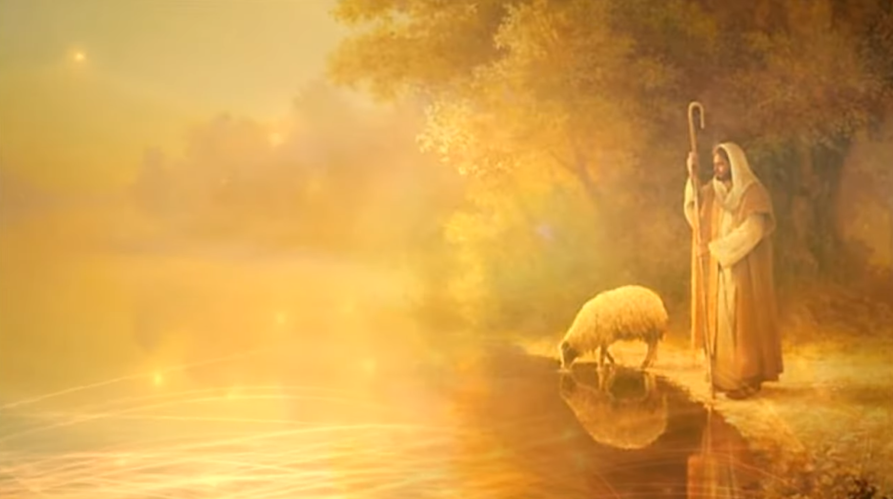
輕輕聽

