Slide 1

主日信息
Sunday Sermon

Slide 2

腓利的生命見證
Life Testimonies of Philip
波特蘭靈糧堂
July 31, 2022

Slide 3
使徒行傳 Acts 6:3-5
所以弟兄們，當從你們中間選出七個有好名聲、被聖靈充滿、智慧充足的人，我們就派他們管理這事。 但我們要專心以祈禱、傳道為事。大眾都喜悅這話，就揀選了司提反，乃是大有信心、聖靈充滿的人，又揀選腓利、伯羅哥羅、尼迦挪、提門、巴米拿，並進猶太教的安提阿人尼哥拉，
5 This proposal pleased the whole group. They chose Stephen, a man full of faith and of the Holy Spirit; also Philip, Procorus, Nicanor, Timon, Parmenas, and Nicolas from Antioch, a convert to Judaism.

Slide 4
使徒行傳 Acts 8:5-8
腓利下撒馬利亞城去，宣講基督。 眾人聽見了，又看見腓利所行的神蹟，就同心合意地聽從他的話。因為有許多人被污鬼附著，那些鬼大聲呼叫，從他們身上出來；還有許多癱瘓的、瘸腿的，都得了醫治。 在那城裡，就大有歡喜。
5 Philip went down to a city in Samaria and proclaimed the Messiah there. When the crowds heard Philip and saw the signs he performed, they all paid close attention to what he said. For with shrieks, impure spirits came out of many, and many who were paralyzed or lame were healed.

Slide 5
使徒行傳 Acts 8:34-39
太監對腓利說：「請問，先知說這話是指著誰？是指著自己呢？是指著別人呢？」 腓利就開口從這經上起，對他傳講耶穌。 二人正往前走，到了有水的地方，太監說：「看哪，這裡有水，我受洗有甚麼妨礙呢？」腓利說：「你若是一心相信，就可以。」他回答說：「我信耶穌基督是 神的兒子。」於是吩咐車站住，腓利和太監二人同下水裡去，腓利就給他施洗。

Slide 6
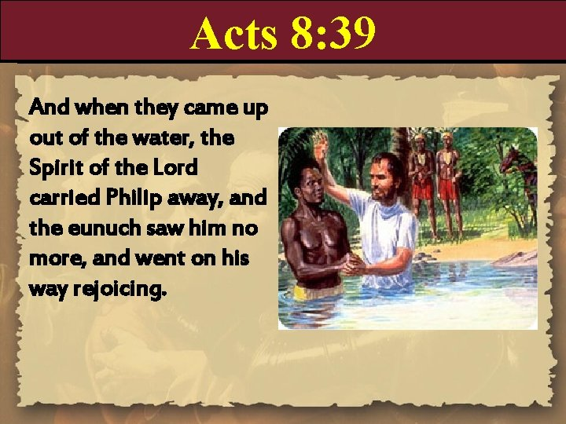

Slide 7
使徒行傳 Acts 8:39-40
從水裡上來，主的靈把腓利提了去，太監也不再見他了，就歡歡喜喜地走路。後來有人在亞鎖都遇見腓利；他走遍那地方，在各城宣傳福音，直到凱撒利亞。
When they came up out of the water, the Spirit of the Lord suddenly took Philip away, and the eunuch did not see him again, but went on his way rejoicing. Philip, however, appeared at Azotus and traveled about, preaching the gospel in all the towns until he reached Caesarea.

Slide 8
使徒行傳 Acts 21:8-9
第二天，我們離開那裡，來到凱撒利亞，就進了傳福音的腓利家裡，和他同住。他是那七個執事裡的一個。他有四個女兒，都是處女，是說預言的。
Leaving the next day, we reached Caesarea and stayed at the house of Philip the evangelist, one of the Seven. He had four unmarried daughters who prophesied.

Slide 9

洗禮的種類和意義
施洗約翰的水洗 (馬太福音 Matthew 3:11-12)
受洗歸入基督耶穌的洗禮 (羅馬書 Romans 6:3-5)
聖靈的洗 (使徒行傳 Acts 1:5, 林前 1 Cor. 12:12-13 )

Slide 10
施洗約翰的水洗
悔改的洗
為耶穌基督做見證，叫人跟隨耶穌

Slide 11
馬太福音 Matthew 3:11-12
我是用水給你們施洗，叫你們悔改。 但那在我以後來的，能力比我更大，我就是給他提鞋也不配。 他要用聖靈與火給你們施洗。 他手裡拿著簸箕，要揚淨他的場，把麥子收在倉裡，把糠用不滅的火燒盡了。」
11 “As for me, I baptize you with water for repentance, but He who is coming after me is mightier than I, and I am not fit to remove His sandals; He will baptize you with the Holy Spirit and fire.

Slide 12
受洗歸入基督耶穌的洗禮
奉聖父、聖子、聖靈的名，將悔改的人浸入水裏，藉以表示受浸者過去敗壞老我的生命與主耶穌一同埋葬，從水裡上來也表示因著主耶穌復活的大能使生命更新而變化
為耶穌基督的死裡復活的大能公開做見證
主耶穌大使命的吩咐

Slide 13
羅馬書 Romans 6:3-5
豈不知我們這受洗歸入基督耶穌的人是受洗歸入他的死嗎？ 所以，我們藉著洗禮歸入死，和他一同埋葬，原是叫我們一舉一動有新生的樣式，像基督藉著父的榮耀從死裡復活一樣。 我們若在他死的形狀上與他聯合，也要在他復活的形狀上與他聯合；
3 Or don’t you know that all of us who were baptized into Christ Jesus were baptized into his death? We were therefore buried with him through baptism into death in order that, just as Christ was raised from the dead through the glory of the Father, we too may live a new life.

Slide 14
聖靈的洗
靠聖靈重生為新造的人，把 神的聖潔與公義 放在人的靈魂裡，使我們能有新的、救贖的、 超自然的屬靈思想與行為
有分於基督的身體 (基督是教會的頭、我們是肢體)
領受聖靈的充滿和澆灌 (內住與恩賜能力外顯)

Slide 15
哥林多前書 1 Corinthians 12:12-13
就如身子是一個，卻有許多肢體；而且肢體雖多，仍是一個身子；基督也是這樣。 我們不拘是猶太人，是希臘人，是為奴的，是自主的，都從一位聖靈受洗，成了一個身體，飲於一位聖靈。
Just as a body, though one, has many parts, but all its many parts form one body, so it is with Christ. For we were all baptized by one Spirit so as to form one body—whether Jews or Gentiles, slave or free—and we were all given the one Spirit to drink.

Slide 16
使徒行傳 Acts 1:5
約翰是用水施洗，但不多幾日，你們要受聖靈的洗。
For John baptized with water, but in a few days you will be baptized with the Holy Spirit.

Slide 17
使徒行傳第二章聖靈降臨與教會建立

Slide 18
使徒行傳 Acts 2:3-4
又有舌頭如火焰顯現出來，分開落在他們各人頭上。 他們就都被聖靈充滿，按著聖靈所賜的口才說起別國的話來。
They saw what seemed to be tongues of fire that separated and came to rest on each of them. All of them were filled with the Holy Spirit and began to speak in other tongues as the Spirit enabled them.

Slide 19
在受了聖靈的洗信主重生之後，
使徒行傳 Acts 2:38-42 約三千人受洗

Slide 20
使徒行傳 Acts 2:38-39
彼得說：「你們各人要悔改，奉耶穌基督的名受洗，叫你們的罪得赦，就必領受所賜的聖靈； 因為這應許是給你們和你們的兒女，並一切在遠方的人，就是主─我們 神所召來的。」
Peter said to them, “Repent, and each of you be baptized in the name of Jesus Christ for the forgiveness of your sins; and you will receive the gift of the Holy Spirit. For the promise is for you and your children and for all who are far off, as many as the Lord our God will call to Himself.”

Slide 21
使徒行傳 Acts 2:40-42
彼得還用許多話作見證，勸勉他們說：「你們當救自己脫離這彎曲的世代。」 於是領受他話的人就受了洗。 那一天，門徒約添了三千人， 都恆心遵守使徒的教訓，彼此交接，擘餅，祈禱。
41 So then, those who had received his word were baptized; and that day there were added about three thousand souls. They were continually devoting themselves to the apostles’ teaching and to fellowship, to the breaking of bread and to prayer.

Slide 22
在受了聖靈的洗信主重生之後，
使徒行傳 Acts 8:34-39 腓利給太監施洗

Slide 23
在受了聖靈的洗信主重生之後，
使徒行傳 Acts 10:44-48 哥尼流家人受洗

Slide 24
使徒行傳 Acts 10:44-48
彼得還說這話的時候，聖靈降在一切聽道的人身上。 那些奉割禮、和彼得同來的信徒，見聖靈的恩賜也澆在外邦人身上，就都希奇； 因聽見他們說方言，稱讚 神為大。 於是彼得說：「這些人既受了聖靈，與我們一樣，誰能禁止用水給他們施洗呢？」就吩咐奉耶穌基督的名給他們施洗。
47 Then Peter answered, “Surely no one can refuse the water for these to be baptized who have received the Holy Spirit just as we did, can he?”

Slide 25
羅馬書 Romans 8:5-6
因為，隨從肉體的人體貼肉體的事；隨從聖靈的人體貼聖靈的事。 體貼肉體的，就是死；體貼聖靈的，乃是生命、平安。
For those who are according to the flesh set their minds on the things of the flesh, but those who are according to the Spirit, the things of the Spirit. For the mind set on the flesh is death, but the mind set on the Spirit is life and peace,

Slide 26
回應詩歌
「求聖靈運行」

Slide 27
同心禱告

