Slide 1

主日信息
Sunday Sermon

Slide 2
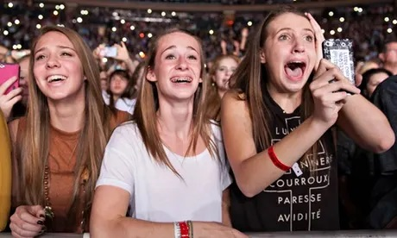

Slide 3
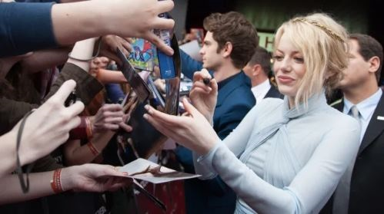

Slide 4
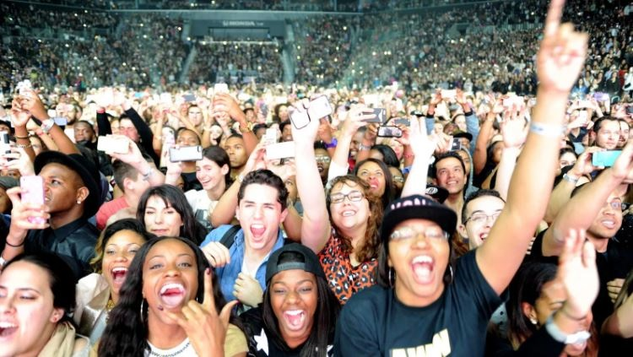

Slide 6
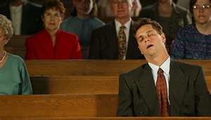

Slide 7
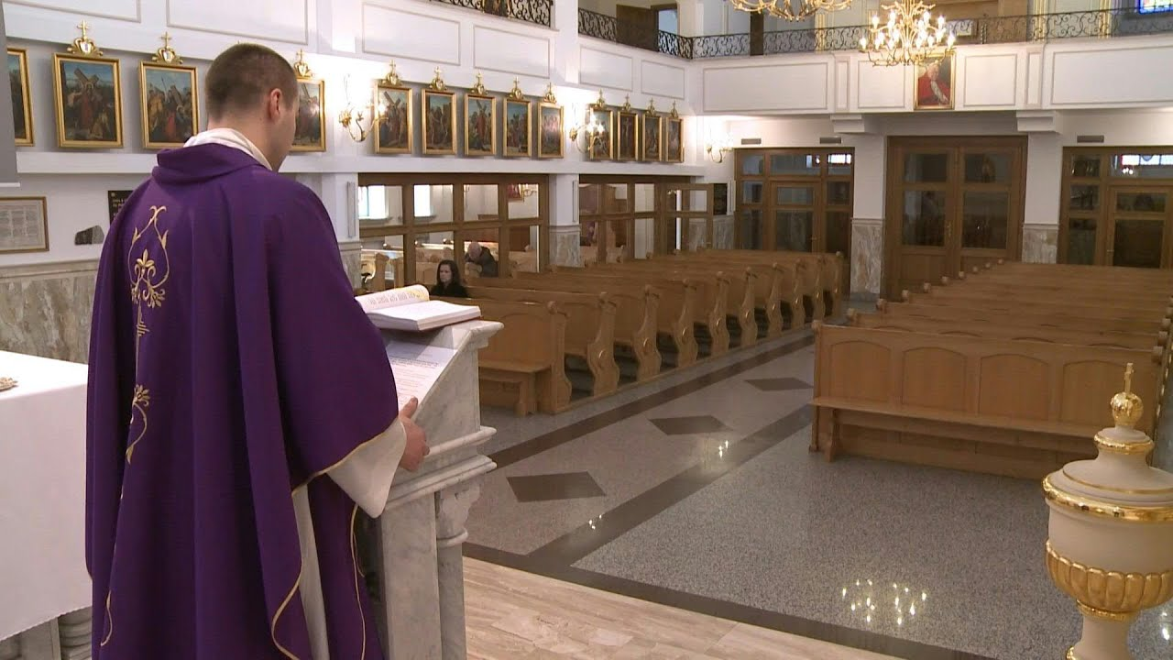

Slide 8
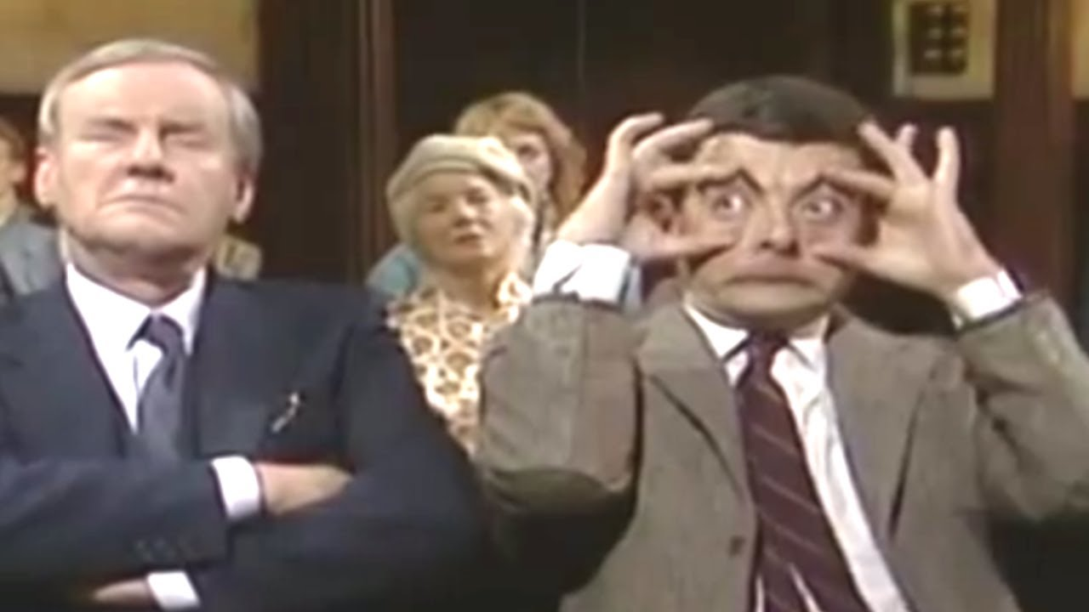

Slide 9
John 約 翰 福 音4:23-24
²³ Yet a time is coming and has now come when the true worshipers will worship the Father in the Spirit and in truth, for they are the kind of worshipers the Father seeks.
²⁴ God is spirit, and His worshipers must worship in the Spirit and in truth.”
時 候 將 到 、 如 今 就 是 了 、 那 真 正 拜 父 的 、 要 用 心 靈 和 誠 實 拜 他 、 因 為 父 要 這 樣 的 人 拜 他 神 是 個 靈 ． 〔 或 無 個 字 〕 所 以 拜 他 的 、 必 須 用 心 靈 和 誠 實 拜 他 。

Slide 10
David in Psalms 139 says
7 Where can I go from your Spirit?
Where can I flee from your presence?
8 If I go up to the heavens, you are there;
if I make my bed in the depths, you are there.
9 If I rise on the wings of the dawn,
if I settle on the far side of the sea,
10 even there your hand will guide me,
your right hand will hold me fast.

Slide 11
What is Worship

Slide 12
Weorth = Worth
Scipe = Ship
(Shape or Quality)

Slide 13
Friendship
Sportmanship
Relationship

Slide 14
When we worship, we are declaring that God has worth, He is worthy
A central part of a Christian’s calling is to declare that God is worthy – that He is worth more than everything else put together

Slide 15
Worship is a response to how good our God is in our lives.

Slide 16
1 Peter 2:9
But you are a chosen people, a royal priesthood, a holy nation, God’s special possession, that you may declare the praises of Him who called you out of darkness into His wonderful light.
彼得前书 2:9
然而你們是蒙揀選的族類，是君尊的祭司，是聖潔的國民，是屬 神的子民，為要叫你們宣揚那召你們出黑暗入奇妙光明者的美德。

Slide 17
We were created to worship Him

Slide 18
Psalm 139
13 For you created my inmost being; you knit me together in my mother’s womb.
14 I praise you because I am fearfully and wonderfully made;
your works are wonderful, I know that full well.
15 My frame was not hidden from you when I was made in the secret place,
when I was woven together in the depths of the earth.
16 Your eyes saw my unformed body;
all the days ordained for me were written in your book
before one of them came to be.
17 How precious to me are your thoughts, O God!
How vast is the sum of them!
18 Were I to count them,
they would outnumber the grains of sand—

Slide 19
Objects of worship

Slide 20
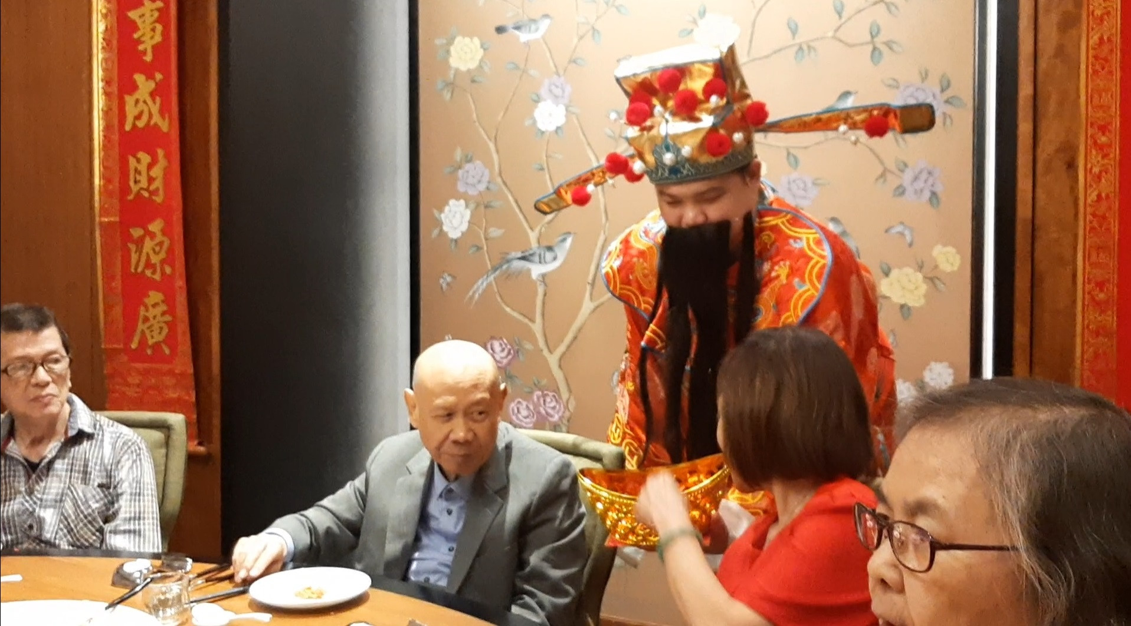
The god of money?

Slide 21
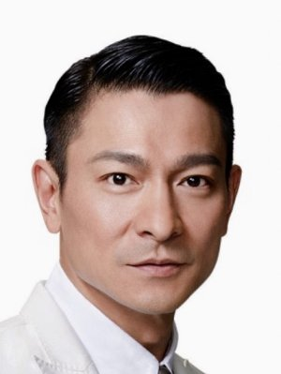
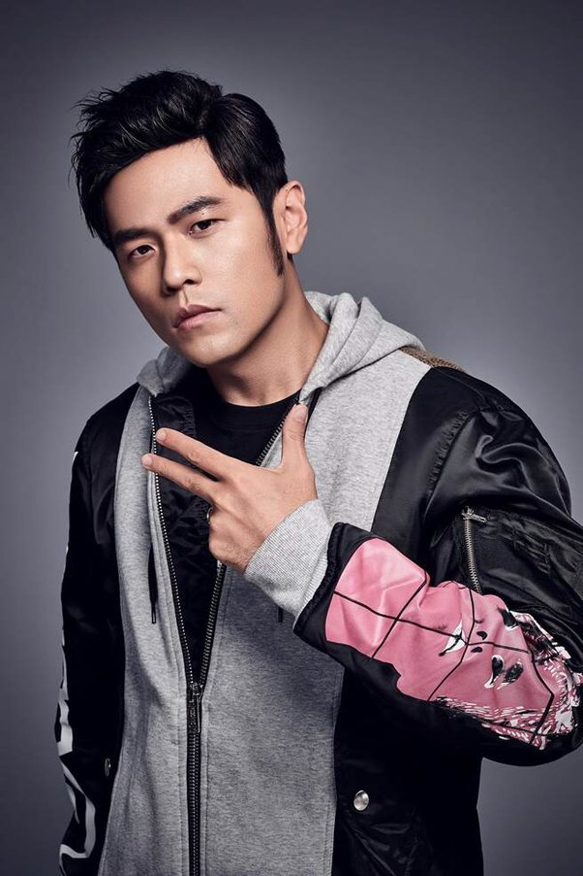

Famous celebrities?

Slide 22
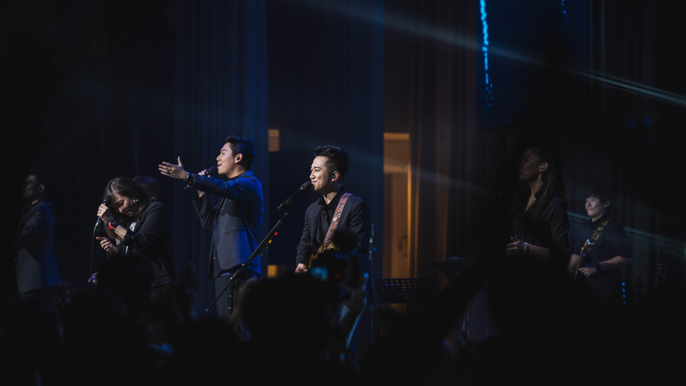
Worship Band?

Slide 23
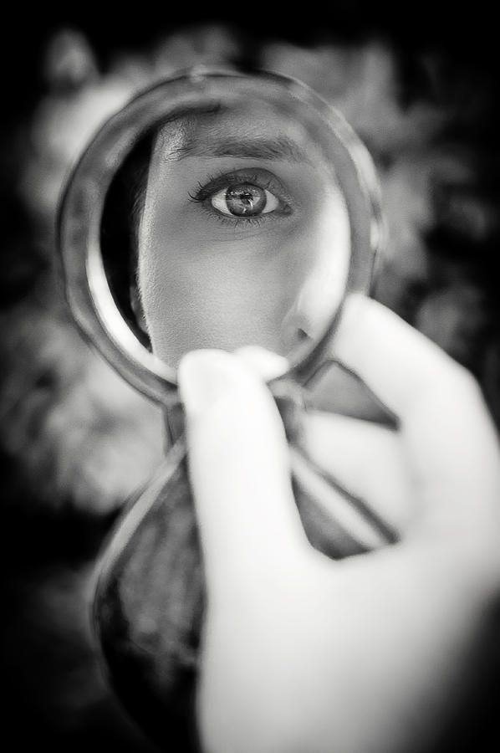
Me?

Slide 24
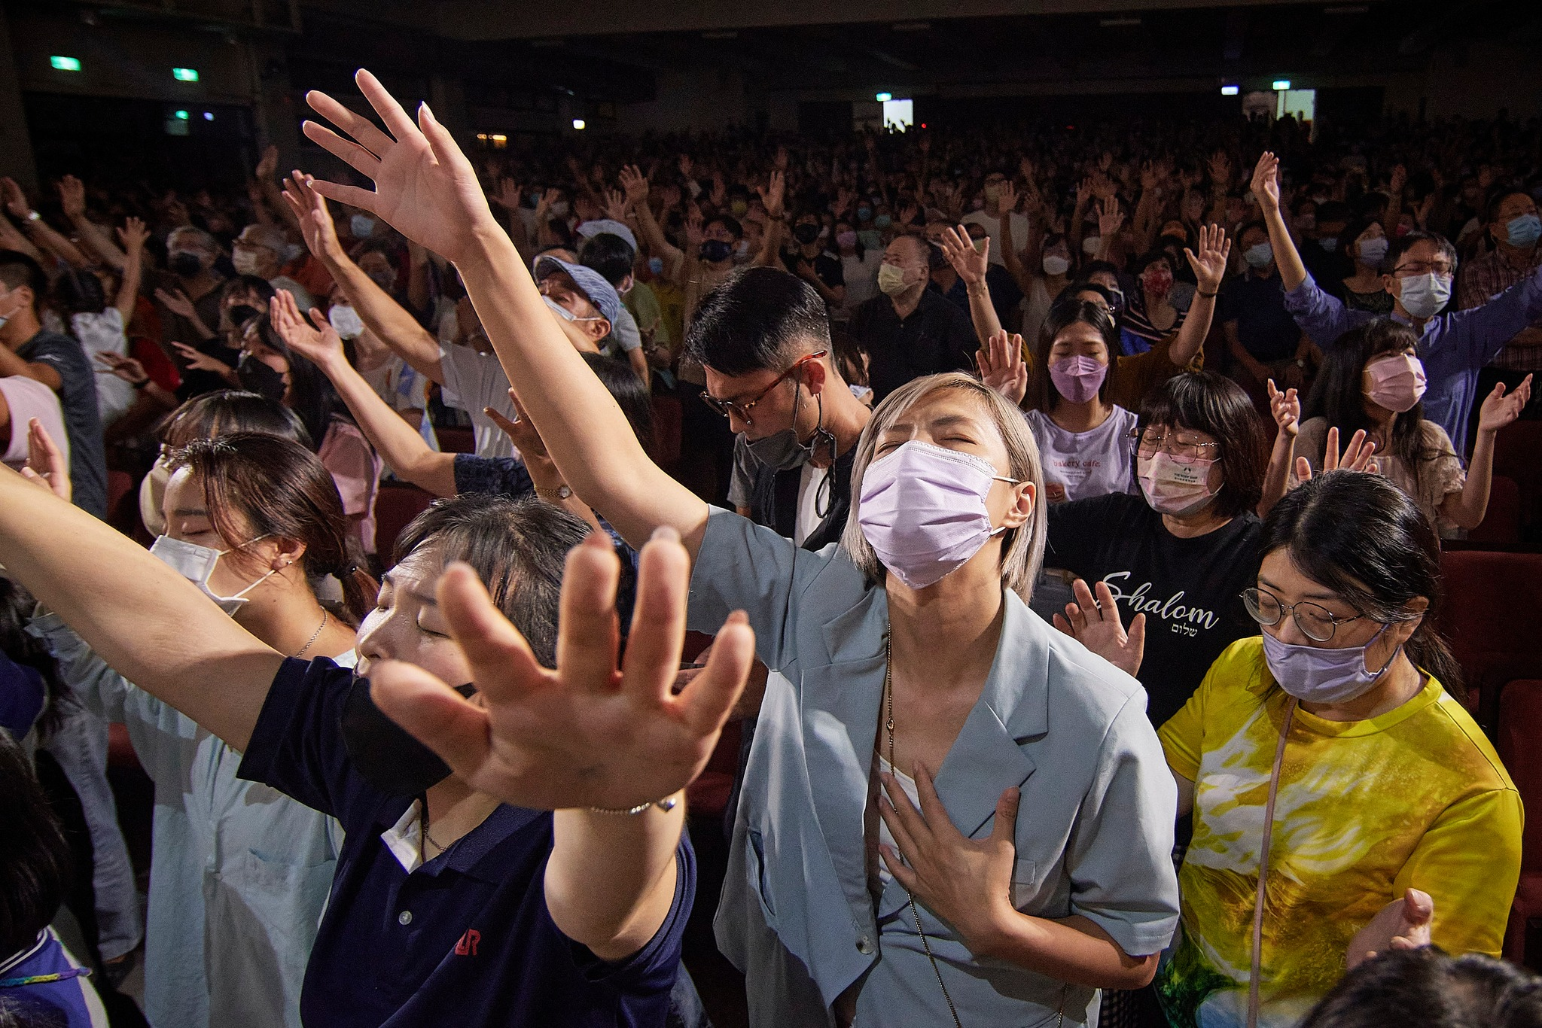

Slide 25
How do we worship?

Slide 26
John 約 翰 福 音4:23-24
²³ Yet a time is coming and has now come when the true worshipers will worship the Father in the Spirit and in truth, for they are the kind of worshipers the Father seeks.
²⁴ God is spirit, and His worshipers must worship in the Spirit and in truth.”
時 候 將 到 、 如 今 就 是 了 、 那 真 正 拜 父 的 、 要 用 心 靈 和 誠 實 拜 他 、 因 為 父 要 這 樣 的 人 拜 他 神 是 個 靈 ． 〔 或 無 個 字 〕 所 以 拜 他 的 、 必 須 用 心 靈 和 誠 實 拜 他 。

Slide 27
Mark馬 可 福 音 12:30
³⁰ Love the Lord your God with all your heart and with all your soul and with all your mind and with all your strength.
你 要 盡 心 、 盡 性 、 盡 意 、 盡 力 、
愛 主 你 的 神 。

Slide 28
Worship that expresses the heart and soul
Giving praise upward

Slide 29
Worship that involves the mind
-with all your mind-
Receiving instructions from above
Listen to what He says
We need to be attentive to what He is telling us

Slide 30
Worship that involves the body
-with all our strength-
How we should live in this world
Transformation of our mind and behavior
Our behavior needs to change

Slide 31
When we really believe that God is worthy of every praise, then we will be willing to listen and to change the way we live in response to such a worthy God
We will trust Him and seek Him and want to please Him as much as we can.
Worship should affect our behavior.

Slide 32
Worship involves all the ways in which we can respond to God, all the ways we can praise Him by what we say and do, all the ways we can demonstrate that God is worthy of all praise and honor and allegiance.

Slide 33
Giving our tithes and offering
Teaching Sunday School
Telling others about God
Caring for the widows and orphans

Slide 34
We can worship God all by ourselves
OR
We can worship together with other brothers and sisters

Slide 35
Christian life was never meant to be solitary
Church attendance promotes fellowship
and encouragement

Slide 36
Acts 使 徒 行 傳 2:42
⁴² And they continued steadfastly in the apostles’ doctrine and fellowship, in the breaking of bread, and in prayers.
都 恆 心 遵 守 使 徒 的 教 訓 、 彼 此 交 接 、 擘 餅 、 祈 禱 。

Slide 37
God inhabits the praises of His people
He is enthroned in the praises of His people

Slide 38
Psalm 22:3
But thou art holy, O thou that inhabitest the praises of Israel.
詩 篇 22:3
但 你 是 聖 潔 的 ， 是 用 以 色 列 的 讚 美 為 寶 座 （ 或 譯 ： 居 所 ） 的 。

Slide 39
Worship draws us closer to God

Slide 40
Worries (job, boss, bills)
Problems (boss, wife, kids)
Sickness (covid, cancer, etc.)

Slide 41
Other distractions
TV (k dramas, news)
Phone (social media, tik tok)

Slide 42
Worship refocuses our attention back on God

Slide 43
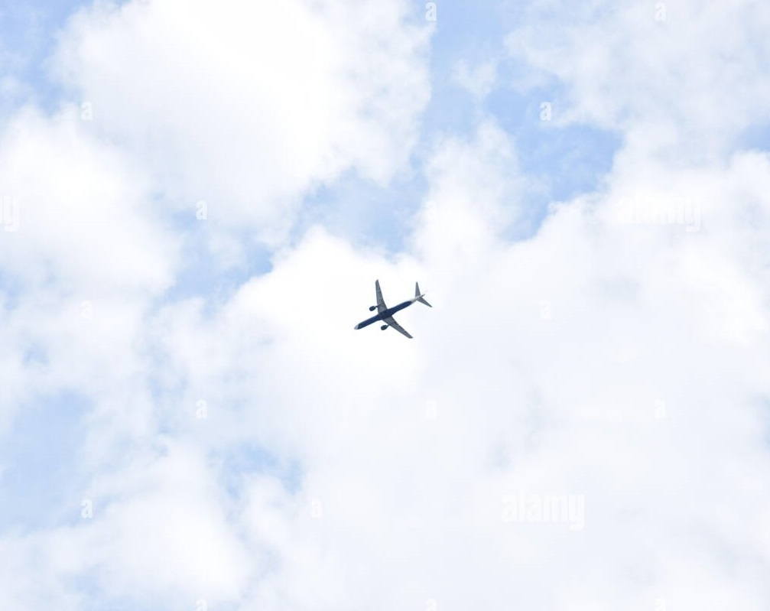

Slide 44
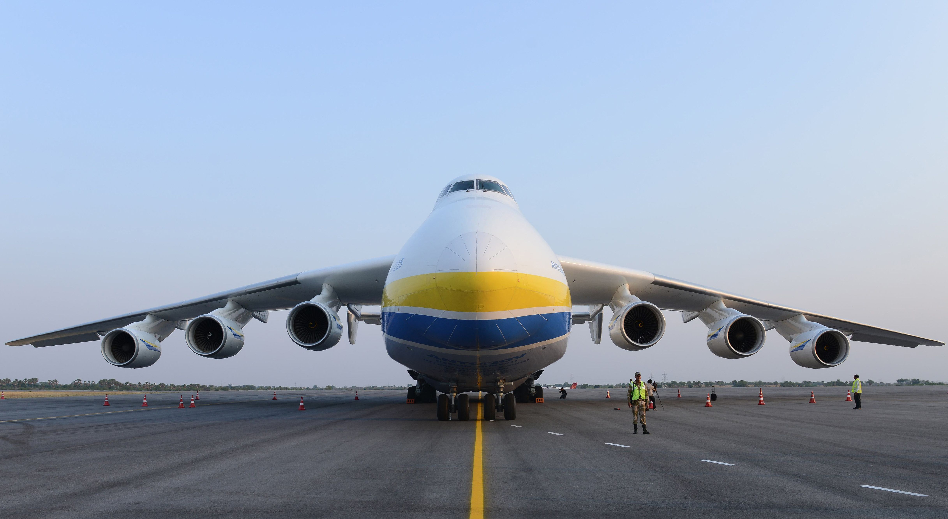

Slide 45
Worship is a lifestyle

Slide 46
When you wake up in the morning, give God praise.
When you are driving to work, give God praise.
When your boss is giving you a piece of their mind, just go ahead and give God praise and worship,
AND watch God do the supernatural on your behalf.

Slide 47
Let go
and
Let God

Slide 48
2 Chronicles 20
¹⁵ Jahaziel said, “King Jehoshaphat, listen! All you who live in Judah and Jerusalem, listen! The Lord says to you, ‘Do not be afraid. Do not lose hope because of this huge army. The battle is not yours. It is God’s. ¹⁶ Tomorrow march down against them. They will be climbing up by the Pass of Ziz. You will find them at the end of the valley in the Desert of Jeruel. ¹⁷ You will not have to fight this battle. Take your positions. Stand firm. You will see how the Lord will save you. Judah and Jerusalem, do not be afraid. Do not lose hope. Go out and face them tomorrow. The Lord will be with you.’ ”
¹⁸ Jehoshaphat bowed down with his face toward the ground. All the people of Judah and Jerusalem also bowed down. They worshiped the Lord. ¹⁹ Then some Levites from the families of Kohath and Korah stood up. They praised the Lord, the God of Israel. They praised him with very loud voices.

Slide 49
²⁰ Early in the morning all the people left for the Desert of Tekoa. As they started out, Jehoshaphat stood up. He said, “Judah, listen to me! People of Jerusalem, listen to me! Have faith in the Lord your God. He’ll take good care of you. Have faith in his prophets. Then you will have success.” ²¹ Jehoshaphat asked the people for advice. Then he appointed men to sing to the Lord. He wanted them to praise the Lord because of his glory and holiness. They marched out in front of the army. They said,
“Give thanks to the Lord.
His faithful love continues forever.”

Slide 50
²² They began to sing and praise him.
Then the Lord hid some men and told them to wait. He wanted them to attack the people of Ammon, Moab and Mount Seir. They had gone into Judah and attacked it. But they lost the battle. ²³ The Ammonites and Moabites rose up against the men from Mount Seir. They destroyed them. They put an end to them. When they finished killing the men from Seir, they destroyed one another.
²⁴ The men of Judah came to the place that looks out over the desert. They turned to look down at the huge army. But all they saw was dead bodies lying there on the ground. No one had escaped.

Slide 51
²⁵ So Jehoshaphat and his men went to carry off their plunder, and they found among them a great amount of equipment and clothing and also articles of value—more than they could take away. There was so much plunder that it took three days to collect it. ²⁶ On the fourth day they assembled in the Valley of Berakah, where they praised the Lord.

Slide 52
Worship Him in ALL circumstances

Slide 53
Paul and Silas

Slide 54
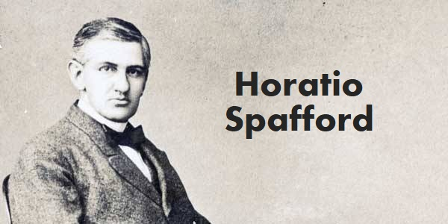

Slide 55
When peace like a river attendeth my way
When sorrows like sea billows roll
Whatever my lot, Thou hast taught me to say
It is well, it is well with my soul

Slide 56
It is well (it is well)
With my soul (with my soul)
It is well, it is well with my soul

Slide 57
Postures of Worship
Standing up (respect)
Bowing down (humility)
Raising hands (victory, surrender, blessing, covering)
Clapping (appreciation, victory, sealing of a contract)

Slide 58
Psalm 100
1 Shout for joy to the LORD, all the earth.
2 Worship the LORD with gladness; come before Him with joyful songs.
3 Know that the LORD is God. It is He who made us, and we are His ; we are His people, the sheep of His pasture.
4 Enter His gates with thanksgiving and His courts with praise; give thanks to Him and praise His name.
5 For the LORD is good and His love endures forever; His faithfulness continues through all generations.

Slide 59
詩 篇 100
（ 稱 謝 詩 。 ） 普 天 下 當 向 耶 和 華 歡 呼 ！
² 你 們 當 樂 意 事 奉 耶 和 華 ， 當 來 向 他 歌 唱 ！
³ 你 們 當 曉 得 耶 和 華 是 神 ！ 我 們 是 他 造 的 ，
也 是 屬 他 的 ； 我 們 是 他 的 民 ，
也 是 他 草 場 的 羊 。
⁴ 當 稱 謝 進 入 他 的 門 ； 當 讚 美 進 入 他 的 院 。
當 感 謝 他 ， 稱 頌 他 的 名 ！
⁵ 因 為 耶 和 華 本 為 善 。 他 的 慈 愛 存 到 永 遠 ；
他 的 信 實 直 到 萬 代 。

Slide 61
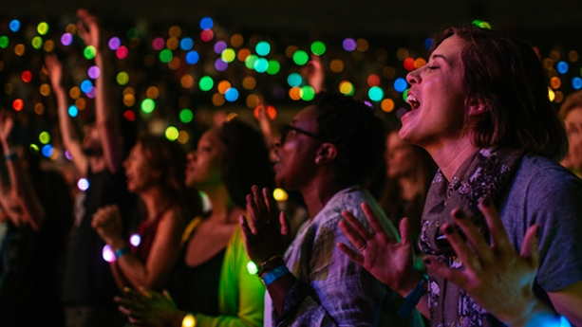

Slide 62
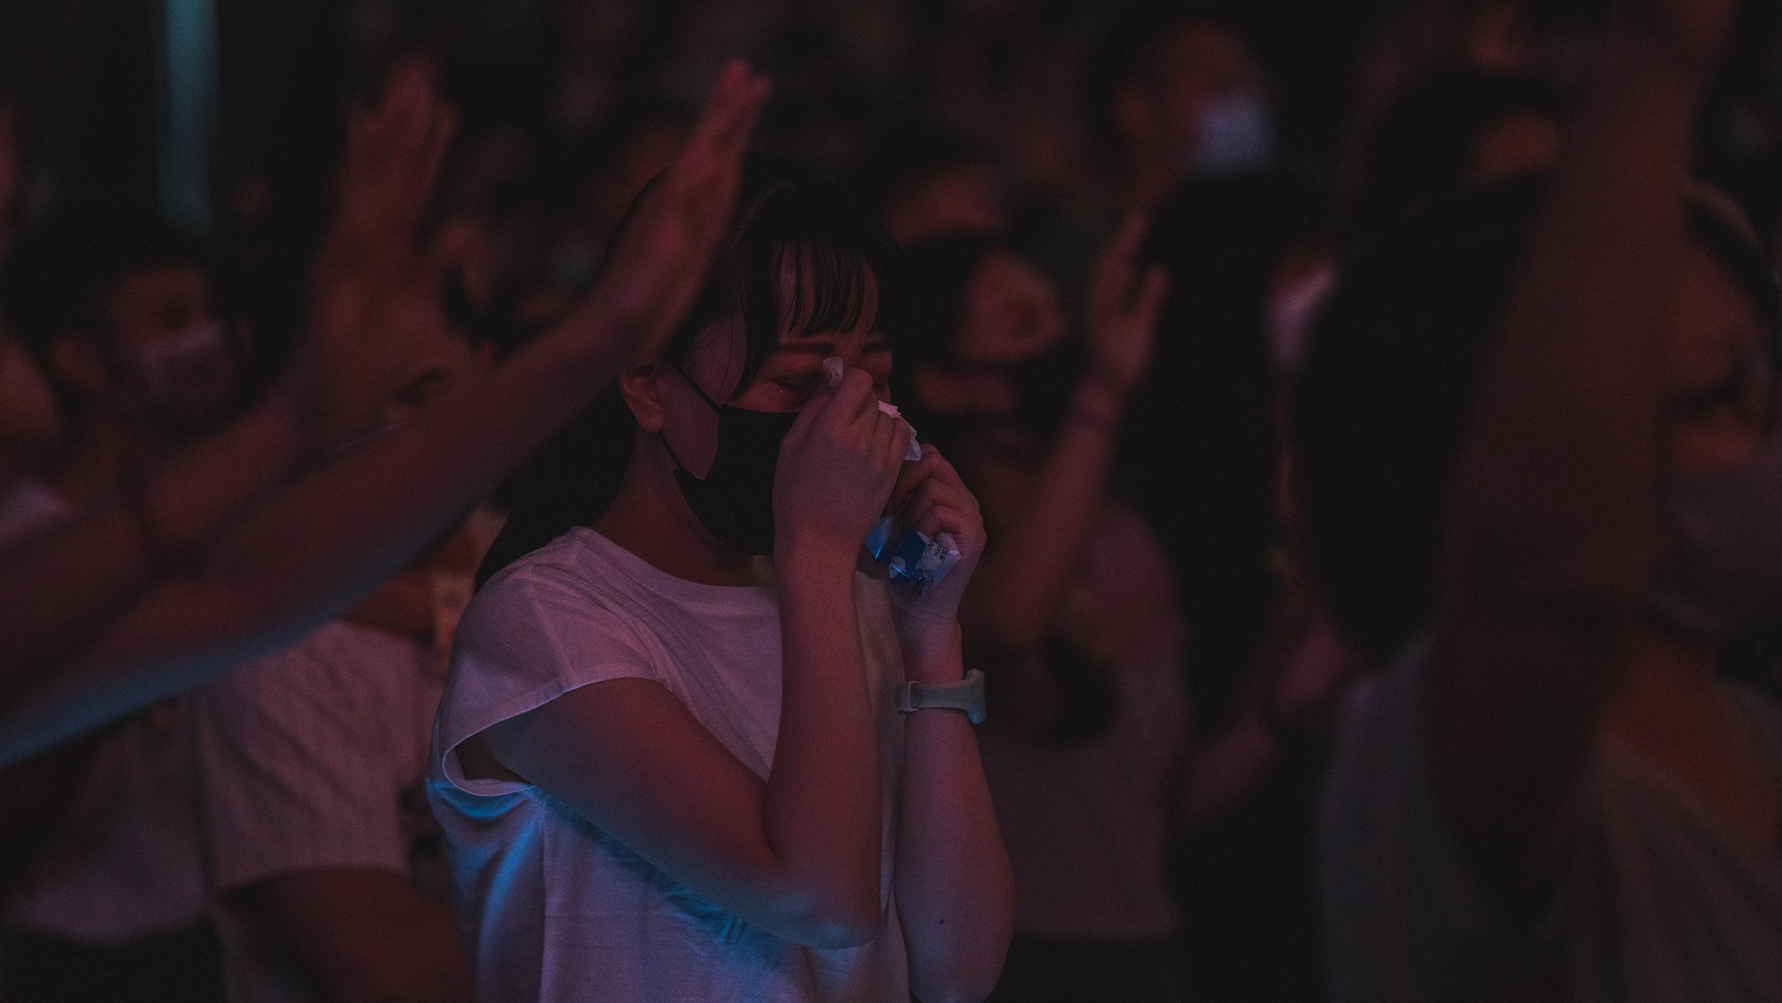

Slide 64
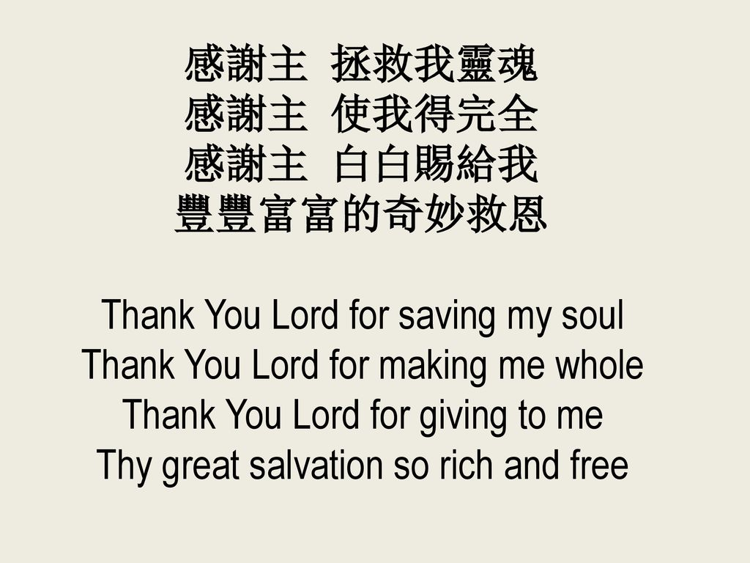

Slide 65
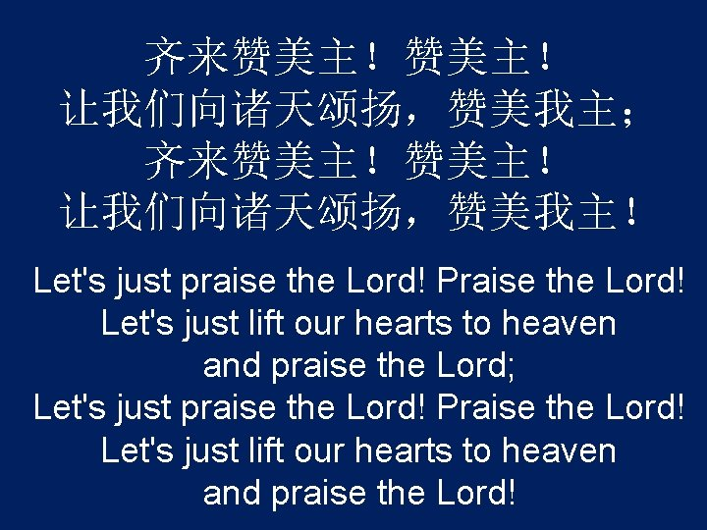

Slide 66
Hallelujah, Hallelujah (4x)
哈利路亞, 哈利路亞 (4x)
Thank you Jesus, Thank you Jesus (4x)
感谢耶稣, 感谢耶稣 (4x)
You are Worthy, You are Worthy (4x)
袮是配得, 袮是配得 (4x)

Slide 67
How Great Is Our God
Notes:
67

Slide 68
The splendor of the King
尊貴榮耀君王
Clothed in majesty
在全地之上
Let all the earth rejoice
願萬民都喜樂
All the earth rejoice
全地都喜樂
Notes:
68

Slide 69
He wraps Himself in light
主祢滿有榮光
And darkness tries to hide
黑暗都躲藏
And trembles at His voice
萬民高聲唱
And trembles at His voice
齊來高聲唱
Notes:
69

Slide 70
How great is our God
我神真偉大
Sing with me
歌頌祢
How great is our God
聖名真偉大
And all will see how great
How great is our God
全地都看見 我神 真偉大
Notes:
70

Slide 71
And age to age He stands
昔在永在君王
And time is in His hands
從今直到永遠
Beginning and the End
祢從不曾改變
Beginning and the End
永存在天地間
Notes:
71

Slide 72
The Godhead three in one
祢是三一真神
Father Spirit Son
父子與聖靈
The Lion and the Lamb
真神的羔羊
The Lion and the Lamb
全能神羔羊
Notes:
72

Slide 73
How great is our God
我神真偉大
Sing with me
歌頌祢聖名
How great is our God
聖名真偉大
And all will see how great
How great is our God
全地都看見 我神真偉大
Notes:
73

Slide 74
Name above all names
祢至聖尊名
Worthy of all praise
配受大讚美
My heart will sing
全心歌頌
How great is our God
我神真偉大
Notes:
74

Slide 75
How great is our God
我神真偉大
Sing with me
歌頌祢聖名
How great is our God
聖名真偉大
And all will see how great
How great is our God
全地都看見 我神 真偉大
Notes:
75

Slide 76
Then sings my soul,
我靈歌唱，
My Savior God to Thee
讚美救主我神
How great Thou art,
祢真偉大,
How great Thou art!
何等偉大!
Notes:
76

Slide 77
O Lord my God! When I in awesome wonder
主啊我神！我每逢舉目觀看，
Consider all the worlds Thy Hands have made,
祢手所造 一切奇妙大工；
I see the stars, I hear the rolling thunder,
看見星宿，又聽到隆隆雷聲，
Thy power throughout the universe displayed;
祢的大能 遍滿了宇宙中。
Notes:
77

Slide 78
Then sings my soul,
我靈歌唱，
My Savior God to Thee
讚美救主我神
How great Thou art,
祢真偉大,
How great Thou art!
何等偉大!
Notes:
78

Slide 79
How great is our God
我神真偉大
Sing with me
歌頌祢聖名
How great is our God
聖名真偉大
And all will see how great
How great is our God
全地都看見 我神 真偉大
Notes:
79

Slide 80

同心禱告

