Slide 1

主日信息
Sunday Sermon

Slide 2

今生若比永恆長
Life Is Short At Best
波特蘭靈糧堂
October 9, 2022

Slide 3
傳道書 Ecclesiastes 3:11
神造萬物，各按其時成為美好，又將永生（原文是永遠）安置在世人心裡。 然而 神從始至終的作為，人不能參透。
He has made everything beautiful in its time. Also, he has put eternity into man's heart, yet so that he cannot find out what God has done from the beginning to the end.

Slide 4
播放詩歌
「今生若比永恆長」

Slide 5
傳道書 Ecclesiastes 3:22
故此，我見人莫強如在他經營的事上喜樂，因為這是他的分。 他身後的事誰能使他回來得見呢？
I have seen that nothing is better than that man should be happy in his activities, for that is his lot. For who will bring him to see what will occur after him?

Slide 6


時間？

Slide 7
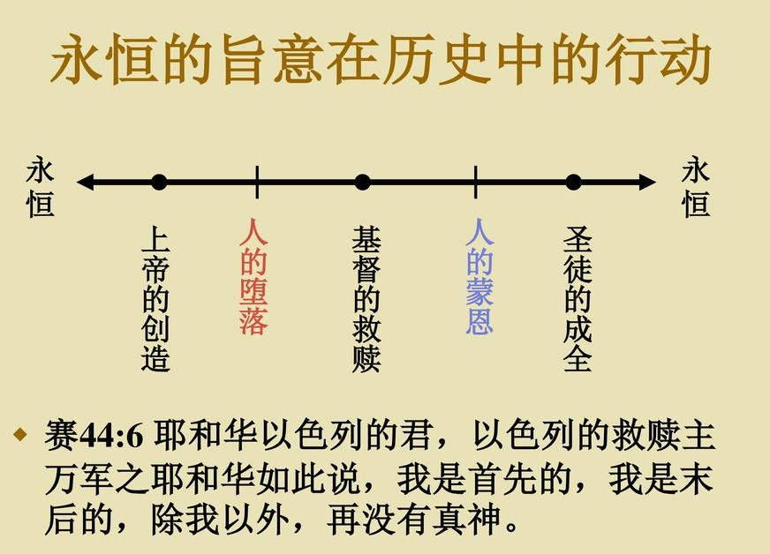

Slide 8
利未記 Leviticus 26:12
我要在你們中間行走；我要作你們的 神，你們要作我的子民。
And I will walk among you and will be your God, and you shall be my people.

Slide 9
啟示錄 Revelation 21:2-3
我又看見聖城新耶路撒冷由 神那裡從天而降，預備好了，就如新婦妝飾整齊，等候丈夫。 我聽見有大聲音從寶座出來說：「看哪， 神的帳幕在人間。 他要與人同住，他們要作他的子民。 神要親自與他們同在，作他們的 神。
3 And I heard a loud voice from the throne saying, “Behold, the dwelling place of God is with man. He will dwell with them, and they will be his people, and God himself will be with them as their God.

Slide 10

真實的我

Slide 11
哥林多後書 2 Corinthians 5:19-20
這就是神在基督裡，叫世人與自己和好，不將他們的過犯歸到他們身上，並且將這和好的道理託付了我們。 所以，我們作基督的使者，就好像神藉我們勸你們一般。我們替基督求你們與神和好。
that is, in Christ God was reconciling[a] the world to himself, not counting their trespasses against them, and entrusting to us the message of reconciliation. Therefore, we are ambassadors for Christ, God making his appeal through us. We implore you on behalf of Christ, be reconciled to God.

Slide 12
恩典 + 真理 + 時間
好時間 vs 壞時間

Slide 13

以弗所書 Ephesians 4:13
直等到我們眾人在真道上同歸於一，認識 神的兒子，得以長大成人，滿有基督長成的身量，
until we all attain to the unity of the faith and of the knowledge of the Son of God, to mature manhood, to the measure of the stature of the fullness of Christ,

Slide 14
雅各書 James 1:2-4
我的弟兄們，你們落在百般試煉中，都要以為大喜樂；因為知道你們的信心經過試驗，就生忍耐。 但忍耐也當成功，使你們成全、完備，毫無缺欠。
Consider it all joy, my brethren, when you encounter various trials, knowing that the testing of your faith produces [b]endurance. And let endurance have its perfect result, so that you may be perfect and complete, lacking in nothing.

Slide 15
恩典 + 真理 + 時間
好時間 vs 壞時間

Slide 16
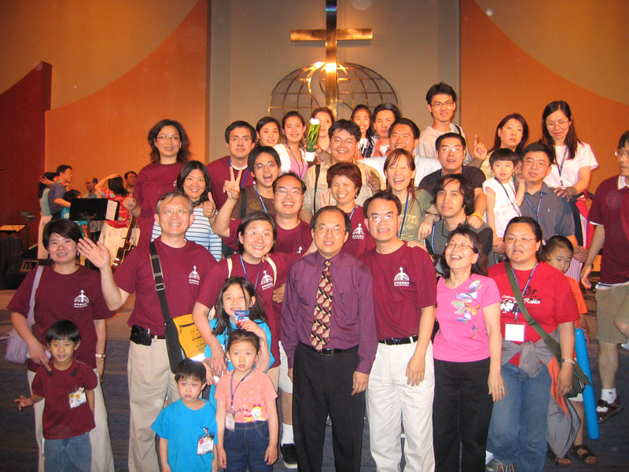

Slide 17
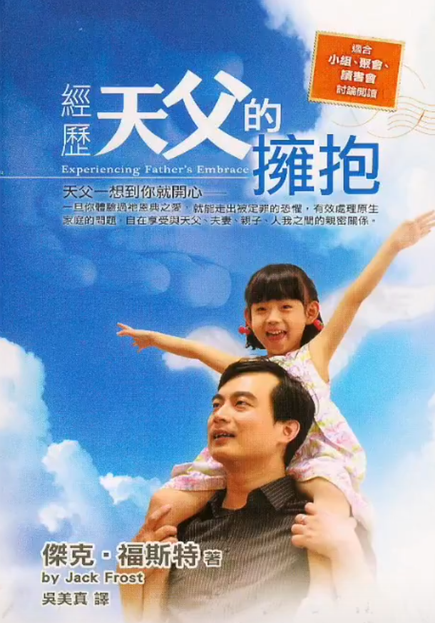


Slide 18
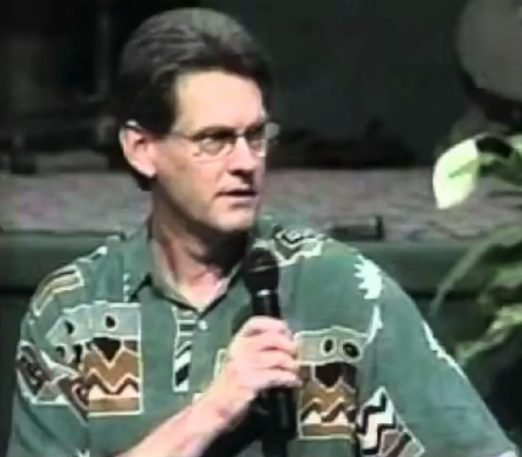
1975 – Jack 與妻 Tricia 結婚
1980 – 遇見神的愛, 從毒癮、酗酒、色情癮得釋放
1984 – 牧養南卡州一個小教會; 快速成長
1986 – 承認需要、接受深度醫治禱告服事
1988 – 擔任北卡州 Evangel Church 教會副牧師
1991 – 辭去牧師職位，創立 Shiloh Place 事工
1995 – 兒子和女兒不理父親，特會經歷天父的擁抱
Jack Frost
牧師

Slide 19
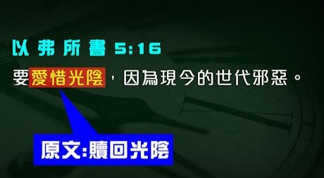
Redeeming the time

Slide 20
全人救贖

Slide 21
帖撒羅尼迦前書 1 Thessalonians 5:23
願賜平安的 神親自使你們全然成聖！ 又願你們的靈與魂與身子得蒙保守，在我們主耶穌基督降臨的時候，完全無可指摘！
Now may the God of peace himself sanctify you completely, and may your whole spirit and soul and body be kept blameless at the coming of our Lord Jesus Christ.

Slide 22
回應詩歌
「親愛耶穌 醫治救主」

Slide 23
同心禱告

