Slide 1

同領聖餐 Holy Communion

Slide 2
哥林多前書 1 Corinthians 11:23-24
主耶穌被賣的那一夜，拿起餅來， 祝謝了，就擘開，說：「這是我的身體，為你們捨的，你們應當如此行，為的是記念我。」
The Lord Jesus, on the night he was betrayed, took bread, and when he had given thanks, he broke it and said, “This is my body, which is for you; do this in remembrance of me.”

Slide 3
哥林多前書 1 Corinthians 11:25
飯後，也照樣拿起杯來，說：「這杯是用我的血所立的新約，你們每逢喝的時候，要如此行，為的是記念我。」
In the same way, after supper he took the cup, saying, “This cup is the new covenant in my blood; do this, whenever you drink it, in remembrance of me.”

Slide 4
哥林多前書 1 Corinthians 11:26, 28
你們每逢吃這餅，喝這杯，是表明主的死，直等到他來。
For whenever you eat this bread and drink this cup, you proclaim the Lord’s death until he comes.
人應當自己省察，然後吃這餅、喝這杯。
Everyone ought to examine themselves before they eat of the bread and drink from the cup.

Slide 5
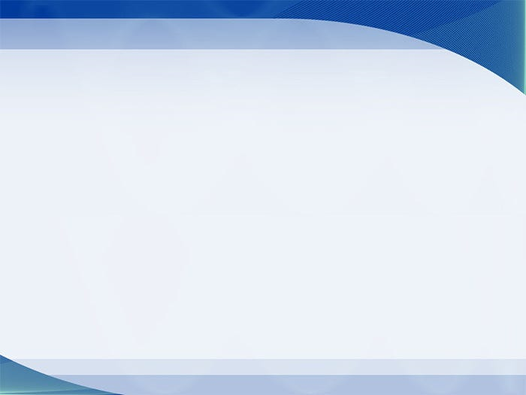
教會的理事會財務報告

Slide 6
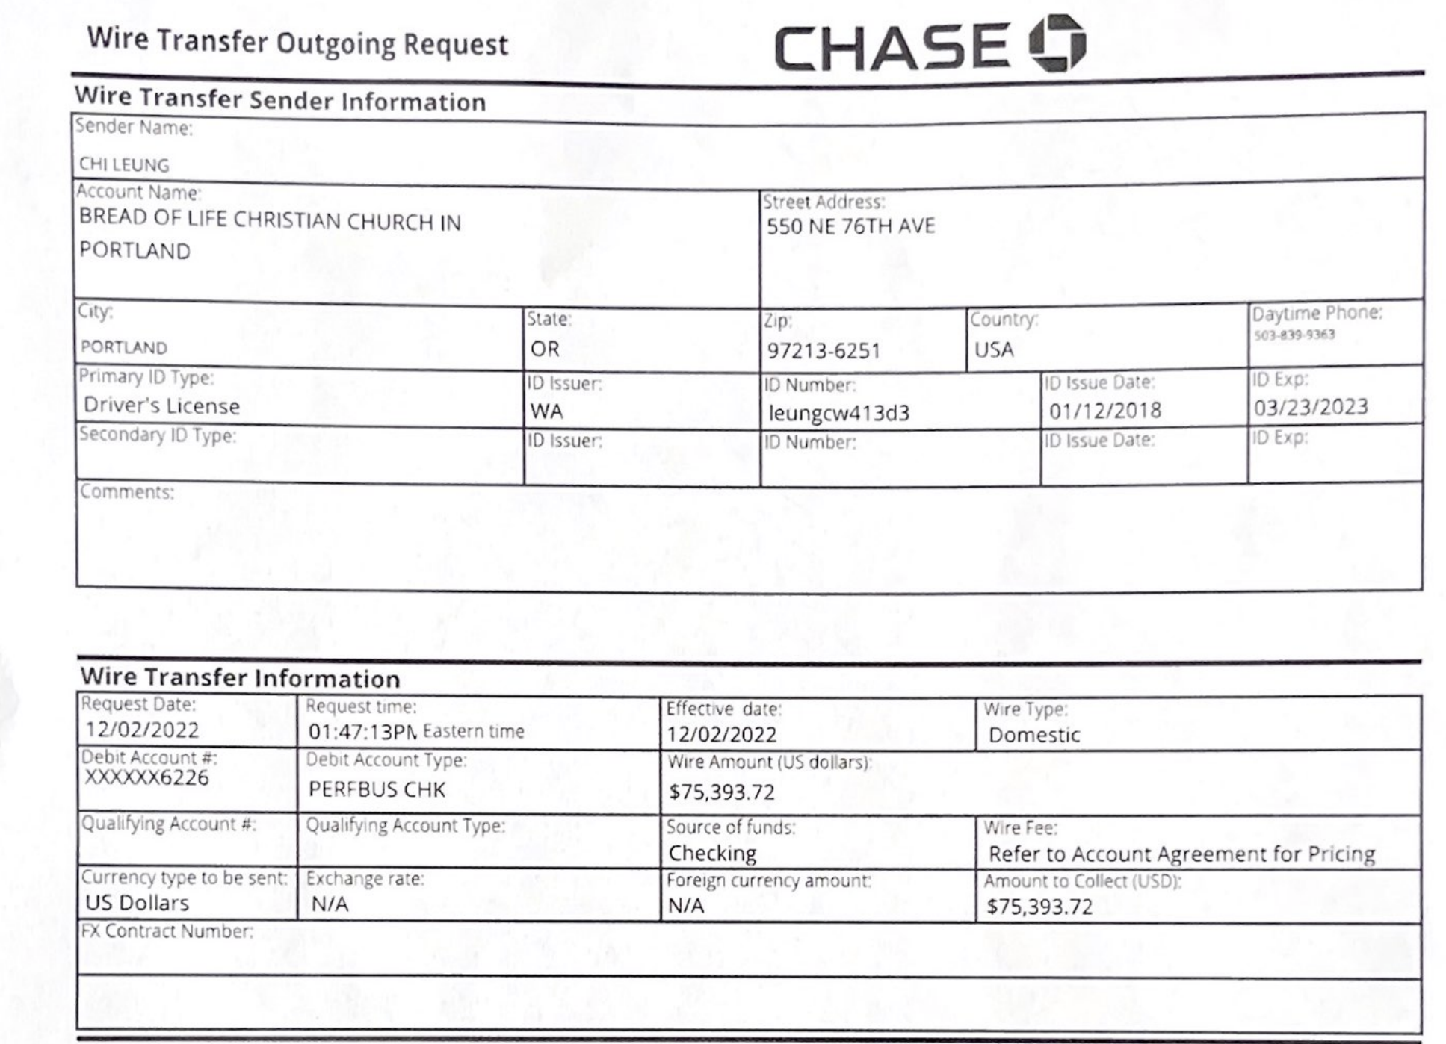
$75,393.72

Slide 7
見證分享
Testimony Sharing
Emma 林蓉姿 姐妹

Slide 8
忘記背後，努力面前的，
向著標杆直跑！
Forget What Is Behind，
Strain toward What Is Ahead,
Press on toward the Goal!

Slide 9
信心之父 – 亞伯拉罕

Slide 10
加拉太書 3：6-7
正如『亞伯拉罕信神，這就算為他的義』。所以，你們要知道：那以信為本的人，就是亞伯拉罕的子孫。
So also Abraham “believed God, and it was credited to him as righteousness.” Understand, then, that those who have faith are children of Abraham.

Slide 11
創世記 12：10-13
那地遭遇饑荒。因饑荒甚大，亞伯蘭就下埃及去，要在那裡暫居。 將近埃及，就對他妻子撒萊說：我知道你是容貌俊美的婦人。埃及人看見你必說：這是他的妻子，他們就要殺我，卻叫你存活。求你說，你是我的妹子，使我因你得平安，我的命也因你存活。

Slide 12
Genesis 12：10-13
Now there was a famine in the land, and Abram went down to Egypt to live there for a while because the famine was severe. As he was about to enter Egypt, he said to his wife Sarai, “I know what a beautiful woman you are. When the Egyptians see you, they will say, ‘This is his wife.’ Then they will kill me but will let you live. Say you are my sister, so that I will be treated well for your sake and my life will be spared because of you.”

Slide 13
創世記 20：1-2
亞伯拉罕從那裡向南地遷去，寄居在加低斯和書珥中間的基拉耳。亞伯拉罕稱他的妻撒拉為妹子，基拉耳王亞比米勒差人把撒拉取了去。
Now Abraham moved on from there into the region of the Negev and lived between Kadesh and Shur. For a while he stayed in Gerar, ² and there Abraham said of his wife Sarah, “She is my sister.” Then Abimelek king of Gerar sent for Sarah and took her.

Slide 14
詩篇 Psalms 103:8-10
耶和華有憐憫，有恩典，不輕易發怒，且有豐盛的慈愛。祂不長久責備，也不永遠懷怒。祂沒有按我們的罪過待我們，也沒有照我們的罪孽報應我們。
The Lord is compassionate and gracious,
slow to anger, abounding in love.
He will not always accuse,
nor will he harbor his anger forever;
he does not treat us as our sins deserve
or repay us according to our iniquities.

Slide 15
詩篇 Psalms 103:11-12
天離地何等的高，祂的慈愛向敬畏祂的人也是何等的大！東離西有多遠，祂叫我們的過犯離我們也有多遠！
For as high as the heavens are above the earth,
so great is his love for those who fear him;
as far as the east is from the west,
so far has he removed our transgressions from us.

Slide 16
詩篇 Psalms 103:13-14
父親怎樣憐恤他的兒女，耶和華也怎樣憐恤敬畏祂的人！因為祂知道我們的本體，思念我們不過是塵土。
As a father has compassion on his children,
so the Lord has compassion on those who fear him;
for he knows how we are formed,
he remembers that we are dust.

Slide 17
腓立比書 Philippians 3:13-14
弟兄們，我不是以為自己已經得著了；我只有一件事，就是忘記背後，努力面前的，向著標竿直跑，要得神在基督耶穌裡從上面召我來得的獎賞。
Brothers and sisters, I do not consider myself yet to have taken hold of it. But one thing I do: Forgetting what is behind and straining toward what is ahead, I press on toward the goal to win the prize for which God has called me heavenward in Christ Jesus.

Slide 18
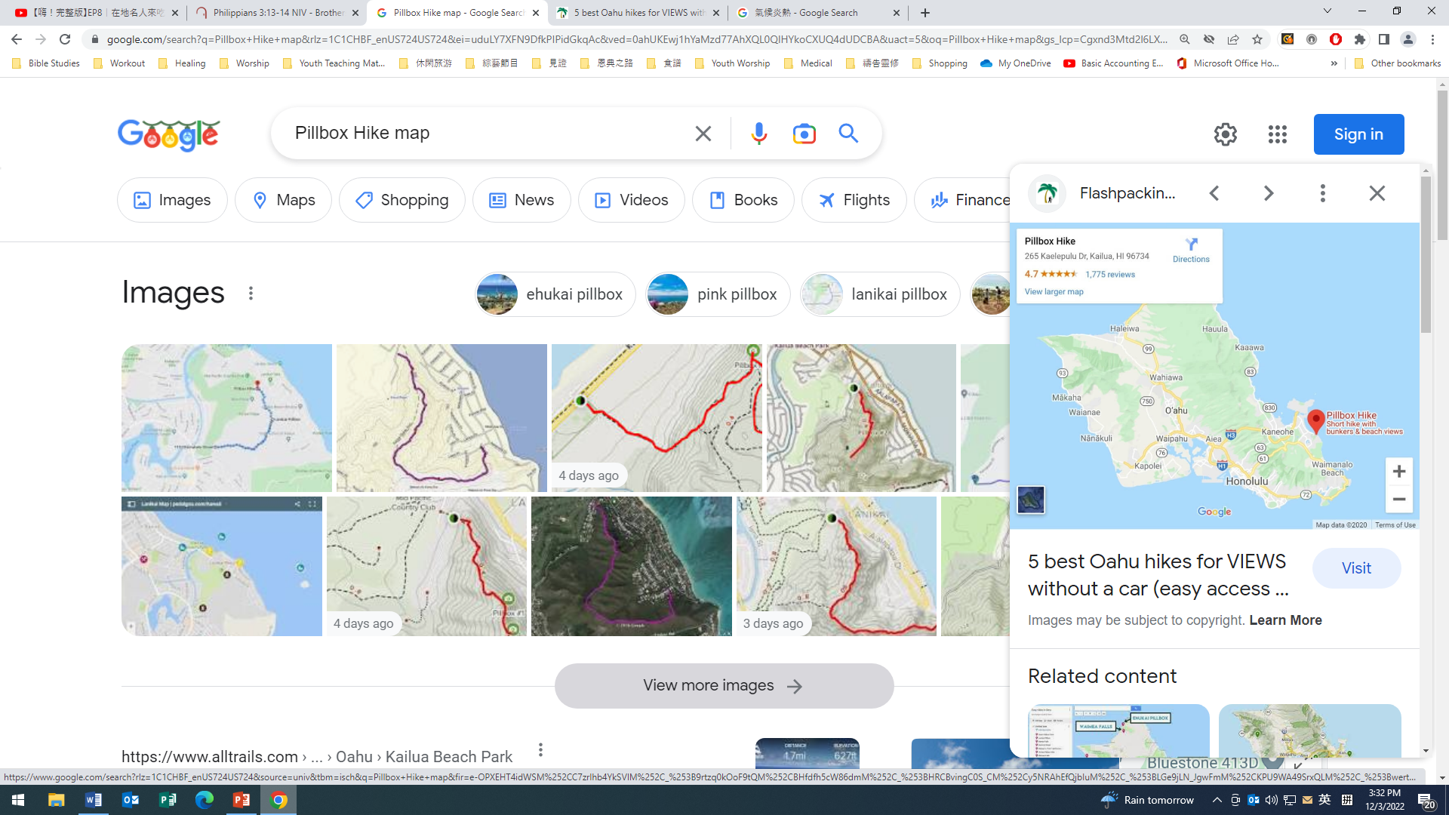

Slide 19
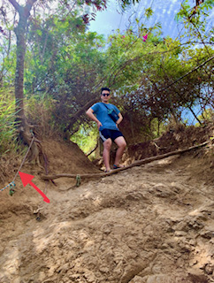

Slide 20


Slide 21

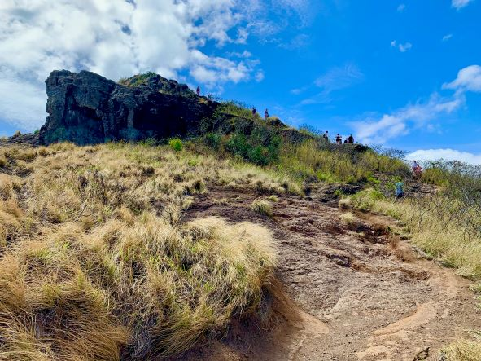

Slide 22
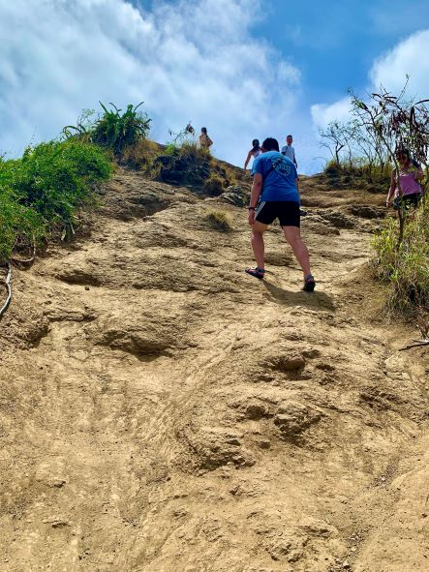
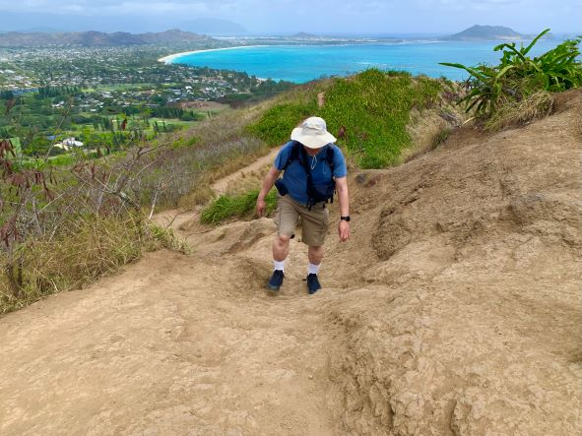

Slide 23
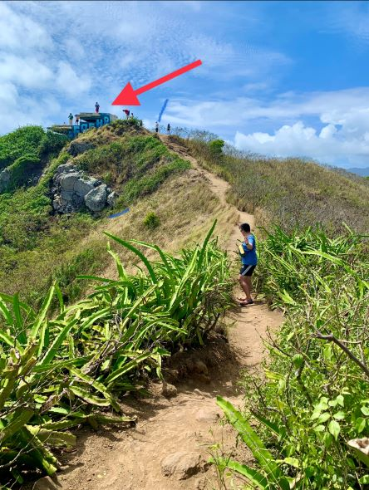

Slide 24
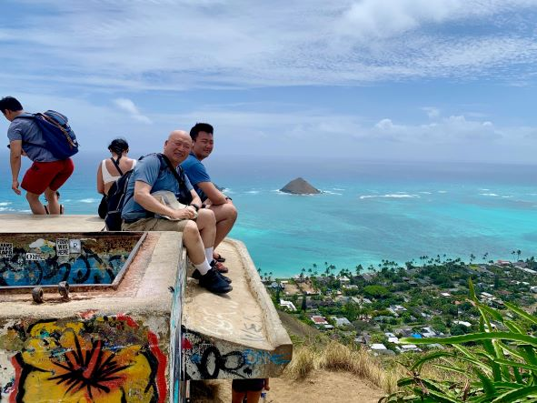

Slide 25
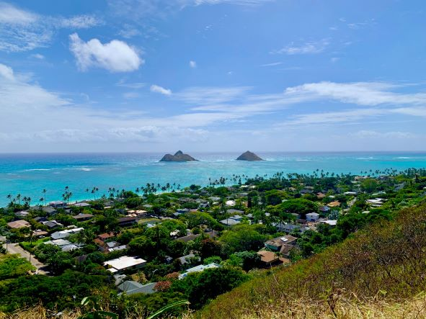


Slide 26
以弗所書 Ephesians 3：20
神能照著運行在我們心裡的大力，充充足足地成就一切，超過我們所求所想的。
Now to him who is able to do immeasurably more than all we ask or imagine, according to his power that is at work within us.

Slide 27
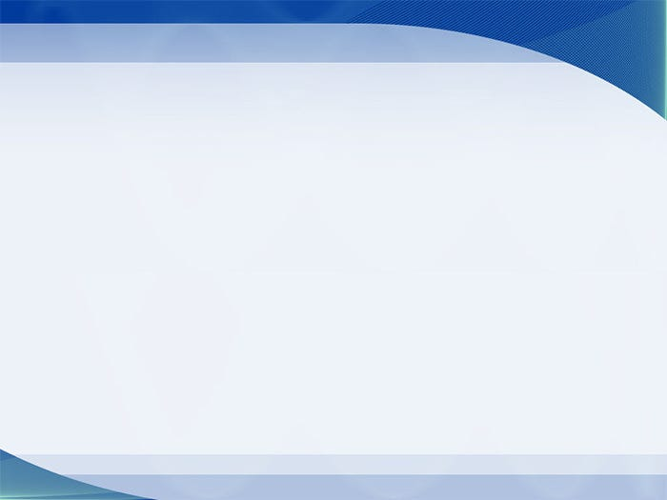
主日信息
Sunday Sermon

Slide 28
為信仰立界線
Boundaries for Faith
波特蘭靈糧堂
December 4, 2022

Slide 29
羅馬書 Romans 1:14-16
我不以福音為恥；這福音本是 神的大能，要救一切相信的，先是猶太人，後是希臘人。
For I am not ashamed of the gospel, because it is the power of God that brings salvation to everyone who believes: first to the Jew, then to the Gentile.

Slide 30
Play video
「基督徒參與台灣選舉」

Slide 31
界線 Boundaries
界線界定了每個人獨立的身分：我們是什麼，不是什麼；喜歡什麼，不喜歡什麼；想要什麼，不想要什麼。
三位一體獨一的真神是相連合一的，祂們彼此之間也是有界限與個別的本質的。
我們是按照 神的形象造的，我們應與他人相連結而不失去自己本體的身分、意志、感覺與個體特質

Slide 32
界線 Boundaries
界線界定了每個人獨立的身分：我們是什麼，不是什麼；喜歡什麼，不喜歡什麼；想要什麼，不想要什麼。
三位一體獨一的真神是相連合一的，祂們彼此之間也是有界限與個別的本質的。
我們是按照 神的形象造的，我們應與他人相連結而不失去自己本體的身分、意志、感覺與個體特質

Slide 33
界線 Boundaries
界線界定了每個人獨立的身分：我們是什麼，不是什麼；喜歡什麼，不喜歡什麼；想要什麼，不想要什麼。
三位一體獨一的真神是相連合一的，祂們彼此之間也是有界限與個別的本質的。
我們是按照 神的形象造的，我們應與他人相連結而不失去自己本體的身分、意志、感覺與個體特質

Slide 34
界線 Boundaries
界線界定了每個人獨立的身分：我們是什麼，不是什麼；喜歡什麼，不喜歡什麼；想要什麼，不想要什麼。
三位一體獨一的真神是相連合一的，祂們彼此之間也是有界限與個別的本質的。
我們是按照 神的形象造的，我們應與他人相連結而不失去自己本體的身分、意志、感覺與個體特質

Slide 35
界線的分類 Categories of Boundaries
身體上的界線 physical
心理上的界線 psychological
情緒上的界線 emotional
屬靈上的界線 spiritual

Slide 36
你才是「老大」 You are the ‘boss’

Slide 37
對別人設立界線是否「太沒愛心？」

Slide 38
約書亞記 Joshua 24:14-15
「現在你們要敬畏耶和華，誠心實意地事奉他，將你們列祖在大河那邊和在埃及所事奉的神除掉，去事奉耶和華。 若是你們以事奉耶和華為不好，今日就可以選擇所要事奉的：是你們列祖在大河那邊所事奉的神呢？是你們所住這地的亞摩利人的神呢？至於我和我家，我們必定事奉耶和華。」
15 But if serving the Lord seems undesirable to you, then choose for yourselves this day whom you will serve, whether the gods your ancestors served beyond the Euphrates, or the gods of the Amorites, in whose land you are living. But as for me and my household, we will serve the Lord.

Slide 39
界線的要素 The Essence of Boundaries
主動營造
被動默許

Slide 40
羅馬書 Romans 12:2
不要效法這個世界，只要心意更新而變化，叫你們察驗何為 神的善良、純全、可喜悅的旨意。
Do not conform to the pattern of this world, but be transformed by the renewing of your mind. Then you will be able to test and approve what God’s will is—his good, pleasing and perfect will.

Slide 41
「台灣地區的弟兄姊妹们，在相對不算長的時間（約10年），了解必須関心、參與、投身公共事務，禱告與行動並重，而許多的牧者也發揮帶頭作用，促進跨越教派、區域的合一，尤其在積極推動 RPG 之後，在 2022 中期選舉，成績斐然。 這是符合耶穌對 Ekklesia （original design for church) 的教導。 感謝讚美主！」
─ 台灣的一位代禱者

Slide 42
回應詩歌
「渴望復興的火」

