Slide 1

主日信息
Sunday Sermon

Slide 2

道成了肉身
The Word Became Flesh
波特蘭靈糧堂
December 25, 2022

Slide 3
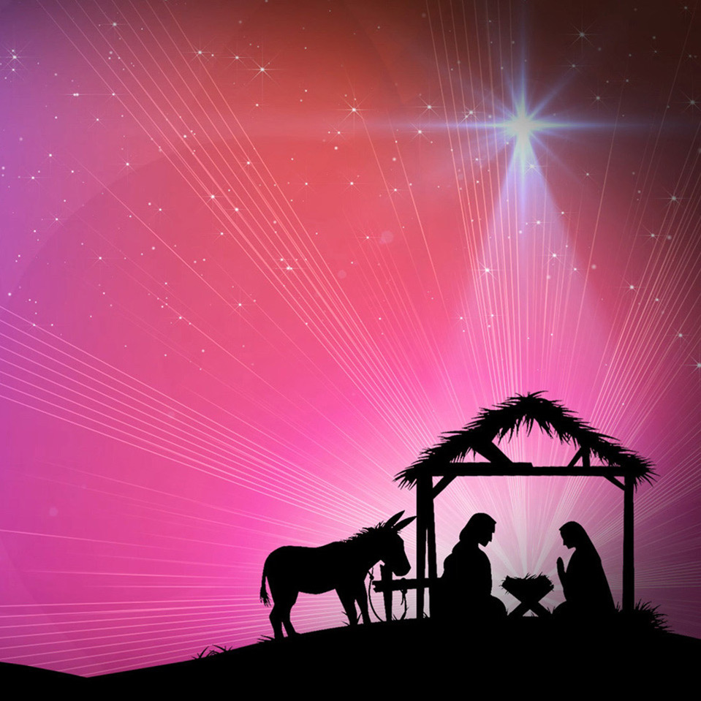
道成了肉身，住在我們中間，
充充滿滿地有恩典有真理。

Slide 4
約翰福音‬ John 1:14,16,17
道成了肉身，住在我們中間，充充滿滿地有恩典有真理。 我們也見過他的榮光，正是父獨生子的榮光。
從他豐滿的恩典裡，我們都領受了，而且恩上加恩。
律法本是藉著摩西傳的；恩典和真理都是由耶穌基督來的。
And the Word became flesh, and dwelt among us, and we saw His glory, glory as of the only begotten from the Father, full of grace and truth.
For of His fullness we have all received, and grace upon grace.
For the Law was given through Moses; grace and truth were realized through Jesus Christ.

Slide 5
恩典 Grace
恩典是完全的饒恕、接納和犧牲給予，是白白得來，而不是靠努力表現可以賺取的。 宇宙中最偉大的恩典就是基督十字架赦罪使信靠祂的人能得到永生的救恩。
Grace is perfect forgiveness, acceptance, sacrificial giving, unmerited blessings. The greatest Grace in the universe is Jesus’ Salvation by dying on the cross for those who believe in Him to receive eternal life.

Slide 6
真理 Truth
真理就是基督的彰顯。 主耶穌說祂就是道路、
真理和生命。 在聖經中，真理講的是 神的標準、神做事的法則，是我們內在生命的規範，而不像宗教律法只是針對表面的行為。
Truth is the manifestation of Jesus as He is the Way, the Truth, and the Life. Biblically, truth refers to God’s standard, the principles of His deeds, and guidance for our inner life.

Slide 7
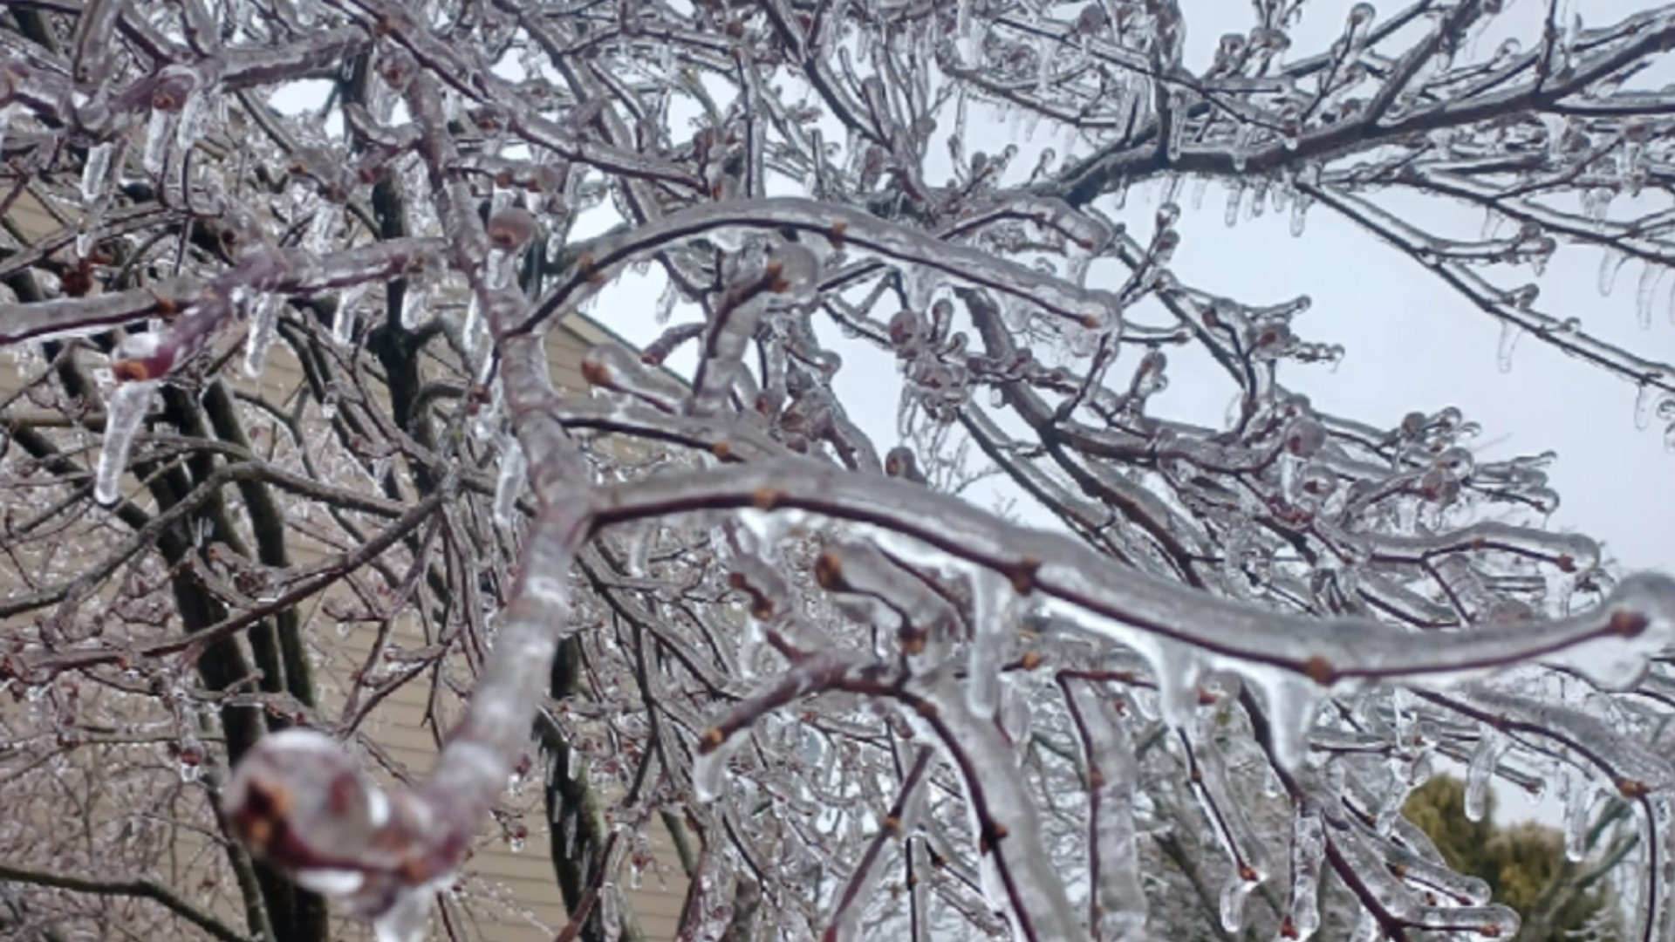
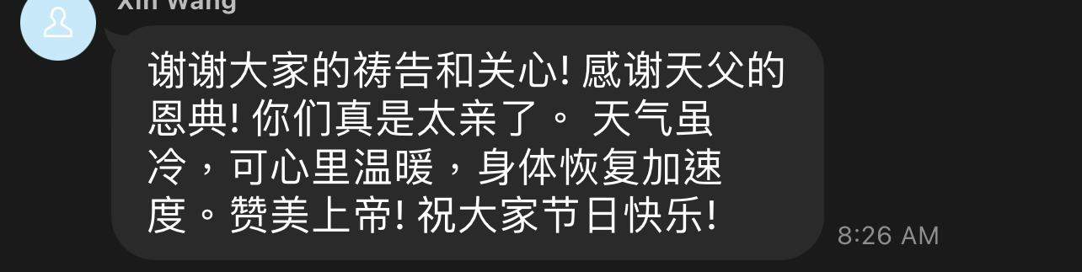

Slide 8
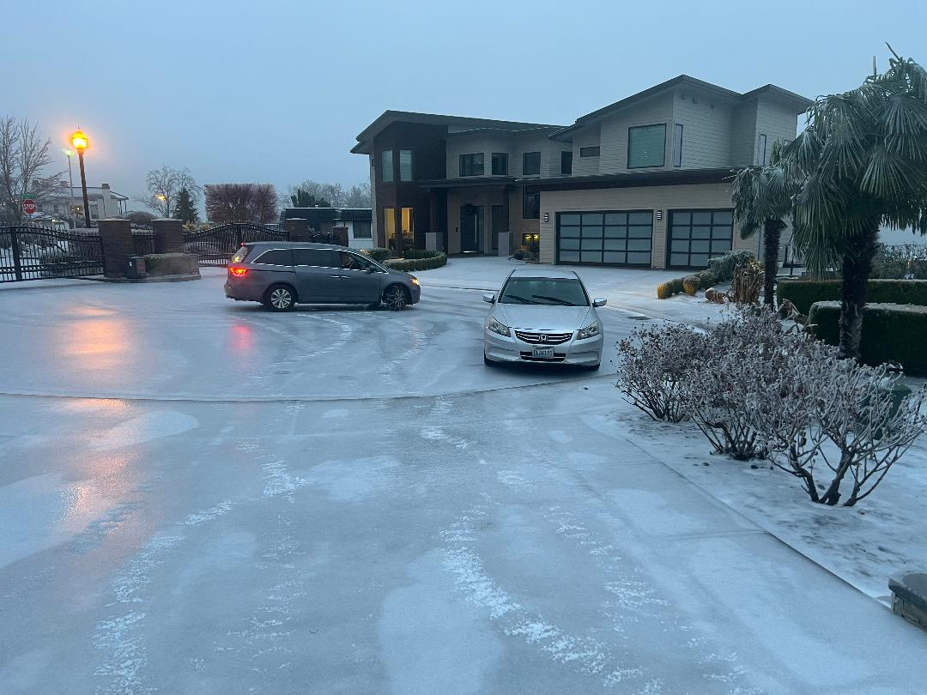

Slide 9
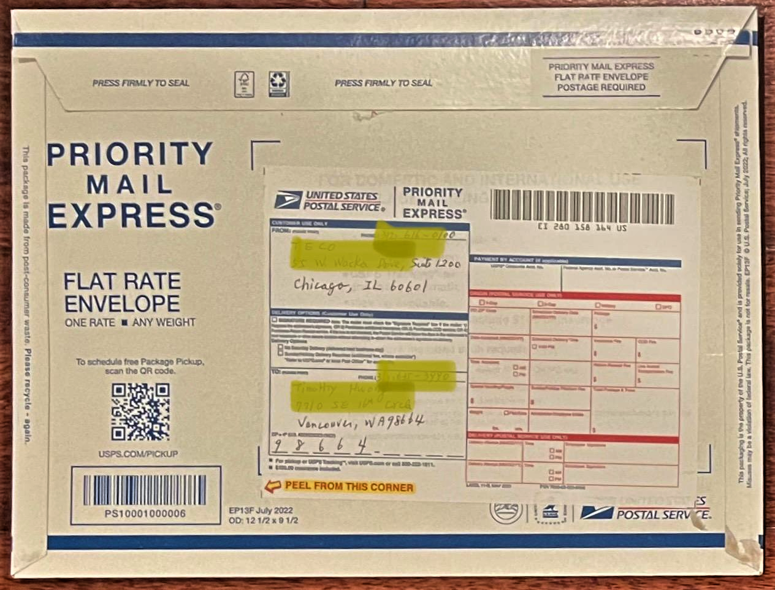

Slide 10
聖誕「快樂」 Merry Christmas
新年「快樂」 Happy New Year

Slide 11


Slide 12
快樂 Happy
不快樂 Unhappy

Slide 13
希伯來書 Hebrews 11:15-16
他們若想念所離開的家鄉，還有可以回去的機會。
他們卻羨慕一個更美的家鄉，就是在天上的。 所以 神被稱為他們的 神，並不以為恥，因為他已經給他們預備了一座城。
If they had been thinking of the country they had left, they would have had opportunity to return. Instead, they were longing for a better country—a heavenly one.
Therefore God is not ashamed to be called their God, for he has prepared a city for them.

Slide 14
哥林多後書 2 Corinthians 4:18
原來我們不是顧念所見的，乃是顧念所不見的；因為所見的是暫時的，所不見的是永遠的。
So we fix our eyes not on what is seen, but on what is unseen, since what is seen is temporary, but what is unseen is eternal.

Slide 15
回應詩歌
「愛中相遇」

Slide 16
介紹青少年
BOLIP Youth Update

Slide 17
青少年短劇
Skit by BOLIP Youth
“A New Home for Christmas”
「耶誕節的新家」

