Slide 1

主日信息
Sunday Sermon

Slide 2

不再是翻新的生命
No Longer A Refurbished Life
波特蘭靈糧堂
January 8, 2023

Slide 3

Refurbished 翻新

Slide 4
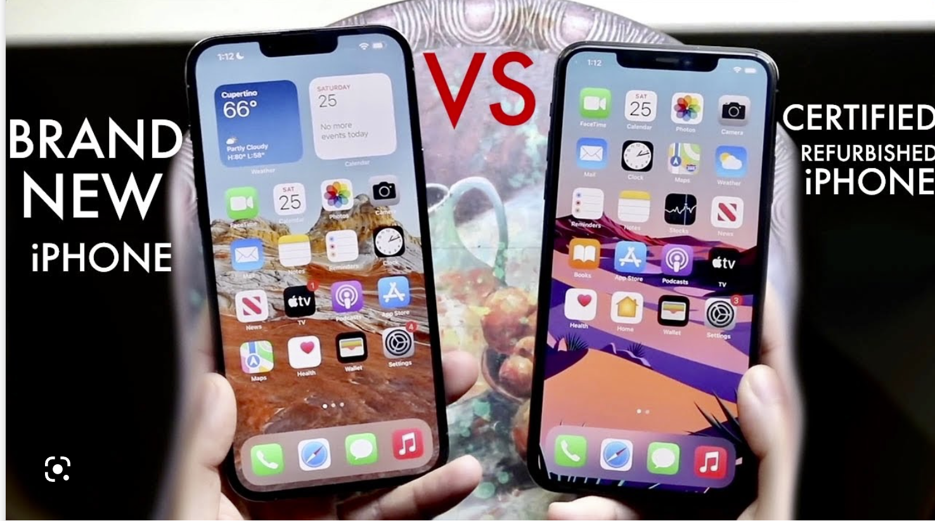

Slide 5
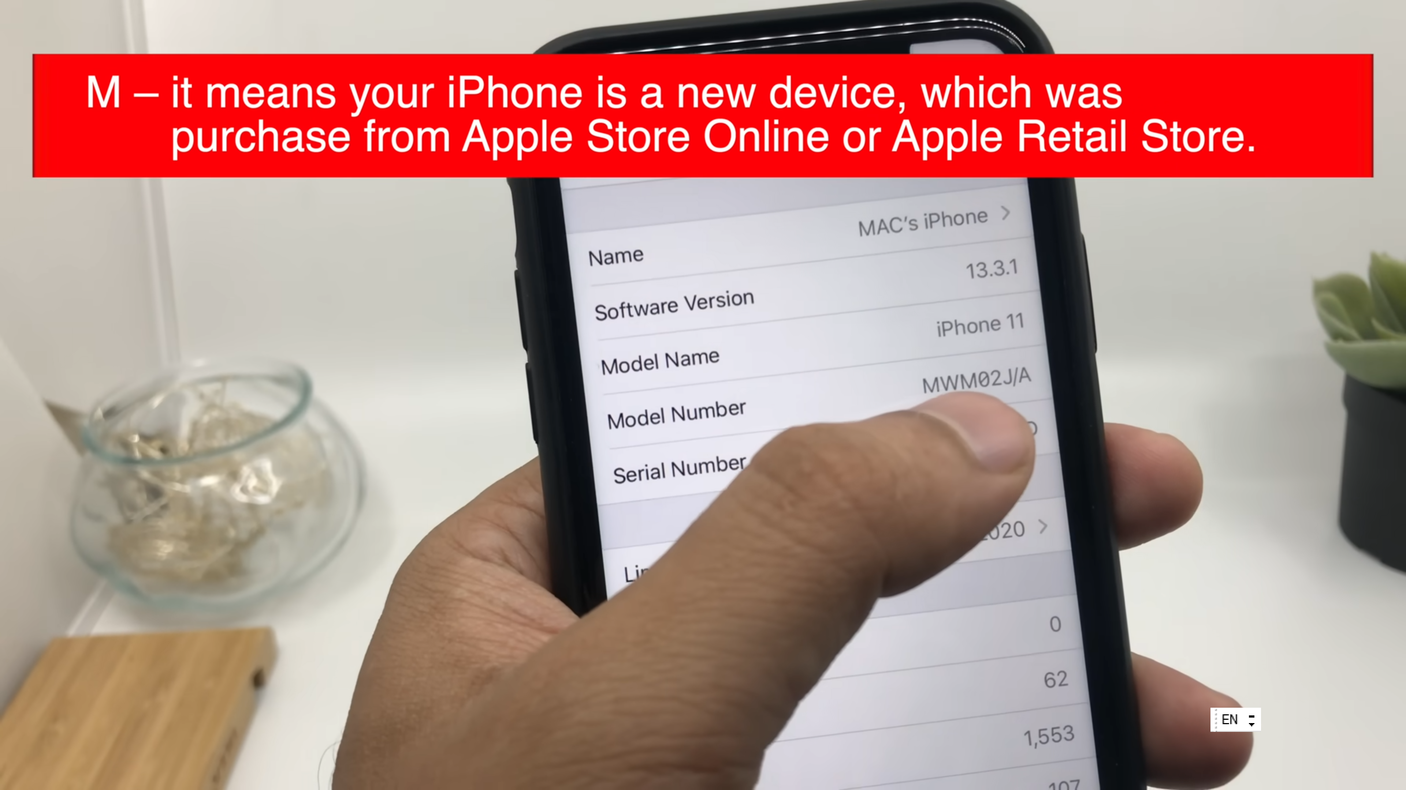

Slide 6
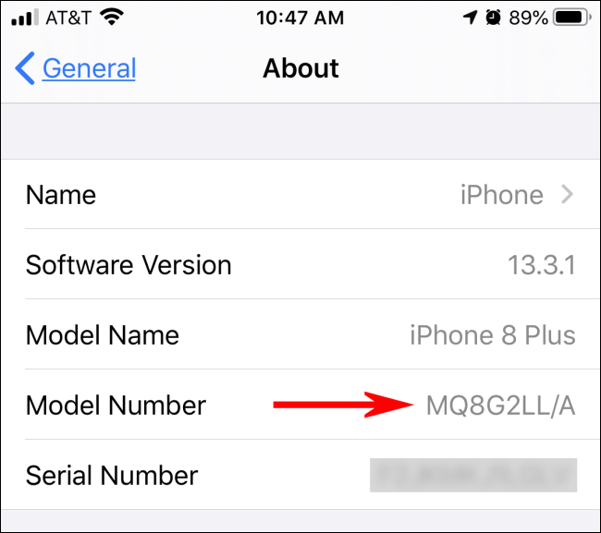
M, F

Slide 7
約翰福音‬ John 3:3-5
耶穌回答說：「我實實在在地告訴你，人若不重生，就不能見 神的國。」尼哥底母說：「人已經老了，如何能重生呢？ 豈能再進母腹生出來嗎？」耶穌說：「我實實在在地告訴你，人若不是從水和聖靈生的，就不能進 神的國。
Jesus replied, “Very truly I tell you, no one can see the kingdom of God unless they are born again.” “How can someone be born when they are old?” Nicodemus asked. “Surely they cannot enter a second time into their mother’s womb to be born!” Jesus answered, “Very truly I tell you, no one can enter the kingdom of God unless they are born of water and the Spirit.

Slide 8
以西結書‬ Ezekiel 36:26-27
我也要賜給你們一個新心，將新靈放在你們裡面，又從你們的肉體中除掉石心，賜給你們肉心。 我必將我的靈放在你們裡面，使你們順從我的律例，謹守遵行我的典章。
I will give you a new heart and put a new spirit in you; I will remove from you your heart of stone and give you a heart of flesh. And I will put my Spirit in you and move you to follow my decrees and be careful to keep my laws.

Slide 9
使徒行傳 Acts 1:4-5
耶穌和他們聚集的時候，囑咐他們說：「不要離開耶路撒冷，要等候父所應許的，就是你們聽見我說過的。 約翰是用水施洗，但不多幾日，你們要受聖靈的洗。」
On one occasion, while he was eating with them, he gave them this command: “Do not leave Jerusalem, but wait for the gift my Father promised, which you have heard me speak about. For John baptized with water, but in a few days you will be baptized with the Holy Spirit.”

Slide 10
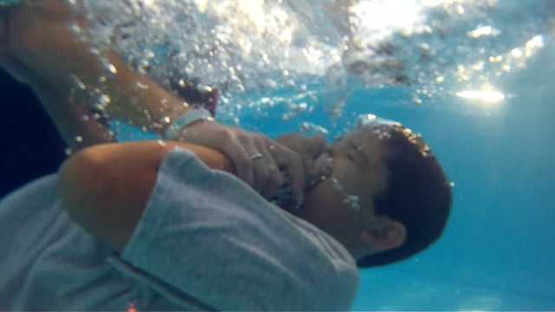
浸水禮 Water Baptism

Slide 11
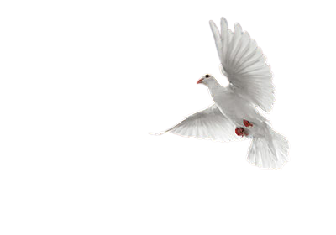
聖靈的洗 Baptism by the Spirit

Slide 12

聖靈的洗 Baptism by the Holy Spirit
重生為新造的人 Born again into a New Creation
加入基督的身體 Become a member of body of Christ
聖靈的充滿和澆灌 Filled by the Holy Spirit

Slide 13
歌羅西書‬ Colossians 3:9-10
不要彼此說謊；因你們已經脫去舊人和舊人的行為，穿上了新人。 這新人在知識上漸漸更新，正如造他主的形像。
Do not lie to each other, since you have taken off your old self with its practices and have put on the new self, which is being renewed in knowledge in the image of its Creator.

Slide 14
聖靈的洗 Baptism by the Holy Spirit
重生為新造的人 Born again into a New Creation
加入基督的身體 Become a member of body of Christ
聖靈的充滿和澆灌 Filled by the Holy Spirit

Slide 15
哥林多前書 1 Corinthians 12:12-13
我們不拘是猶太人，是希臘人，是為奴的，是自主的，都從一位聖靈受洗，成了一個身體，飲於一位聖靈。
For we were all baptized by one Spirit so as to form one body—whether Jews or Gentiles, slave or free—and we were all given the one Spirit to drink.

Slide 16
聖靈的洗 Baptism by the Holy Spirit
重生為新造的人 Born again into a New Creation
加入基督的身體 Become a member of body of Christ
聖靈的充滿和澆灌 Filled by the Holy Spirit

Slide 17
使徒行傳 Acts 1:8
但聖靈降臨在你們身上，你們就必得著能力，並要在耶路撒冷、猶太全地，和撒馬利亞，直到地極，作我的見證。
But you will receive power when the Holy Spirit comes on you; and you will be my witnesses in Jerusalem, and in all Judea and Samaria, and to the ends of the earth.

Slide 18
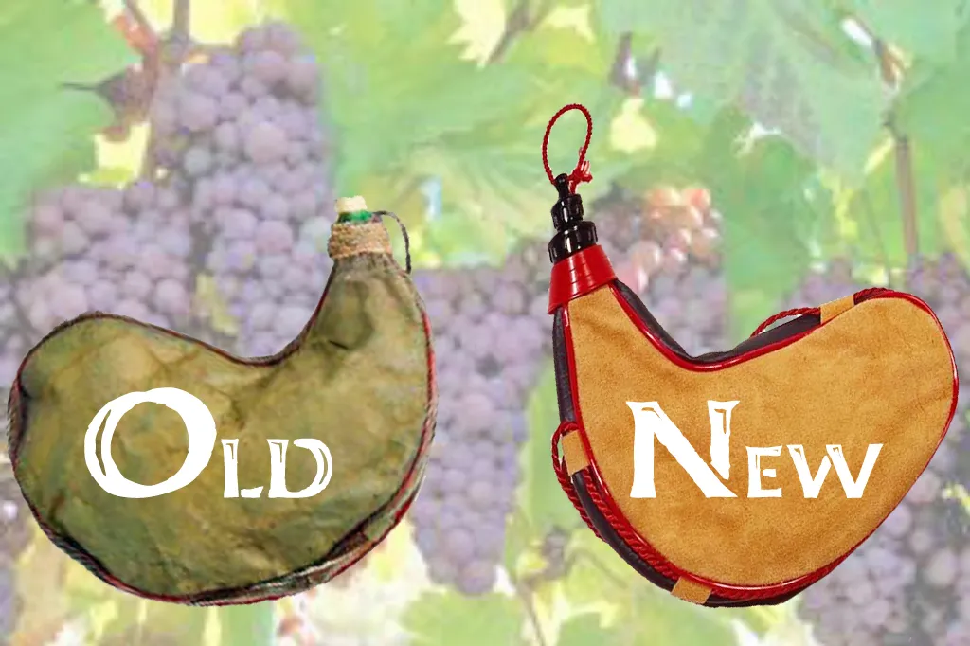

Slide 19
路加福音‬ Luke 5:37-38
也沒有人把新酒裝在舊皮袋裡；若是這樣，新酒必將皮袋裂開，酒便漏出來，皮袋也就壞了。
但新酒必須裝在新皮袋裡。
And no one pours new wine into old wineskins. Otherwise, the new wine will burst the skins; the wine will run out and the wineskins will be ruined. No, new wine must be poured into new wineskins.

Slide 20
回應詩歌
「聖靈, 歡迎你降臨」

