Slide 1

主日信息
Sunday Sermon

Slide 2

Ignite The World Ministries
“I am the light of the world. Whoever follows me will never walk in darkness, but will have the light of life.” John 8:12

Slide 3
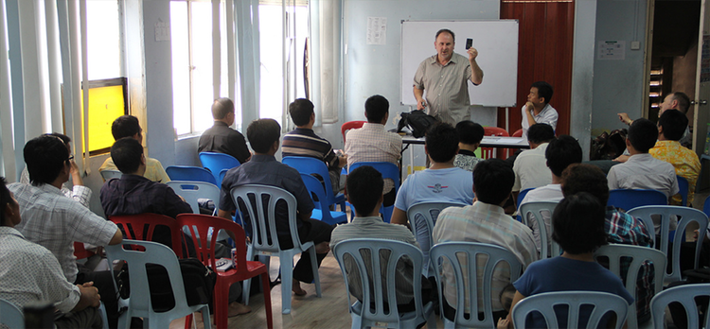
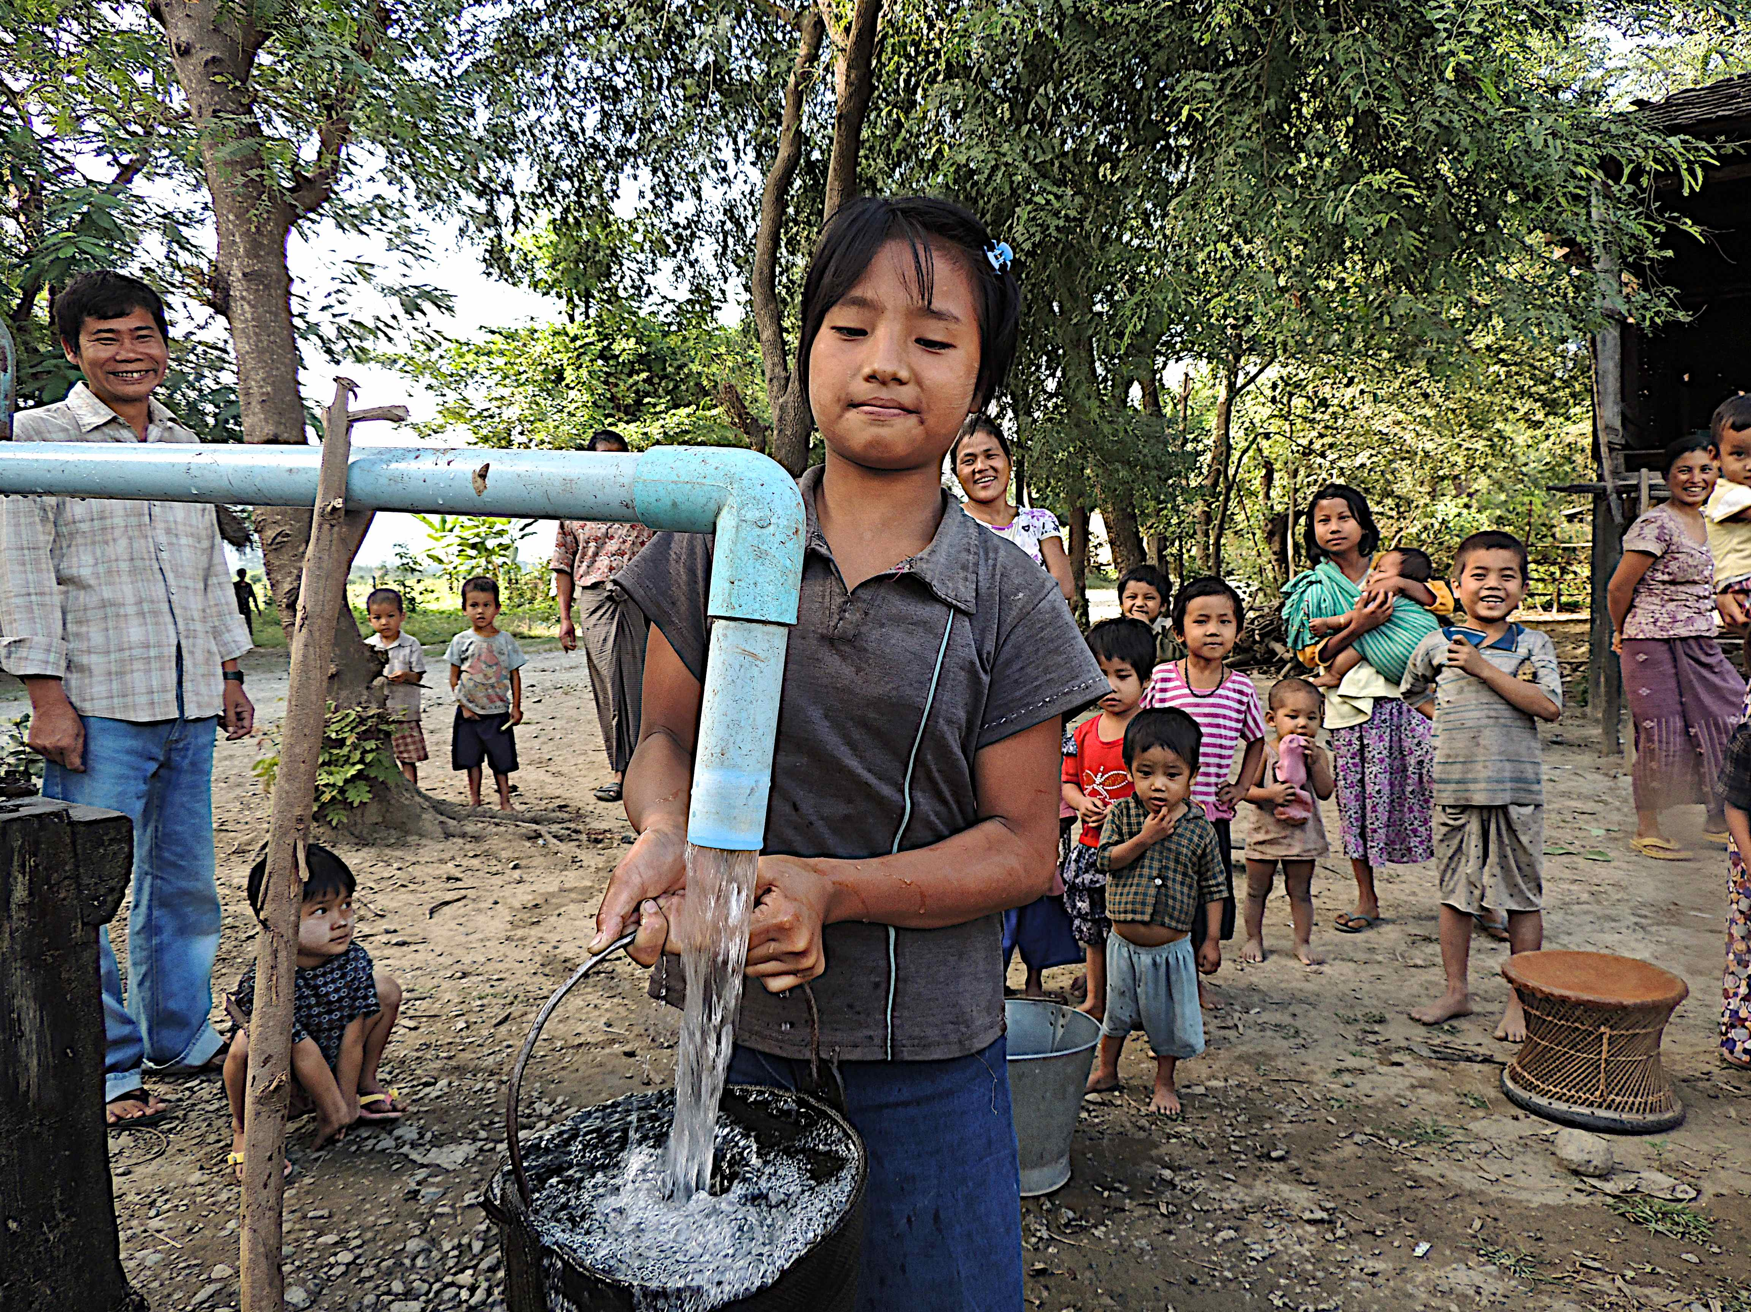
What we do
Evangelism
Training/Equipping Evangelists
Compassion Relief

Slide 4
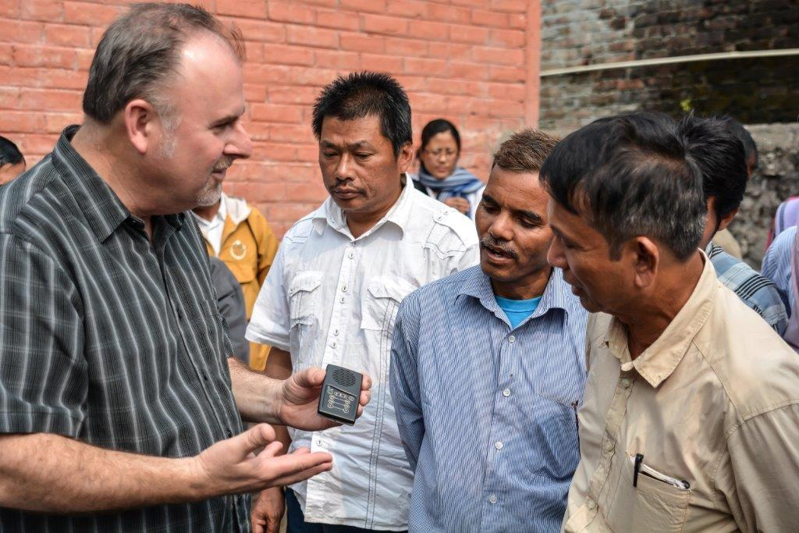
Who we are
We are a team of committed Christians dedicated to change the world for Jesus Christ with the supernatural power of the Gospel.
Our mission... is to bring hope to the nations through the transforming power of Jesus Christ by way of evangelism, evangelism training and missionary church planting, compassion relief projects and the ministry of prayer.
CORE VALUES
Honoring God
Demonstrating Integrity
Loving People
Forming Partnerships
Changing Societies

Slide 5
馬太福音‬ Matthew 28:19-20
所以，你們要去，使萬民作我的門徒，奉父、子、聖靈的名給他們施洗。 凡我所吩咐你們的，都教訓他們遵守，我就常與你們同在，直到世界的末了。
Therefore go and make disciples of all nations, baptizing them in the name of the Father and of the Son and of the Holy Spirit, and teaching them to obey everything I have commanded you. And surely I am with you always, to the very end of the age.

Slide 6
馬太福音‬ Matthew 9:37-38
於是對門徒說：「要收的莊稼多，做工的人少。 所以，你們當求莊稼的主打發工人出去收他的莊稼。」
Then he said to his disciples, “The harvest is plentiful but the workers are few. Ask the Lord of the harvest, therefore, to send out workers into his harvest field.”

Slide 7

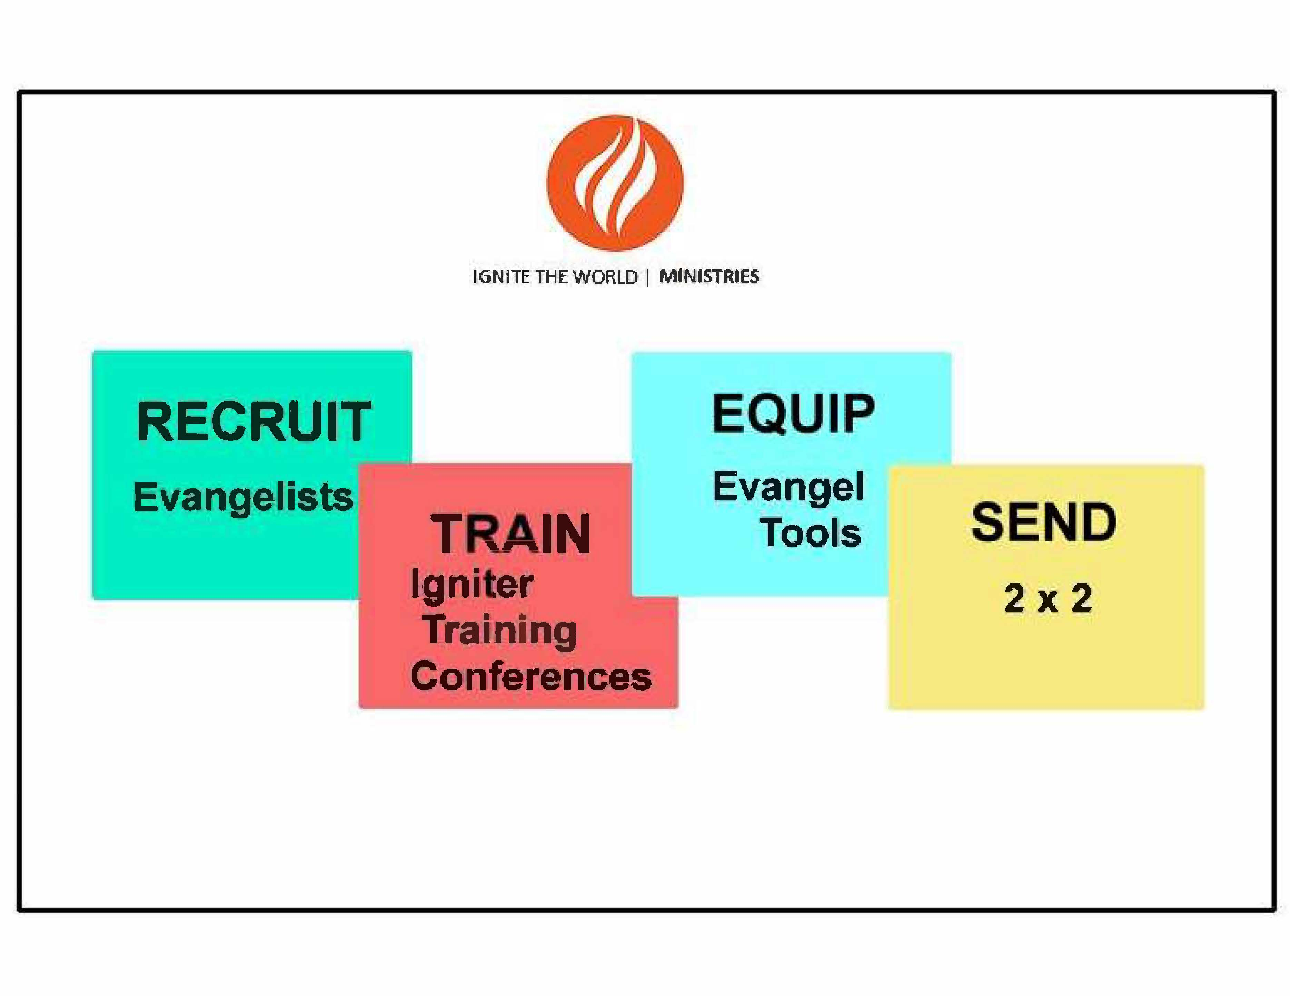
4-step evangelism strategy

Slide 8
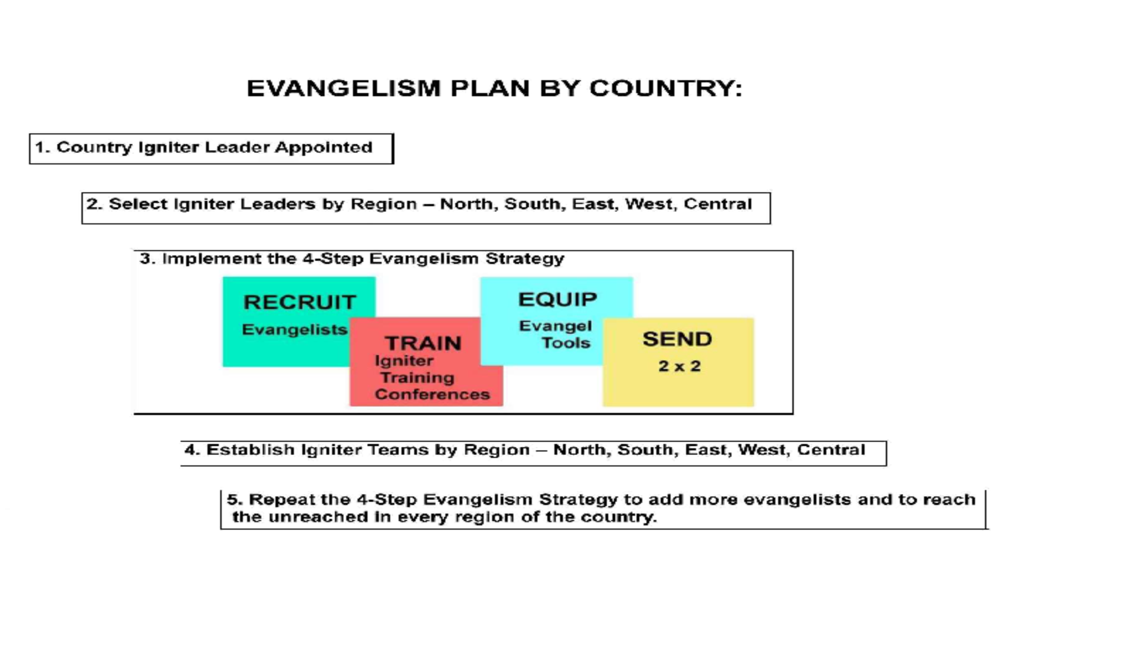
Evangelism Plan by Country

Slide 9
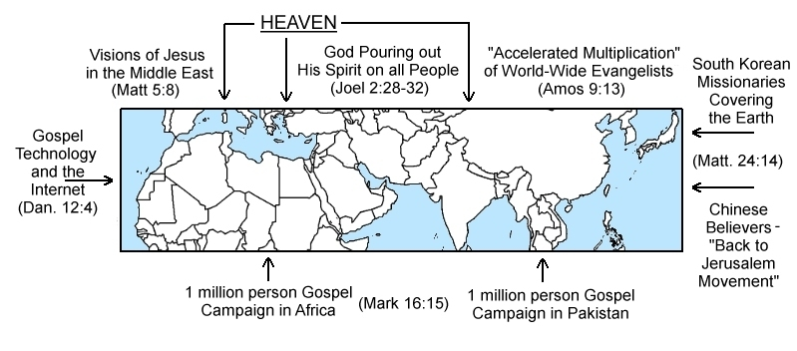
The 10-40 Window

Slide 10
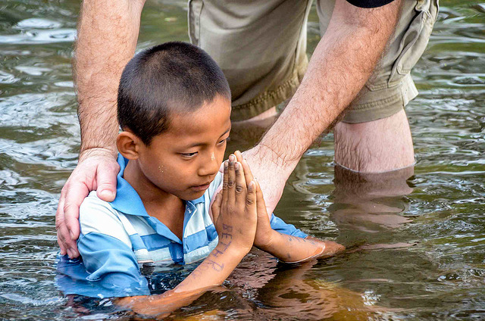
How you can help
Travel on a mission with us
Financially support & pray for us
Sponsor a project

