Slide 1

為了榮耀的緣故
For The Glory
波特蘭靈糧堂
February 26, 2023

Slide 2
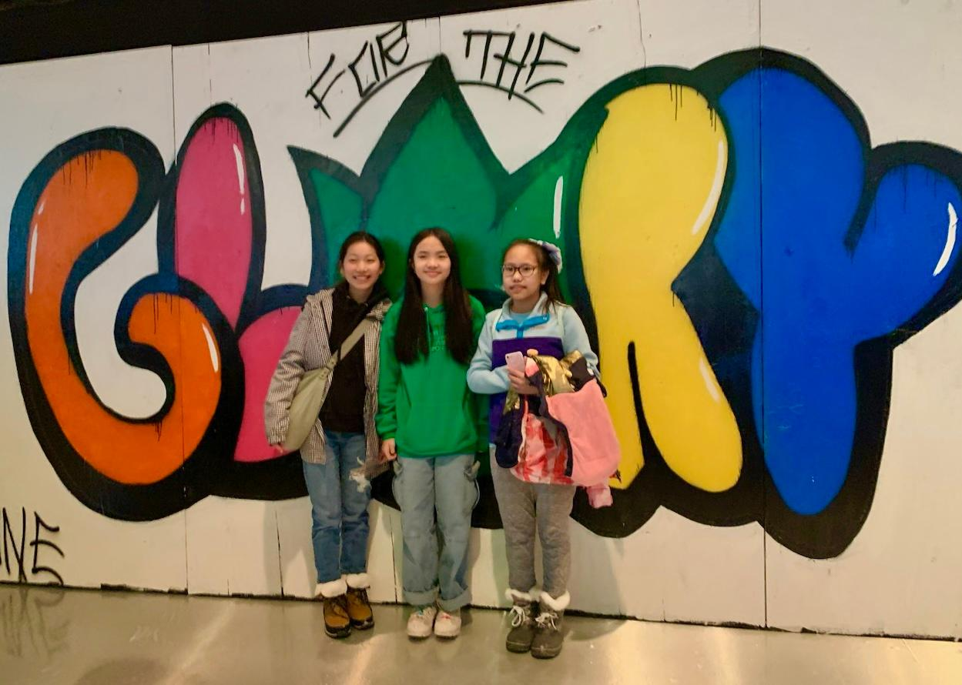

Slide 3

主耶穌為自己禱告
約翰福音‬ John 17:1-5

Slide 4
約翰福音‬ John 17: 1, 3-5
1 耶穌說了這話，就舉目望天，說：「父啊，時候到了，願你榮耀你的兒子，使兒子也榮耀你；
3 耶穌說了這話，就舉目望天，說：「父啊，時候到了，願你榮耀你的兒子，使兒子也榮耀你；
4 我在地上已經榮耀你，你所託付我的事，我已成全了。
5 父啊，現在求你使我同你享榮耀，就是未有世界以先，我同你所有的榮耀。

Slide 5
主耶穌為門徒禱告
約翰福音‬ John 17:6-19

Slide 6
約翰福音‬ John 17: 10-11
凡是我的，都是你的；你的也是我的，並且我因他們得了榮耀。 從今以後，我不在世上，他們卻在世上；我往你那裡去。 聖父啊，求你因你所賜給我的名保守他們，叫他們合而為一像我們一樣。
All I have is yours, and all you have is mine. And glory has come to me through them. I will remain in the world no longer, but they are still in the world, and I am coming to you. Holy Father, protect them by the power of your name, the name you gave me, so that they may be one as we are one.

Slide 7
主耶穌為信徒禱告
約翰福音‬ John 17:20-26

Slide 8
約翰福音‬ John 17: 22
你所賜給我的榮耀，我已賜給他們，使他們合而為一，像我們合而為一。
I have given them the glory that you gave me, that they may be one as we are one—

Slide 9
榮耀與合一

Slide 10
渴慕神的榮耀

Slide 11
羅馬書‬ Romans 3:23-24
因為世人都犯了罪，虧缺了 神的榮耀；如今卻蒙 神的恩典，因基督耶穌的救贖，就白白地稱義。
for all have sinned and fall short of the glory of God, and all are justified freely by his grace through the redemption that came by Christ Jesus.

Slide 12
約翰福音‬ John 17: 22
你所賜給我的榮耀，我已賜給他們，使他們合而為一，像我們合而為一。
I have given them the glory that you gave me, that they may be one as we are one—

Slide 13
什麼是榮耀的教會？

Slide 14
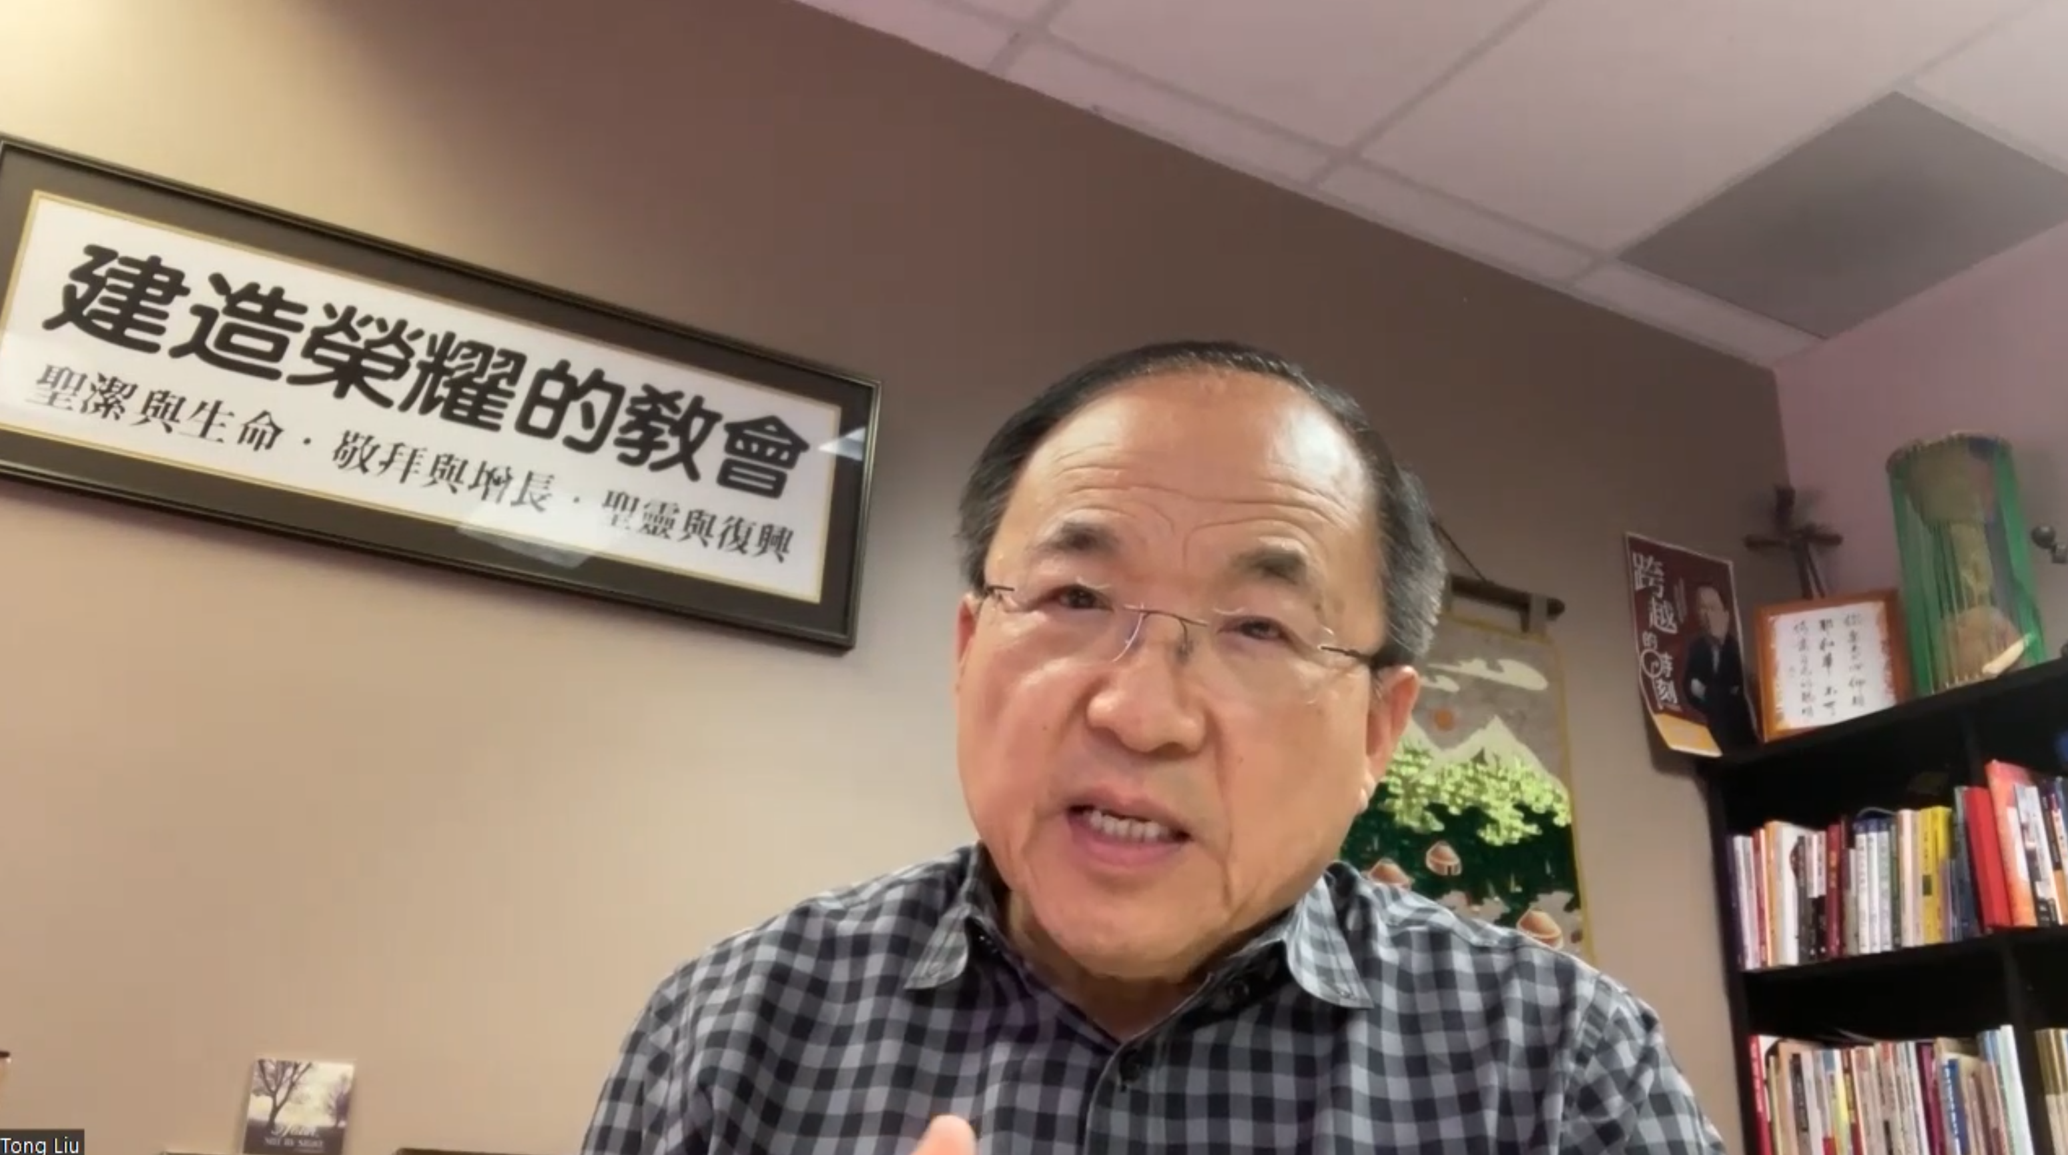
什麼是榮耀的教會？

Slide 15
合一的深度

Slide 16
為父的心與兩代同行

Slide 17
關係導向與事工導向

Slide 18
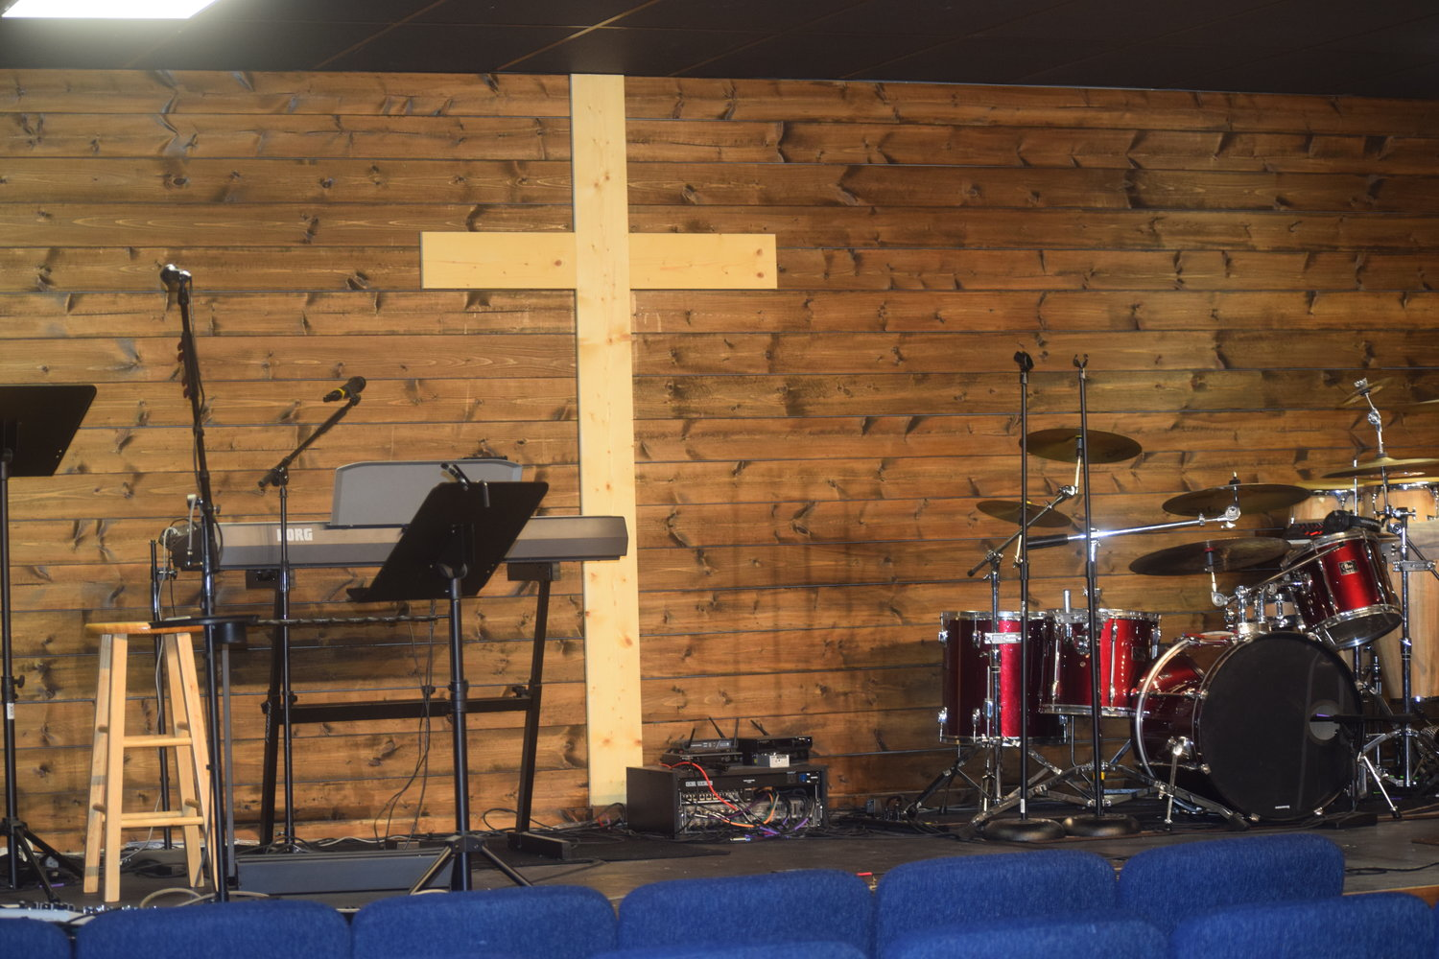

Slide 19
尊榮文化
跨越熟悉感
透過聖靈來認出神在人身上的作為

Slide 20
榮上加榮的呼召

Slide 21
哥林多後書‬ 2 Cor. 3:17-18
主就是那靈；主的靈在哪裡，那裡就得以自由。 我們眾人既然敞著臉得以看見主的榮光，好像從鏡子裡返照，就變成主的形狀，榮上加榮，如同從主的靈變成的。
Now the Lord is the Spirit, and where the Spirit of the Lord is, there is freedom. And we all, who with unveiled faces contemplate the Lord’s glory, are being transformed into his image with ever-increasing glory, which comes from the Lord, who is the Spirit.

Slide 22
哥林多後書‬ 2 Cor. 4:16-18
所以，我們不喪膽。外體雖然毀壞，內心卻一天新似一天。 我們這至暫至輕的苦楚，要為我們成就極重無比、永遠的榮耀。原來我們不是顧念所見的，乃是顧念所不見的；因為所見的是暫時的，所不見的是永遠的。
Therefore we do not lose heart. Though outwardly we are wasting away, yet inwardly we are being renewed day by day. For our light and momentary troubles are achieving for us an eternal glory that far outweighs them all.

Slide 23
羅馬書‬ Romans 5:1-3a
我們既因信稱義，就藉著我們的主耶穌基督得與 神相和。 我們又藉著他，因信得進入現在所站的這恩典中，並且歡歡喜喜盼望 神的榮耀。 不但如此，就是在患難中也是歡歡喜喜的；
Therefore, since we have been justified through faith, we have peace with God through our Lord Jesus Christ, through whom we have gained access by faith into this grace in which we now stand. And we boast in the hope of the glory of God. Not only so, but we also glory in our sufferings,

