Slide 1

主日信息
Sunday Sermon

Slide 2

復活的新生命
New Life of Resurrection
波特蘭靈糧堂
April 9, 2023

Slide 3

耶和華的節期（The Feasts of Jehovah）
(利未記 Leviticus 23 章)

Slide 4
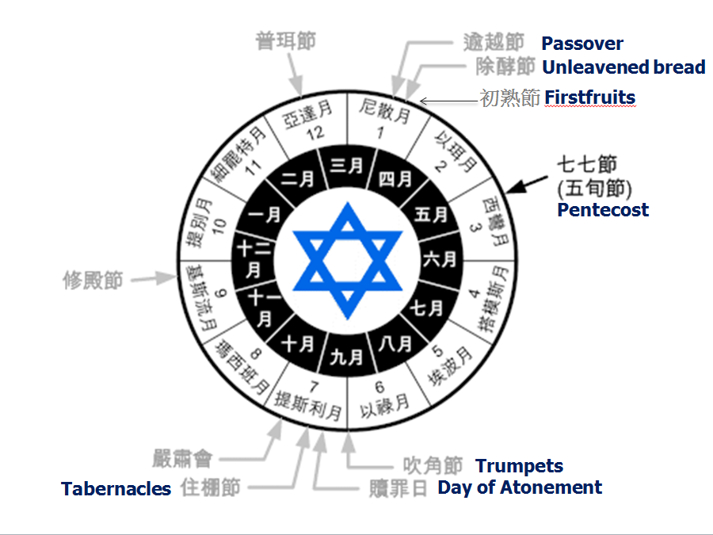

Slide 5
逾越節 Passover (利未記 Leviticus 23:5)
  主耶穌是被殺的羔羊 ─ 救恩的根基
  Jesus the lamb was slain ─ Foundation of Salvation
除酵節 Feast of Unleavened Bread (利 Lev. 23:6-8)
  脫離罪的成聖的生命
  Cleansing sins in holy walk of life
初熟節 Feast of Firstfruits (利未記 Lev. 23:10)
  基督首先從死裡復活使我們成為新造的人
  Christ rose from the dead as head of new creation

Slide 6
基督的復活完成了救恩
The Resurrection of Christ Completes Salvation

Slide 7
哥林多前書‬ 1 Corinthians 15:17-20
基督若沒有復活，你們的信便是徒然，你們仍在罪裡。 就是在基督裡睡了的人也滅亡了。 我們若靠基督只在今生有指望，就算比眾人更可憐。 但基督已經從死裡復活，成為睡了之人初熟的果子。
And if Christ has not been raised, your faith is futile; you are still in your sins. Then those also who have fallen asleep in Christ are lost. If only for this life we have hope in Christ, we are of all people most to be pitied. But Christ has indeed been raised from the dead, the firstfruits of those who have fallen asleep.

Slide 8

羅馬書 Romans 10:9-10
你若口裡認耶穌為主，心裡信 神叫他從死裡復活，就必得救。 因為，人心裡相信就可以稱義，口裡承認就可以得救。
If you declare with your mouth, “Jesus is Lord,” and believe in your heart that God raised him from the dead, you will be saved. For it is with your heart that you believe and are justified, and it is with your mouth that you profess your faith and are saved.

Slide 9
叫耶穌從死裡復活的聖靈今天也活在你裡面
The Spirit who raised Jesus from the dead is living in you

Slide 10
羅馬書‬ Romans 8:11
然而，叫耶穌從死裡復活者的靈若住在你們心裡，那叫基督耶穌從死裡復活的，也必藉著住在你們心裡的聖靈，使你們必死的身體又活過來。
And if the Spirit of Him who raised Jesus from the dead is living in you, He who raised Christ from the dead will also give life to your mortal bodies because of His Spirit who lives in you.

Slide 11
神的生命在你裡面保守你全人健康
The Life of God is in YOU - keeping you well

Slide 12
醫治禱告
Prayer for Healing

Slide 13
見證分享 Testimony Sharing
Tina 姚海波 姐妹

Slide 14
以赛亚书 53:5, Isaiah 53:5
哪知他为我们的过犯受害， 为我们的罪孽压伤。 因他受的刑罚，我们得平安； 因他受的鞭伤，我们得医治。
But he was wounded for our transgressions, he was bruised for our iniquities; the chastisement of our peace was upon him, and with his stripes we are healed.

Slide 15
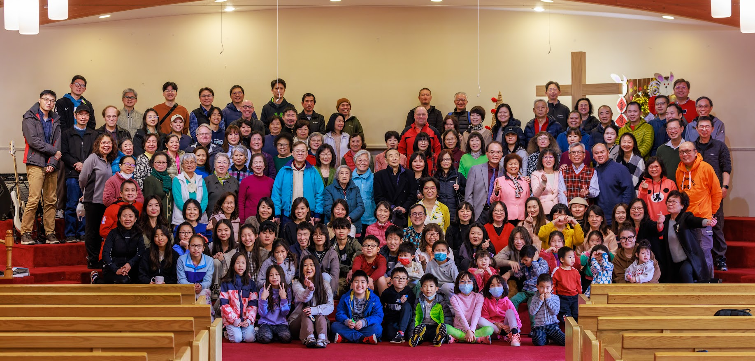
约翰一书 3:18 John 3:18
小子们哪，我们相爱，不要只在言语和舌头上，总要在行为和诚实上。
“Dear children, let’s not merely say that we love each other; let us show the truth by our actions.”

Slide 16
箴言 27：2 Proverbs 27:2
要让外人夸奖你，不可自己夸奖自己。
Let another praise you, and not your own mouth

Slide 17




04.09.23
New Chapter
To Haibo

Slide 18
請五位今天下午要在大堂受洗的弟兄姐妹分享受洗見證 baptism testimonies sharing：
Julie 朱靓 姐妹
Erica 郭姿均 姐妹
Sia 张苹苹 姐妹
Jieying 司徒潔英 姐妹
Xiaodong 夏暁东 弟兄

Slide 19
受洗見證分享 Baptism testimony Sharing
Erica 郭姿均 姐妹

Slide 20
受洗見證分享 Baptism testimony Sharing
Sia 张苹苹 姐妹

Slide 21
受洗見證分享 Baptism testimony Sharing
Jieying 司徒潔英 姐妹

Slide 22
受洗見證分享 Baptism testimony Sharing
Xiaodong 夏曉東 弟兄

Slide 23
受洗見證分享 Baptism testimony Sharing
Julie 朱靓 姐妹

Slide 24
回應詩歌 Response Song
「我需要有你在我生命中
I Need You in My Life」

