Slide 1

主日信息
Sunday Sermon

Slide 2

代表主耶穌的服事
Serving On Behalf of Lord Jesus
波特蘭靈糧堂
April 16, 2023

Slide 3
約翰福音‬ John 12:26
若有人服事我，就當跟從我；我在哪裡，服事我的人也要在那裡；若有人服事我，我父必尊重他。
Whoever serves me must follow me; and where I am, my servant also will be. My Father will honor the one who serves me.

Slide 4

準確的代表主耶穌的服事
            內在生命的境界
            權能事奉的境界

Slide 5
準確的代表主耶穌的服事
            內在生命的境界

Slide 6
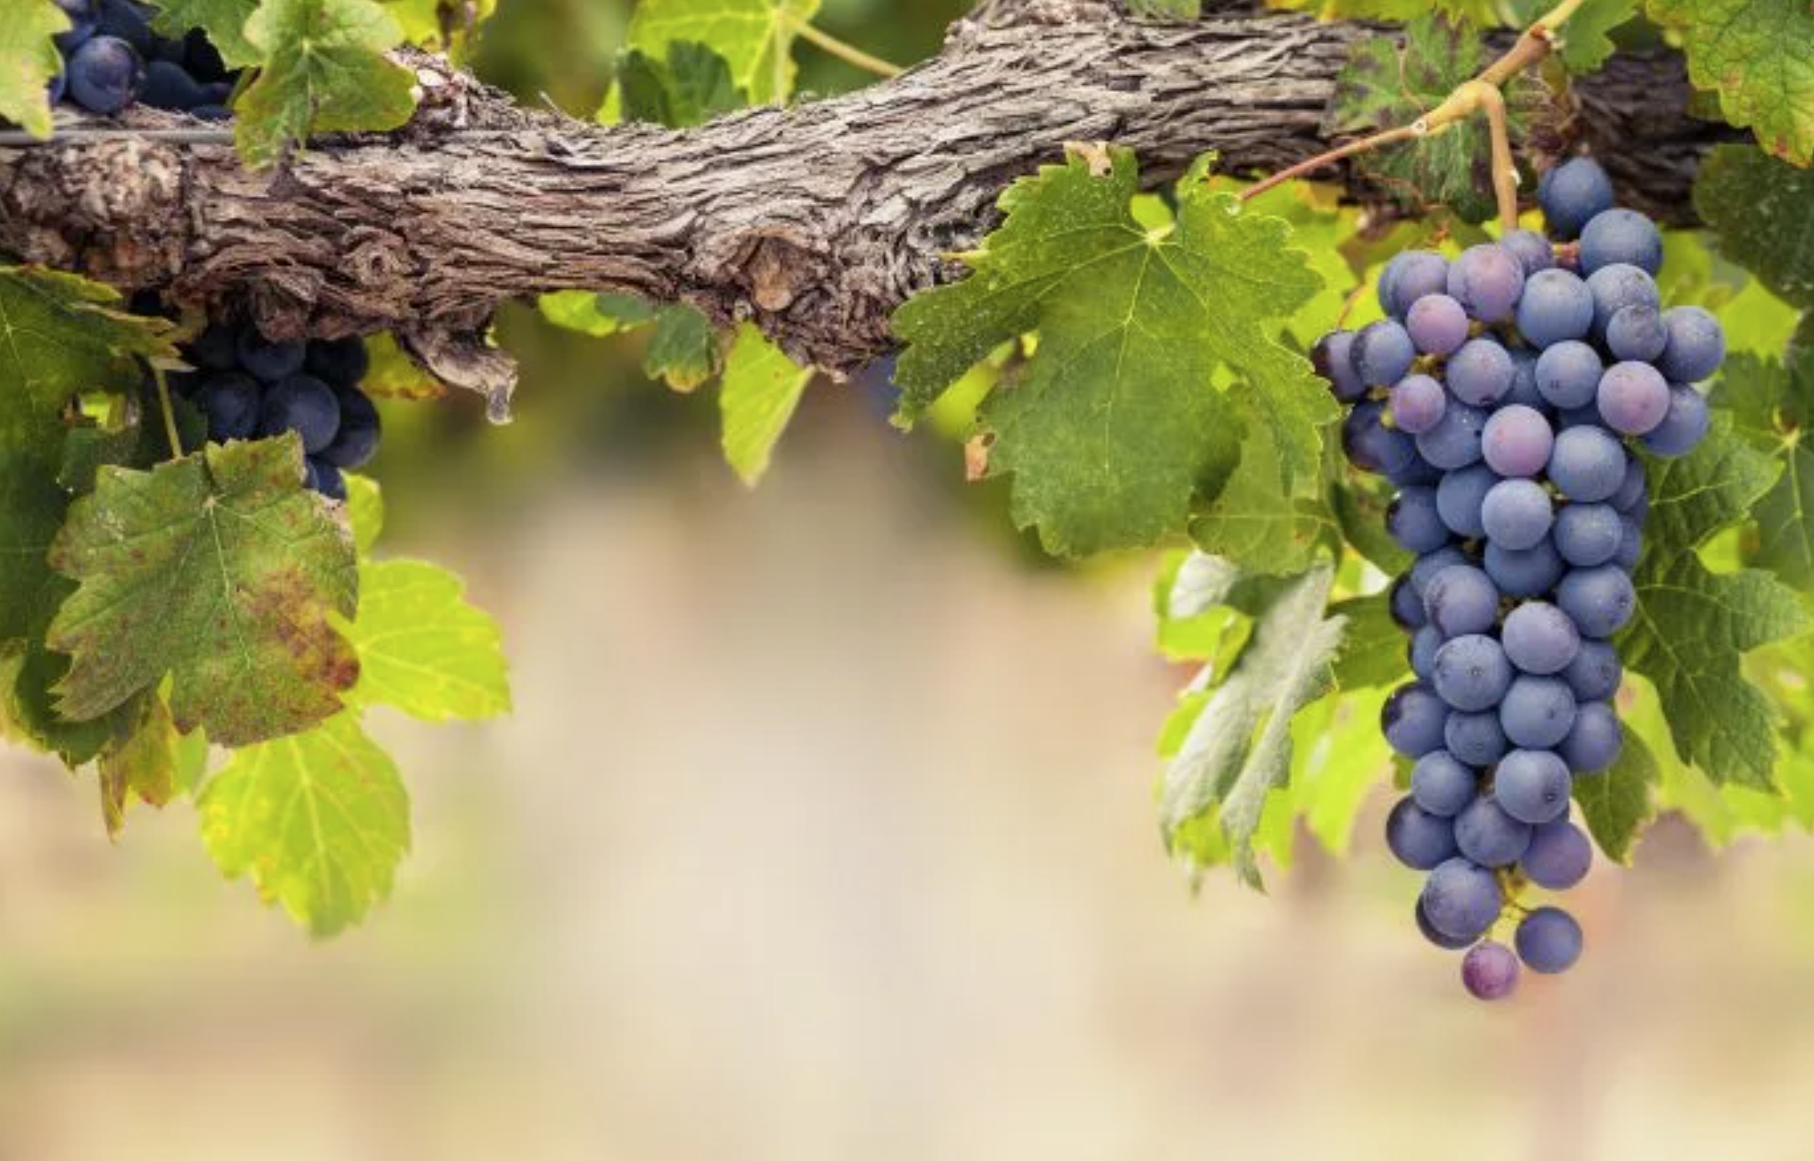
約翰福音‬ John 15:5
我是葡萄樹，你們是枝子。 常在我裡面的，我也常在他裡面，這人就多結果子；因為離了我，你們就不能做甚麼。
I am the vine; you are the branches. If you remain in me and I in you, you will bear much fruit; apart from me you can do nothing.

Slide 7
「做事」的境界
或
「內在生命」的境界

Slide 8
馬太福音‬ Matthew 5:13-14
13 你們是世上的鹽。鹽若失了味，怎能叫它再鹹呢？ 以後無用，不過丟在外面，被人踐踏了。
14 你們是世上的光。城造在山上是不能隱藏的。
You are the salt of the earth. But if the salt loses its saltiness, how can it be made salty again? It is no longer good for anything, except to be thrown out and trampled underfoot. You are the light of the world. A town built on a hill cannot be hidden.

Slide 9
「做」光「做」鹽
或
「是」光「是」鹽

Slide 10
哥林多前書‬ 1 Cor. 3:11-13
因為那已經立好的根基就是耶穌基督，此外沒有人能立別的根基。若有人用金、銀、寶石、草木、禾秸在這根基上建造，各人的工程必然顯露，因為那日子要將它表明出來，有火發現；這火要試驗各人的工程怎樣。
For no one can lay any foundation other than the one already laid, which is Jesus Christ. If anyone builds on this foundation using gold, silver, costly stones, wood, hay or straw, their work will be shown for what it is, because the Day will bring it to light. It will be revealed with fire, and the fire will test the quality of each person’s work.

Slide 11
「金、銀、寶石」
或是
「草木、禾秸」

Slide 12
準確的代表主耶穌的服事
            內在生命的境界
            權能事奉的境界

Slide 13
彼得前書‬ 1 Peter 4:10-11
各人要照所得的恩賜彼此服事，作 神百般恩賜的好管家。 若有講道的，要按著 神的聖言講；若有服事人的，要按著 神所賜的力量服事，叫 神在凡事上因耶穌基督得榮耀。
Each of you should use whatever gift you have received to serve others, as faithful stewards of God’s grace in its various forms. If anyone speaks, they should do so as one who speaks the very words of God. If anyone serves, they should do so with the strength God provides, so that in all things God may be praised through Jesus Christ.

Slide 14
服事主應有的心態
            從心裡遵行神的旨意
            順服直接和代理的權柄
            甘心樂意、殷勤、火熱

Slide 15
服事主應有的心態
            從心裡遵行神的旨意

Slide 16
以弗所書‬ Ephesians 6:6-7
不要只在眼前事奉，像是討人喜歡的，要像基督的僕人，從心裡遵行 神的旨意。 甘心事奉，好像服事主，不像服事人。
Obey them not only to win their favor when their eye is on you, but as slaves of Christ, doing the will of God from your heart. Serve wholeheartedly, as if you were serving the Lord, not people,

Slide 17
服事主應有的心態
            從心裡遵行神的旨意
            順服直接和代理的權柄

Slide 18
羅馬書‬ Romans 13:1-2
在上有權柄的，人人當順服他，因為沒有權柄不是出於 神的。 凡掌權的都是 神所命的。 所以，抗拒掌權的就是抗拒 神的命；抗拒的必自取刑罰。
Let everyone be subject to the governing authorities, for there is no authority except that which God has established. The authorities that exist have been established by God. Consequently, whoever rebels against the authority is rebelling against what God has instituted, and those who do so will bring judgment on themselves..

Slide 19
順服權柄的操練
        順服神直接的權柄
        順服神所設立代理的權柄

Slide 20
服事主應有的心態
            從心裡遵行神的旨意
            順服直接和代理的權柄
            甘心樂意、殷勤、火熱

Slide 21
羅馬書‬ Romans 12:11
殷勤，不可懶惰；要心裡火熱，常常服事主。
Never be lacking in zeal, but keep your spiritual fervor, serving the Lord.

Slide 22
服事主的恩典
蒙神的喜悅獎賞
生命的長大成熟

Slide 23
馬太福音‬ Matthew 25:20-21
那領五千銀子的又帶著那另外的五千來，說：『主啊，你交給我五千銀子。請看，我又賺了五千。』主人說：『好，你這又良善又忠心的僕人，你在不多的事上有忠心，我要把許多事派你管理；可以進來享受你主人的快樂。』
The man who had received five bags of gold brought the other five. ‘Master,’ he said, ‘you entrusted me with five bags of gold. See, I have gained five more.’ “His master replied, ‘Well done, good and faithful servant! You have been faithful with a few things; I will put you in charge of many things. Come and share your master’s happiness!’

Slide 24
D2B 見證分享 Testimony Sharing
Keny Wu 姐妹

Slide 25
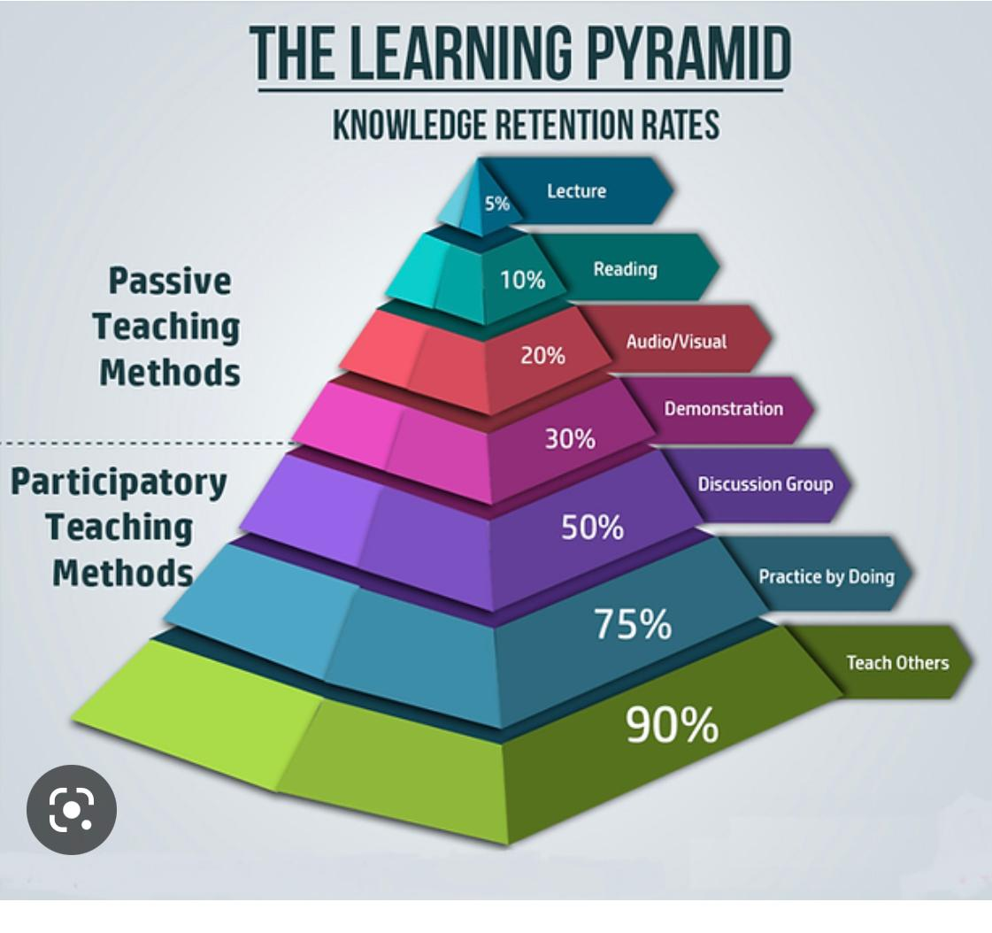
学习金字塔
知识保留率
演讲
阅读
被动教学法
音频/视频
示范
讨论组
边做边实践
参与式教学法
教别人

Slide 26
填寫服事意願問卷調查表

Slide 27
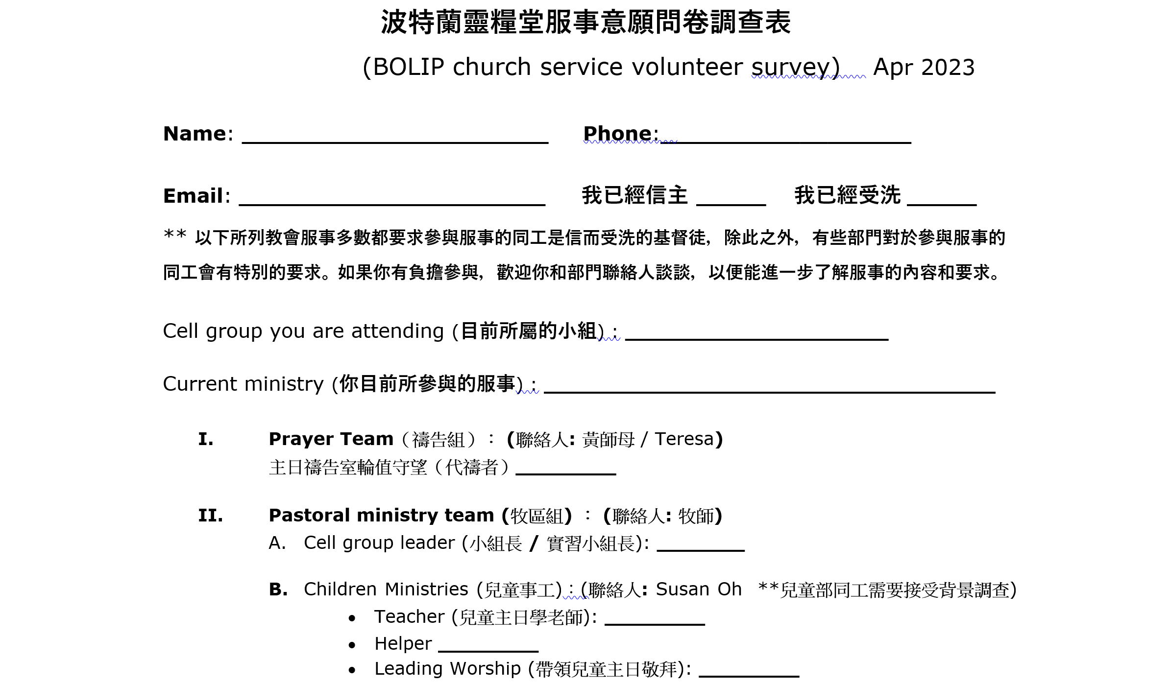

Slide 28
回應詩歌 Response Song
「新的親密」

