Slide 1

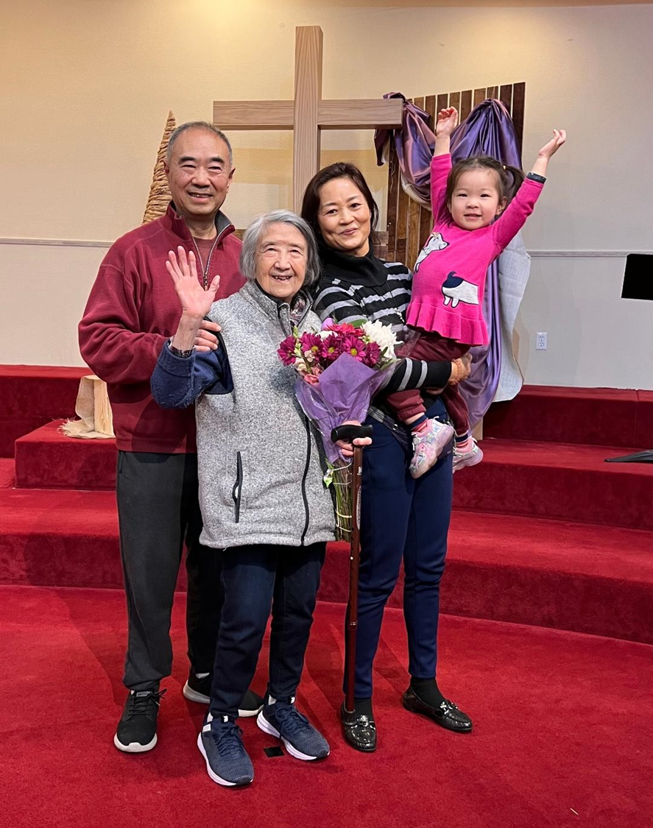
見證分享 Testimony Sharing
方志 弟兄

Slide 2

主日信息
Sunday Sermon

Slide 3
神如何對我們說話
How God Speaks to Us
波特蘭靈糧堂
April 30, 2023

Slide 4

「啟示」是基督信仰的核心

Slide 5
聖經都是 神所默示的，於教訓、督責、使人歸正、教導人學義都是有益的，叫屬 神的人得以完全，預備行各樣的善事。
(提摩太後書 2 Timothy 3:16)
All Scripture is God-breathed and is useful for teaching, rebuking, correcting and training in righteousness, so that the servant of God may be thoroughly equipped for every good work.

Slide 6
聖經中彌賽亞/末世的預言與個人性預言

Slide 7
我就俯伏在他腳前要拜他。 他說：「千萬不可！ 我和你，並你那些為耶穌作見證的弟兄同是作僕人的，你要敬拜 神。」因為預言中的靈意乃是為耶穌作見證。
(啟示錄 Revelation 19:10)
At this I fell at his feet to worship him. But he said to me, “Don’t do that! I am a fellow servant with you and with your brothers and sisters who hold to the testimony of Jesus. Worship God! For it is the Spirit of prophecy who bears testimony to Jesus.”

Slide 8
我向一切聽見這書上預言的作見證，若有人在這預言上加添甚麼， 神必將寫在這書上的災禍加在他身上；這書上的預言，若有人刪去甚麼， 神必從這書上所寫的生命樹和聖城刪去他的分。
(啟示錄 Revelation 22:18-19)
I warn everyone who hears the words of the prophecy of this scroll: If anyone adds anything to them, God will add to that person the plagues described in this scroll. 19 And if anyone takes words away from this scroll of prophecy, God will take away from that person any share in the tree of life and in the Holy City, which are described in this scroll.

Slide 9
神對舊約中的先知的要求

Slide 10
耶和華的話臨到我說：「人子啊，你要說預言攻擊以色列中說預言的先知，對那些本己心發預言的說：『你們當聽耶和華的話。』」主耶和華如此說：「愚頑的先知有禍了，他們隨從自己的心意，卻一無所見。
(以西結書 Ezekiel 13:1-3)
The word of the Lord came to me: “Son of man, prophesy against the prophets of Israel who are now prophesying. Say to those who prophesy out of their own imagination: ‘Hear the word of the Lord! This is what the Sovereign Lord says: Woe to the foolish prophets who follow their own spirit and have seen nothing!

Slide 11
神對新約中的先知的期許

Slide 12
但作先知講道(預言)的，是對人說，要造就、安慰、勸勉人。
(哥林多前書 1 Corinthians 14:3)
But the one who prophesies speaks to people for their strengthening, encouraging and comfort.

Slide 13
個人性預言 Personal Prophecy

Slide 14
舊約中個人性預言的例子

Slide 15
那時，耶和華的靈在會中臨到利未人亞薩的後裔─瑪探雅的玄孫，耶利的曾孫，比拿雅的孫子，撒迦利雅的兒子雅哈悉。 他說：「猶大眾人、耶路撒冷的居民，和約沙法王，你們請聽。耶和華對你們如此說：『不要因這大軍恐懼驚惶；因為勝敗不在乎你們，乃在乎 神。 明日你們要下去迎敵，他們是從洗斯坡上來，你們必在耶魯伊勒曠野前的谷口遇見他們。 猶大和耶路撒冷人哪，這次你們不要爭戰，要擺陣站著，看耶和華為你們施行拯救。不要恐懼，也不要驚惶。
(歷代志下 2 Chronicles 20:14-17)
But the one who prophesies speaks to people for their strengthening, encouraging and comfort.

Slide 16
新約中個人性預言的例子

Slide 17
當那些日子，有幾位先知從耶路撒冷下到安提阿。 內中有一位，名叫亞迦布，站起來，藉著聖靈指明天下將有大饑荒。（這事到革老丟年間果然有了。） 於是門徒定意照各人的力量捐錢，送去供給住在猶太的弟兄。
(使徒行傳 Acts 11:27-29)
During this time some prophets came down from Jerusalem to Antioch. One of them, named Agabus, stood up and through the Spirit predicted that a severe famine would spread over the entire Roman world. (This happened during the reign of Claudius.) The disciples, as each one was able, decided to provide help for the brothers and sisters living in Judea.

Slide 18
他們事奉主、禁食的時候，聖靈說：「要為我分派巴拿巴和掃羅，去做我召他們所做的工。」 於是禁食禱告，按手在他們頭上，就打發他們去了。 他們既被聖靈差遣，就下到西流基，從那裡坐船往塞浦路斯去。
(使徒行傳 Acts 13:2-4)
While they were worshiping the Lord and fasting, the Holy Spirit said, “Set apart for me Barnabas and Saul for the work to which I have called them.” So after they had fasted and prayed, they placed their hands on them and sent them off.
The two of them, sent on their way by the Holy Spirit, went down to Seleucia and sailed from there to Cyprus.

Slide 19
神藉著「異夢」與「異象」向我們說話

Slide 20
神說、一次、兩次、世人卻不理會。 人躺在床上沉睡的時候 神就用夢、和夜間的異象、 開通他們的耳朵、將當受的教訓印在他們心上、 好叫人不從自己的謀算、不行驕傲的事．攔阻人不陷於坑裡、不死在刀下。
(約伯記 Job 33:14-17)
For God does speak—now one way, now another— though no one perceives it. In a dream, in a vision of the night, when deep sleep falls on people as they slumber in their beds,he may speak in their ears and terrify them with warnings, to turn them from wrongdoing and keep them from pride,

Slide 21
「異夢」、「異象」與「說預言」的應許

Slide 22
這正是先知約珥所說的： 神說：在末後的日子，我要將我的靈澆灌凡有血氣的。 你們的兒女要說預言；你們的少年人要見異象；老年人要做異夢。 在那些日子，我要將我的靈澆灌我的僕人和使女，他們就要說預言。
(使徒行傳 Acts 2:16-18)
No, this is what was spoken by the prophet Joel: “‘In the last days, God says, I will pour out my Spirit on all people. Your sons and daughters will prophesy, your young men will see visions, your old men will dream dreams. Even on my servants, both men and women, I will pour out my Spirit in those days, and they will prophesy.

Slide 23
什麼是 Rhema (ῥῆμα)

Slide 24
以賽亞書 Isaiah 55:8-9
耶和華說、我的意念、非同你們的意念、我的道路、非同你們的道路。 天怎樣高過地、照樣我的道路、高過你們的道路、我的意念、高過你們的意念。
"For my thoughts are not your thoughts, neither are your ways my ways," declares the LORD. "As the heavens are higher than the earth, so are my ways higher than your ways and my thoughts than your thoughts.

Slide 25
Rhema (ῥῆμα) 的流動
Rhema (ῥῆμα) 神的話 word of God 好像一股意念，自發的從我們心中流出來。 所以當我傾聽主的聲音時，我是聆聽著自發的思潮。 當我安靜等候調向 神默想渴慕主時，我乃是調向其自發性的流動。 神的聲音常常是輕微而且柔和的。 Rhema (ῥῆμα) 包含聖經的話語 Word of God.

Slide 26
Rhema (ῥῆμα) 是聖靈恩賜的根基
      知識的言語 word of knowledge
      智慧的言語 word of wisdom
      先知預言 prophecy
      辨別諸靈 discerning of spirits

Slide 27
信主的人有聽主聲音的 DNA

Slide 28
我的羊聽我的聲音，我也認識他們，他們也跟著我。 我又賜給他們永生；他們永不滅亡，誰也不能從我手裡把他們奪去。
(約翰福音 John 10:27-28)
My sheep listen to my voice; I know them, and they follow me. I give them eternal life, and they shall never perish; no one will snatch them out of my hand.

Slide 29
神今天百分之百會對我說話！
100% certainty God will speak to me today!

Slide 30
回應詩歌 Response Song
「輕輕聽」

