Slide 1

主日信息
Sunday Sermon

Slide 2

信仰的傳承
Inheritance of Faith
波特蘭靈糧堂
June 4, 2023

Slide 3
約翰福音 John 15:16
不是你們揀選了我，是我揀選了你們，並且分派你們去結果子，叫你們的果子常存，使你們奉我的名，無論向父求甚麼，他就賜給你們。
You did not choose Me but I chose you, and appointed you that you would go and bear fruit, and that your fruit would remain, so that whatever you ask of the Father in My name He may give to you. (NASB)

Slide 4
約翰福音 John 3:16
神愛世人，甚至將他的獨生子賜給他們，叫一切信他的，不致滅亡，反得永生。
For God so loved the world, that He gave His only begotten Son, that whoever believes in Him shall not perish, but have eternal life. (NASB)

Slide 5
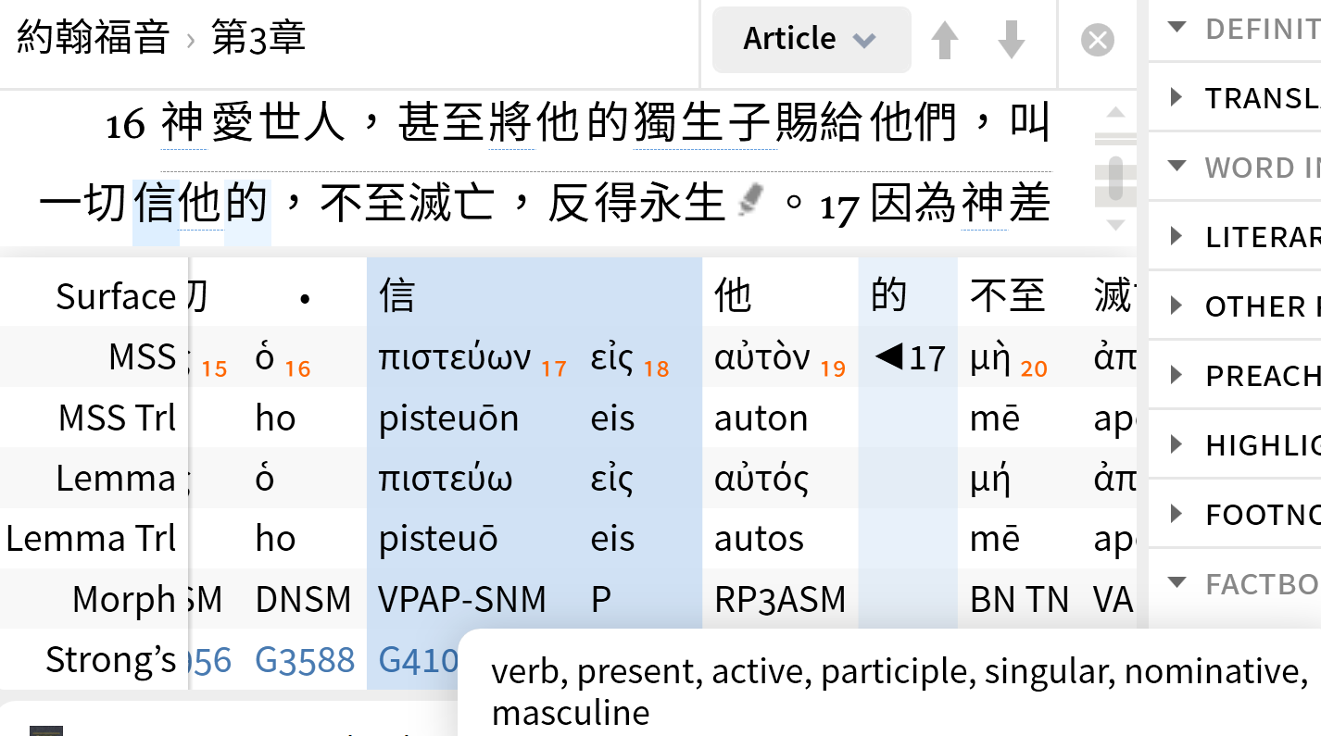

Slide 6
提摩太後書 2 Timothy 1:5
想到你心裡無偽之信，這信是先在你外祖母羅以和你母親友尼基心裡的，我深信也在你的心裡。
For I am mindful of the sincere faith within you, which first dwelt in your grandmother Lois and your mother Eunice, and I am sure that it is in you as well.

Slide 7
見證分享 Testimony Sharing
Anabel Chang 張恩予 姐妹

Slide 8
Some of My Story
Anabel Chang 張恩予

Slide 9
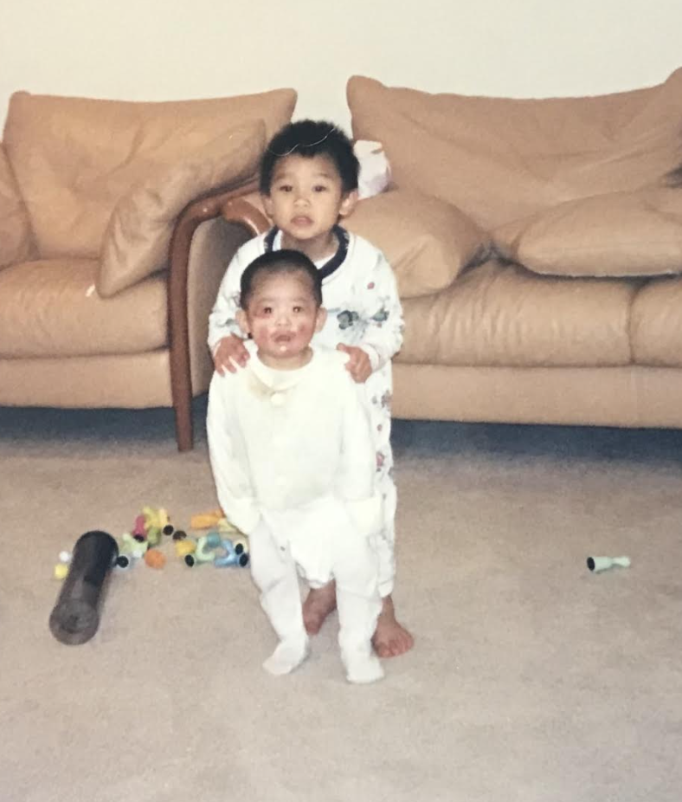
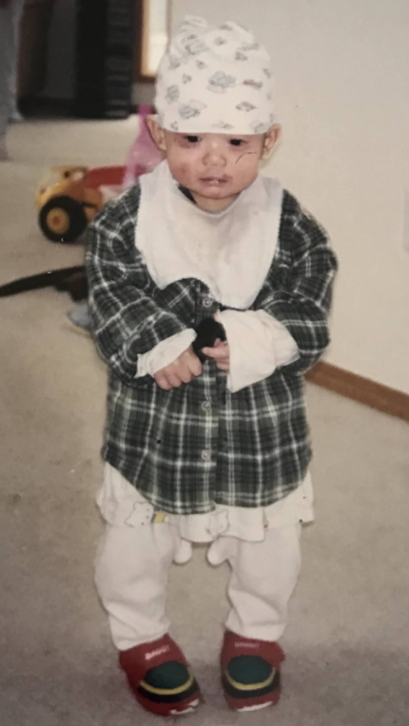

Slide 10
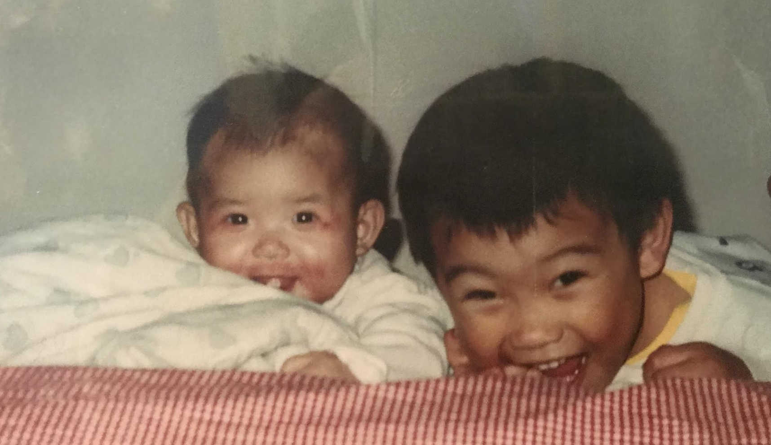

Slide 11
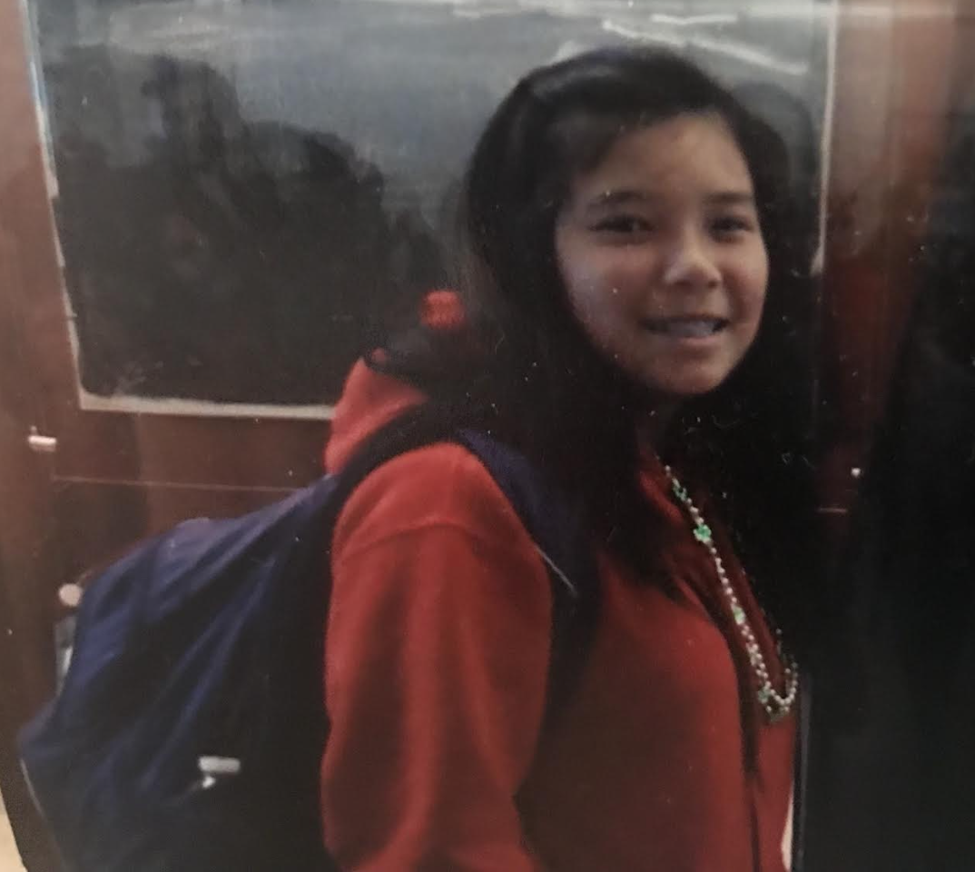

Slide 12
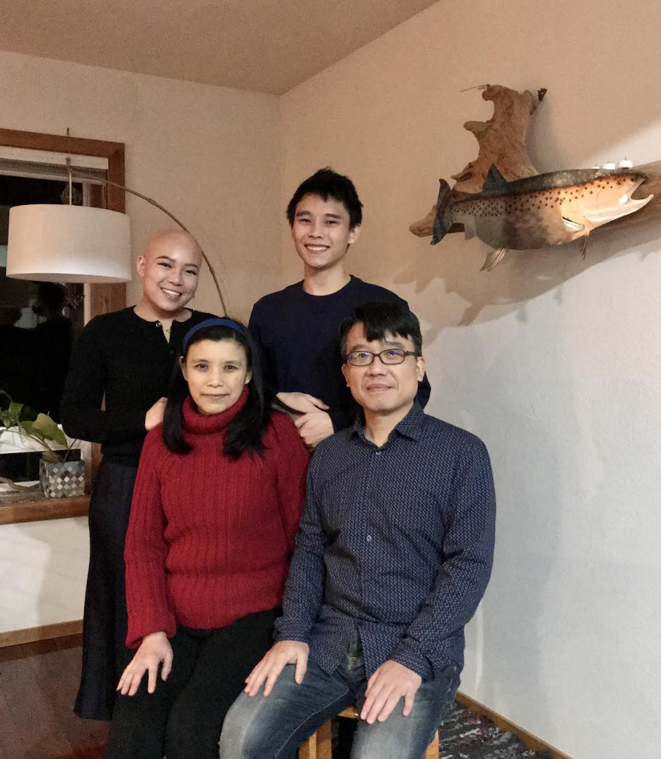
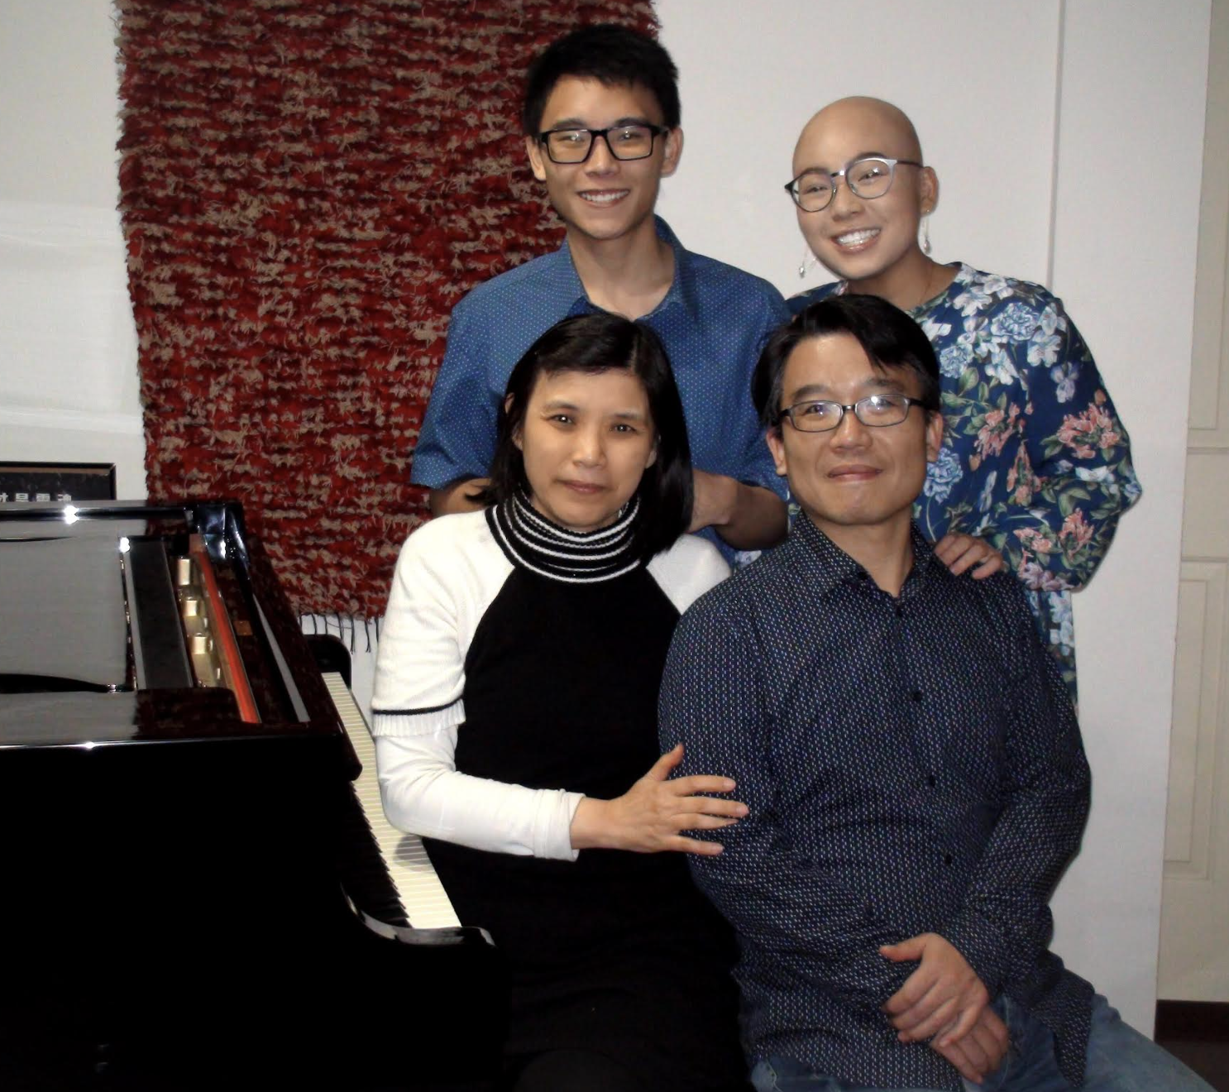

Slide 13

信仰的傳承 Inheritance of Faith
    純正的真道 Sound doctrine
    生命的見證 Life testimonies
    代禱的愛 Intercessory love

Slide 14
信仰的傳承 Inheritance of Faith
    純正的真道 Sound doctrine

Slide 15
提摩太前書 1 Timothy 6:12
你要為真道打那美好的仗，持定永生。 你為此被召，也在許多見證人面前，已經作了那美好的見證。
Fight the good fight of faith; take hold of the eternal life to which you were called, and you made the good confession in the presence of many witnesses.

Slide 16
彼得前書 1 Peter 3:15
只要心裡尊主基督為聖。 有人問你們心中盼望的緣由，就要常作準備，以溫柔、敬畏的心回答各人；
but sanctify Christ as Lord in your hearts, always being ready to make a defense to everyone who asks you to give an account for the hope that is in you, yet with gentleness and reverence; (NASB)

Slide 17

華人常見的信主的挑戰
      祭祖 Worshipping ancestor
      無神論 Atheism
      中國文化背景 Chinese culture background
      異端 Heresies

Slide 18
信仰的傳承 Inheritance of Faith
    純正的真道 Sound doctrine
    生命的見證 Life testimonies

Slide 19
路得記 Ruth 1:15-16
拿俄米說：「看哪，你嫂子已經回她本國和她所拜的神那裡去了，你也跟著你嫂子回去吧！」 路得說：「不要催我回去不跟隨你。你往哪裡去，我也往那裡去；你在哪裡住宿，我也在那裡住宿；你的國就是我的國，你的 神就是我的 神。
Then she said, “Behold, your sister-in-law has gone back to her people and her gods; return after your sister-in-law.” But Ruth said, “Do not urge me to leave you or turn back from following you; for where you go, I will go, and where you lodge, I will lodge. Your people shall be my people, and your God, my God.

Slide 20
信仰的傳承 Inheritance of Faith
    純正的真道 Sound doctrine
    生命的見證 Life testimonies
    代禱的愛 Intercessory love

Slide 21
提摩太後書 2 Timothy 1:3-4
我感謝 神，就是我接續祖先用清潔的良心所事奉的 神。 祈禱的時候，不住的想念你，
記念你的眼淚，晝夜切切地想要見你，好叫我滿心快樂。
I thank God, whom I serve with a clear conscience the way my forefathers did, as I constantly remember you in my prayers night and day, longing to see you, even as I recall your tears, so that I may be filled with joy.

Slide 22
信仰的傳承 Inheritance of Faith
    純正的真道 Sound doctrine
    生命的見證 Life testimonies
    代禱的愛 Intercessory love

Slide 23
提摩太後書 2 Timothy 1:11-12
我為這福音奉派作傳道的，作使徒，作師傅。 為這緣故，我也受這些苦難。 然而我不以為恥；因為知道我所信的是誰，也深信他能保全我所交付他的，直到那日。
for which I was appointed a preacher and an apostle and a teacher. For this reason I also suffer these things, but I am not ashamed; for I know whom I have believed and I am convinced that He is able to guard what I have entrusted to Him until that day.

Slide 24
回應詩歌 Response Song
「惟我深知所信的是誰」

