Slide 1

主日信息
Sunday Sermon

Slide 2
Jocelyn （黃薰儀）是阿爸的愛女，一個愛唱歌、愛在大自然裡敬拜的姐妹，創作有近三百首詩歌。出生於台灣，三十二歲移民美國，定居在加州舊金山灣區。 2006年回應呼召全時間事奉神，曾在中國宣教（深圳）兩年（2008-2010年），建立敬拜團隊及引進醫治釋放事工。 六年前神將非洲孤兒院事工量給Jocelyn 姐妹，她因此建立了活水湧流事工 LivingWaterInMe Ministries，除了直屬的烏干達孤兒院，Jocelyn 也曾任生命河基金會理事，專注於西非的孤兒院事工。 除了敬拜，在神的帶領下，Jocelyn 在走禱上累積十多年經歷，足跡涵蓋中國（深圳、北京）、以色列、哈薩克、非洲（西非 Slave Coast 及埃及），以及美國本土四十幾個州；去年奉神差遣，將事工駐地北遷至 Oregon，專注為 Pacific Northwest 地區禱告。

Slide 3
劇本寫好了!
The Script Has Been Written!
Jocelyn Huang 06/18/2023

Slide 4
你可以帶我去教會嗎？
“Can you please take me to church?”
Jubilee
River of Life 生命河靈糧堂
Forerunner 慕主先鋒 （前身為慕主錫安堂）

Slide 5
Mission Impossible! 不可能的任務 1
帶敬拜 Worship Lead
神感動
此道甚難！
親密關係建立的開始

Slide 6
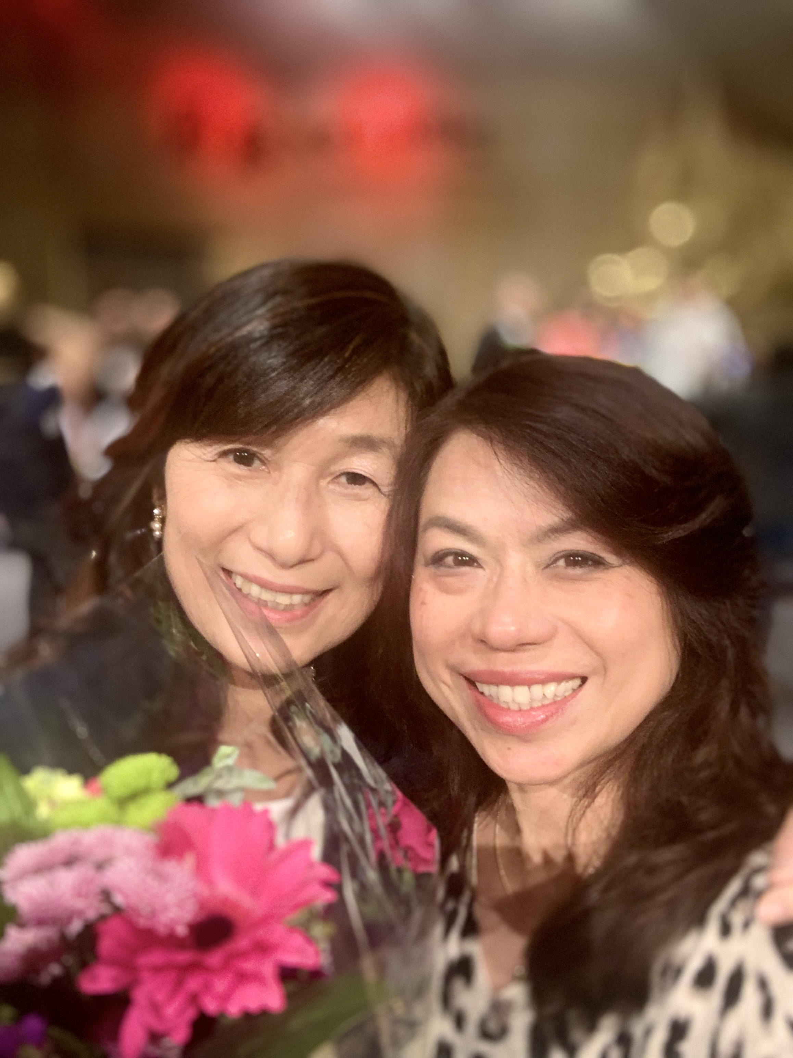
與主密契
Intimacy with the Lord
仰望詩歌
SongCatcher or Songwriter—
  “I don’t know. I just know!”
  才幹與恩賜的區別 Difference between talents and gifts.
聽到了就去做。主給一大袋「字」，交代說：「不要怕，只管寫，不要停止。」
    夜間主在異象中對保羅說、不要怕、只管講、不要閉口。（使徒行傳18:9）One night the Lord spoke to Paul in a vision: “Do not be afraid; keep on speaking, do not be silent. (Acts 18:9 NIV)

Slide 7
Mission Impossible! 不可能的任務 2
司琴 Piano Accompaniment
”怎麼可能！“ That’s impossible!”
耶和華對摩西說，這百姓藐視我要到幾時呢？我在他們中間行了這一切神蹟，他們還不信我要到幾時呢？（民數記14：11）
The Lord said to Moses, “How long will these people treat me with contempt? How long will they refuse to believe in me, in spite of all the signs I have performed among them? (Numbers 14:11 NIV)

Slide 8
回應呼召走出去！
Step out of the comfort zone to answer the call！
Fear 懼怕
Skill 技巧
Practice and more practice 爭取操練機會（生命河事奉學校、琴與爐禱告會、小家、小組、豐收神學院禱告會司琴）
去中國第一項任務印證神的呼召（以斯帖名言）
God enables the available! 願意擺上，神就恩膏！

Slide 9
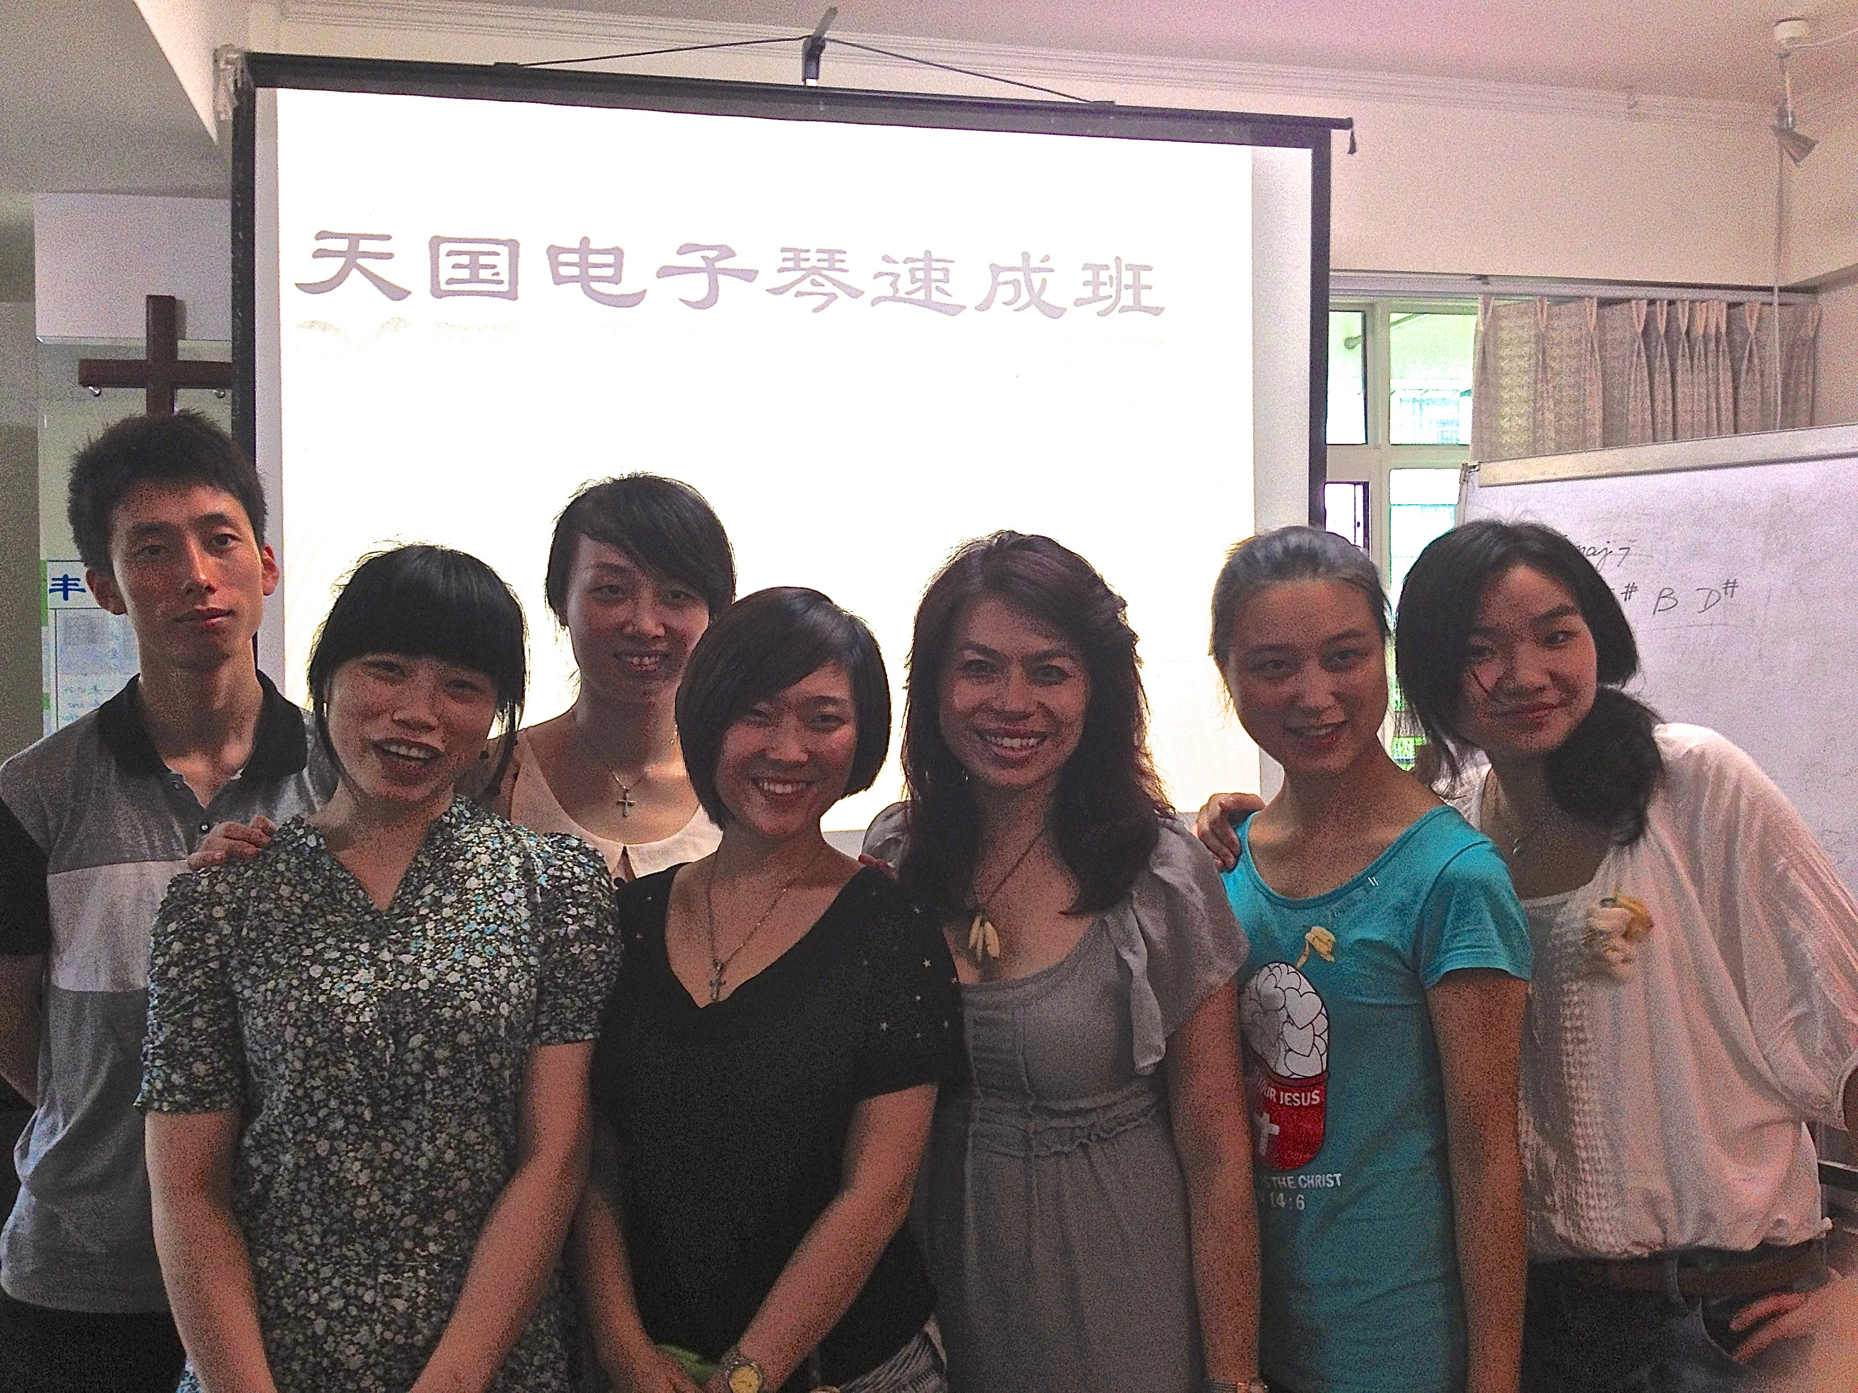
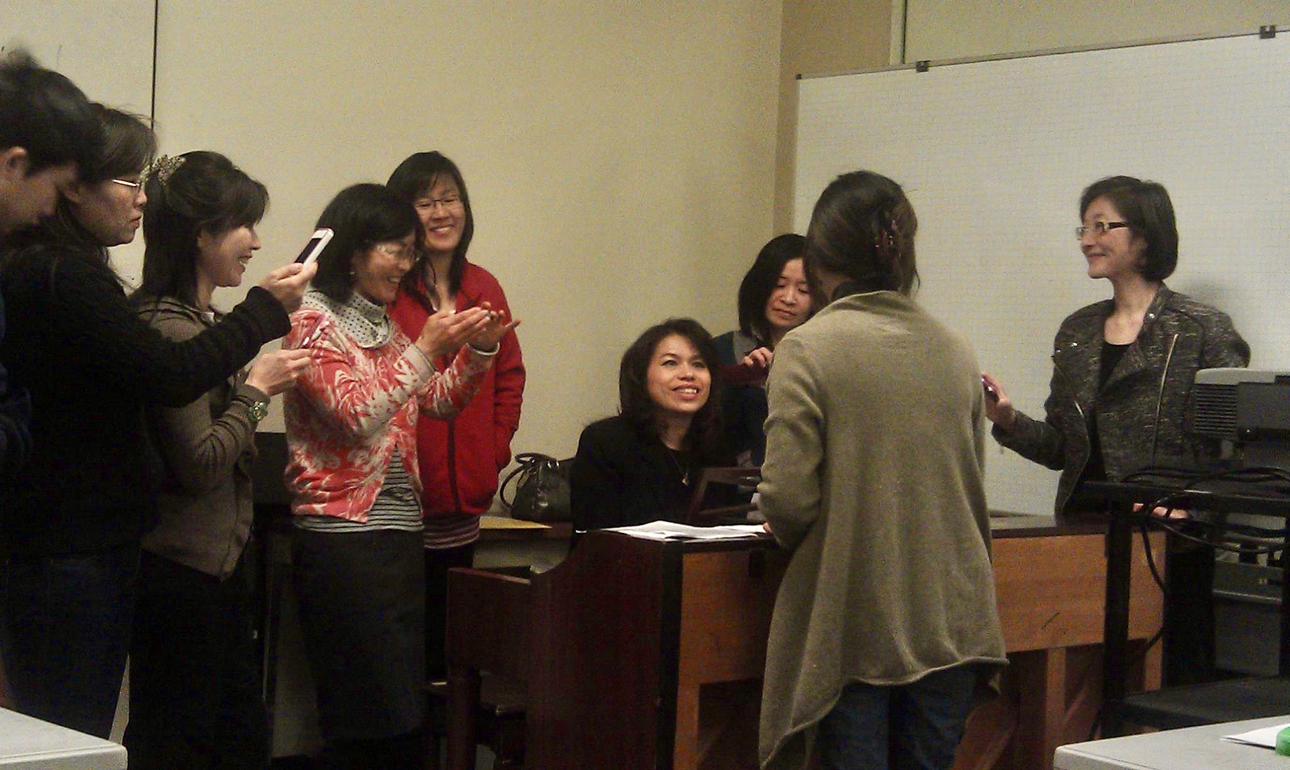
超乎得勝者！
More Than A Conqueror!
https://www.youtube.com/watch?v=NMolNZbEY64
從怕，到彈，到教！
在美國生命河靈糧堂主日學連續兩年教「實用基礎司琴班」。
在成都為大學生開闢密集班，為中國的復興預備樂手。

Slide 10
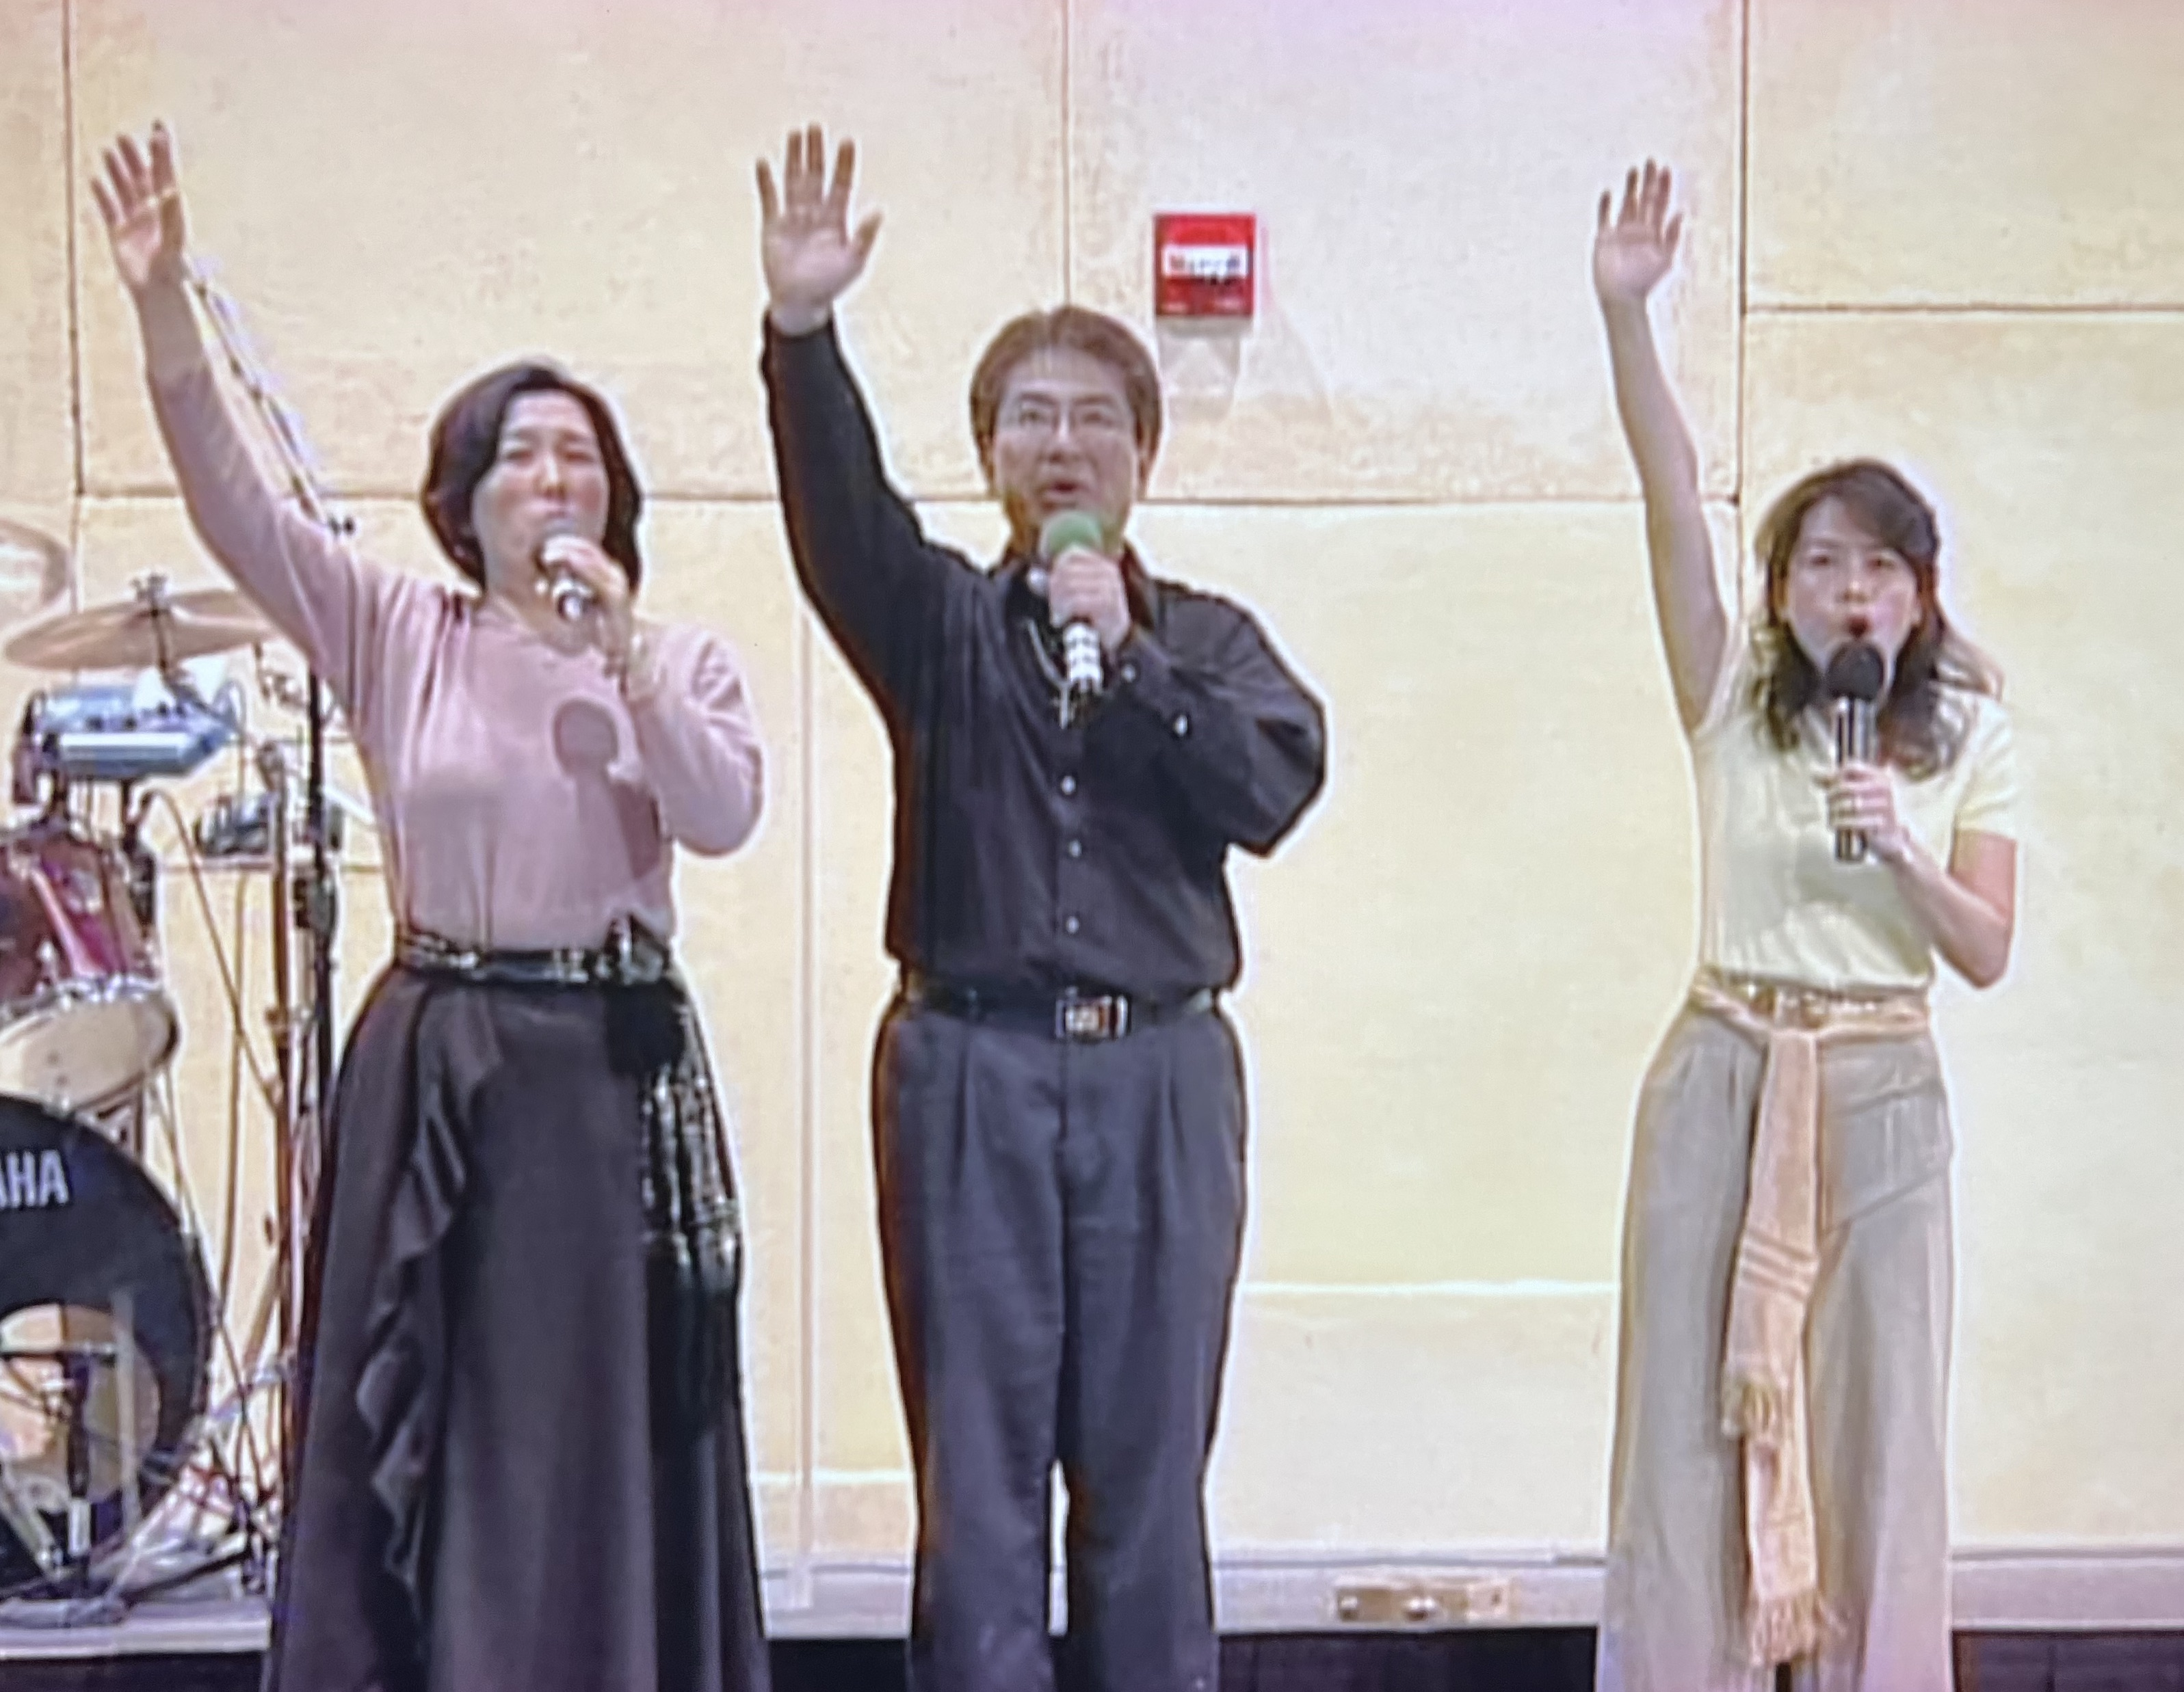
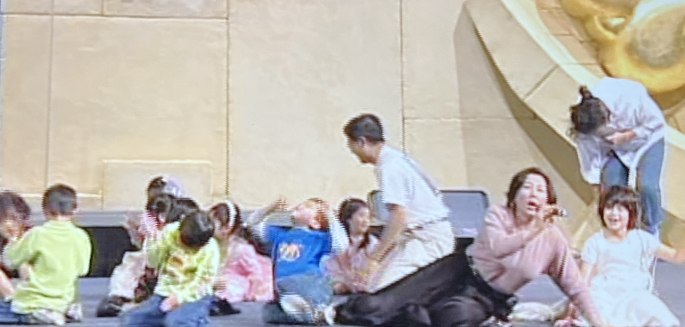
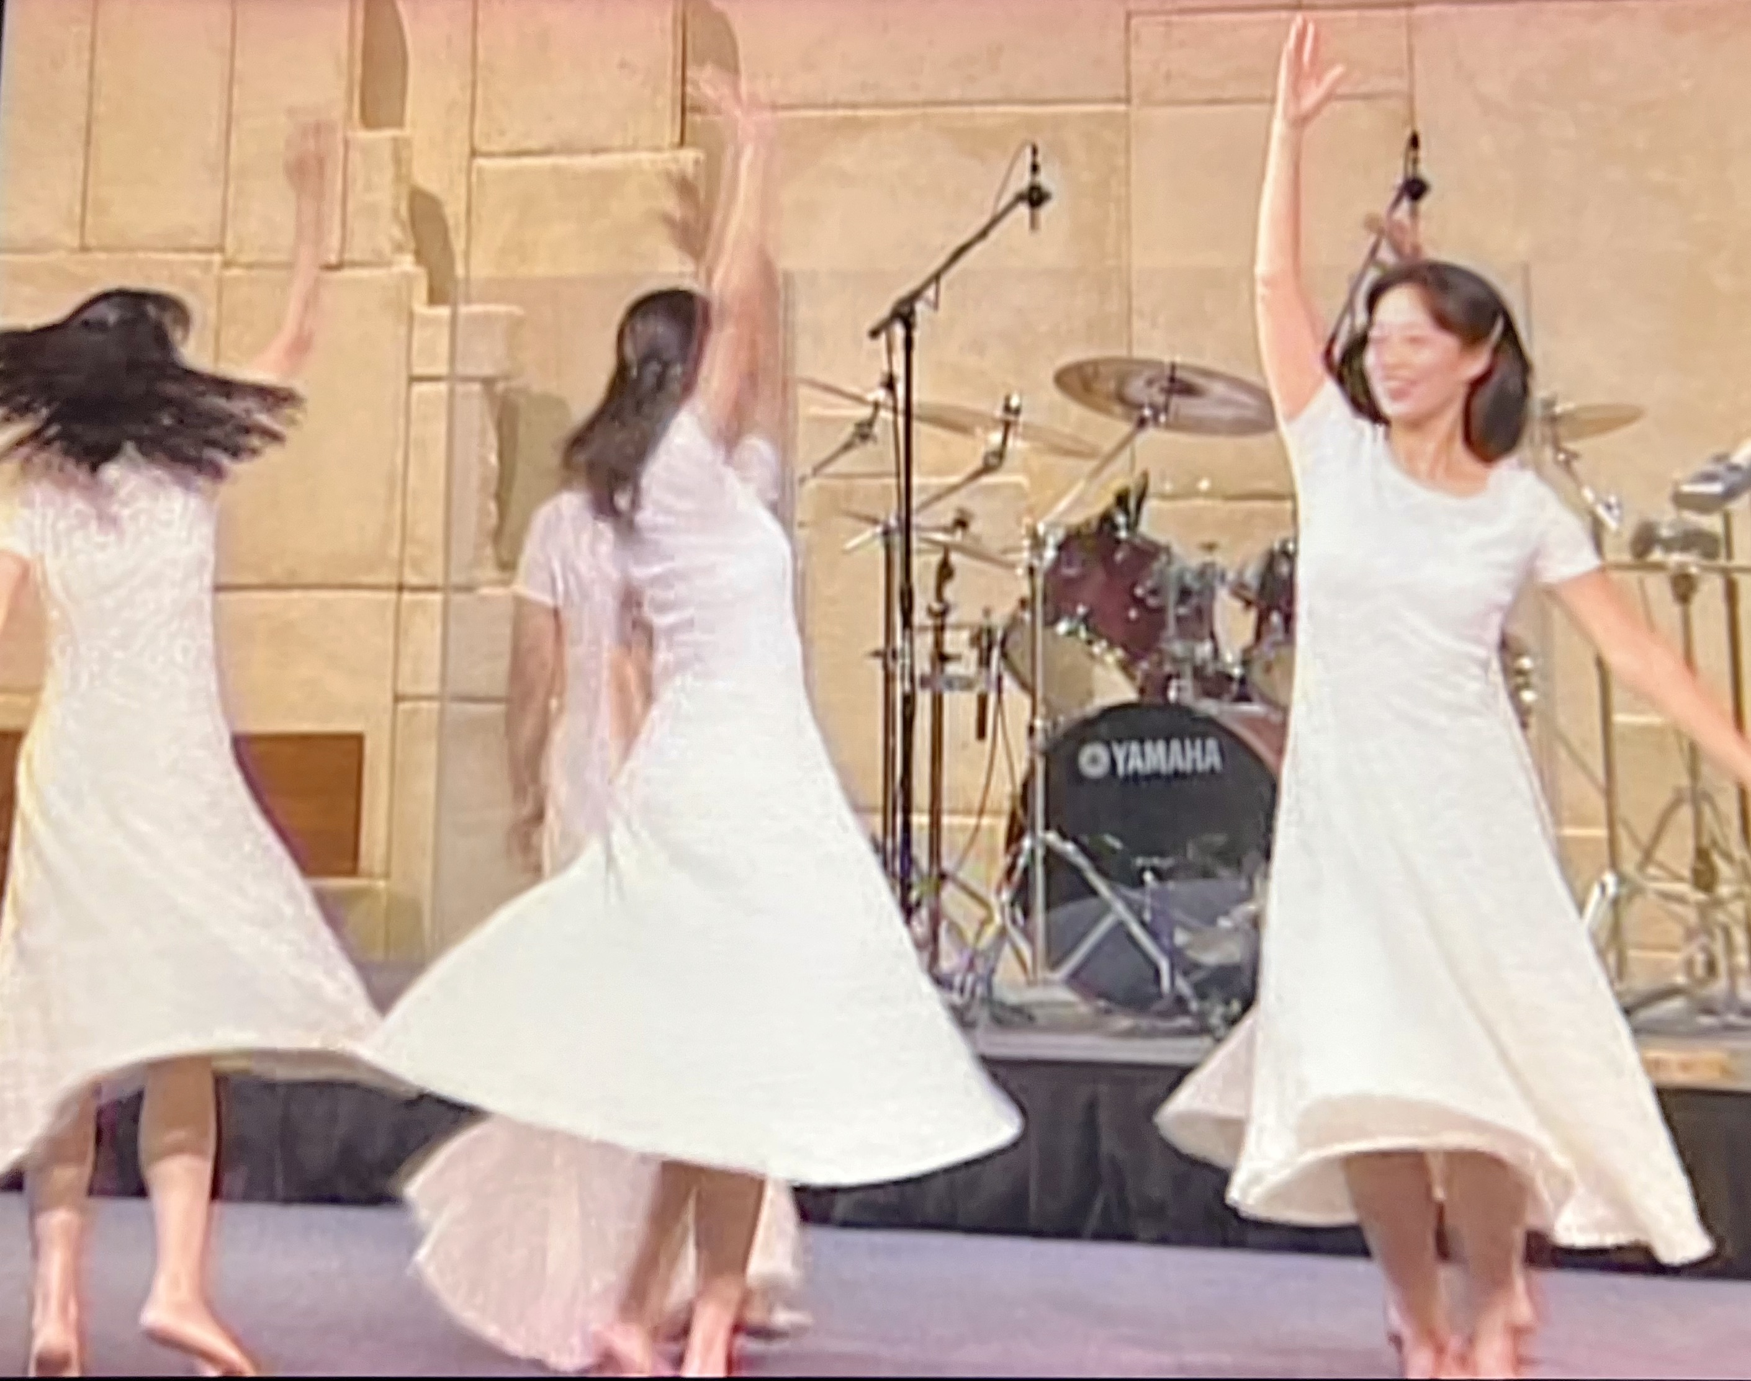
劇本已經寫好了！（1）
眾神之中
誰能像你
誰能像你
至聖至榮
可頌可畏
施行奇事
你伸出右手
地就吞滅他們
The script has been written! (1)
神早有預備--「出埃及記」音樂劇
Musical “Exodus” was already there!
以色列人遭埃及奴工逼迫。神啊！求你申我的冤，為我辯屈！
滿空星星亮晶晶 夜涼如水沁我心
瑩瑩火光示真情 歌珊恩典到如今

Slide 11
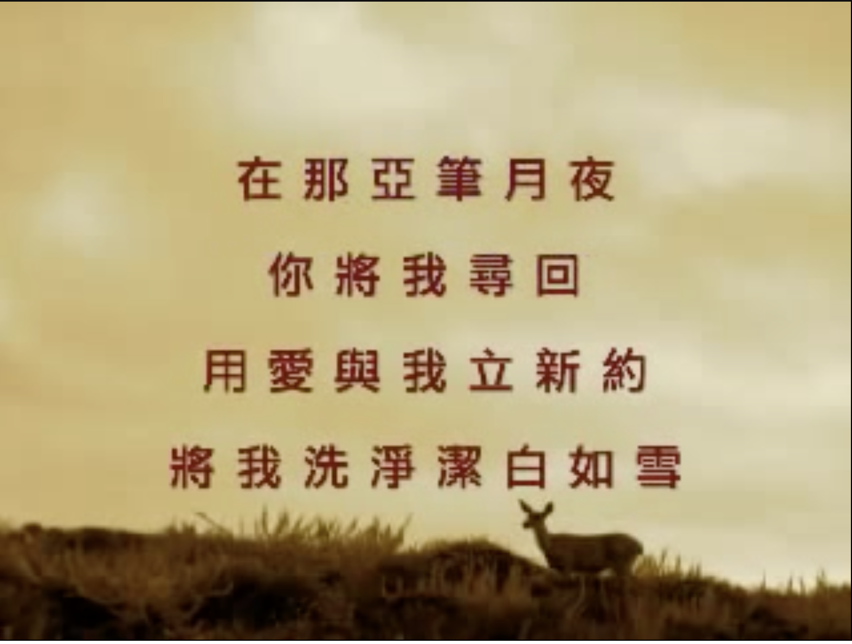
First Worship Song in the Bible
聖經記載第一首人向神獻上的敬拜的歌
亞倫的姐姐女先知米利暗、手裡拿著鼓、眾婦女也跟他出去拿鼓跳舞。米利暗應聲說、你們要歌頌耶和華、因他大大戰勝、將馬和騎馬的投在海中。（出埃及記15:20-21）Then Miriam the prophet, Aaron’s sister, took a timbrel in her hand, and all the women followed her, with timbrels and dancing. Miriam sang to them: “Sing to the Lord, for he is highly exalted. Both horse and driver He has hurled into the sea.” (Exodus 15:20-21 NIV)
「堅定的愛」Steadfast Love https://www.youtube.com/watch?v=IF6mpnL7FvI
YouTube channel: livingwaterinme

Slide 12
劇本已經寫好了！（2）
The script has been written! (2)
一個夢 A Dream—
第一個呼召 My First Calling：
  LOVING 愛的進行式
LOVING
黃 薰 儀

Slide 13
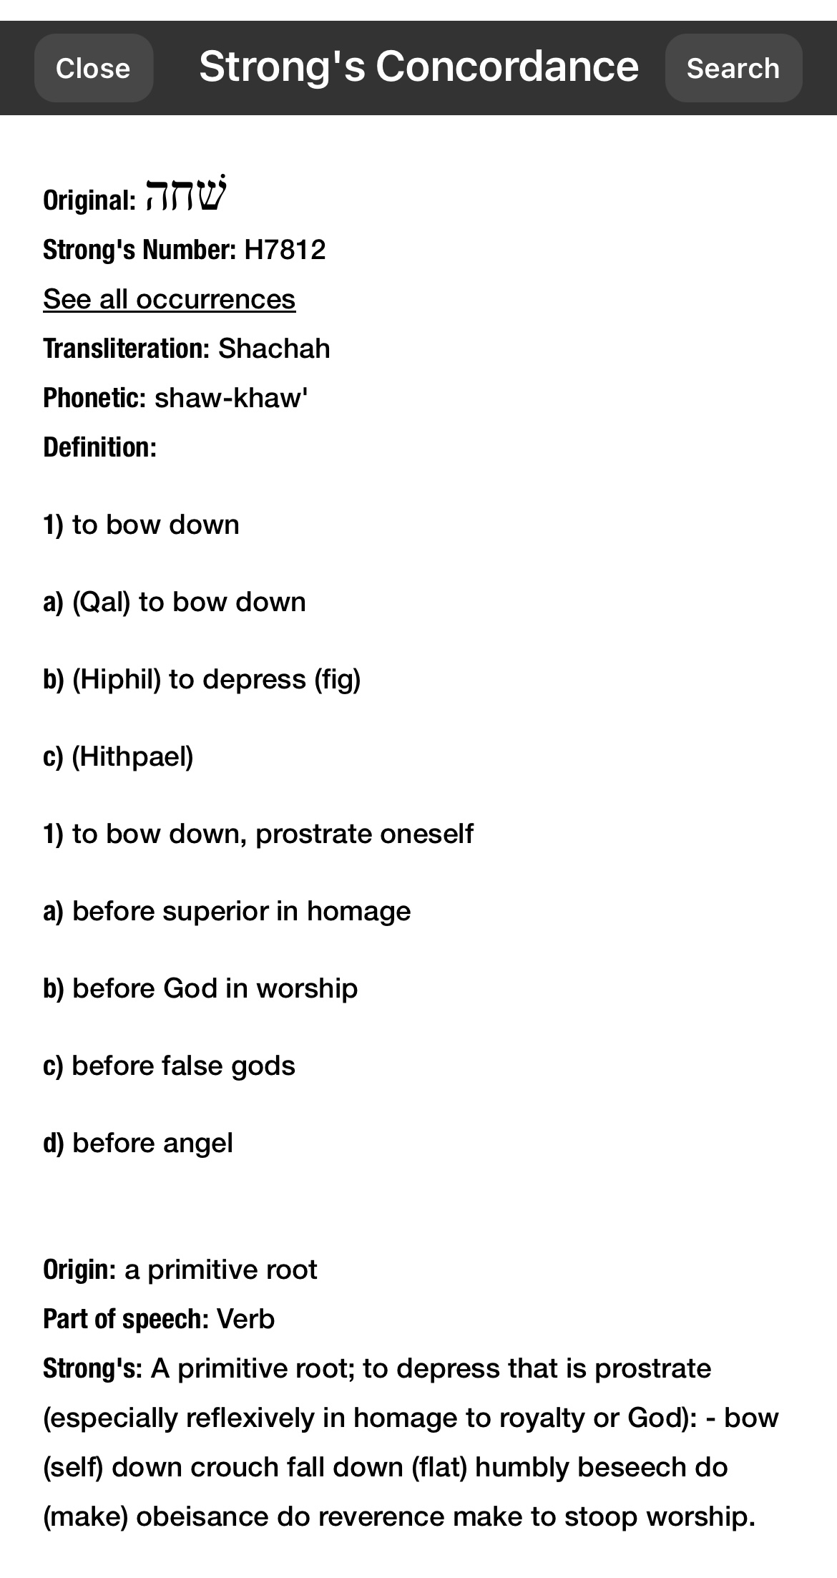
What’s Worship?
什麼是敬拜？
降服 Submission
尊敬 Reverence
獻祭 Offering

Slide 14
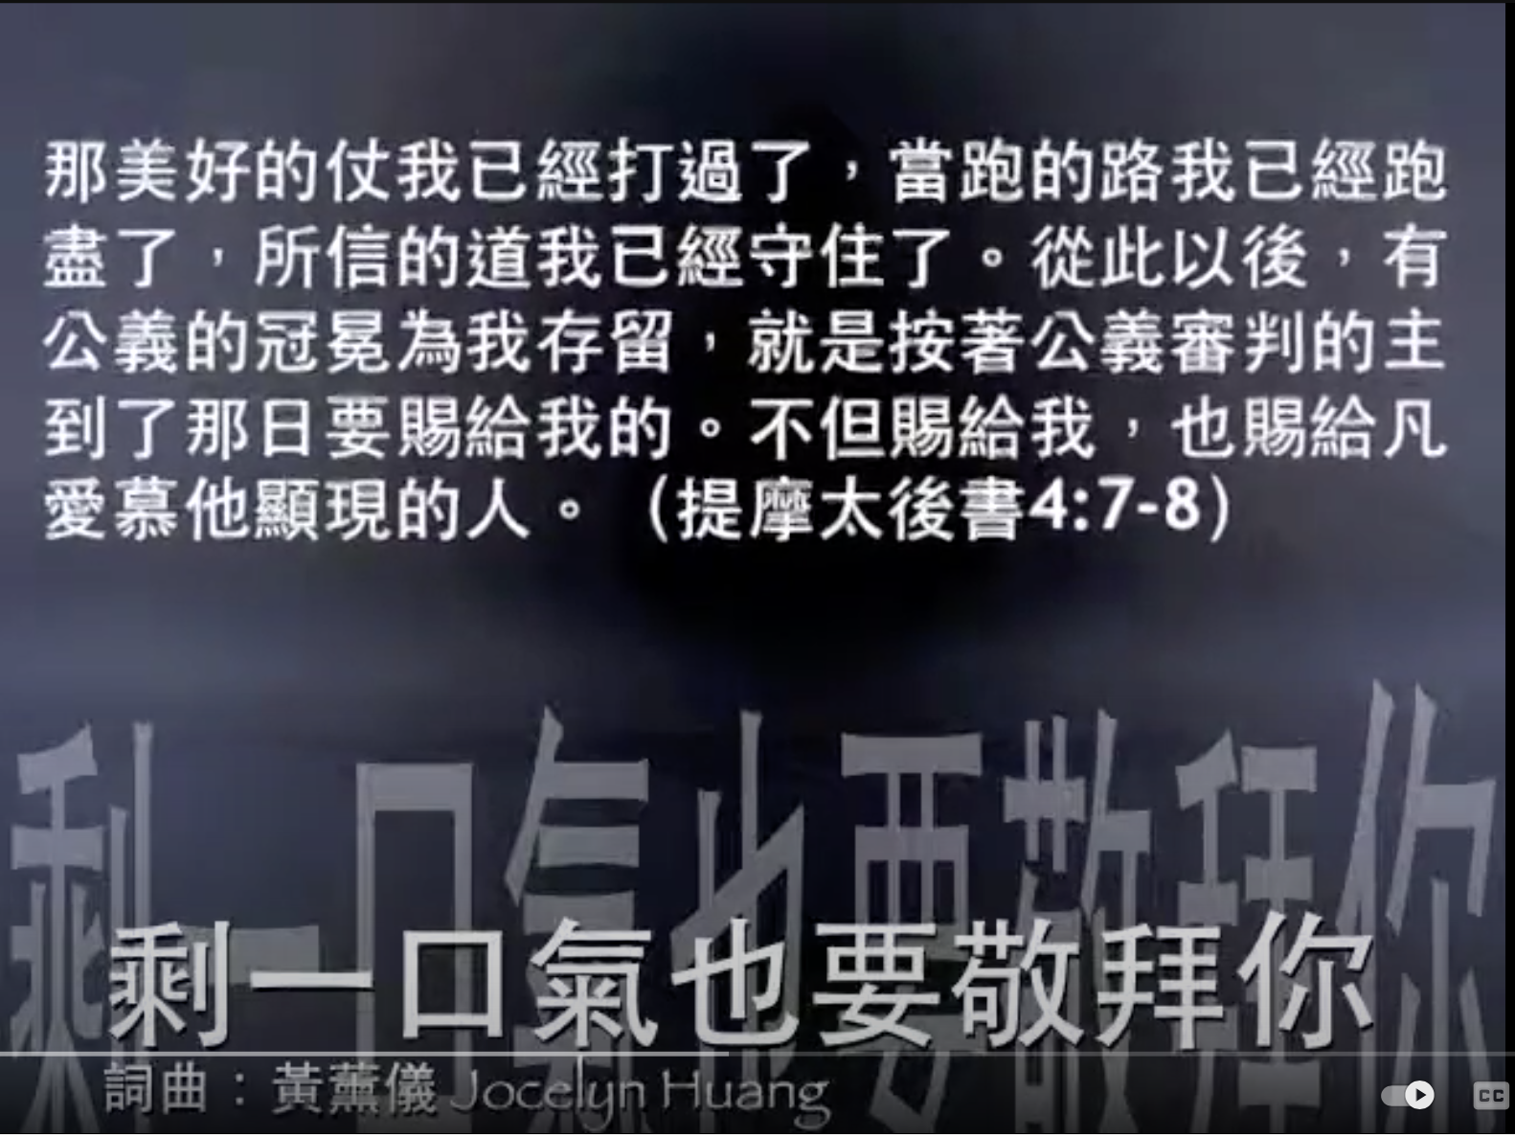
First Mention of “Worship”
聖經最早提到「敬拜」之處
聖經最早提到「敬拜」 First mention of “Worship” in the Bible—
  亞伯拉罕對他的僕人說，你們和驢在此等候，我與童子往那裡去拜一拜，就回到你們這裡來。（創世紀22:5）
  He said to his servants, “Stay here with the donkey while I and the boy go over there. We will worship and then we will come back to you.” (Genesis 22:5 NIV)
  雅各說，你要向我起誓，約瑟就向他起了誓。於是以色列在床頭上〔或作扶著杖頭〕敬拜 神。（創世紀47:31）
  “Swear to me,” he said. Then Joseph swore to him, and Israel worshiped as he leaned on the top of his staff. (Genesis 47:31 NIV)
  So Israel bowed himself on the head of the bed. (NKJV)
  Then Israel bowed in worship at the head of the bed. (NASB
「剩一口氣也要敬拜你」—
  https://www.youtube.com/watch?v=FrtJgI7NMFs

Slide 15
獻上活祭
A Living Sacrifice
所以基督到世上來的時候，就說：『 神阿，祭物和禮物是你不願意的；你曾給我預備了身體。』燔祭和贖罪祭是你不喜歡的，那時我說，神阿，我來了為要照你的旨意行。我的事在經卷上已經記載了。』（希伯來書10：7）
Therefore, when Christ came into the world, he said: “Sacrifice and offering you did not desire, but a body you prepared for me; with burnt offerings and sin offerings you were not pleased. Then I said, ‘Here I am—it is written about me in the scroll— I have come to do your will, my God.’” (Hebrew 10:7)
Be an willing and obedient vessel to do God’s Will.

Slide 16
愛是敬拜的底蘊
Love is the undertone of worship
敬拜和讚美的差別 Difference between Worship & Praise
我若能說萬人的方言、並天使的話語、卻沒有愛、我就成了鳴的鑼、響的鈸一般。我若有先知講道之能、也明白各樣的奧秘、各樣的知識．而且有全備的信、叫我能夠移山、卻沒有愛、我就算不得甚麼。我若將所有的賙濟窮人、又捨己身叫人焚燒、卻沒有愛、仍然與我無益。（哥林多前書13:1-3）
If I speak in the tongues of men or of angels, but do not have love, I am only a resounding gong or a clanging cymbal. If I have the gift of prophecy and can fathom all mysteries and all knowledge, and if I have a faith that can move mountains, but do not have love, I am nothing. If I give all I possess to the poor and give over my body to hardship that I may boast, but do not have love, I gain nothing. (1 Corinthians 13:1-3)

Slide 17
你是我愛的表述
You’re An Expression of My Love.

Slide 18
劇本已經寫好了！（3）
The script has been written! (3)
生命冊 Book of Life
  The Scroll of Times and Seasons: Father’s perfect will for our lives and our destinies.
  The Scroll of Life and Times: A chronology of the choices we make of our own will and the path we choose for our ourselves on the earth.
Source: “Building your business with the blueprint of Heaven: Seeing what Heaven sees and making it happen” by Dr. Ron Horner

Slide 19
凡事都有定期
There is a time for everything!
“Your past does not define you.”
  “手扶著犁向後看的，不配進神的國 Plow Forward” （報告神悅納人的禧年專輯）https://www.youtube.com/watch?v=thfLGMSnbAE
  KTSF「活出精彩」專訪從兩腿癱瘓、情感破產中興起歌唱的黃薰儀姐妹 https://www.youtube.com/watch?v=0Teb7Vo6M4k&t=858s
Your present cannot confine you.
Keep moving! 不斷前進 （Mantle 故事）
  要擴張你帳幕之地，張大你居所的幔子，不要限止；要放長你的繩子，堅固你的橛子。因為你要向左向右開展；你的後裔必得多國為業，又使荒涼的城邑有人居住。不要懼怕，因你必不致蒙羞；也不要抱愧，因你必不致受辱。你必忘記幼年的羞愧，不再記念你寡居的羞辱。因為造你的是你的丈夫；萬軍之耶和華是他的名。救贖你的是以色列的聖者；他必稱為全地之神。（以賽亞書54: 2-5)
  Enlarge the place of your tent, stretch your tent curtains wide, do not hold back; lengthen your cords, strengthen your stakes. For you will spread out to the right and to the left; your descendants will dispossess nations and settle in their desolate cities. “Do not be afraid; you will not be put to shame. Do not fear disgrace; you will not be humiliated. You will forget the shame of your youth and remember no more the reproach of your widowhood. For your Maker is your husband— the Lord Almighty is his name— the Holy One of Israel is your Redeemer; he is called the God of all the earth. (Isaiah 54: 2-5)

Slide 20
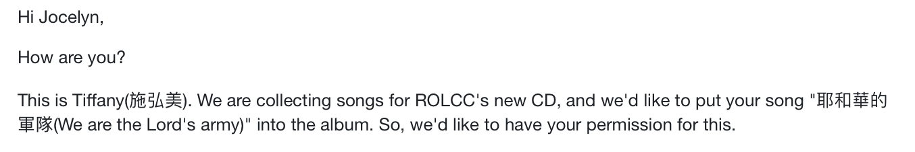
藍圖一步步展開
Blueprint Unfolded…
對中國的呼召（去哪個教會？孩子中文學校見證、王院長及劉牧師支持、醫治釋放特會在三自教會）
「你會寫很多戰歌。」

Slide 21
要得著上好的！
The fullness of the Kingdom
耶穌說，我實在告訴你們，人為 神的國，撇下房屋、或是妻子、弟兄、父母、兒女，沒有在今世不得百倍，在來世不得永生的。（路加福音18:29-30）
So He said to them, “Assuredly, I say to you, there is no one who has left house or parents or brothers or wife or children, for the sake of the kingdom of God, who shall not receive many times more in this present time, and in the age to come eternal life.” (Luke 18:29-30 NKJV)
事工 vs. 事工的主 Ministry vs. Master of the Ministry
聖殿 vs 聖殿的主神 Temple vs. The Lord God the Temple

Slide 22
Play mp3 file
「How Can I Have Just A Little Bit Of You」

Slide 23
How Can I Have Just A Little Bit Of You?
我怎能只有你的一點點？ 詞曲：黃薰儀 Jocelyn Huang Verse 1/1
把你名字 寫上千遍
I scribbled your name again and again
寫到你在我的眼前出現
Until you showed up as if we had a date
萬語千言 在一瞬之間
So much is said in an instance
愛情熾烈如火焰
Your love is burning like a flame

Slide 24
How can I have just a little bit of you?
我怎能只有你的一點點？ Verse 2/2
我以為是我的思念
Has it been my imagination,
教我變得如此瘋癲
A vision out of my foolish craze?
直到你一把將我攬在身邊
But then I fall into your embrace
馨香氣息瀰漫我鼻尖
Your fragrance permeates the whole space

Slide 25
How can I have just a little bit of you?
我怎能只有你的一點點？ Chorus 1/2
我怎能只有你的一點點？
How can I have just a little bit of you?
你是我至深的愛戀
You’re on my mind in everything I do
我要貼在你身邊
I will stay close by your side
不容任何事物存在我們中間
Let no nothing ever come between you and me

Slide 26
How can I have just a little bit of you?
我怎能只有你的一點點？ Chorus 2/2
我怎能只有你的一點點？
How can I have just a little bit of you?
你是我至深的愛戀
You’re on my mind in everything I do
我要住在你裡面
I will dwell inside of you
讓你填滿我的時間
Have you fill my eyes and my time
佔據整個心田
Fill up all my life

Slide 27
How can I have just a little bit of you?
我怎能只有你的一點點？ Bridge
你知道我的從前
You know my yesterdays
擁有我的明天
And all my days to come
我可以在你面前
There’s no way I can hide
無庸遮遮掩掩
There’s no need I should hide
把喜怒哀樂全然攤開在你眼前
My life’s an open book. No secret hides before you!

Slide 28
How can I have just a little of you?
我怎能只有你的一點點？ Coda
我願醒時與你同行探險
I will walk with you in every valley
夜裡在你懷中安眠
And will climb with you every mountain
白髮加添
Day after day
愛更新鮮
Whatever it takes
情深繾綣
May this love we have
在地如在天
Never ever fade

Slide 29
How Can I Have Just A Little Bit Of You?
我怎能只有你的一點點？ 詞曲：黃薰儀 Jocelyn Huang Verse 1/1
把你名字 寫上千遍
I scribbled your name again and again
寫到你在我的眼前出現
Until you showed up as if we had a date
萬語千言 在一瞬之間
So much is said in an instance
愛情熾烈如火焰
Your love is burning like a flame

Slide 30
How can I have just a little bit of you?
我怎能只有你的一點點? Verse 2/2
我以為是我的思念
Has it been my imagination,
教我變得如此瘋癲
A vision out of my foolish craze?
直到你一把將我攬在身邊
But then I fall into your embrace
馨香氣息瀰漫我鼻尖
Your fragrance permeates the whole space

Slide 31
How can I have just a little bit of you?
我怎能只有你的一點點？ Chorus 1/2
我怎能只有你的一點點？
How can I have just a little bit of you?
你是我至深的愛戀
You’re on my mind in everything I do
我要貼在你身邊
I will stay close by your side
不容任何事物存在我們中間
Let no nothing ever come between you and me

Slide 32
How can I have just a little bit of you?
我怎能只有你的一點點？ Chorus 2/2
我怎能只有你的一點點？
How can I have just a little bit of you?
你是我至深的愛戀
You’re on my mind in everything I do
我要住在你裡面
I will dwell inside of you
讓你填滿我的時間
Have you fill my eyes and my time
佔據整個心田
Fill up all my life

Slide 33
How can I have just a little of you?
我怎能只有你的一點點？ Coda
我願醒時與你同行探險
I will walk with you in every valley
夜裡在你懷中安眠
And will climb with you every mountain
白髮加添
Day after day
愛更新鮮
Whatever it takes
情深繾綣
May this love we have
在地如在天
Never ever fade

Slide 34
How can I have just a little bit of you?
我怎能只有你的一點點？ Ending
白髮加添
Day after day
愛更新鮮
Whatever it takes
情深繾綣
May this love we have
在地如在天
Never ever fade

Slide 35
How can I have just a little bit of you?
我怎能只有你的一點點？ Last page
情深繾綣
May this love we have
在地如在天
Never ever fade

