Slide 1
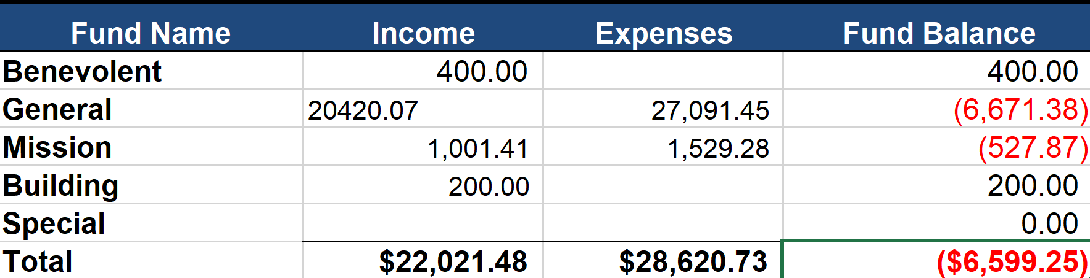
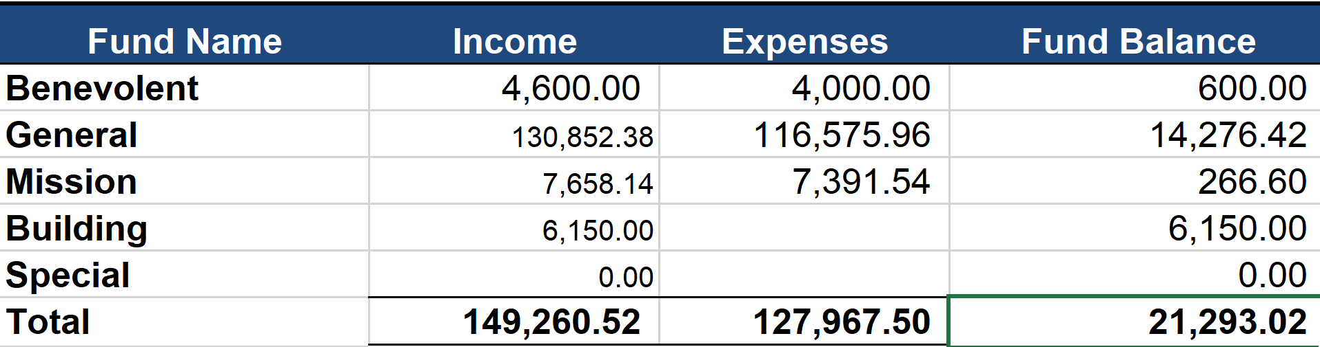
教會 July 2023 財務收支概況 Financial Status
2023 YTD BOLIP Net Cash Flow/Balance

Slide 2

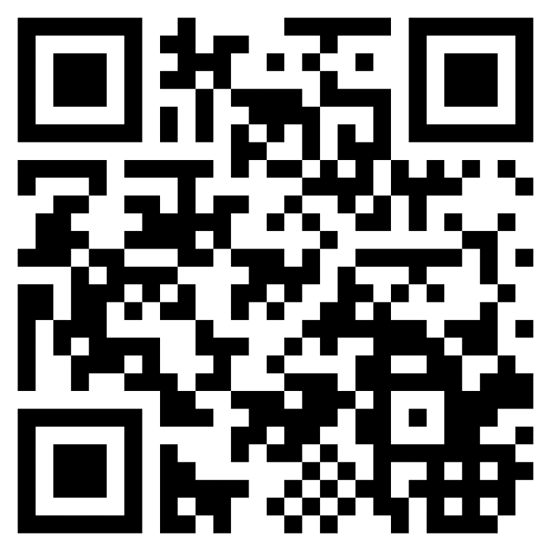
愛心奉獻 Offering
網上奉獻： 除了 Paypal 奉獻以外，歡迎使用 ZELLE 奉獻給教會帳號 bolip.donation@gmail.com
請在 comment 註明奉獻要歸給: 一般常費、會堂基金、宣教基金、 或是 慈惠基金。
支票奉獻：抬頭請寫 BOLIP

Slide 3
哥林多後書‬ 2 Corinthians. 9:6-7
「少種的少收，多種的多收」，這話是真的。 各人要隨本心所酌定的，不要作難，不要勉強，因為捐得樂意的人是 神所喜愛的。
The point is this: whoever sows sparingly will also reap sparingly, and whoever sows bountifully will also reap bountifully. Each one must give as he has decided in his heart, not reluctantly or under compulsion, for God loves a cheerful giver.

Slide 4
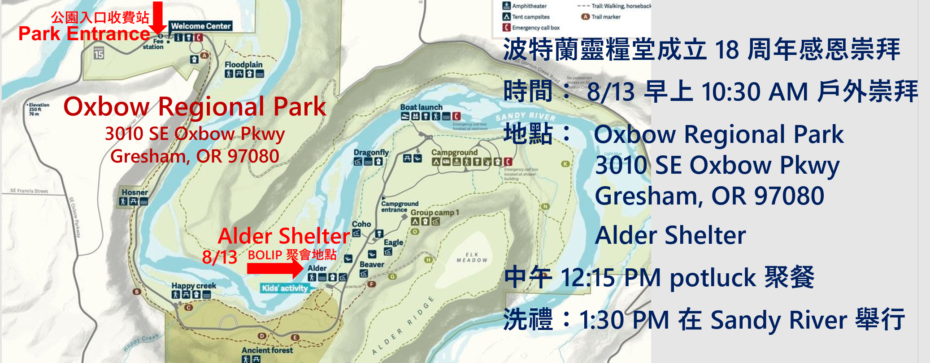

Slide 5
8/13 Oxbow Park 戶外主日受洗者名單
劉旭峯 Louis Liu 弟兄
王諾 Noah Wang 弟兄
Rita Hung
祝向永 XiangYong Zhu 弟兄
孙畅 Chang Vicky Sun 姐妹
陳方焜 弟兄一家
黃婕 姐妹（妻）
王麗芬 姐妹（岳母）
罗佩英 Mandy 姐妹
張立成 LiCheng Zhang 弟兄
刘小敏 姐妹
林國琴 GuoQin Lin 姐妹

Slide 6

主日信息
Sunday Sermon

Slide 7
何等恩典
How Could It Be
波特蘭靈糧堂
August 6, 2023

Slide 8
詩篇 Psalm 139:13-15
我的肺腑是你所造的；我在母腹中，你已覆庇我。 我要稱謝你，因我受造，奇妙可畏；你的作為奇妙，這是我心深知道的。 我在暗中受造，在地的深處被聯絡；那時，我的形體並不向你隱藏。
For you created my inmost being; you knit me together in my mother’s womb. I praise you because I am fearfully and wonderfully made; your works are wonderful, I know that full well. My frame was not hidden from you when I was made in the secret place, when I was woven together in the depths of the earth.

Slide 9
詩篇 Psalm 139:16-18
我未成形的體質，你的眼早已看見了；你所定的日子，我尚未度一日，你都寫在你的冊上了。 神啊，你的意念向我何等寶貴！ 其數何等眾多！ 我若數點，比海沙更多；我睡醒的時候，仍和你同在。
Your eyes saw my unformed body; all the days ordained for me were written in your book before one of them came to be. How precious to me are your thoughts, God! How vast is the sum of them! Were I to count them, they would outnumber the grains of sand—when I awake, I am still with you.

Slide 10
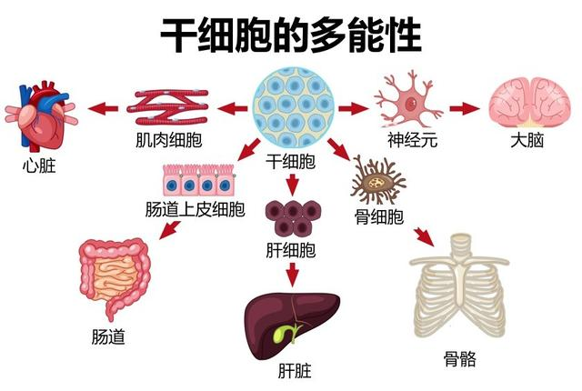

Slide 11
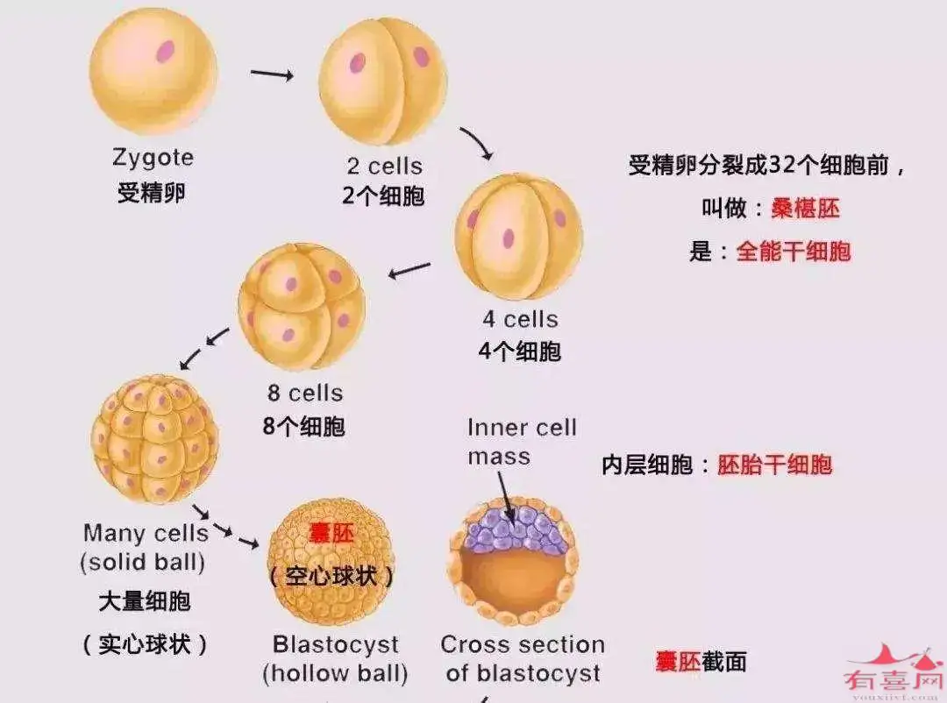
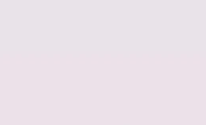

Slide 12
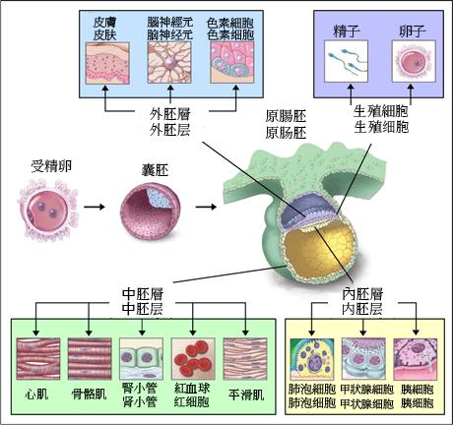

Slide 13
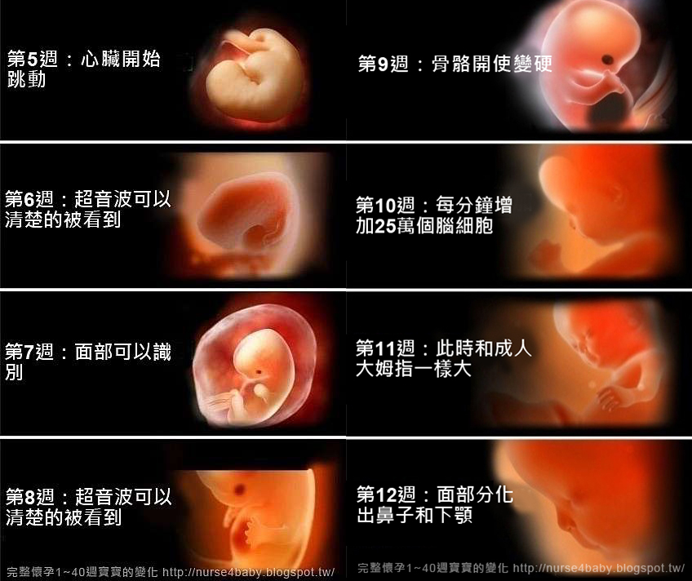

Slide 14
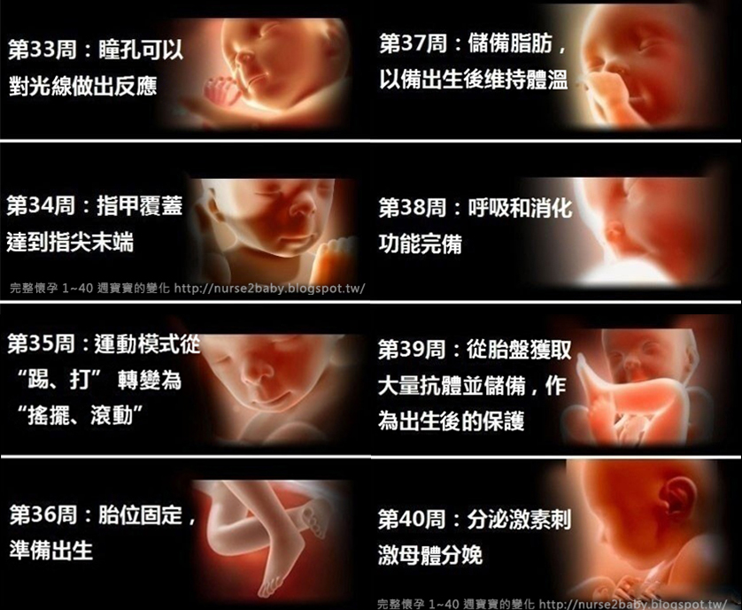

Slide 15
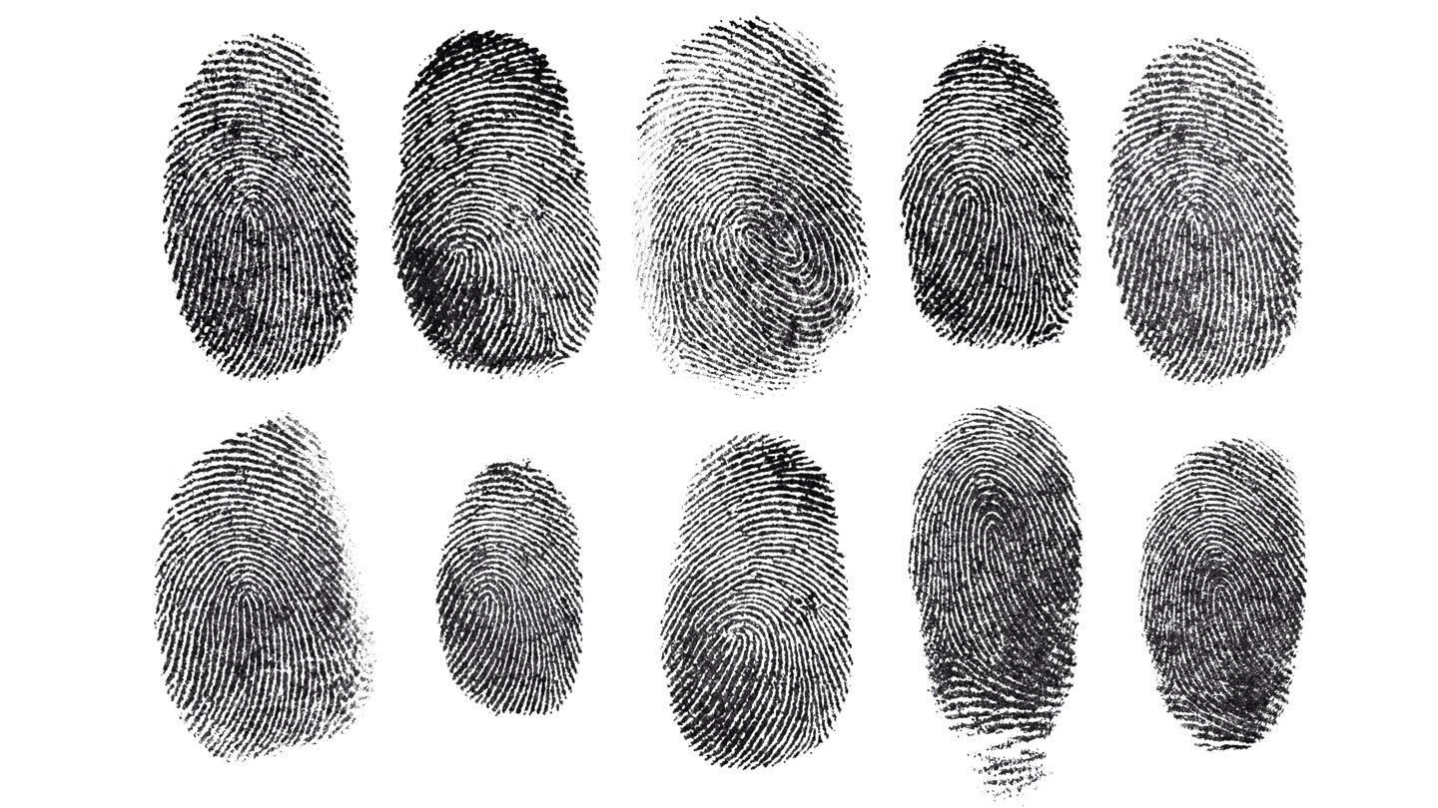

Slide 16
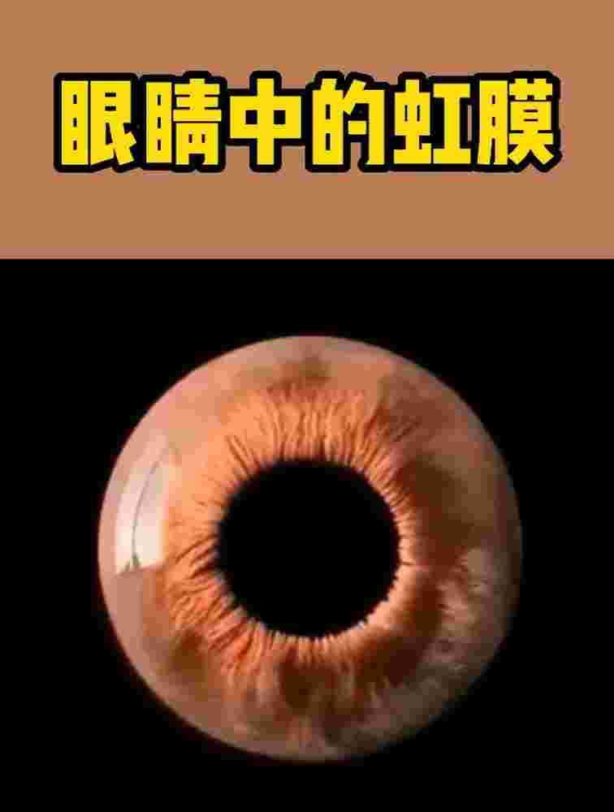
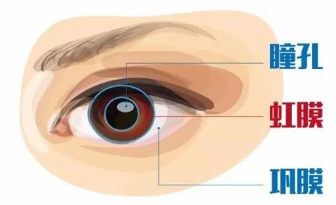
Iris

Slide 17
馬太福音 Matthew 18:2-4
耶穌便叫一個小孩子來，使他站在他們當中，說：「我實在告訴你們，你們若不回轉，變成小孩子的樣式，斷不得進天國。 所以，凡自己謙卑像這小孩子的，他在天國裡就是最大的。
And calling to him a child, he put him in the midst of them and said, “Truly, I say to you, unless you turn and become like children, you will never enter the kingdom of heaven. Whoever humbles himself like this child is the greatest in the kingdom of heaven.

Slide 18
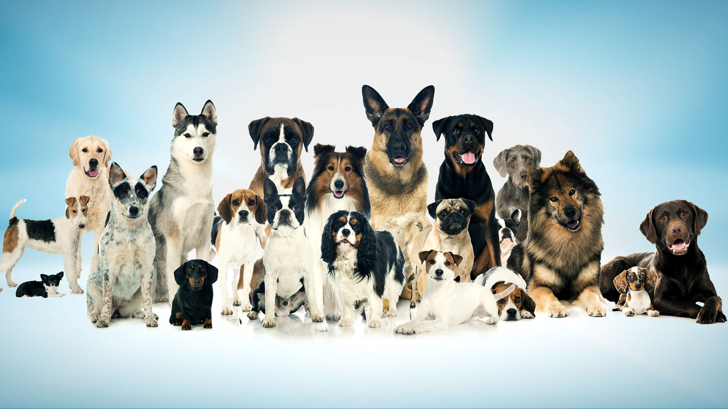
哪一隻最 「美」？

Slide 19
雅各書 James 3:9-11
我們用舌頭頌讚那為主、為父的，又用舌頭咒詛那照著 神形像被造的人。 頌讚和咒詛從一個口裡出來！ 我的弟兄們，這是不應當的！ 泉源從一個眼裡能發出甜苦兩樣的水嗎？
With it we bless our Lord and Father, and with it we curse people who are made in the likeness of God. From the same mouth come blessing and cursing. My brothers, these things ought not to be so. Does a spring pour forth from the same opening both fresh and salt water?

Slide 20
詩篇 Psalm 139:17-18
神啊，你的意念向我何等寶貴！ 其數何等眾多！ 我若數點，比海沙更多；我睡醒的時候，仍和你同在。
How precious to me are your thoughts, God! How vast is the sum of them! Were I to count them, they would outnumber the grains of sand—when I awake, I am still with you.

Slide 21
以弗所書 Ephesians 1:4-5
就如 神從創立世界以前，在基督裡揀選了我們，使我們在他面前成為聖潔，無有瑕疵；又因愛我們，就按著自己的意旨所喜悅的，預定我們藉著耶穌基督得兒子的名分，
even as he chose us in him before the foundation of the world, that we should be holy and blameless before him. In love he predestined us for adoption to himself as sons through Jesus Christ, according to the purpose of his will,

Slide 22
以弗所書 Ephesians 3:16-20
求他按著他豐盛的榮耀，藉著他的靈，叫你們心裡的力量剛強起來，使基督因你們的信，住在你們心裡，叫你們的愛心有根有基，能以和眾聖徒一同明白基督的愛是何等長闊高深，並知道這愛是過於人所能測度的，便叫 神一切所充滿的，充滿了你們。 神能照著運行在我們心裡的大力充充足足地成就一切，超過我們所求所想的。
16 that according to the riches of his glory he may grant you to be strengthened with power through his Spirit in your inner being, 17 so that Christ may dwell in your hearts through faith—that you, being rooted and grounded in love,

Slide 23
見證分享 Testimony Sharing
Vicky Sun 孙畅 姐妹
Agatha Chang 李麗卿 姐妹

Slide 24
回應詩歌 Response Song
「何等恩典 How Could It Be」

