Slide 1
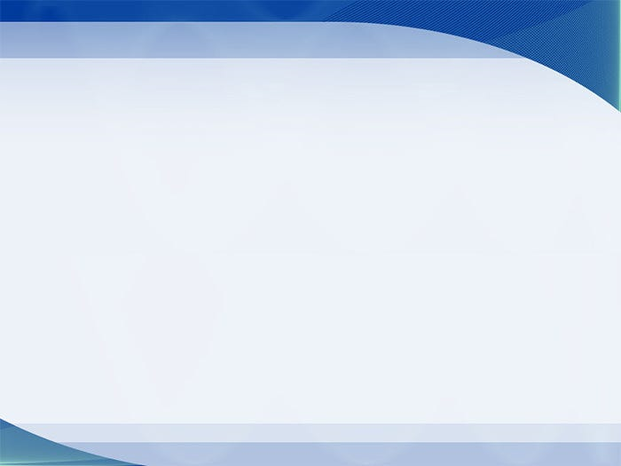
Play video
經歷神營會見證分享
Testimony Sharing on Encounter Retreat
姚海波 姐妹

Slide 2
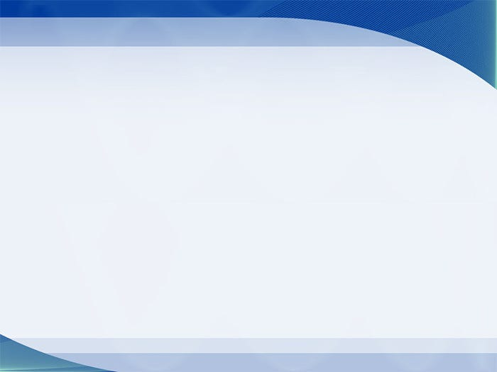
主日信息
Sunday Sermon

Slide 3
醫治的禱告
Healing Prayers
波特蘭靈糧堂
September 10, 2023

Slide 4
約翰福音 John 14:11-12
你們當信我，我在父裡面，父在我裡面；即或不信，也當因我所做的事信我。 我實實在在地告訴你們，我所做的事，信我的人也要做，並且要做比這更大的事，因為我往父那裡去。
Believe me when I say that I am in the Father and the Father is in me; or at least believe on the evidence of the works themselves. Very truly I tell you, whoever believes in me will do the works I have been doing, and they will do even greater things than these, because I am going to the Father.

Slide 5

醫治禱告的真理
    神渴望我們得著豐盛健康的生命
    主耶穌已經為我們的醫治付上代價
    聖靈是醫治的靈，並賜下醫病的恩賜

Slide 6
約翰福音 John 10:10
盜賊來，無非要偷竊、殺害、毀壞；我來了，是要叫羊得生命，並且得的更豐盛。
The thief comes only to steal and kill and destroy; I have come that they may have life, and have it to the full.

Slide 7
約翰一書 1 John 3:8b
神的兒子顯現出來，為要除滅魔鬼的作為。
The reason the Son of God appeared was to destroy the devil’s work.

Slide 8
約翰三書 3 John 1:2
親愛的兄弟啊，我願你凡事興盛，身體健壯，正如你的靈魂興盛一樣。
Beloved, I pray that in all respects you may prosper and be in good health, just as your soul prospers.

Slide 9
醫治禱告的真理
    神渴望我們得著豐盛健康的生命
    主耶穌已經為我們的醫治付上代價
    聖靈是醫治的靈，並賜下醫病的恩賜

Slide 10
以賽亞書 Isaiah 53:5
哪知他為我們的過犯受害，為我們的罪孽壓傷。因他受的刑罰我們得平安，因他受的鞭傷我們得醫治。
But he was pierced for our transgressions,
he was crushed for our iniquities;
the punishment that brought us peace was on him,
and by his wounds we are healed.

Slide 11
醫治禱告的真理
    神渴望我們得著豐盛健康的生命
    主耶穌已經為我們的醫治付上代價
    聖靈是醫治的靈，並賜下醫病的恩賜

Slide 12
使徒行傳 Acts 10:38
神怎樣以聖靈和能力膏拿撒勒人耶穌，這都是你們知道的。 他周流四方，行善事，醫好凡被魔鬼壓制的人，因為神與他同在。
how God anointed Jesus of Nazareth with the Holy Spirit and power, and how he went around doing good and healing all who were under the power of the devil, because God was with him.

Slide 13
哥林多前書 1 Cor. 12:9
又有一人蒙這位聖靈賜他信心，還有一人蒙這位聖靈賜他醫病的恩賜，
to another faith by the same Spirit, to another gifts of healing by that one Spirit,

Slide 14
醫治禱告的真理
    神渴望我們得著豐盛健康的生命
    主耶穌已經為我們的醫治付上代價
    聖靈是醫治的靈，並賜下醫病的恩賜

Slide 15
醫治禱告的操練
          我們的參與
          信心與醫治 (主能、主肯)
          宣告神的名字
          神的話語帶來醫治

Slide 16
馬太福音 Matthew 10:7-8
隨走隨傳，說『天國近了！』醫治病人，叫死人復活，叫長大痲瘋的潔淨，把鬼趕出去。你們白白地得來，也要白白地捨去。
As you go, proclaim this message: ‘The kingdom of heaven has come near.’ Heal the sick, raise the dead, cleanse those who have leprosy, drive out demons. Freely you have received; freely give.

Slide 17
路加福音 Luke 9:1-2
耶穌叫齊了十二個門徒，給他們能力、權柄，制伏一切的鬼，醫治各樣的病，又差遣他們去宣傳 神國的道，醫治病人，
When Jesus had called the Twelve together, he gave them power and authority to drive out all demons and to cure diseases, and he sent them out to proclaim the kingdom of God and to heal the sick.

Slide 18
雅各書 James 5:14-16
你們中間有病了的呢，他就該請教會的長老來；他們可以奉主的名用油抹他，為他禱告。 出於信心的祈禱要救那病人，主必叫他起來；他若犯了罪，也必蒙赦免。 所以你們要彼此認罪，互相代求，使你們可以得醫治。 義人祈禱所發的力量是大有功效的。
14 Is anyone among you sick? Let them call the elders of the church to pray over them and anoint them with oil in the name of the Lord.

Slide 19
醫治禱告的操練
          我們的參與
          信心與醫治 (主能、主肯)
          宣告神的名字
          神的話語帶來醫治

Slide 20
使徒行傳 Acts 3:16
們因信他的名，他的名便叫你們所看見所認識的這人健壯了；正是他所賜的信心，叫這人在你們眾人面前全然好了。
By faith in the name of Jesus, this man whom you see and know was made strong. It is Jesus’ name and the faith that comes through him that has completely healed him, as you can all see.

Slide 21
馬可福音 Mark 9:22-23
鬼屢次把他扔在火裡、水裡，要滅他。 你若能做甚麼，求你憐憫我們，幫助我們。」耶穌對他說：「你若能信，在信的人，凡事都能。」
“It has often thrown him into fire or water to kill him. But if you can do anything, take pity on us and help us.” “‘If you can’?” said Jesus. “Everything is possible for one who believes.”

Slide 22
馬可福音 Mark 1:40-41
有一個長大痲瘋的來求耶穌，向他跪下，說：「你若肯，必能叫我潔淨了。」耶穌動了慈心，就伸手摸他，說：「我肯，你潔淨了吧！」
A man with leprosy came to him and begged him on his knees, “If you are willing, you can make me clean.”
Jesus was indignant. He reached out his hand and touched the man. “I am willing,” he said. “Be clean!”

Slide 23
醫治禱告的操練
          我們的參與
          信心與醫治 (主能、主肯)
          宣告神的名字
          神的話語帶來醫治

Slide 24
出埃及記‬‬ Exodus 15:26
又說：「你若留意聽耶和華─你 神的話，又行我眼中看為正的事，留心聽我的誡命，守我一切的律例，我就不將所加與埃及人的疾病加在你身上，因為我─耶和華是醫治你的。」
He said, “If you listen carefully to the Lord your God and do what is right in his eyes, if you pay attention to his commands and keep all his decrees, I will not bring on you any of the diseases I brought on the Egyptians, for I am the Lord, who heals you.”

Slide 25
使徒行傳‬‬ Acts 4:12
除他以外，別無拯救；因為在天下人間，沒有賜下別的名，我們可以靠著得救。
Salvation is found in no one else, for there is no other name under heaven given to mankind by which we must be saved.

Slide 26
腓立比書‬‬ Philippians 2:9-10
所以， 神將他升為至高，又賜給他那超乎萬名之上的名，叫一切在天上的、地上的，和地底下的，因耶穌的名無不屈膝，
Therefore God exalted him to the highest place
and gave him the name that is above every name,
that at the name of Jesus every knee should bow,
in heaven and on earth and under the earth,

Slide 27

宣告耶穌超乎萬名至上的名
奉主的名宣告，沒有別的名，只有主耶穌的名在我身上顯為大，超過一切疾病的名。 奉主的名吩咐我身上各樣的疾病要降伏在主耶穌的名下，使我可以靠主耶穌的名得救、得痊癒！

Slide 28
醫治禱告的操練
          我們的參與
          信心與醫治 (主能、主肯)
          宣告神的名字
          神的話語帶來醫治

Slide 29
箴言 Proverbs 4:20-22
我兒，要留心聽我的言詞，側耳聽我的話語， 都不可離你的眼目，要存記在你心中。 因為得著它的，就得了生命，又得了醫全體的良藥。
My son, pay attention to what I say; turn your ear to my words. Do not let them out of your sight, keep them within your heart; for they are life to those who find them and health to one’s whole body.

Slide 30

為頭痛、頭疾的醫治禱告
(經文與禱告範例)

Slide 31
詩篇 Psalm 23:5
在我敵人面前，你為我擺設筵席；你用油膏了我的頭，使我的福杯滿溢。
You prepare a table before me
in the presence of my enemies.
You anoint my head with oil;
my cup overflows.

Slide 32
約翰福音 John 19:1-2
當下彼拉多將耶穌鞭打了。 兵丁用荊棘編做冠冕戴在他頭上，給他穿上紫袍，
Then Pilate took Jesus and had him flogged. The soldiers twisted together a crown of thorns and put it on his head. They clothed him in a purple robe

Slide 33
為頭痛、頭疾的醫治禱告
(用手按頭痛的部位)，奉主耶穌的名宣告，神用油膏了我的頭，斷開頭上一切的重軛。因為主耶穌為了我披戴荊棘冠冕受難，我的偏頭痛、暈眩、耳鳴、中風、或腦瘤的頭部疾病要得到醫治，宣告神要使我福杯滿溢！

Slide 34
為失眠的醫治禱告
(經文與禱告範例)

Slide 35
詩篇 Psalm 127:2
你們清晨早起，夜晚安歇，吃勞碌得來的飯，本是枉然；惟有耶和華所親愛的，必叫他安然睡覺。
In vain you rise early
and stay up late,
toiling for food to eat—
for he grants sleep to those he loves.

Slide 36
為失眠的醫治禱告
求主保守我每天從早到晚不因為生活忙碌和生活的擔子沉重而身體疲累、思慮煩惱甚至不能入睡。 感謝神建造和看守我所經營的，使我不再為生活憂慮。 奉主的名宣告我是神所親愛的，神必叫我安然入睡、得到充分的休息！

Slide 37
為眼疾的醫治禱告
(經文與禱告範例)

Slide 38
使徒行傳 Acts 9:17-18
亞拿尼亞就去了，進入那家，把手按在掃羅身上，說：「兄弟掃羅，在你來的路上向你顯現的主，就是耶穌，打發我來，叫你能看見，又被聖靈 充滿。」 掃羅的眼睛上，好像有鱗立刻掉下來，他就能看見。 於是起來受了洗；
Then Ananias went to the house and entered it. Placing his hands on Saul, he said, “Brother Saul, the Lord—Jesus, who appeared to you on the road as you were coming here—has sent me so that you may see again and be filled with the Holy Spirit.” Immediately, something like scales fell from Saul’s eyes, and he could see again. He got up and was baptized,

Slide 39
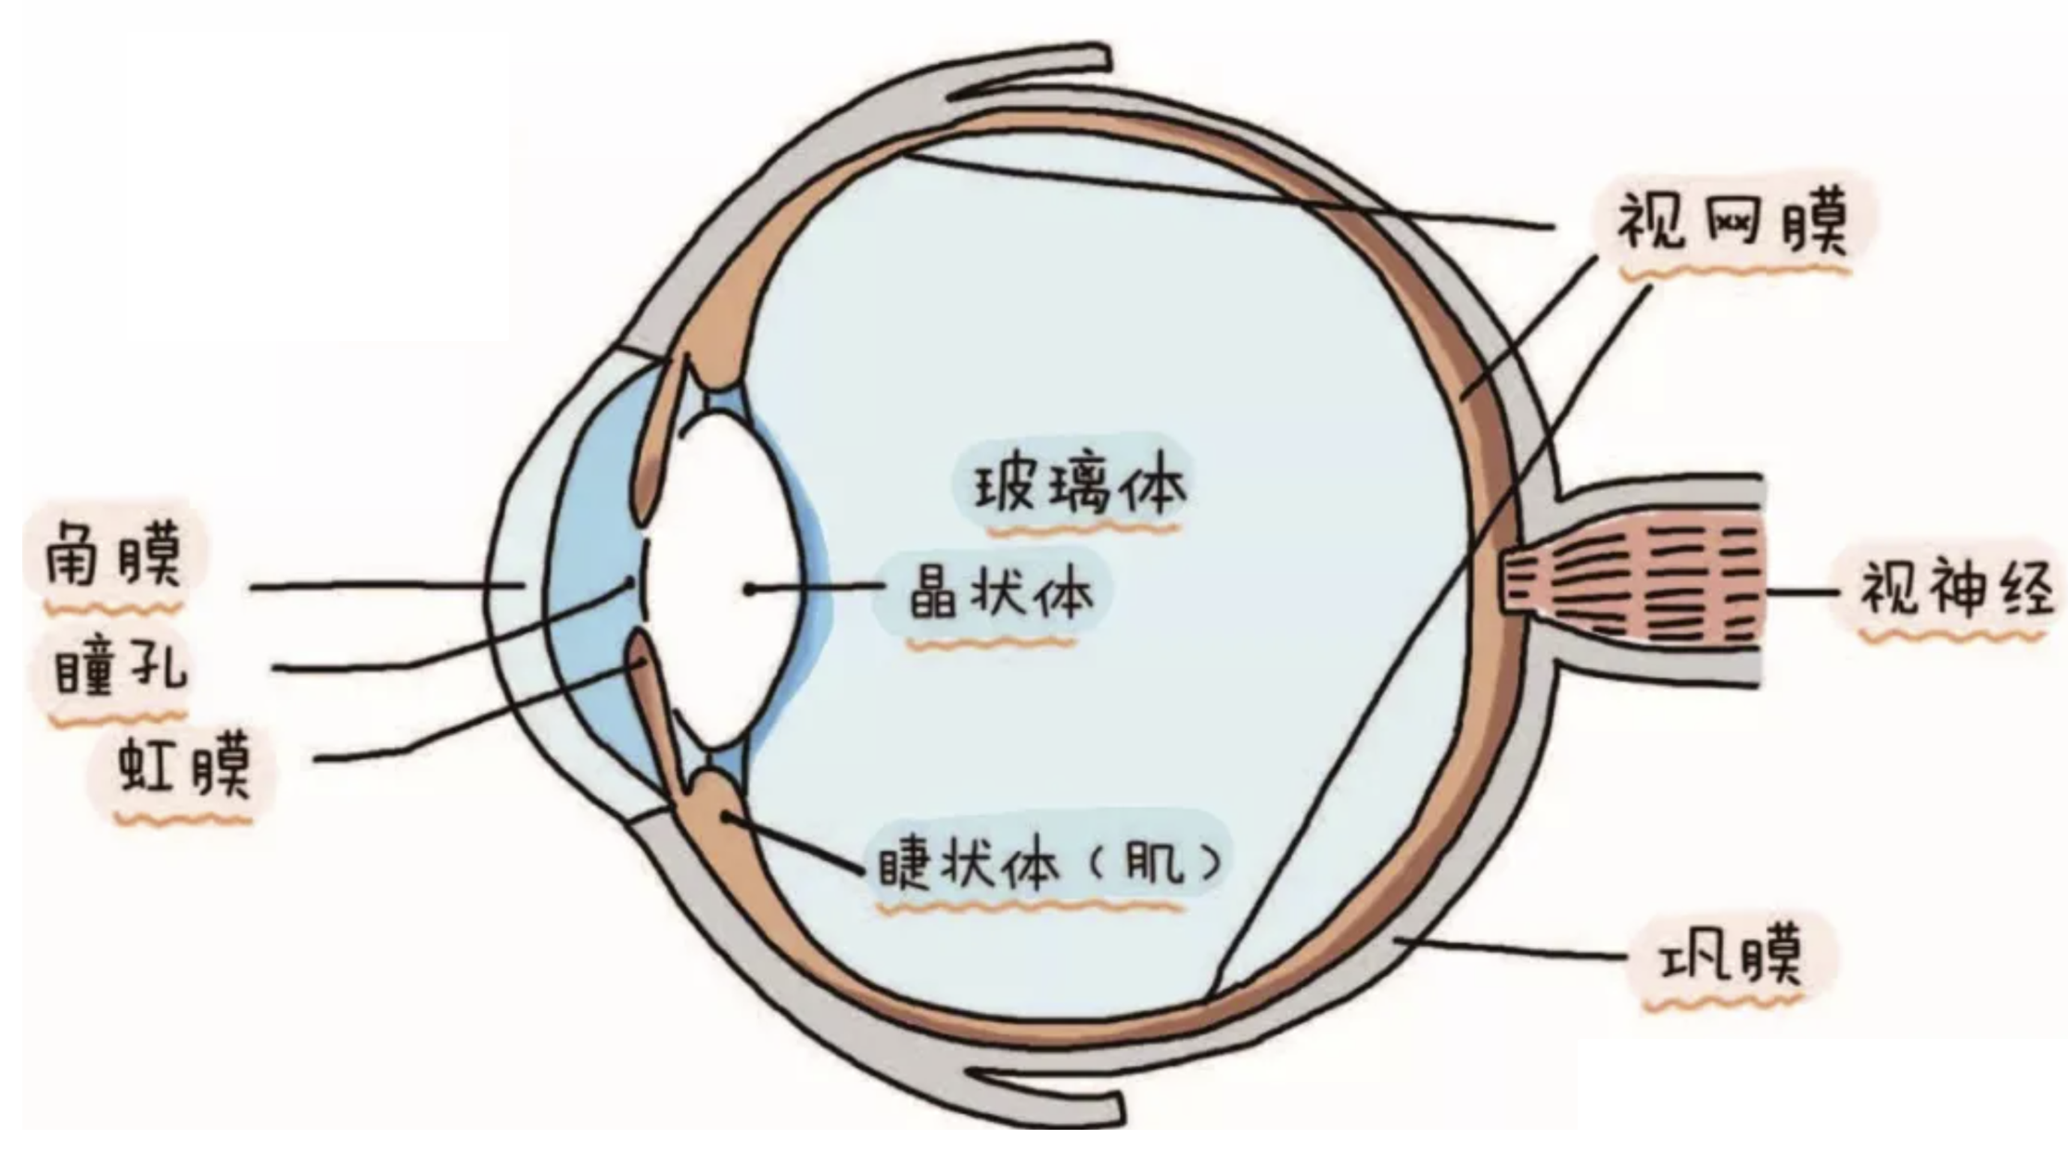
為眼疾的醫治禱告
(按手在眼睛的部位)，奉主的名吩咐我眼球的 結構和視力回復正常的功能，使我的青光眼、白內障、黃斑病變、飛蚊症得到痊癒並使我被聖靈充滿！

Slide 40
為腰背疼痛的醫治禱告
(經文與禱告範例)

Slide 41
路加福音 Luke 13:11-13
有一個女人被鬼附著，病了十八年，腰彎得一點直不起來。 耶穌看見，便叫過她來，對她說：「女人，你脫離這病了！」 於是用兩隻手按著她；她立刻直起腰來，就歸榮耀與 神。
and a woman was there who had been crippled by a spirit for eighteen years. She was bent over and could not straighten up at all. When Jesus saw her, he called her forward and said to her, “Woman, you are set free from your infirmity.” Then he put his hands on her, and immediately she straightened up and praised God.

Slide 42
為腰背疼痛的醫治禱告
(用手按腰背的部位)，奉主的名吩咐腰椎背骨回復神創造時的原位，脫離綑綁與壓制，使腰骨得自由，能直起身來，椎間盤突出、背痛和關節炎完全得痊癒！

Slide 43
為腿痛、腿疾的醫治禱告
(經文與禱告範例)

Slide 44
使徒行傳 Acts 3:7-8
於是拉著他的右手，扶他起來；他的腳和踝子骨立刻健壯了，就跳起來，站著，又行走，同他們進了殿，走著，跳著，讚美 神。
Taking him by the right hand, he helped him up, and instantly the man’s feet and ankles became strong. He jumped to his feet and began to walk. Then he went with them into the temple courts, walking and jumping, and praising God.

Slide 45
為腿痛、腿疾的醫治禱告
(伸展雙腿，用雙手握住踝子骨)，奉主耶穌的名吩咐脊椎直立起來，神經、肌肉、筋腱、和韌帶強健有力，而且要放鬆下來，支持骨骼和關節，奉主的名踝子骨要健壯起來，關節炎和坐骨神經痛得到痊癒！

Slide 46
為無力的膝的醫治禱告
(經文與禱告範例)

Slide 47
以賽亞書 Isaiah 35:3
你們要使軟弱的手堅壯，無力的膝穩固。
Strengthen the feeble hands,
steady the knees that give way;

Slide 48
為無力的膝的醫治禱告
(用手按膝蓋骨的部位)，奉主的名吩咐一切筋腱、韌帶、軟骨都穩固起來，消除關節炎所造成的疼痛和無力，宣告膝蓋骨液滋潤滋長，使膝蓋骨健壯得痊癒！

Slide 49
為不孕、流產的醫治禱告
(經文與禱告範例)

Slide 50
出埃及記 Exodus 23:25-26
你們要事奉耶和華─你們的 神，他必賜福與你的糧與你的水，也必從你們中間除去疾病。 你境內必沒有墜胎的，不生產的。 我要使你滿了你年日的數目。
Worship the Lord your God, and his blessing will be on your food and water. I will take away sickness from among you, and none will miscarry or be barren in your land. I will give you a full life span.

Slide 51
為不孕、流產的醫治禱告
感謝神當我和我全家定意要來事奉神 (無論是時間、金錢、力量、恩賜等)，必能因歡心樂意事奉神而經歷家中的糧與水蒙神祝福，婦科的疾病要除去，生養之福要代替墜胎與不孕！

Slide 52
為返老還童禱告
(經文與禱告範例)

Slide 53
詩篇 Psalm 103:4-5
他救贖你的命脫離死亡，以仁愛和慈悲為你的冠冕。 他用美物使你所願的得以知足，以致你如鷹返老還童。
who redeems your life from the pit
and crowns you with love and compassion,
who satisfies your desires with good things
so that your youth is renewed like the eagle’s.

Slide 54
為返老還童禱告
求主保守我當年紀變大、胃口不好、身體的功能失調、被疾病所苦時，不至氣餒。 奉主的名宣告神要以仁愛和慈悲為我的冠冕，用美物使我所願的得以知足，以致我如鷹返老還童、重新活出美好！

Slide 55

醫治禱告的操練
          我們的參與
          信心與醫治 (主能、主肯)
          宣告神的名字
          神的話語帶來醫治

Slide 56
每天可以為自己做的醫治禱告
奉主耶穌的名吩咐我身體裡面每一個細胞得到充分的營養和氧氣的供應，除去細胞中的毒素和病變，激發受損的細胞修復和再生的能力。 求主天天賜給我喜樂的心成為良藥，使我身體的免疫系統強健起來！

Slide 57
以賽亞書 Isaiah 53:5
哪知他為我們的過犯受害，為我們的罪孽壓傷。因他受的刑罰我們得平安，因他受的鞭傷我們得醫治。
But he was pierced for our transgressions,
he was crushed for our iniquities;
the punishment that brought us peace was on him,
and by his wounds we are healed.

Slide 58
回應詩歌 Response Song
「因著十架愛」

Slide 59

同領聖餐 Holy Communion

Slide 60

哥林多前書 1 Corinthians 11:23-24
主耶穌被賣的那一夜，拿起餅來， 祝謝了，就擘開，說：「這是我的身體，為你們捨的，你們應當如此行，為的是記念我。」
The Lord Jesus, on the night he was betrayed, took bread, and when he had given thanks, he broke it and said, “This is my body, which is for you; do this in remembrance of me.”

Slide 61
哥林多前書 1 Corinthians 11:25
飯後，也照樣拿起杯來，說：「這杯是用我的血所立的新約，你們每逢喝的時候，要如此行，為的是記念我。」
In the same way, after supper he took the cup, saying, “This cup is the new covenant in my blood; do this, whenever you drink it, in remembrance of me.”

Slide 62
哥林多前書 1 Corinthians 11:26, 28
你們每逢吃這餅，喝這杯，是表明主的死，直等到他來。
For whenever you eat this bread and drink this cup, you proclaim the Lord’s death until he comes.
人應當自己省察，然後吃這餅、喝這杯。
Everyone ought to examine themselves before they eat of the bread and drink from the cup.

