Slide 1

七月初十是贖罪日；你們要守為聖會，並要刻苦己心，也要將火祭獻給耶和華。 (利未記 23:27)

Slide 2

主日信息
Sunday Sermon

Slide 3

有人在為你禱告
Someone is praying for you
波特蘭靈糧堂
September 24, 2023

Slide 4
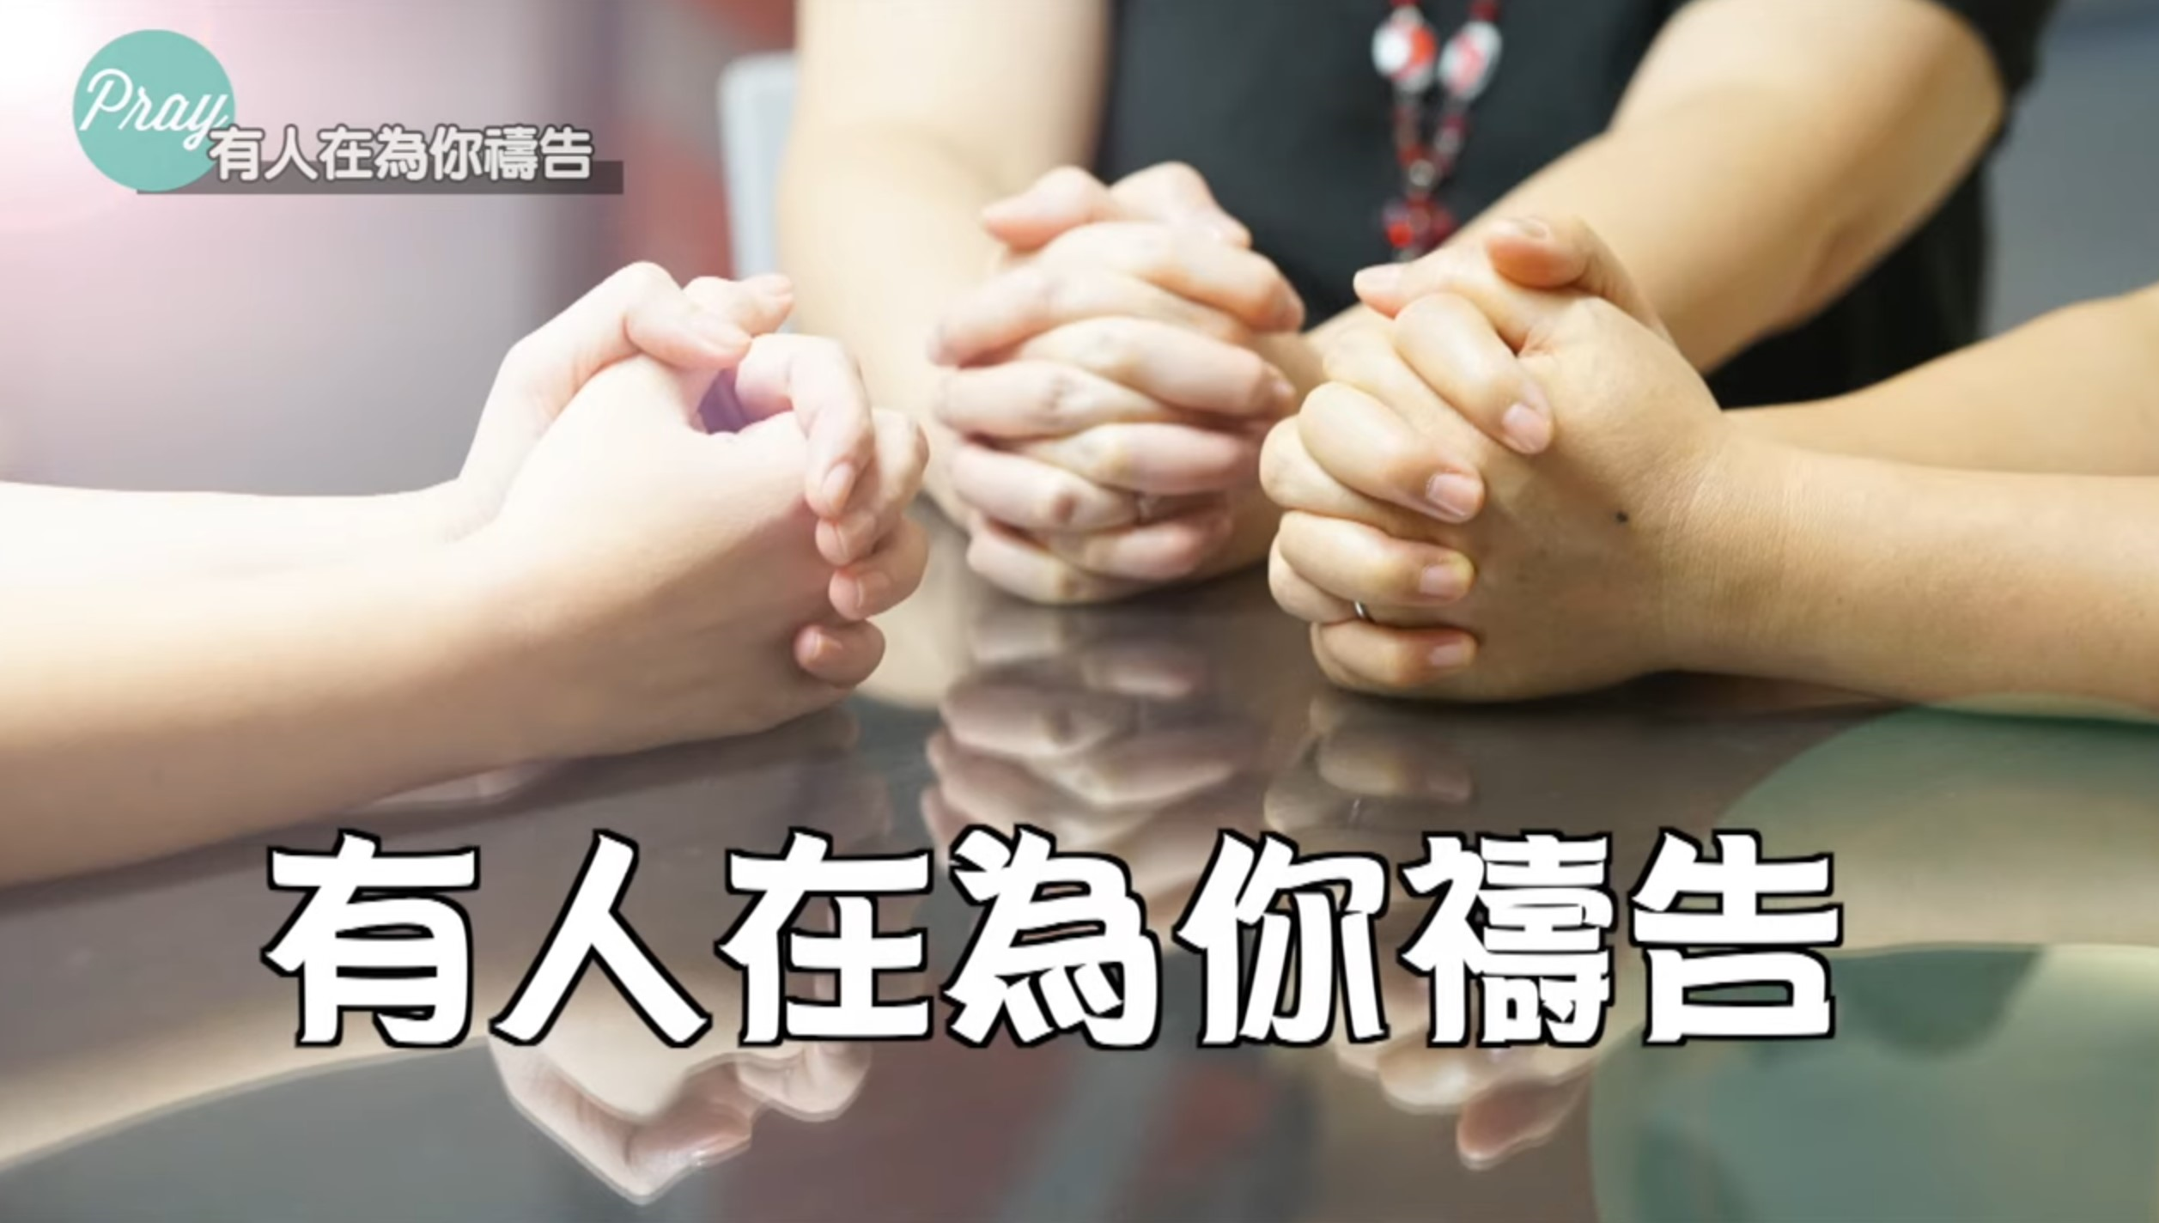

Slide 5

「代禱」與「代禱者」

Slide 6

「代禱」與「代禱者」 Intercession & Intercessors
    代禱就是從神領受啟示為別人禱告。
    代禱者是神將祂自己的心意啟示的對象。 有些事情神要成就在地上時，祂會在地上 尋找代禱者能夠站在祂和地上的百姓中間。 這些代禱者裡面會有一個很深的渴望，領受神的旨意能成就在他所居住的這片土地上，成就在他所屬的族群中間。 代禱者是神在地上設立的代表，目的是在於要幫助人連於神、幫助人能夠更愛耶穌。

Slide 7
有功效的代禱

Slide 8
有功效的代禱 Effective Intercession
    爭戰得勝 (「耶和華尼西」)
    復興神的作為
    為自己帶來祝福

Slide 9
出埃及記 Exodus 17:10-13
於是約書亞照著摩西對他所說的話行，和亞瑪力人爭戰。摩西、亞倫，與戶珥都上了山頂。摩西何時舉手，以色列人就得勝，何時垂手，亞瑪力人就得勝。但摩西的手發沉，他們就搬石頭來，放在他以下，他就坐在上面。亞倫與戶珥扶著他的手，一個在這邊，一個在那邊，他的手就穩住，直到日落的時候。約書亞用刀殺了亞瑪力王和他的百姓。
11 Whenever Moses held up his hand, Israel prevailed, and whenever he lowered his hand, Amalek prevailed.

Slide 10
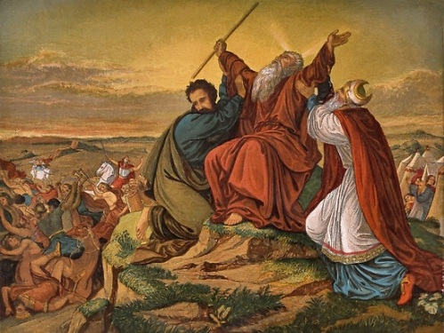

Slide 11
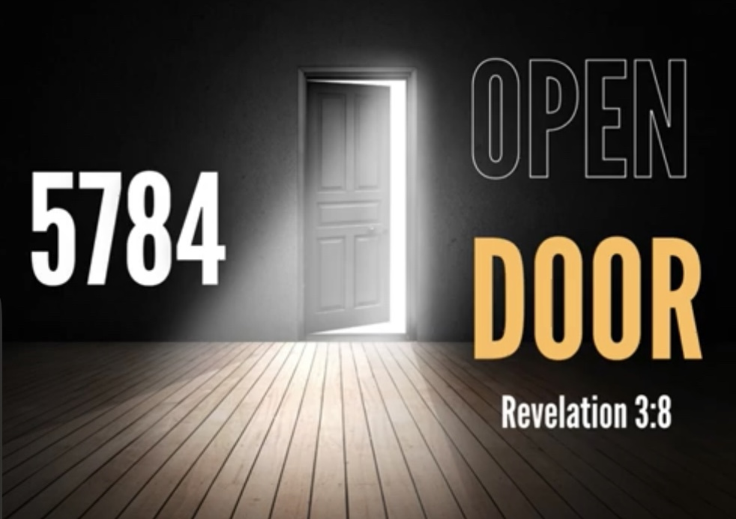

Slide 12
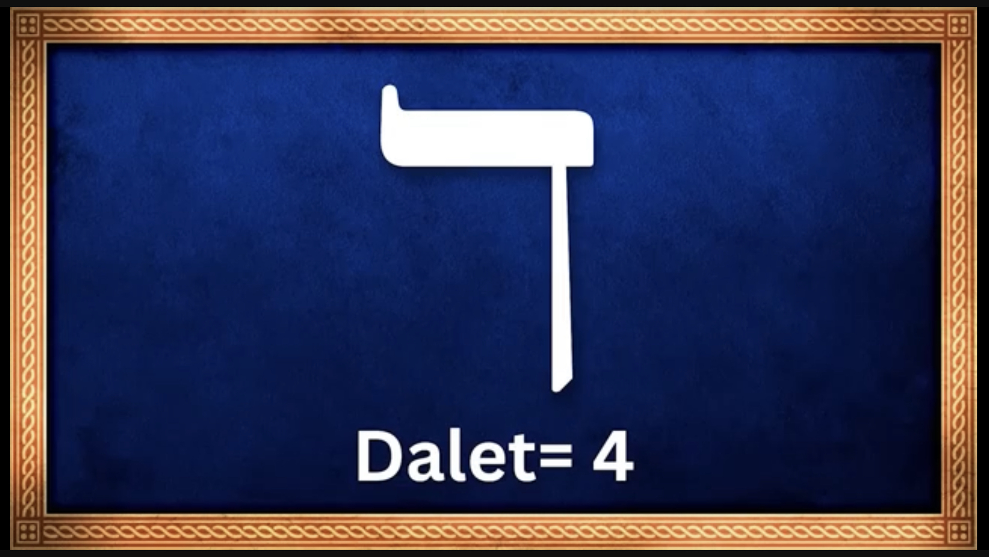

Slide 13
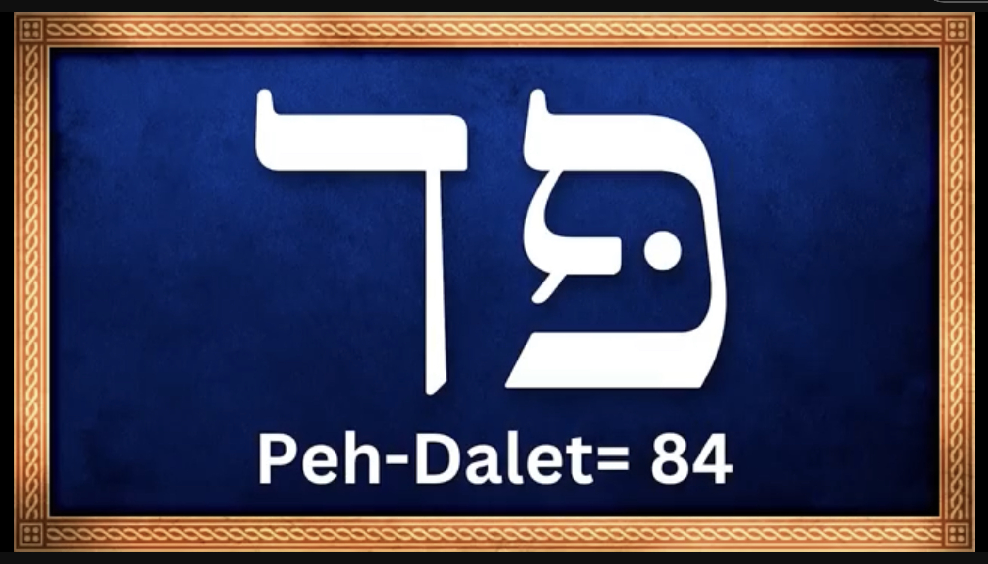

Slide 14
有功效的代禱 Effective Intercession
    爭戰得勝 (「耶和華尼西」)
    復興神的作為
    為自己帶來祝福

Slide 15
以西結書 Ezekiel 22:30
我在他們中間尋找一人重修牆垣，在我面前為這國站在破口防堵，使我不滅絕這國，卻找不著一個。
I looked for someone among them who would build up the wall and stand before me in the gap on behalf of the land so I would not have to destroy it, but I found no one.

Slide 16
哈巴谷書 Habakkuk 3:2
耶和華啊，我聽見你的名聲（或譯：言語）就懼怕。 耶和華啊，求你在這些年間復興你的作為，在這些年間顯明出來；在發怒的時候以憐憫為念。
Lord, I have heard of your fame;
I stand in awe of your deeds, Lord.
Repeat them in our day,
in our time make them known;
in wrath remember mercy.

Slide 17
馬太福音 Matthew 6:9-10
所以，你們禱告要這樣說：我們在天上的父：願人都尊你的名為聖。 願你的國降臨；願你的旨意行在地上，如同行在天上。
Our Father in heaven,
hallowed be your name,
your kingdom come,
your will be done,
on earth as it is in heaven.

Slide 18
有功效的代禱 Effective Intercession
    爭戰得勝 (「耶和華尼西」)
    復興神的作為
    為自己帶來祝福

Slide 19
約伯記 Job 42:10
約伯為他的朋友祈禱。 耶和華就使約伯從苦境（原文是擄掠）轉回，並且耶和華賜給他的比他從前所有的加倍。
The Lord restored the fortunes of Job when he prayed for his friends, and the Lord increased all that Job had twofold.

Slide 20
提摩太前書 1 Timothy 2:1-3
我勸你，第一要為萬人懇求、禱告、代求、祝謝；為君王和一切在位的，也該如此，使我們可以敬虔、端正、平安無事地度日。 這是好的，在 神我們救主面前可蒙悅納。
I urge, then, first of all, that petitions, prayers, intercession and thanksgiving be made for all people— for kings and all those in authority, that we may live peaceful and quiet lives in all godliness and holiness. This is good, and pleases God our Savior,

Slide 21
有功效的代禱 Effective Intercession
    爭戰得勝 (「耶和華尼西」)
    復興神的作為
    為自己帶來祝福

Slide 22
代禱者的榜樣與呼召

Slide 23
約翰福音 John 17:20-22
我不但為這些人祈求，也為那些因他們的話信我的人祈求，使他們都合而為一。 正如你父在我裡面，我在你裡面，使他們也在我們裡面，叫 世人可以信你差了我來。你所賜給我的榮耀，我已賜給他們，使他們合而為一，像我們合而為一。
“My prayer is not for them alone. I pray also for those who will believe in me through their message, that all of them may be one, Father, just as you are in me and I am in you. May they also be in us so that the world may believe that you have sent me. I have given them the glory that you gave me, that they may be one as we are one

Slide 24
羅馬書 Romans 8:33-34
誰能控告 神所揀選的人呢？ 有 神稱他們為義了。 誰能定他們的罪呢？ 有基督耶穌已經死了，而且從死裡復活，現今在 神的右邊，也替我們祈求。
Who will bring any charge against those whom God has chosen? It is God who justifies. Who then is the one who condemns? No one. Christ Jesus who died—more than that, who was raised to life—is at the right hand of God and is also interceding for us.

Slide 25
以弗所書 Ephesians 1:15-18
因此，我既聽見你們信從主耶穌，親愛眾聖徒， 就為你們不住地感謝 神。 禱告的時候，常提到你們，求我們主耶穌基督的 神，榮耀的父，將那賜人智慧和啟示的靈賞給你們，使你們真知道他，並且照明你們心中的眼睛，使你們知道他的恩召有何等指望，他在聖徒中得的基業有何等豐盛的榮耀；
16 I have not stopped giving thanks for you, remembering you in my prayers. I keep asking that the God of our Lord Jesus Christ, the glorious Father, may give you the Spirit of wisdom and revelation, so that you may know him better.

Slide 26
以弗所書 Ephesians 3:14-18
因此，我在父面前屈膝，求他按著他豐盛的榮耀，藉著他的靈，叫你們心裡的力量剛強起來，使基督因你們的信，住在你們心裡，叫你們的愛心有根有基，能以和眾聖徒一同明白基督的愛是何等長闊高深，
For this reason I kneel before the Father, from whom every family in heaven and on earth derives its name. I pray that out of his glorious riches he may strengthen you with power through his Spirit in your inner being, so that Christ may dwell in your hearts through faith. And I pray that you, being rooted and established in love,

Slide 27
歌羅西書 Colossians 4:1-2
你們要恆切禱告，在此警醒感恩。 也要為我們禱告，求 神給我們開傳道的門，能以講基督的奧祕（我為此被捆鎖），叫我按著所該說的話將這奧祕發明出來。
Devote yourselves to prayer, being watchful and thankful. And pray for us, too, that God may open a door for our message, so that we may proclaim the mystery of Christ, for which I am in chains.

Slide 28
當你覺得寂寞孤單 你內心將要破碎
要記得有人在為你禱告
是否你正處在 狂風暴雨之中
你的船支離破碎 疲倦失意
別失望 此時此刻有人為你禱告
寧靜平安將要進入你心

Slide 29
回應詩歌 Response Song
「有人在為你禱告」

Slide 30
Play Video
「為身體病痛、術後休養禱告」

