Slide 1

主日信息
Sunday Sermon

Slide 2

從冒犯中得自由
Set Free from Offense
波特蘭靈糧堂
October 1, 2023

Slide 3
約翰三書 3 John 1:2
親愛的兄弟啊，我願你凡事興盛，身體健壯，正如你的靈魂興盛一樣。
Beloved, I pray that in all respects you may prosper and be in good health, just as your soul prospers.

Slide 4

從冒犯中得自由 Set Free from Offense
    冒犯的本質與影響力
    面對冒犯的反應 reaction 或行動 action
    從冒犯中得釋放和恢復

Slide 5
路加福音 Luke 17:1
耶穌又對門徒說：「絆倒人的事是免不了的；但那絆倒人的有禍了。
Then said he unto the disciples, It is impossible but that offences will come: but woe unto him, through whom they come!

Slide 6
從冒犯中得自由 Set Free from Offense
    冒犯的本質與影響力
    面對冒犯的反應 reaction 或行動 action
    從冒犯中得釋放和恢復

Slide 7
馬太福音 Matthew 5:43-44
你們聽見有話說：『當愛你的鄰舍，恨你的仇敵。』只是我告訴你們，要愛你們的仇敵，為那逼迫你們的禱告。
You have heard that it was said, ‘Love your neighbor and hate your enemy.’ But I tell you, love your enemies and pray for those who persecute you,

Slide 8

如何面對冒犯決定你是否繼續成長

Slide 9
彼得前書 1 Peter 3:9-11
不以惡報惡，以辱罵還辱罵，倒要祝福；因你們是為此蒙召，好叫你們承受福氣。 因為經上說：人若愛生命，願享美福，須要禁止舌頭不出惡言，嘴唇不說詭詐的話；也要離惡行善，尋求和睦，一心追趕。
Do not repay evil with evil or insult with insult. On the contrary, repay evil with blessing, because to this you were called so that you may inherit a blessing. For, “Whoever would love life and see good days must keep their tongue from evil and their lips from deceitful speech.

Slide 10
被冒犯時為何不要「加倍奉還」？

Slide 11
詩篇 Psalm 109:17-20
他愛咒罵，咒罵就臨到他；他不喜愛福樂，福樂就與他遠離！ 他拿咒罵當衣服穿上；這咒罵就如水進他裡面，像油入他的骨頭。 願這咒罵當他遮身的衣服，當他常束的腰帶！這就是我對頭和用惡言議論我的人從耶和華那裡所受的報應。
He loved to pronounce a curse—may it come back on him.
He found no pleasure in blessing—may it be far from him.
He wore cursing as his garment; it entered into his body like water, into his bones like oil. May it be like a cloak wrapped about him, like a belt tied forever around him. May this be the Lord’s payment to my accusers, to those who speak evil of me.

Slide 12
羅馬書 Romans 12:14
逼迫你們的，要給他們祝福；只要祝福，不可咒詛。
Bless those who persecute you; bless and do not curse.

Slide 13
羅馬書 Romans 12:20-21
所以，「你的仇敵若餓了，就給他吃，若渴了，就給他喝；因為你這樣行就是把炭火堆在他的頭上。」你不可為惡所勝，反要以善勝惡。
On the contrary:
“If your enemy is hungry, feed him;
if he is thirsty, give him something to drink.
In doing this, you will heap burning coals on his head.”
Do not be overcome by evil, but overcome evil with good.

Slide 14
從冒犯中得自由 Set Free from Offense
    冒犯的本質與影響力
    面對冒犯的反應 reaction 或行動 action
    從冒犯中得釋放和恢復
        設立界線、管理情緒
        立刻開始為冒犯你的人禱告
        信靠神的主權和應許
        領受福氣、進入命定

Slide 15
約瑟面對冒犯的榜樣

Slide 16
創世記 Genesis 50:18-20
他的哥哥們又來俯伏在他面前，說：「我們是你的僕人。」 約瑟對他們說：「不要害怕， 我豈能代替 神呢？ 從前你們的意思是要害我，但 神的意思原是好的，要保全許多人的性命，成就今日的光景。
His brothers then came and threw themselves down before him. “We are your slaves,” they said. But Joseph said to them, “Don’t be afraid. Am I in the place of God? You intended to harm me, but God intended it for good to accomplish what is now being done, the saving of many lives.

Slide 17
從冒犯中得自由 Set Free from Offense
    冒犯的本質與影響力
    面對冒犯的反應 reaction 或行動 action
    從冒犯中得釋放和恢復
        設立界線、管理情緒
        立刻開始為冒犯你的人禱告
        信靠神的主權和應許
        領受福氣、進入命定

Slide 18
路加福音 Luke 23:33-34
到了一個地方，名叫「髑髏地」，就在那裡把耶穌釘在十字架上，又釘了兩個犯人：一個在左邊，一個在右邊。 當下耶穌說：「父啊！ 赦免他們；因為他們所做的，他們不曉得。」兵丁就拈鬮分他的衣服。
When they came to the place called the Skull, they crucified him there, along with the criminals—one on his right, the other on his left. Jesus said, “Father, forgive them, for they do not know what they are doing.” And they divided up his clothes by casting lots.

Slide 19
從冒犯中得自由 Set Free from Offense
    冒犯的本質與影響力
    面對冒犯的反應 reaction 或行動 action
    從冒犯中得釋放和恢復
        設立界線、管理情緒
        立刻開始為冒犯你的人禱告
        信靠神的主權和應許
        領受福氣、進入命定

Slide 20
生命中沒有一個傷害是神不知道的

Slide 21
羅馬書 Romans 12:17-19
不要以惡報惡；眾人以為美的事要留心去做。
若是能行，總要盡力與眾人和睦。親愛的弟兄，不要自己伸冤，寧可讓步，聽憑主怒；因為經上記著：「主說：『伸冤在我，我必報應。』」
Do not repay anyone evil for evil. Be careful to do what is right in the eyes of everyone. If it is possible, as far as it depends on you, live at peace with everyone. Do not take revenge, my dear friends, but leave room for God’s wrath, for it is written: “It is mine to avenge; I will repay,” says the Lord.

Slide 22
從冒犯中得自由 Set Free from Offense
    冒犯的本質與影響力
    面對冒犯的反應 reaction 或行動 action
    從冒犯中得釋放和恢復
        設立界線、管理情緒
        立刻開始為冒犯你的人禱告
        信靠神的主權和應許
        領受福氣、進入命定

Slide 23
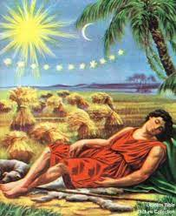
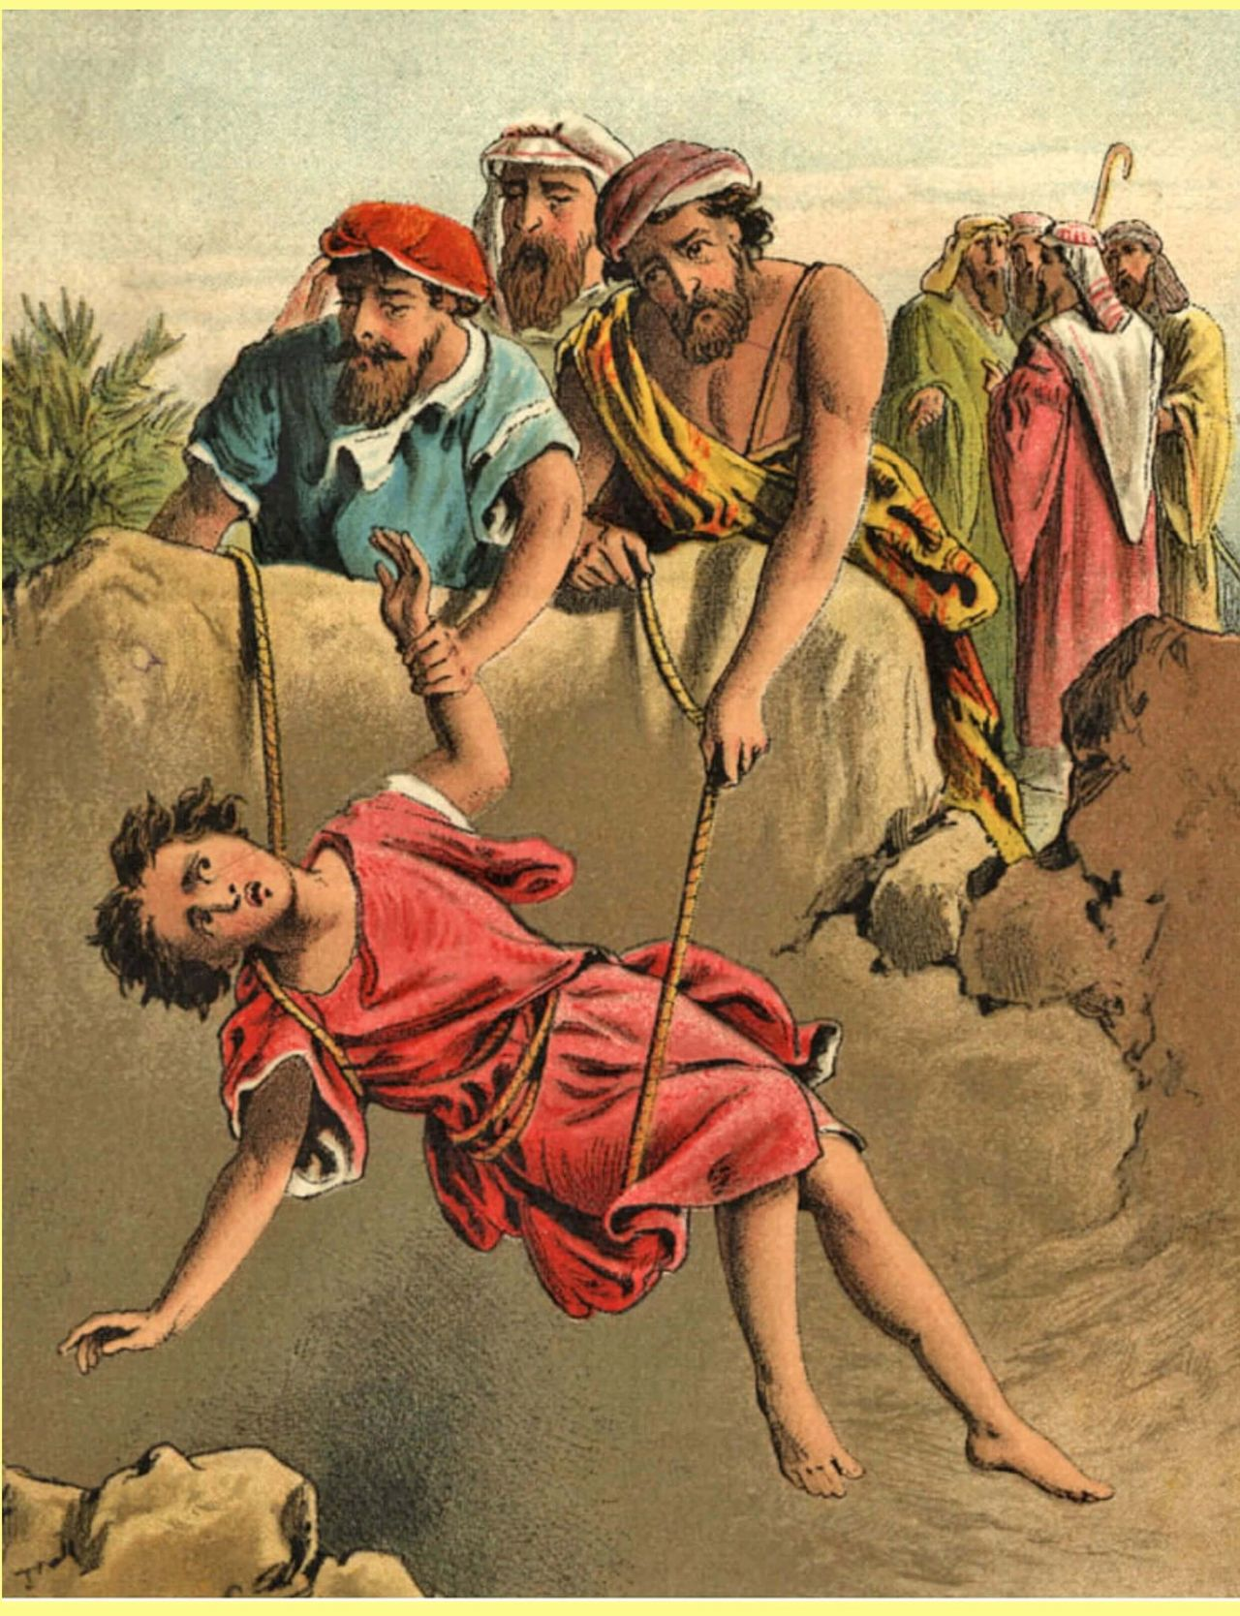
神藉異夢啟示約瑟的命定

Slide 24
創世記 Genesis 45:7-8
神差我在你們以先來，為要給你們存留餘種在世上，又要大施拯救，保全你們的生命。 這樣看來，差我到這裡來的不是你們，乃是 神。他又使我如法老的父，作他全家的主，並埃及全地的宰相。
But God sent me ahead of you to preserve for you a remnant on earth and to save your lives by a great deliverance. “So then, it was not you who sent me here, but God. He made me father to Pharaoh, lord of his entire household and ruler of all Egypt.

Slide 25
回應詩歌 Response Song
「因著十架愛」

Slide 26

同領聖餐 Holy Communion

Slide 27

哥林多前書 1 Corinthians 11:23-24
主耶穌被賣的那一夜，拿起餅來， 祝謝了，就擘開，說：「這是我的身體，為你們捨的，你們應當如此行，為的是記念我。」
The Lord Jesus, on the night he was betrayed, took bread, and when he had given thanks, he broke it and said, “This is my body, which is for you; do this in remembrance of me.”

Slide 28
哥林多前書 1 Corinthians 11:25
飯後，也照樣拿起杯來，說：「這杯是用我的血所立的新約，你們每逢喝的時候，要如此行，為的是記念我。」
In the same way, after supper he took the cup, saying, “This cup is the new covenant in my blood; do this, whenever you drink it, in remembrance of me.”

Slide 29
哥林多前書 1 Corinthians 11:26, 28
你們每逢吃這餅，喝這杯，是表明主的死，直等到他來。
For whenever you eat this bread and drink this cup, you proclaim the Lord’s death until he comes.
人應當自己省察，然後吃這餅、喝這杯。
Everyone ought to examine themselves before they eat of the bread and drink from the cup.

Slide 30
箴言 Proverbs 4:23-24
你要保守你心，勝過保守一切，因為一生的果效是由心發出。 你要除掉邪僻的口，棄絕乖謬的嘴。
Above all else, guard your heart,
for everything you do flows from it.
Keep your mouth free of perversity;
keep corrupt talk far from your lips.

Slide 31
「跨越的人生」 見證分享
XiangLi 卢向莉 姐妹

