Slide 1

主日信息
Sunday Sermon

Slide 2
新婦戰士的差派—從城市到列邦
The Commissioning of a Bridal Warrior—
From cities to nations
Jocelyn Huang 11/05/2023

Slide 3
新婦戰士的養成
The Making of a Bridal Warrior
Jocelyn Huang 07/09/2023

Slide 4
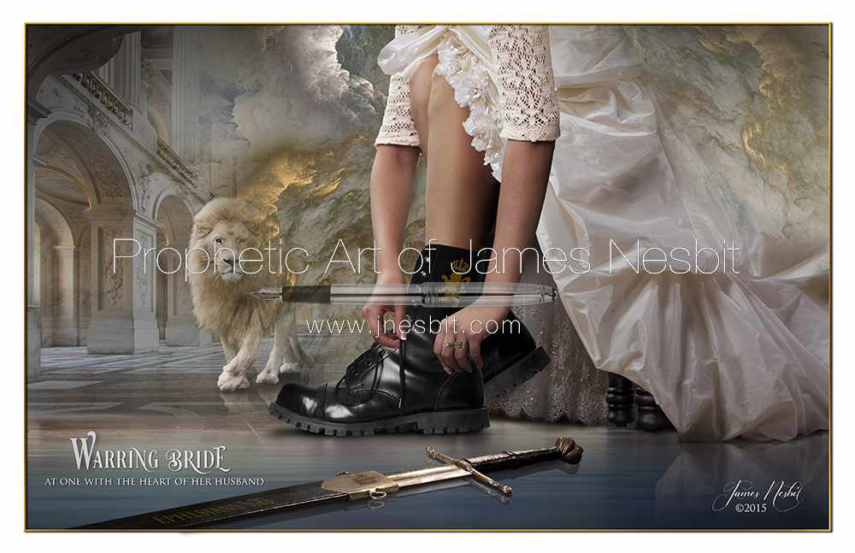
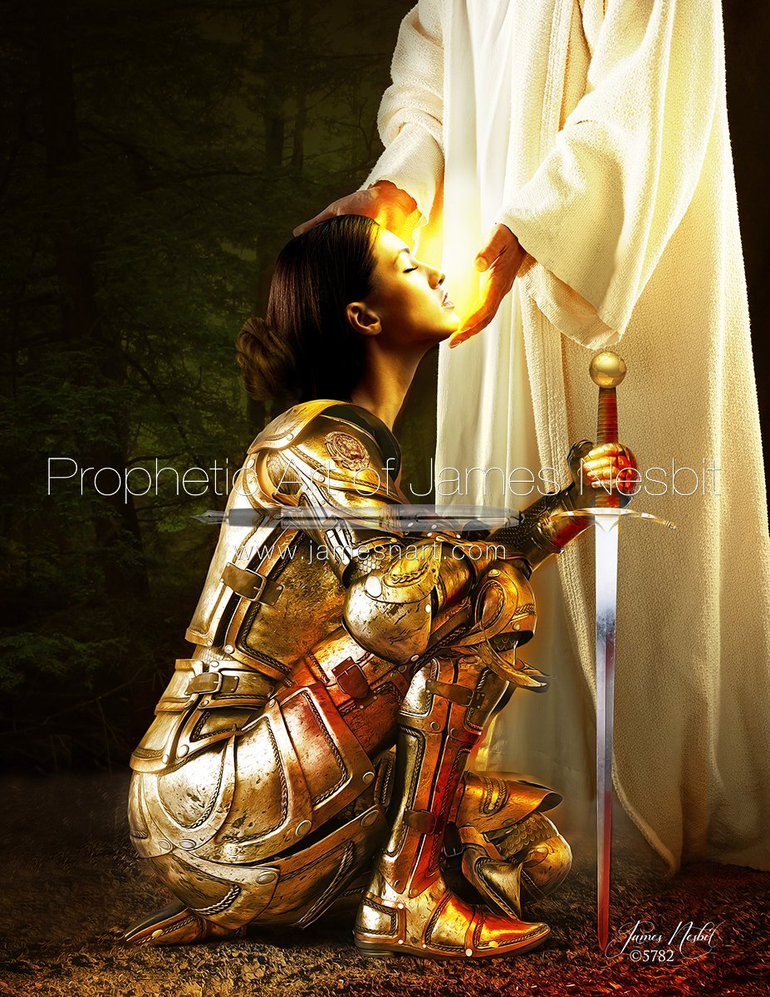
什麼是「新婦戰士」？
What is a Bridal Warrior?
教會是基督的新婦。基督是頭，教會是身體，各信徒是肢體。
  我們要歡喜快樂，將榮耀歸給他。因為羔羊婚娶的時候到了，
  新婦也自己預備好了，就蒙恩得穿光明潔白的細麻衣。
  這細麻衣就是聖徒所行的義。（啓示錄19:7-8）
有國度（Kingdom of God/Kingdom of Heaven 神的國、天國）的概念及認識。（何謂國度Kingdom？福音兩層次：Gospel of Salvation 及 Gospel of the Kingdom；得救只是起點）
有崗位、有紀律、有目標、有能力。（「耶和華的軍隊」的概念 ）

Slide 5
新婦戰士的養成
The Making of a Bridal Warrior
A. 破碎 Getting Undone
B. 蛻變 Metamorphosis

Slide 6
A. 破碎 Undone
— You are not who you think you are.
— Get on the Table!

Slide 7
B. 蛻變 Metamorphosis
認識神 Have an experiential knowledge of Him
裝備做主工人 Get equipped as a minister
與主同工。在那裏，將我的愛情給你。Send me!
4. 以基督的心為心 Alignment with God

Slide 8
B. 蛻變 Metamorphosis
1. 認識神 Have an experiential knowledge of Him
體會神的心、領受他的愛、明白神的旨意及做事的法則、學習從神而來的智慧。
Word 固定讀經
家庭祭壇 Family Altar
C. 肢體團契 Fellowship
D. 被聖靈充滿 Be filled with the Holy Spirit！

Slide 9
B. 蛻變 Metamorphosis
2. 裝備做主工人 Get equipped as a minister
凡只能喫奶的，都不熟練仁義的道理，因為他是嬰孩。惟獨長大成人的，纔能喫乾糧，他們的心竅，習練得通達，就能分辨好歹了。（希伯來書5：13-14）
  服事肢體 Prayer meeting every Sunday afternoon with the cell group.
  恩賜習練 先知性歌唱 Prophetic singing. Sharpening the ability to hear from the Lord.
  屬靈爭戰的學習與操練 願賜平安的 神，親自使你們全然成聖。又願你們的靈、與魂、與身子，得蒙保守，在我主耶穌基督降臨的時候，完全無可指摘。（帖撒前書5；23）
  教會運作的學習與參與（生命河事奉學校）
  權能事奉的裝備與服事 Get empowered to be sent out.
    Yes? No? Wait! 有目的的延遲。母親節女兒的夢、楊師母預言->豐收神學院受訓。
    耶穌和他們聚集的時候，囑咐他們說，不要離開耶路撒冷，要等候父所應許的，就是你們聽見我說過的。聖靈降臨在你們身上，你們就必得著能力，並要在耶路撒冷、猶太全地和撒瑪利亞，直到地極，作我的見證。（使徒行傳1:4，8）
    我說的話講的道，不是用智慧委婉的言語，乃是用聖靈和大能的明證，叫你們的信不在乎人的智慧，只在乎 神的大能。（哥林多前書2:4-5）

Slide 10
B. 蛻變 Metamorphosis
3. 與主同工。在那裏，將我的愛情給你。Send me!
潔淨的器皿
  當烏西雅王崩的那年，我見主坐在高高的寶座上。他的衣裳垂下，遮滿聖殿。其上有撒拉弗侍立，各有六個翅膀，用兩個翅膀遮臉，兩個翅膀遮腳，兩個翅膀飛翔。...有一撒拉弗飛到我跟前，手裡拿著紅炭，是用火剪從壇上取下來的，將炭沾我的口，說：看哪！這炭沾了你的嘴，你的罪孽便除掉，你的罪惡就赦免了。我又聽見主的聲音說：「我可以差遣誰呢？誰肯為我們去呢？」我說：「我在這裡，請差遣我。」（以賽亞書6:1-2，6-8）
願意的心
  於是對門徒說，要收的莊稼多，作工的人少，所以你們當求莊稼的主，打發工人出去，收他的莊稼。（馬太福音 9：37-38）我們早晨起來往葡萄園去看看葡萄發芽開花沒有、石榴放蕊沒有。我在那裡要將我的愛情給你。（雅歌7:12）因為被召的人多、選上的人少。（馬太福音22:14）這樣，那在後的將要在前，在前的將要在後了。〔有古卷在此有因為被召的人多選上的人少〕（馬太福音20:16）
恩賜的建造 God enables the “available!”
  One Sent. A revival in Shenzhen, China. 2-years of deep plowing in China. Word, Worship, Intercession, Inner Healing and Deliverance, breaking the wall between the home church and the 3-self church, prayer for Foxconn….
  《瑞士刀的故事》

Slide 11
B. 蛻變 Metamorphosis
4. 以基督的心為心 Alignment with God
校準，與神的心對齊，機動
“I want you to pray for America.” 9/11/2011
《美國不是我的夢》
  https://www.facebook.com/photo/?fbid=10210121228530691&set=a.1860253229544
我是葡萄樹，你們是枝子。常在我裡面的，我也常在他裡面，這人就多結果子。因為離了我，你們就不能作甚麼。（約翰福音15:5）

Slide 12
起飛—從城市到列國
A. 為你的城市求平安 Palo Alto Gunn High School teen suicides Nov. 2014
  「我感覺神在你的community也有在使用你，但是主說，時候到了，你要把那個community baton交出去，因為Different assignment, different direction God will lead you and guide you.」9/1/2015

Slide 13
起飛—從城市到列國
B. SF Bay Area /Santa Clara Valley (the Silicon Valley) (2016)
Bay Area is missed out! Not on my watch! Bay Areans, let's catch up! We need fire!
Revival Map of the United States (Made by John Boruff)
(Look at Portland.)

Slide 14
起飛—從城市到列國
B. SF Bay Area /Santa Clara Valley (the Silicon Valley) (2016)
乾旱是悖逆神的一個表徵。Drought could a consequential result of rebellion toward God.
人子啊，你要對這地說：「你是未得潔淨之地，在惱恨的日子也沒有雨下在你以上。」（以西結書22:24） “Son of man, say to the land, ‘You are a land that has not been cleansed or rained on in the day of wrath.’” (Ezekiel 22:24)

Slide 15
起飛—從城市到列國
B. SF Bay Area /Santa Clara Valley (the Silicon Valley) (2016)
你們若留意聽從我今日所吩咐的誡命，愛耶和華你們的神，盡心、盡性事奉他，他必按時降秋雨春雨，在你們的地上，使你們可以收藏五穀、新酒、和油。（申命記11:13-14）
你的民因得罪你，你懲罰他們，使天閉塞不下雨；他們若向此處禱告，承認你的名、離開他們的罪，求你在天上垂聽，赦免你僕人以色列民的罪，將當行的善道指教他們、且降雨在你的地，就是你賜給你民為業之地。（列王紀上8:35-36）

Slide 16
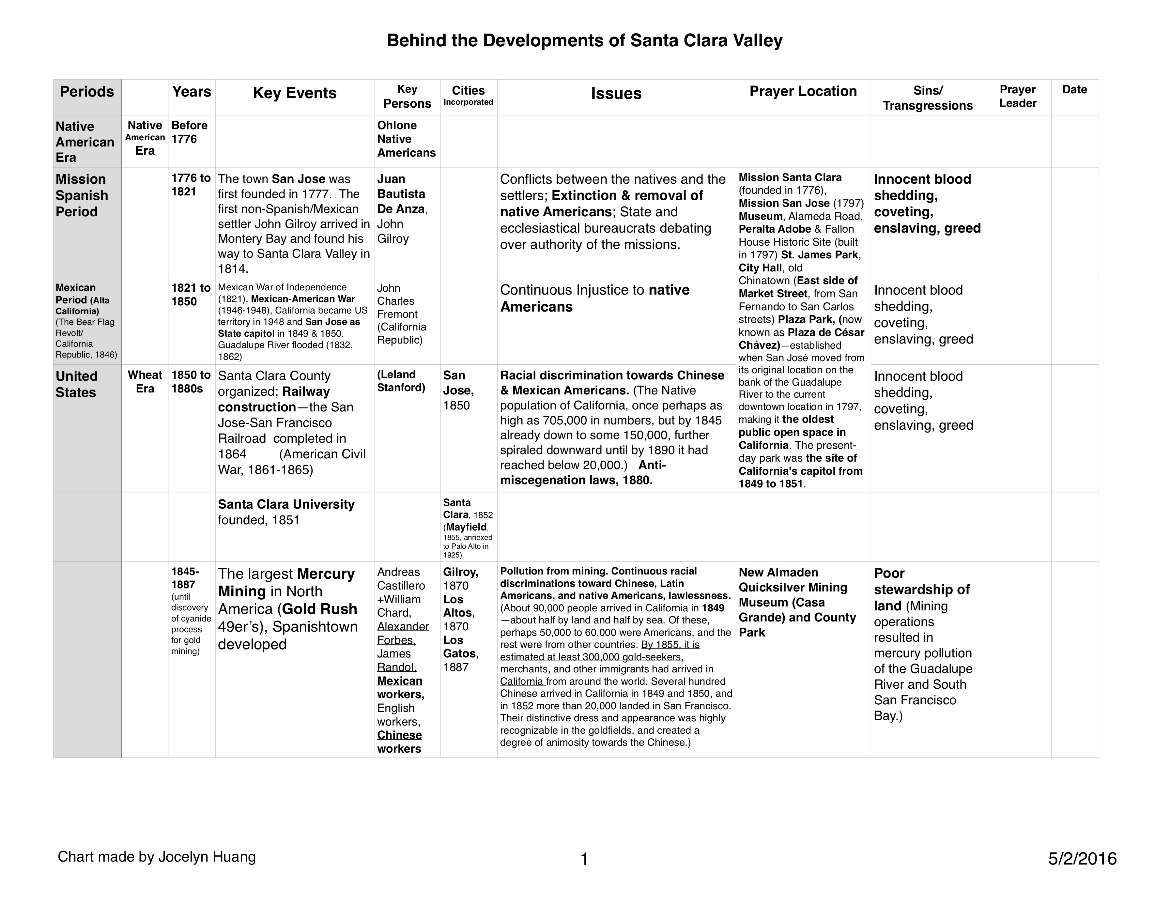
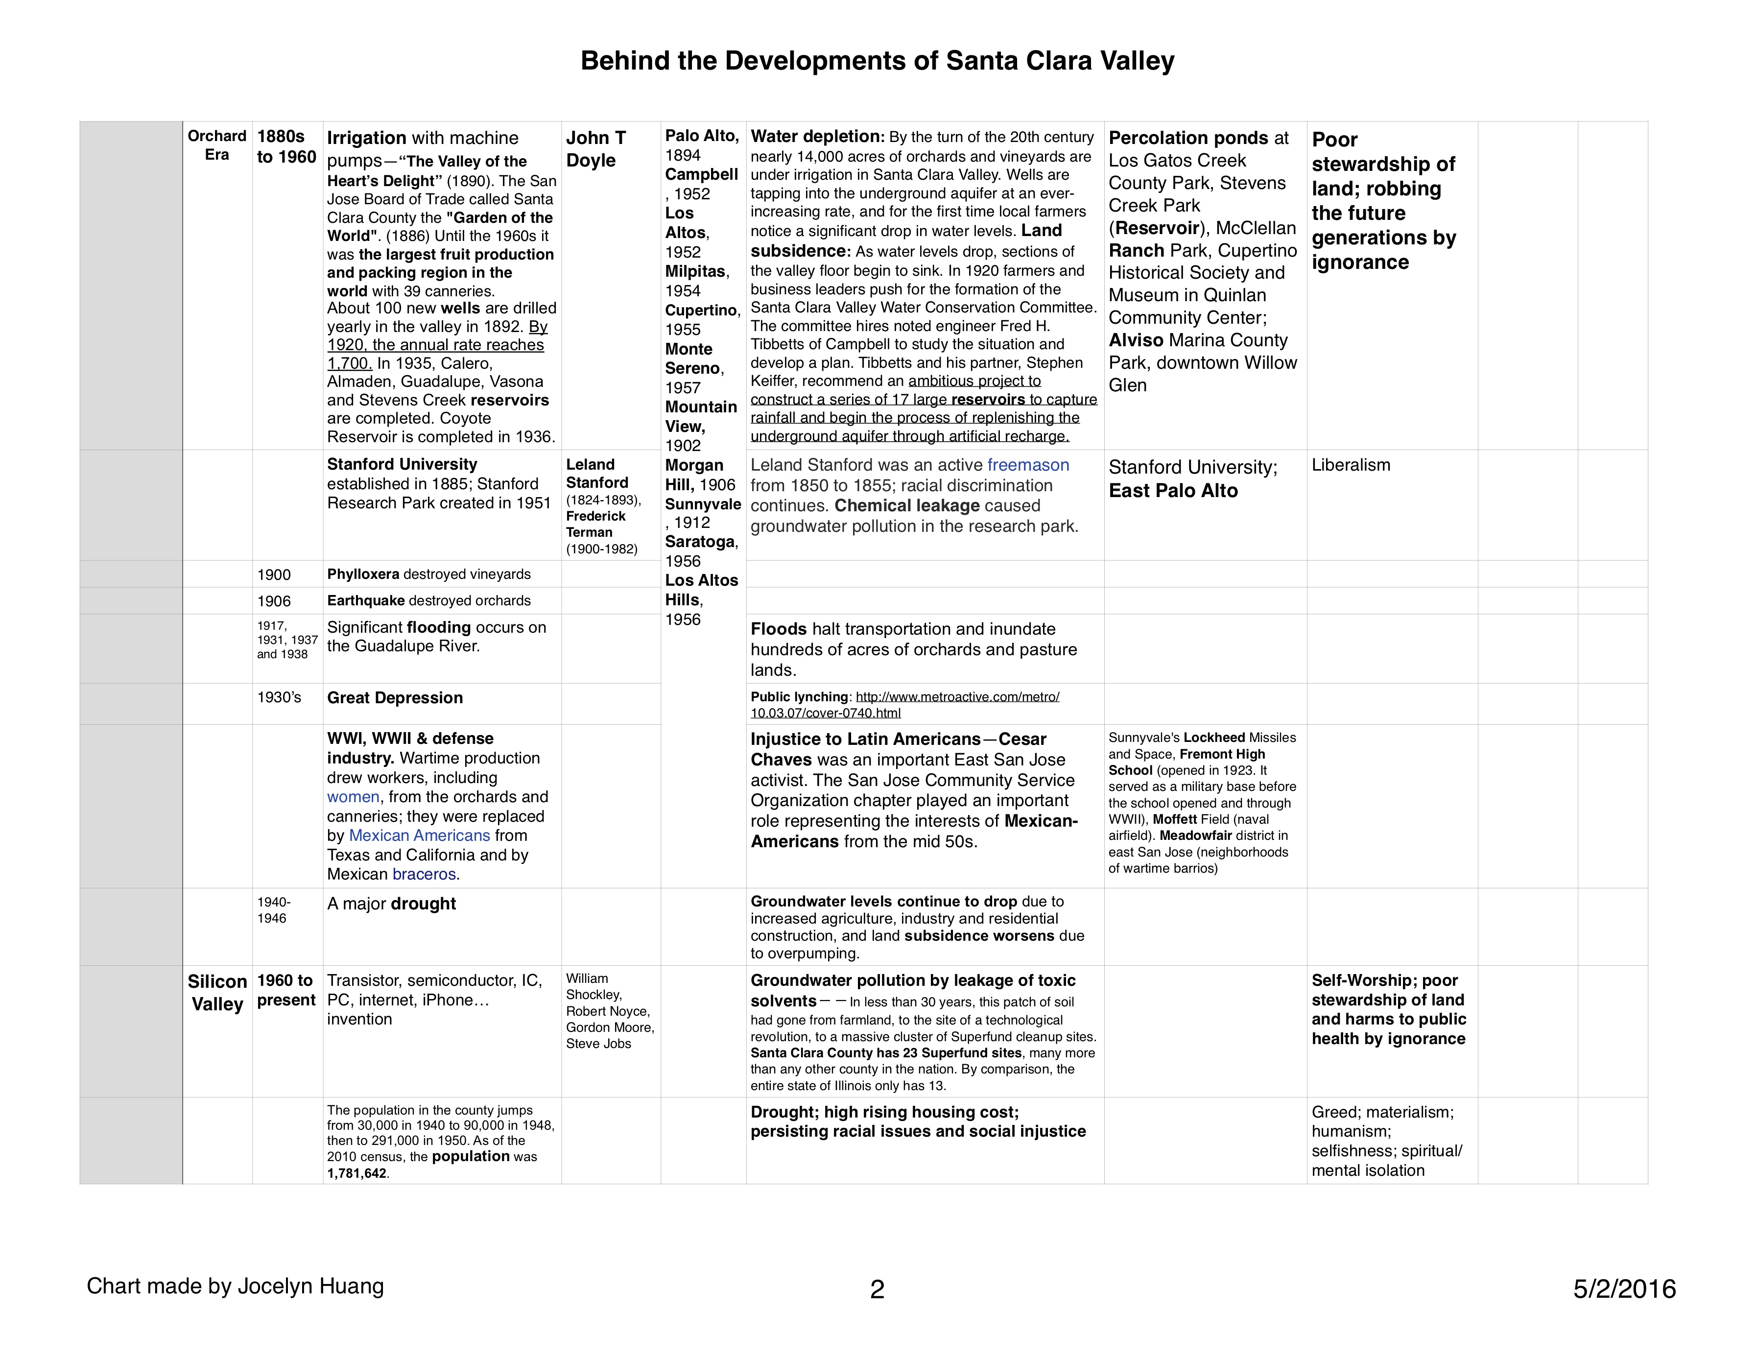
繪製屬靈地圖 Spiritual Mapping
谁建立了你们的城市？Who built your city?
他们所坚持的信念为何？What were their beliefs?
他们的信念是以圣经为基础吗？Were those beliefs biblical?
他们所采取的行动如何影响你所居住的社会呢？How did the actions they adopted influence the society you live?
若你们的城市是建立在公义和真理的基础上，那么这样的基础何时发生改变呢？什么人改变了它呢？If your city was build upon the foundation of righteousness and truth, since when was it changed, and who changed it?
这如何影响你们社会的思想模式呢？How did that change impact the paradigm of your society?
你们社会经由社会、媒体和其他沟通管道所传递的信念和教导为何呢？What are the beliefs and teachings your society has delivered to the people through media or other channels?
因着此种错误的思想、法律、或行动所建立的坚固营垒有哪些呢？What are the strongholds fortified because of such incorrect doctrines, laws, or actions?
George Otis Jr./Peter Wagner/Cindy Jacobs

Slide 17
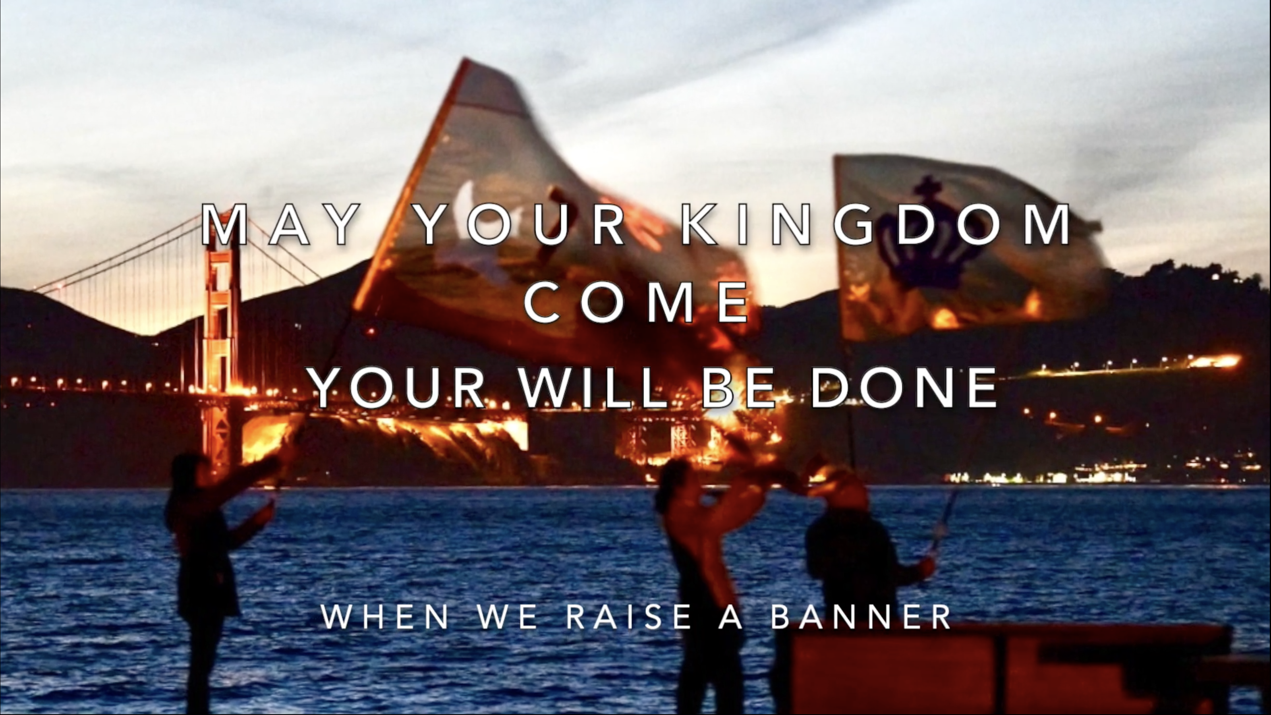

Slide 18
“Brown is the new green?”
It’s a lie!
Refuse it!
The drought since 2011 was broken at the end of our strategic prayer movement!

Slide 19
起飛—從城市到列國
C.The East Bay Oakland, Richmond, Fremont (2019-2020)
The root of the increasing crime rate in the Bay Area and California.
Impact of slavery (Africa->South. America->the US)
Imports of different religions with the influx of immigrants from the East.

Slide 20
起飛—從城市到列國
D. Go International!
Serving International Students—為列國預備宣教士

Slide 21
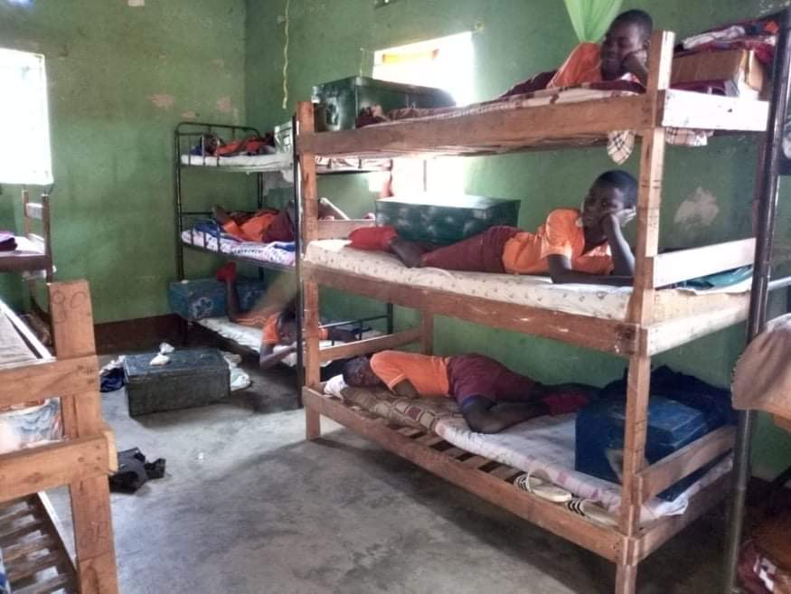
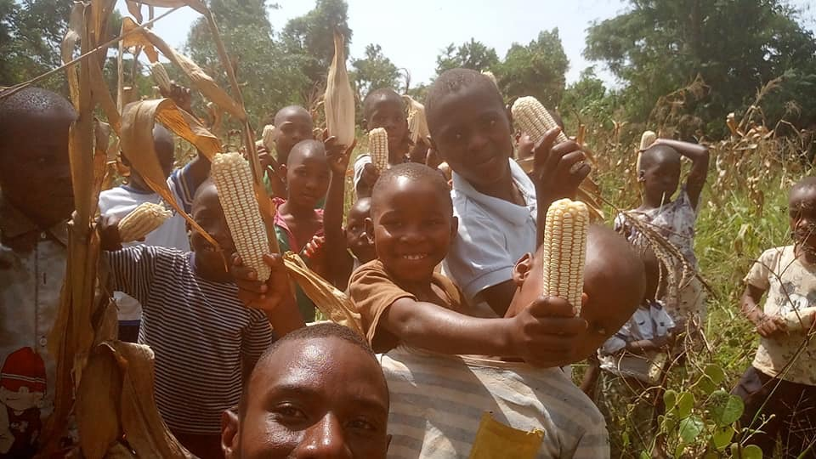
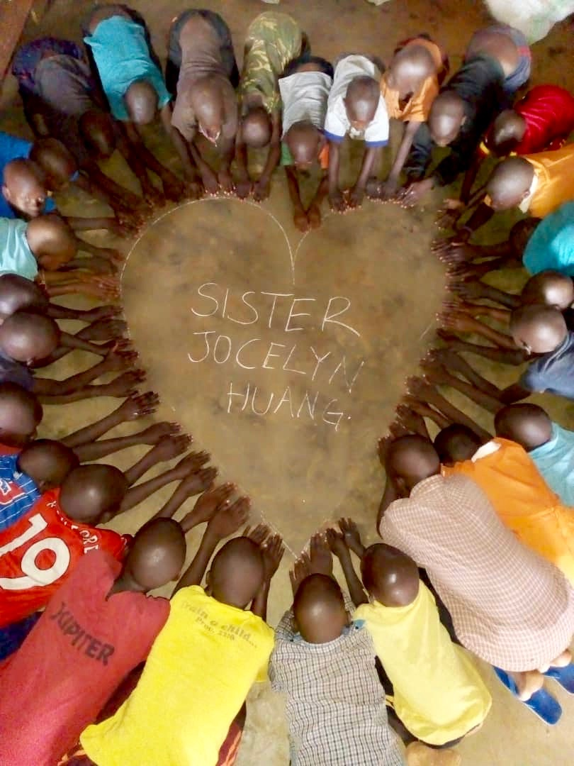
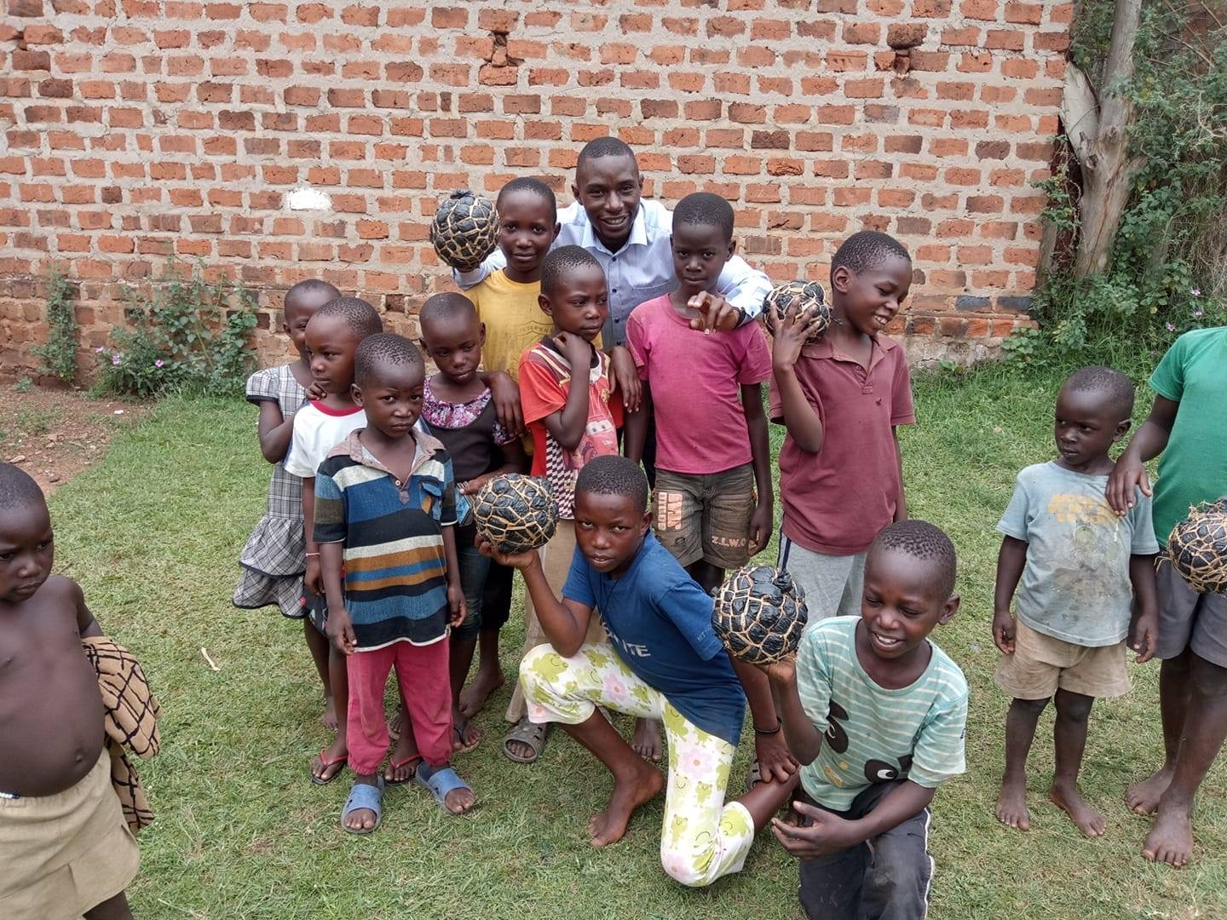
起飛—從城市到列國
E. 孤兒院的託付
“Nations will be set free by the heart that you have!”… I see the wealth of the Kingdom being put in your hand and you’re gonna sow it into people, into lands, into nations. And you’re gonna see orphanages rise up and become a Kingdom family. You’re gonna see the broken restored… I’m seeing different types of ministers rising up. I’m seeing evangelists. And people are healing. I’m seeing teachers, and doctors, and lawyers. I’m seeing people that will take what you give them as a second chance and I see them express it upon another generation… I’m seeing children all over. Not only Asian, but I see African... I see the African families being restored. God is gonna use you in many different cultures to break lines of colors and race and bring them into a place of Kingdom understanding.

Slide 22
起飛—從城市到列國
F. China— A China Cry Heard in the Throne Room
God uses nature to speak or to confirm what He is doing in a multi-facet way. Before my mission trip to China, I received my commission--
  I HEAR A SOUND FROM HEAVEN!!! LIKE A RUSHING MIGHTY WIND.「我聽見有天上來的聲音，如同疾風吹來--
  MY DAUGHTER, CARRY THAT SOUND TO CHINA!!! 我的女兒啊！把這聲音帶到中國!!!
  I CAN HEAR THEIR CRIES!!!!!!!!! 我聽見她們的哭聲!!!!!!!!
  I HEAR IN MY THRONE ROOM A CHINA CRY!!!!!!!!! 我在我的寶座上聽見中國的哭聲!!!!!!!!!
  BUT MY DAUGHTER, I HAVE BEEN CRYING FOR CHINA SINCE BEFOR I CREATED THE HEAVENS AND THE EARTH!!! 女兒啊！在我創造天地之前，我已經為中國哭泣！
  GO SHARE MY HEART...YOUR FATHER'S HEART WITH THEM… 去分享我的心！與她們分享你天父的心......
  ALL MY DAUGHTERS IN CHINA AND THROUGHOUT ALL OF ASIA NEED TO KNOW HOW MUCH THEIR FATHER GOD LOVES THEM!!!!!!!!! 中國及全亞洲的女兒們需要知道，她們的天父有何等愛她們.......」
Hence I prepared a song to go with my mission--"Come, Mighty Wind Of The Spirit!"（屬靈的疾風吹來！）And God prepared the first typhoon of this year to go with it! What's more interesting is the typhoon that hit Shenzhen on Monday evening was named "Merbok" which means "the declaratory place." （宣告的地方！）

Slide 23
起飛—從城市到列國
G. Israel, Kazhakstan, West Africa, Egypt (2017-2020)

Slide 24
起飛—從城市到列國
Northwest Council—
“The last frontier is becoming the first battleground.”
“The greatest challenge in the next three years is the United States. Which way it’s going to turn to? If America chooses ME, I’ll restore it!” (2/7/2022)
H. All over the US (2020-2023)
Decrees sent out over cities
7/9/2020
I saw decrees written on polished carbonado (black stones) regarding the destinies of cities sent flying out in the air. They were the judgments spoken over the cities.
East Coast
West Coast
Civil War Route
Mississippi River
Water Sources
Fault Lines
Lewis & Clark Trail
Portland to NYC
Portland MAX routes
Five Volcanos
Over 40 states

Slide 25
恩膏的提升及境界的擴張
Increase of Anointing & Expansion of Dominion
認識神（真理、神的心、神的愛）Truth--Know His standing orders
敏銳神的帶領 Sensitivity—Know His daily orders
  神的季節
  神的時候
  神的聲音
等候神（安息在神裡面）Intimacy-- A friend, a bride
順服 Obedience— A servant
忠心 Faithfulness— A general

Slide 26
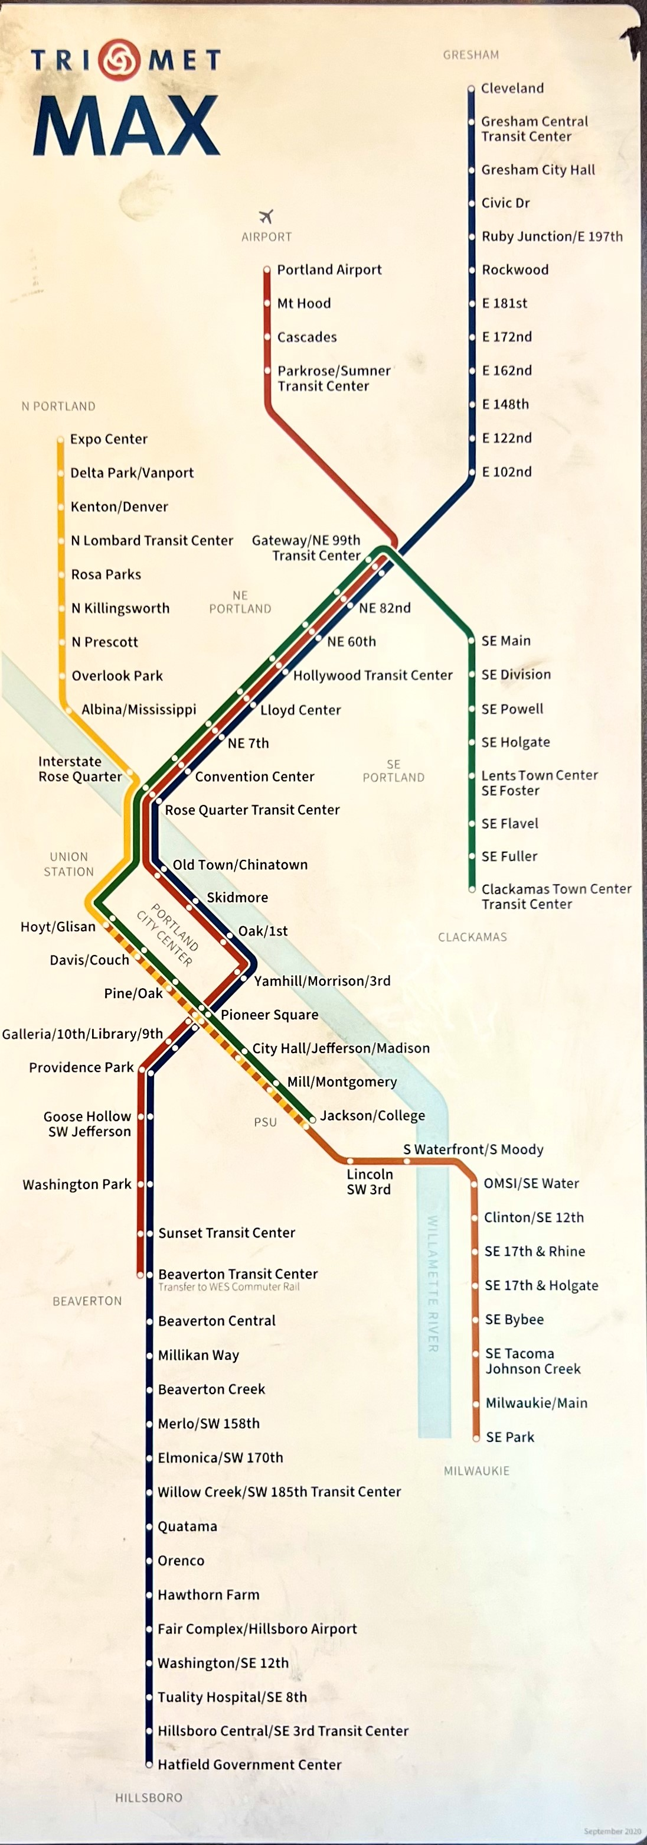
深耕波特蘭
Portland MAX routes (November 2022)

Slide 27
深耕波特蘭
Five Volcanos (February-March 2023)
  Mount Baker
  Mount Rainier
  Mount St. Helens
  Mount Hood
  Mount Shasta
Mount Tabor

Slide 28
深耕波特蘭
換心手術 Heart Transplant Surgery 9/5/2023
愛的電擊！“Release the paddle of love.” “I want you to court Portland!”
“A shock wave is coming to Portland! I AM turning Portland to turn the nation!”

Slide 29
深耕波特蘭
Ezekiel 37 vision re. Portland 10/15/2023
Prophesy over Portland 10/17/2023
  Ekklesia, Arise!

Slide 30
深耕波特蘭
A portal is opened! 10/21/2023
Mother Ship Washed to the Open! 10/23/2023

Slide 31
Beached Mother Ship Washed into the Open!
Dreamed that the small ship my ill mother was in was carried into the river that was flowing into the open sea! My mother was ill and disabled. She was under a kind of medical help. There were medical equipment in that ship. It was totally unexpected that the water level would rise up suddenly and the ship was in no time carried away into the major waterway! I saw her ship going through a hole under a bridge. The water was churning and swift so it looked yellow. There was no way I could pull it back. Just a brief moment ago, I even had to add water into where the ship was parked (not anchored) in, like a marina. Now I thought she would wake up shocked to see herself in the open water! I needed to get help to rescue her, I thought. I myself felt the urge to use the restroom but I could not find one in this place like a hospital. I suddenly saw something like one for the surgical team. I went over. A guy from the surgical center was about to go to as well. I got there first. I opened the door and found it to be like a closet! There were no toilet in the restroom! It was strange that in such a big organization there were no restrooms!

Slide 32
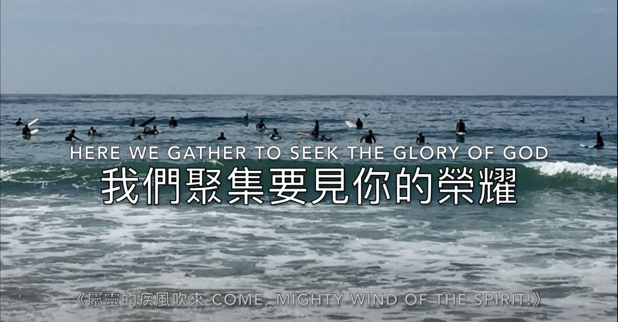
等候許久的門已經敞開！
復興的浪潮已經襲來
A Kairos Moment is Here!
Issachar Anointing
趁時而做
乘駕浪潮之上 vs 旁觀
醫治釋放得更新
播種愛，收割喜樂！

Slide 33
回應詩歌 Response Song
「屬靈的疾風吹來」

