Slide 1

主日信息
Sunday Sermon

Slide 2

屬靈的榜樣
Spiritual Examples
波特蘭靈糧堂
November 12, 2023

Slide 3
腓立比書 Philippians 3:17
弟兄們，你們要一同效法我，也當留意看那些照我們榜樣行的人。
Join together in following my example, brothers and sisters, and just as you have us as a model, keep your eyes on those who live as we do.

Slide 4

保羅的屬靈榜樣 Paul’s Spiritual Examples
    透明敞開 Transparency and Genuineness
    領人歸主 Leading People to Christ
    關係導向 Relationship Oriented Ministries
    倚靠聖靈 Leaning On the Holy Spirit

Slide 5

保羅的屬靈榜樣 Paul’s Spiritual Example
透明敞開
Transparency and Genuineness

Slide 6
羅馬書 Romans 12:3-4
我憑著所賜我的恩對你們各人說：不要看自己過於所當看的；要照著 神所分給各人信心的大小，看得合乎中道。 正如我們一個身子上有好些肢體，肢體也不都是一樣的用處。
For by the grace given me I say to every one of you: Do not think of yourself more highly than you ought, but rather think of yourself with sober judgment, in accordance with the faith God has distributed to each of you. For just as each of us has one body with many members, and these members do not all have the same function,

Slide 7
哥林多後書 2 Cor. 12:5-6
為這人，我要誇口；但是為我自己，除了我的軟弱以外，我並不誇口。 我就是願意誇口也不算狂，因為我必說實話；只是我禁止不說，恐怕有人把我看高了，過於他在我身上所看見、所聽見的。
I will boast about a man like that, but I will not boast about myself, except about my weaknesses. Even if I should choose to boast, I would not be a fool, because I would be speaking the truth. But I refrain, so no one will think more of me than is warranted by what I do or say,

Slide 8
哥林多後書 2 Cor. 12:8-9
為這事，我三次求過主，叫這刺離開我。 他對我說：「我的恩典夠你用的，因為我的能力是在人的軟弱上顯得完全。」所以，我更喜歡誇自己的軟弱，好叫基督的能力覆庇我。
Three times I pleaded with the Lord to take it away from me. But he said to me, “My grace is sufficient for you, for my power is made perfect in weakness.” Therefore I will boast all the more gladly about my weaknesses, so that Christ’s power may rest on me.

Slide 9


在基督裡誠實看自己
Truthful Self-perception in Christ

Slide 10
提摩太前書 1 Timothy 1:15-16
「基督耶穌降世，為要拯救罪人。」這話是可信的，是十分可佩服的。 在罪人中我是個罪魁。
然而，我蒙了憐憫，是因耶穌基督要在我這罪魁身上顯明他一切的忍耐，給後來信他得永生的人作榜樣。
Here is a trustworthy saying that deserves full acceptance: Christ Jesus came into the world to save sinners—of whom I am the worst. But for that very reason I was shown mercy so that in me, the worst of sinners, Christ Jesus might display his immense patience as an example for those who would believe in him and receive eternal life.

Slide 11
保羅的屬靈榜樣 Paul’s Spiritual Example
領人歸主
Leading People to Christ

Slide 12
哥林多前書 1 Cor. 4:6-7
弟兄們，我為你們的緣故，拿這些事轉比自己和亞波羅，叫你們效法我們不可過於聖經所記，免得你們自高自大，貴重這個，輕看那個。 使你與人不同的是誰呢？ 你有甚麼不是領受的呢？ 若是領受的，為何自誇，彷彿不是領受的呢？
Now, brothers and sisters, I have applied these things to myself and Apollos for your benefit, so that you may learn from us the meaning of the saying, “Do not go beyond what is written.” Then you will not be puffed up in being a follower of one of us over against the other. For who makes you different from anyone else? What do you have that you did not receive? And if you did receive it, why do you boast as though you did not?

Slide 13
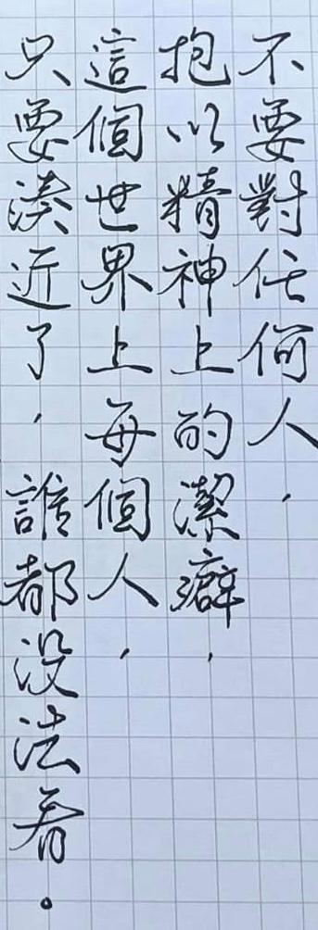



Slide 14
屬靈遮蓋與權柄
Spiritual Covering and Authority

Slide 15
哥林多前書 1 Cor. 11:18-19
第一，我聽說，你們聚會的時候彼此分門別類，我也稍微地信這話。 在你們中間不免有分門結黨的事，好叫那些有經驗的人顯明出來。
In the first place, I hear that when you come together as a church, there are divisions among you, and to some extent I believe it. No doubt there have to be differences among you to show which of you have God’s approval.

Slide 16
保羅的屬靈榜樣 Paul’s Spiritual Example
關係導向
Relationship Oriented Ministries

Slide 17
以弗所書 Ephesians 2:18-19
因為我們兩下藉著他被一個聖靈所感，得以進到父面前。 這樣，你們不再作外人和客旅，是與聖徒同國，是 神家裡的人了；
For through him we both have access to the Father by one Spirit.
Consequently, you are no longer foreigners and strangers, but fellow citizens with God’s people and also members of his household,

Slide 18
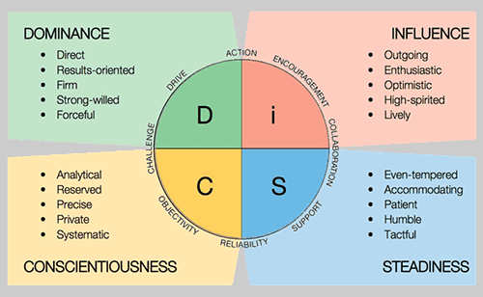
保羅是 D 型？ Was Paul a D type?

Slide 19
羅馬書 Romans 16:13-15
又問在主蒙揀選的魯孚和他母親安；他的母親就是我的母親。 又問亞遜其土、弗勒干、黑米、八羅巴、黑馬，並與他們在一處的弟兄們安。 又問非羅羅古和猶利亞，尼利亞和他姊妹，同阿林巴並與他們在一處的眾聖徒安。
Greet Rufus, chosen in the Lord, and his mother, who has been a mother to me, too. Greet Asyncritus, Phlegon, Hermes, Patrobas, Hermas and the other brothers and sisters with them.
Greet Philologus, Julia, Nereus and his sister, and Olympas and all the Lord’s people who are with them.

Slide 20
哥林多前書 1 Cor. 16:19-21
亞細亞的眾教會問你們安。 亞居拉和百基拉並在他們家裡的教會，因主多多地問你們安。
眾弟兄都問你們安。 你們要親嘴問安，彼此務要聖潔。 我─保羅親筆問安。
The churches in the province of Asia send you greetings. Aquila and Priscilla[a] greet you warmly in the Lord, and so does the church that meets at their house. All the brothers and sisters here send you greetings. Greet one another with a holy kiss. I, Paul, write this greeting in my own hand.

Slide 21
保羅的屬靈榜樣 Paul’s Spiritual Example
倚靠聖靈
Leaning On the Holy Spirit

Slide 22
哥林多前書 1 Cor. 2:3-5
我在你們那裡，又軟弱，又懼怕又甚戰兢。 我說的話、講的道，不是用智慧委婉的言語，乃是用聖靈和大能的明證，叫你們的信不在乎人的智慧，只在乎 神的大能。
I came to you in weakness with great fear and trembling. My message and my preaching were not with wise and persuasive words, but with a demonstration of the Spirit’s power, so that your faith might not rest on human wisdom, but on God’s power.

Slide 23
加拉太書 Galatians 5:25-26
我們若是靠聖靈得生，就當靠聖靈行事。 不要貪圖虛名，彼此惹氣，互相嫉妒。
Since we live by the Spirit, let us keep in step with the Spirit. Let us not become conceited, provoking and envying each other.

Slide 24
聖靈更新 & 權能事奉
Renewal by the Spirit & Power Ministries

Slide 25
保羅的屬靈榜樣 Paul’s Spiritual Examples
    透明敞開 Transparency and Genuineness
    領人歸主 Leading People to Christ
    關係導向 Relationship Oriented Ministries
    倚靠聖靈 Leaning On the Holy Spirit

Slide 26
回應詩歌 Response Song
「我需要有你在我生命中
I need You in my life」

