Slide 1

主日信息
Sunday Sermon
Pastor Elaine Saville
Allegra Ministries

Slide 2
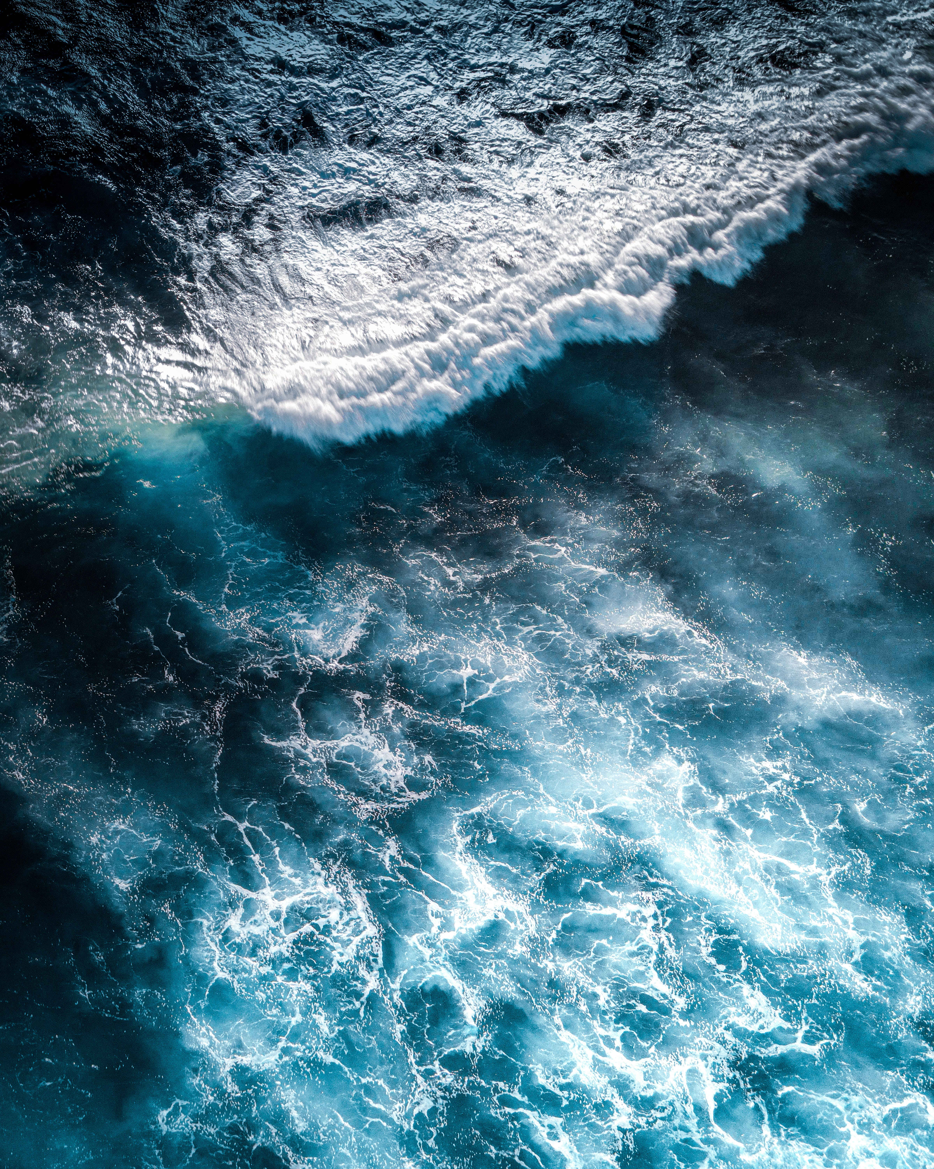
Overcoming Waters of Adversity
勝過風浪

Slide 3
Play video
“Ocean Waves”

Slide 4
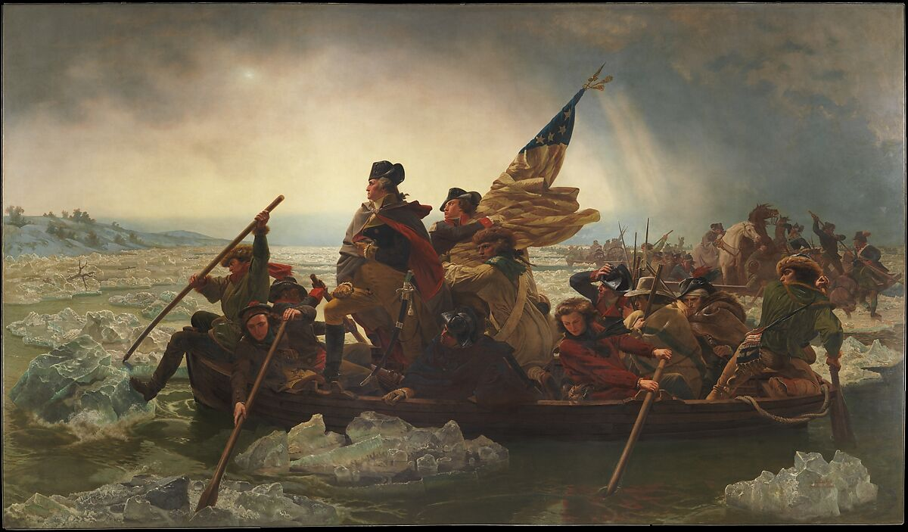

Slide 5
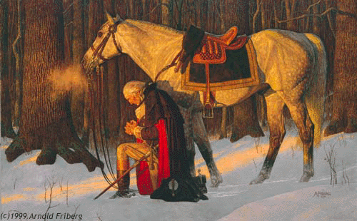

Slide 6
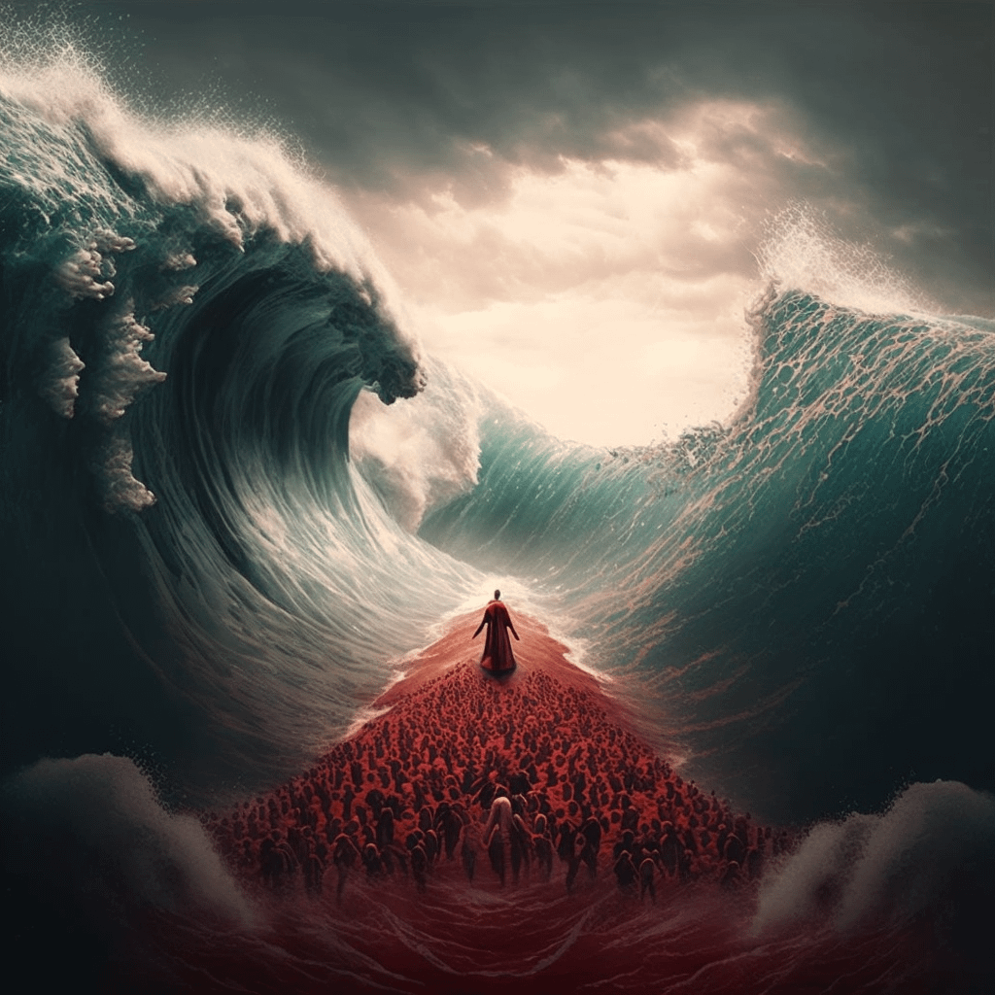

Slide 7
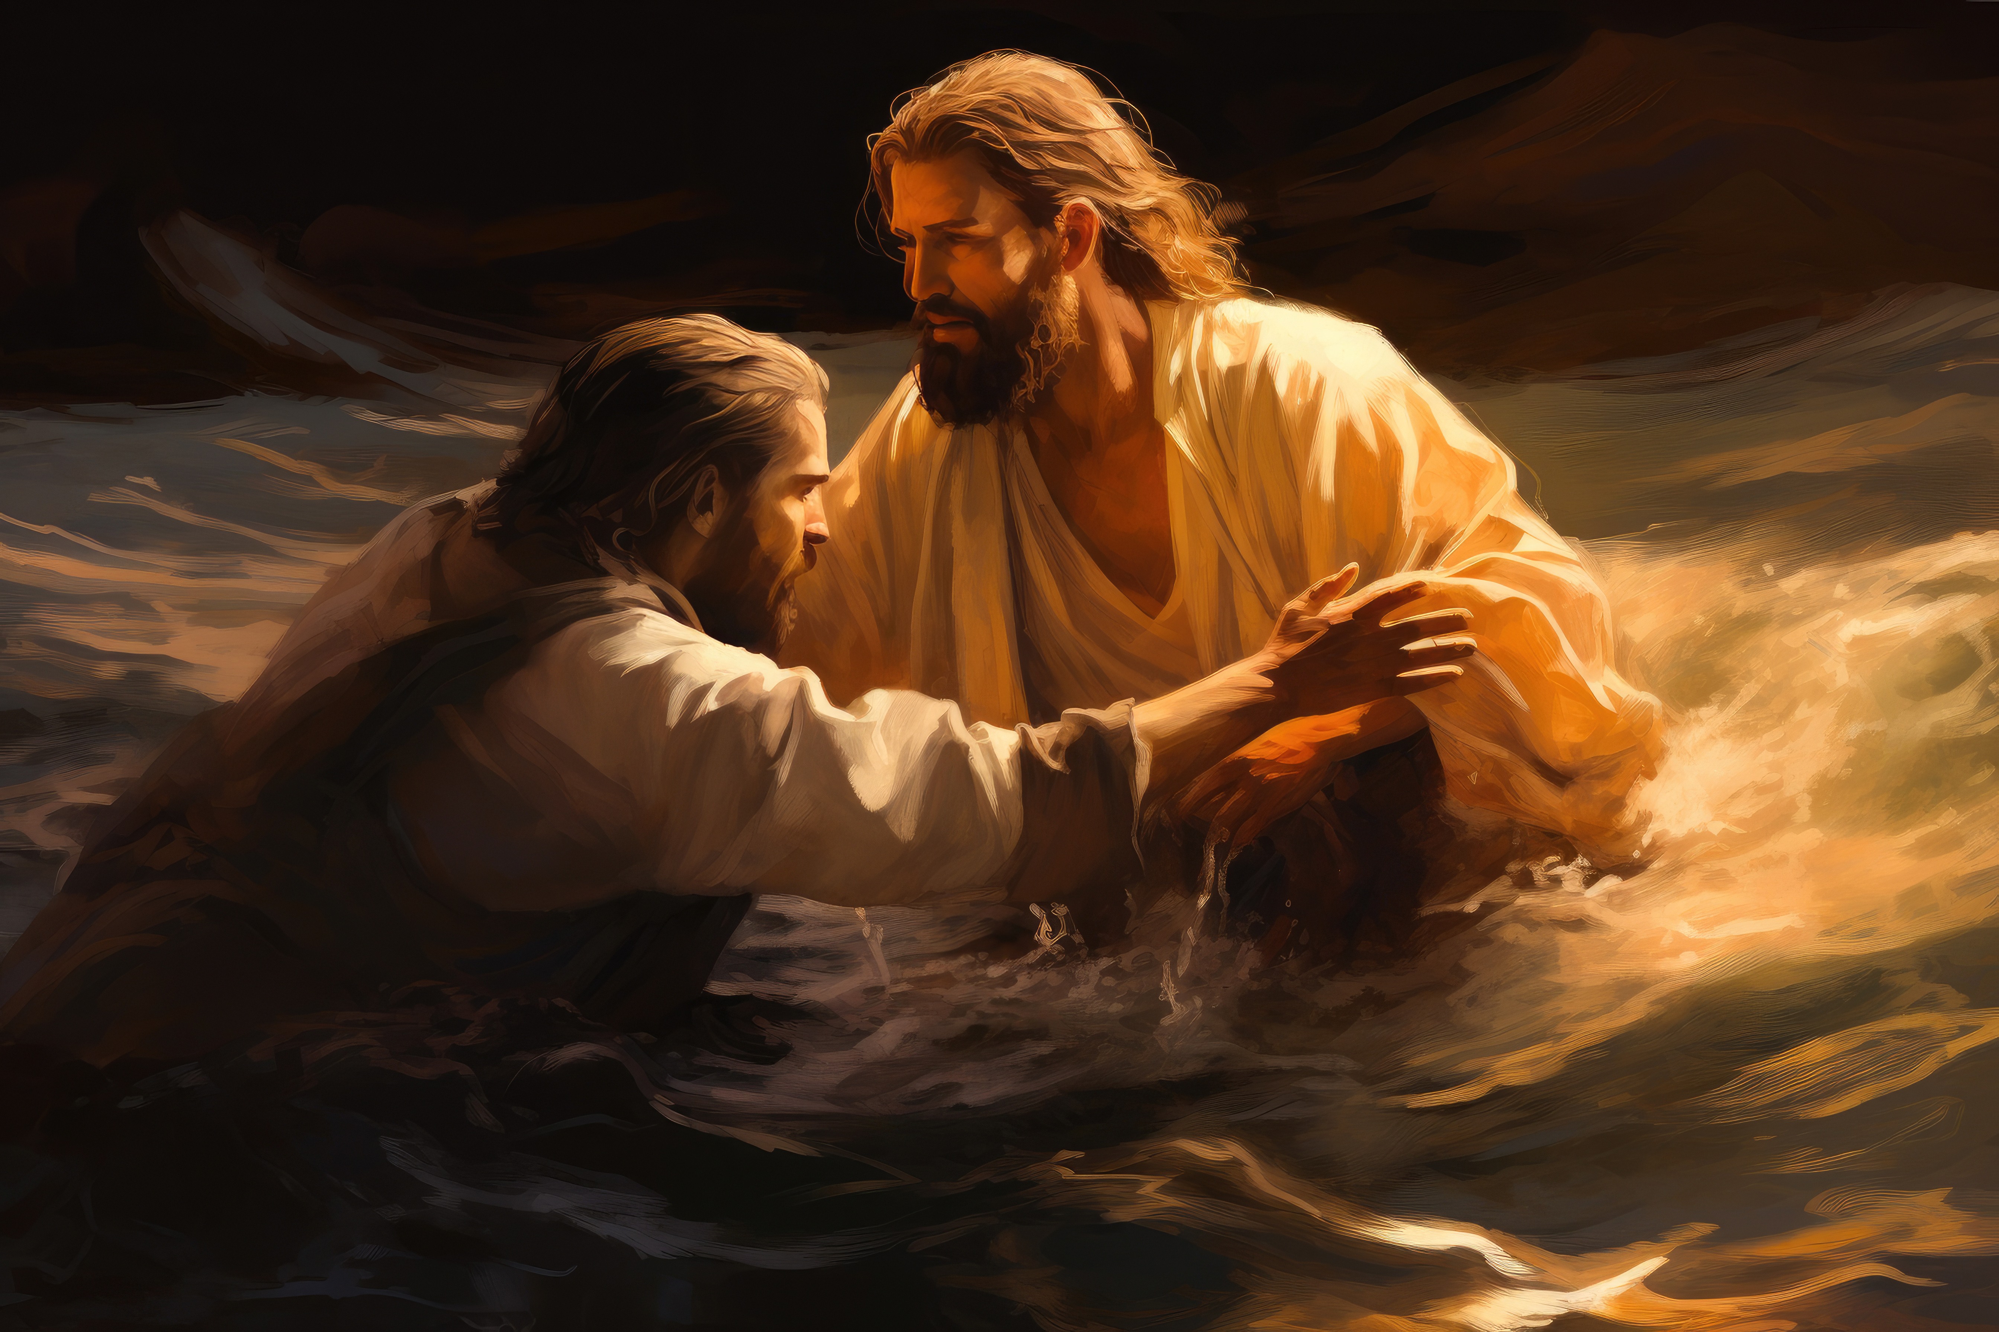

Slide 8

First Landing at Cape Henry, Virginia. April 29, 1607
1607年4月29日 首次著陸 維吉尼亞州的亨利角
May all who see this cross remember what we have done here; and may those who come here to inhabit join us in this Covenant and this most noble work, that the Holy Scriptures may be fulfilled. From these very shores the gospel shall go forth, not only to this new world, but the entire world.

Slide 9
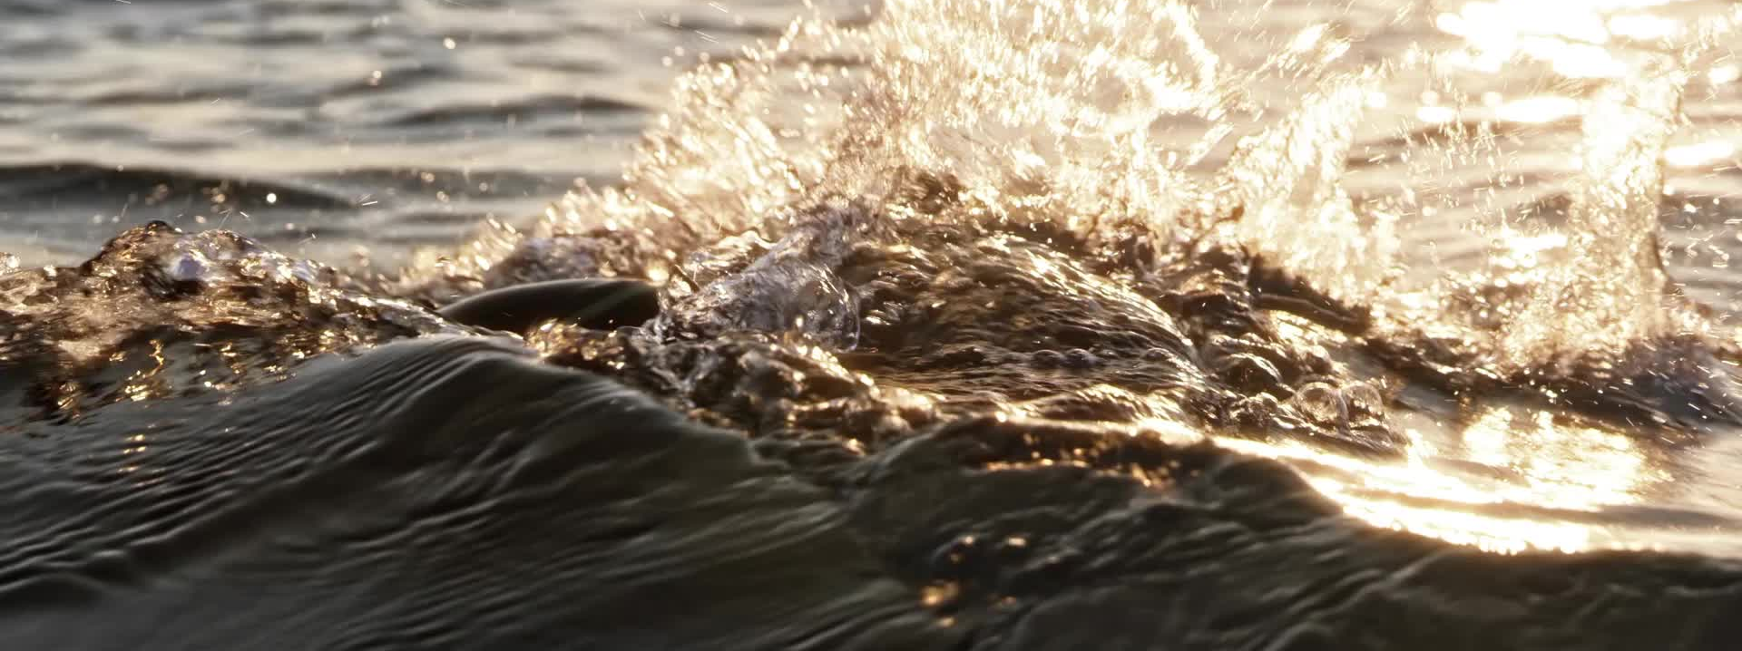
禱告：迫切、受聖靈感動、信任神
抓到異象/再度夢想/回想應許
運用信心、記念神的約、看見勝利
Pray: Fervently, Holy Spirit Inspired, Trusting God
Catch the Vision/Dream Again/Rehearse the Promises
Exercise Faith, Remember the Covenant, See the Victory

Slide 10
定睛於耶穌
停留在可安歇的水邊
領受軍令/在權柄和能力中行事
歡慶
Keep Eyes Fixed on Jesus
Stay by the Still Waters
Get Your Marching Orders/Act in Power and Authority
Celebrate

Slide 11
