Slide 1
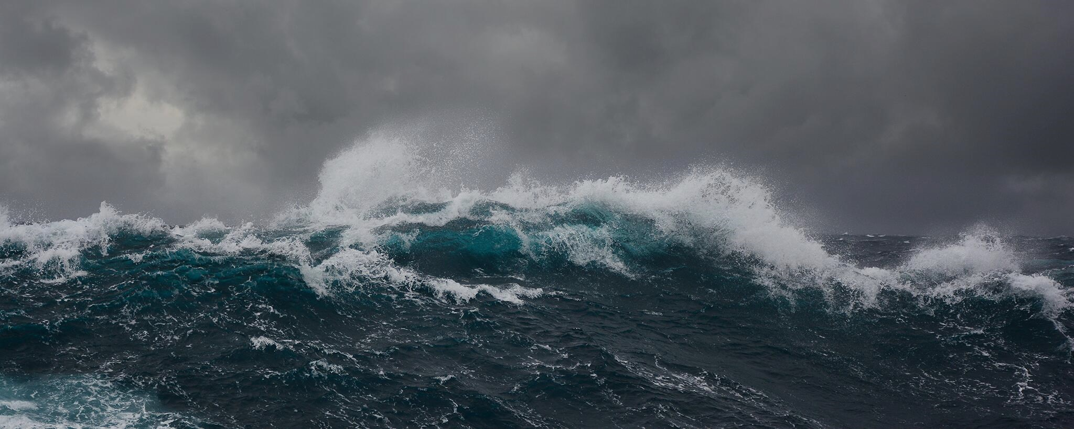


Slide 2

祂要斷開沈重軛
He Will Break the Heavy Yoke
波特蘭靈糧堂
January 28, 2024

Slide 3

箴言 Proverbs 13:12
所盼望的遲延未得，令人心憂；所願意的臨到，卻是生命樹。
Hope deferred makes the heart sick,
but a longing fulfilled is a tree of life.

Slide 4

瑪拉基書 Malachi 3:1
萬軍之耶和華說：「我要差遣我的使者在我前面預備道路。 你們所尋求的主必忽然進入他的殿；立約的使者，就是你們所仰慕的，快要來到。」
“I will send my messenger, who will prepare the way before me. Then suddenly the Lord you are seeking will come to his temple; the messenger of the covenant, whom you desire, will come,” says the Lord Almighty.

Slide 5
但以理書 Daniel 3:4-7
那時傳令的大聲呼叫說：「各方、各國、各族的人哪，有令傳與你們：你們一聽見角、笛、琵琶、琴、瑟、笙，和各樣樂器的聲音，就當俯伏敬拜尼布甲尼撒王所立的金像。 凡不俯伏敬拜的，必立時扔在烈火的窯中。」因此各方、各國、各族的人民一聽見角、笛、琵琶、琴、瑟，和各樣樂器的聲音，就都俯伏敬拜尼布甲尼撒王所立的金像。」
6 Now Whoever does not fall down and worship will immediately be thrown into a blazing furnace.

Slide 6
但以理書 Daniel 3:14-15
尼布甲尼撒問他們說：「沙得拉、米煞、亞伯尼歌，你們不事奉我的神，也不敬拜我所立的金像，是故意的嗎？ 你們再聽見角、笛、琵琶、琴、瑟、笙，和各樣樂器的聲音，若俯伏敬拜我所造的像，卻還可以；若不敬拜，必立時扔在烈火的窯中，有何神能救你們脫離我手呢？」
15 Now when you hear the sound of the horn, flute, zither, lyre, harp, pipe and all kinds of music, if you are ready to fall down and worship the image I made, very good. But if you do not worship it, you will be thrown immediately into a blazing furnace. Then what god will be able to rescue you from my hand?”

Slide 7
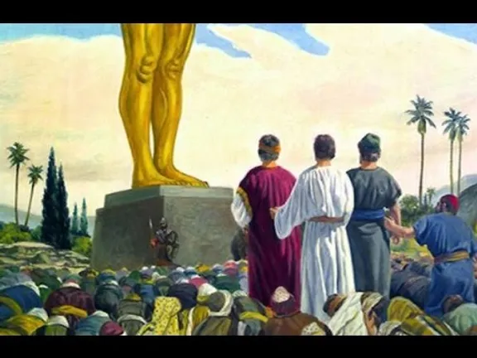

Slide 8
但以理書 Daniel 3:16-18
沙得拉、米煞、亞伯尼歌對王說：「尼布甲尼撒啊，這件事我們不必回答你；即便如此，我們所事奉的 神能將我們從烈火的窯中救出來。王啊，他也必救我們脫離你的手；即或不然，王啊，你當知道我們決不事奉你的神，也不敬拜你所立的金像。」
17 If we are thrown into the blazing furnace, the God we serve is able to deliver us from it, and he will deliver us from Your Majesty’s hand. But even if he does not, we want you to know, Your Majesty, that we will not serve your gods or worship the image of gold you have set up.”

Slide 9
但以理書 Daniel 3:19-22
當時，尼布甲尼撒怒氣填胸，向沙得拉、米煞、 亞伯尼歌變了臉色，吩咐人把窯燒熱，比尋常更加七倍；又吩咐他軍中的幾個壯士，將沙得拉、米煞、亞伯尼歌捆起來，扔在烈火的窯中。 這三人穿著褲子、內袍、外衣，和別的衣服，被捆起來扔在烈火的窯中。因為王命緊急，窯又甚熱，那抬沙得拉、米煞、亞伯尼歌的人都被火焰燒死。」
22 The king’s command was so urgent and the furnace so hot that the flames of the fire killed the soldiers who took up Shadrach, Meshach and Abednego,

Slide 10
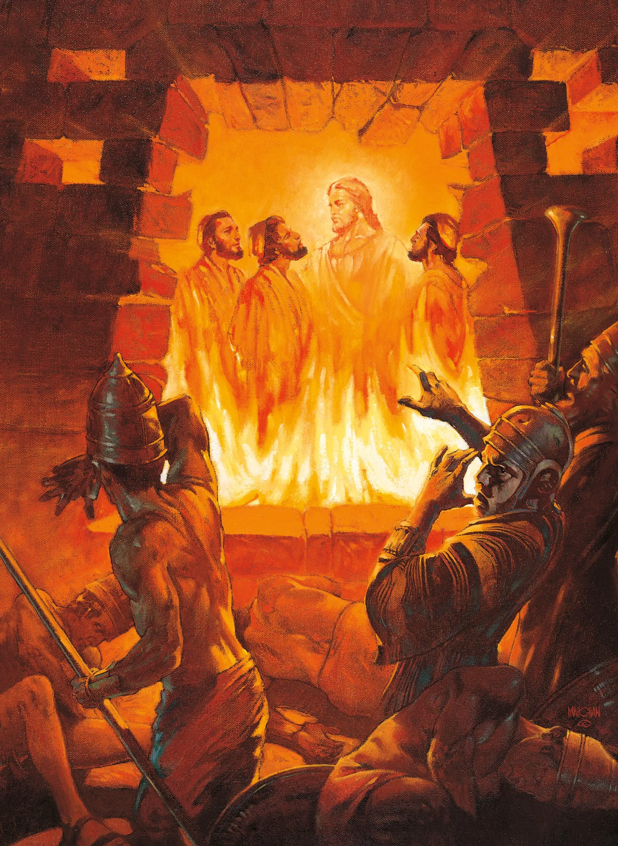

Slide 11
但以理書 Daniel 3:23-25
沙得拉、米煞、亞伯尼歌這三個人都被捆著落在烈火的窯中。 那時，尼布甲尼撒王驚奇，急忙起來，對謀士說：「我捆起來扔在火裡的不是三個人嗎？」他們回答王說：「王啊，是。」 王說：「看哪，我見有四個人，並沒有捆綁，在火中遊行，也沒有受傷；那第四個的相貌好像神子。」
22 The king’s command was so urgent and the furnace so hot that the flames of the fire killed the soldiers who took up Shadrach, Meshach and Abednego,

Slide 12
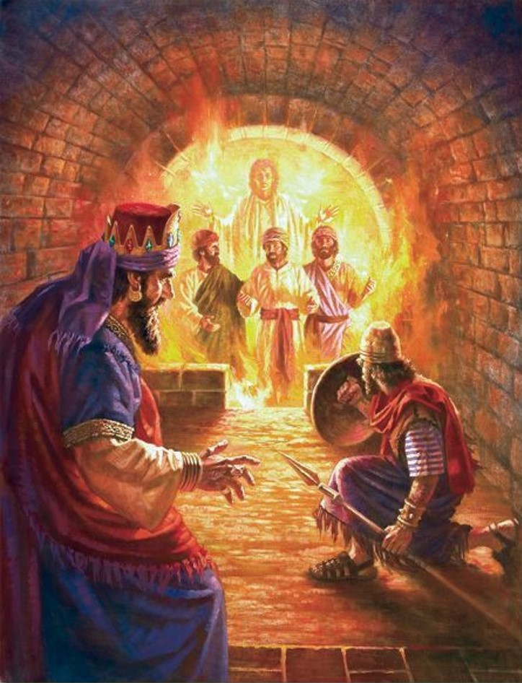

Slide 13
但以理書 Daniel 3:26-27
於是，尼布甲尼撒就近烈火窯門，說：「至高 神的僕人沙得拉、米煞、亞伯尼歌出來，上這裡來吧！」沙得拉、米煞、亞伯尼歌就從火中出來了。 那些總督、欽差、巡撫，和王的謀士一同聚集看這三個人，見火無力傷他們的身體，頭髮也沒有燒焦，衣裳也沒有變色，並沒有火燎的氣味。
27 and the satraps, prefects, governors and royal advisers crowded around them. They saw that the fire had not harmed their bodies, nor was a hair of their heads singed; their robes were not scorched, and there was no smell of fire on them

Slide 14
但以理書 Daniel 3:28-30
尼布甲尼撒說：「沙得拉、米煞、亞伯尼歌的 神是應當稱頌的！他差遣使者救護倚靠他的僕人，他們不遵王命，捨去己身，在他們 神以外不肯事奉敬拜別神。 現在我降旨，無論何方、何國、何族的人，謗讟沙得拉、米煞、亞伯尼歌之 神的，必被凌遲，他的房屋必成糞堆，因為沒有別神能這樣施行拯救。」 那時王在巴比倫省，高升了沙得拉、米煞、亞伯尼歌。
30 Then the king promoted Shadrach, Meshach and Abednego in the province of Babylon.

Slide 15
雅各書 James 1:2-4
我的弟兄們，你們落在百般試煉中，都要以為大喜樂；因為知道你們的信心經過試驗，就生忍耐。 但忍耐也當成功，使你們成全、完備，毫無缺欠。
Consider it all joy, my brethren, when you encounter various trials, knowing that the testing of your faith produces endurance. And let endurance have its perfect result, so that you may be perfect and complete, lacking in nothing.

Slide 16
以賽亞書 Isaiah 26:3
堅心倚賴你的，你必保守他十分平安，因為他倚靠你。
You will keep in perfect peace
those whose minds are steadfast,
because they trust in you.

Slide 17
以賽亞書 Isaiah 10:27
到那日，亞述王的重擔必離開你的肩頭；他的軛必離開你的頸項；那軛也必因肥壯的緣故撐斷（或譯：因膏油的緣故毀壞）。
So it will be in that day, that [a]his burden will be removed from your shoulders and his yoke from your neck, and the yoke will be broken because of fatness.

Slide 18

回應詩歌 Response Song
「祂要斷開沈重軛」

