Slide 1
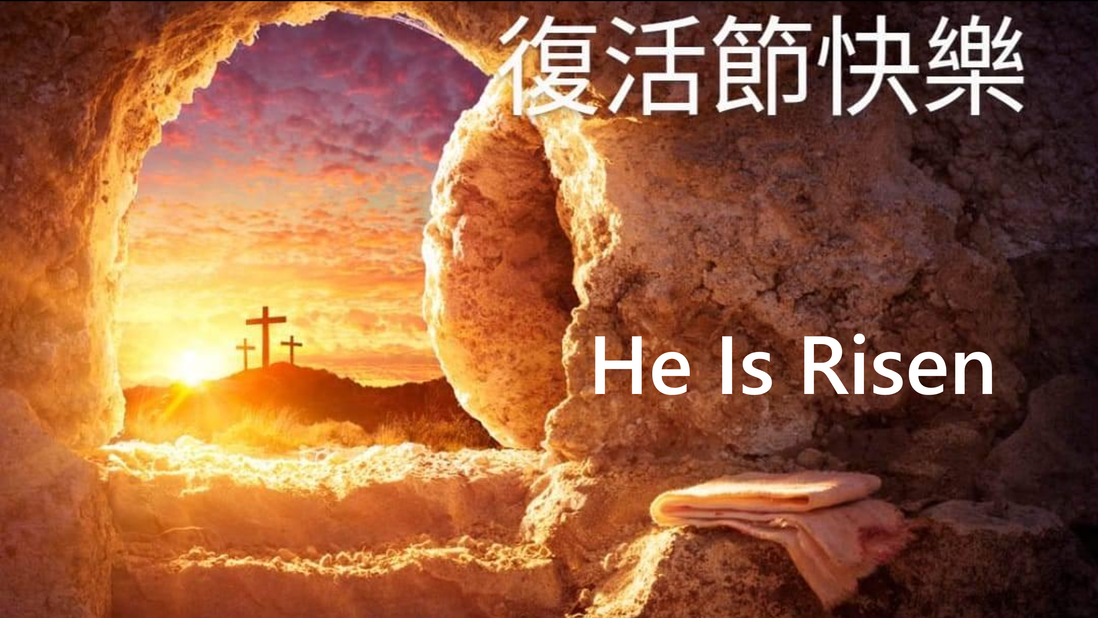
He Is Risen

Slide 2

Sharing on Resurrection Sunday
復活節主日的分享
Annie Lin 林久恩 姐妹
March 31, 2024

Slide 3
Sharing on Resurrection Sunday
復活節主日的分享
Stephen Oh 胡恩瀚 弟兄
March 31, 2024

Slide 4
Count the Costs
計算代價

Slide 5
Luke 14
28 “Suppose one of you wants to build a tower. Won’t you first sit down and estimate the cost to see if you have enough money to complete it? 29 For if you lay the foundation and are not able to finish it, everyone who sees it will ridicule you, 30 saying, ‘This person began to build and wasn’t able to finish.’
路加福音 Luke 14:28-30
你們哪一個要蓋一座樓，不先坐下算計花費，能蓋成不能呢？ 恐怕安了地基，不能成功，看見的人都笑話他，說：『這個人開了工，卻不能完工。』

Slide 6
Luke 14
31 “Or suppose a king is about to go to war against another king. Won’t he first sit down and consider whether he is able with ten thousand men to oppose the one coming against him with twenty thousand? 32 If he is not able, he will send a delegation while the other is still a long way off and will ask for terms of peace. 33 In the same way, those of you who do not give up everything you have cannot be my disciples.
路加福音 Luke 14:31-33
或是一個王出去和別的王打仗，豈不先坐下酌量，能用一萬兵去敵那領二萬兵來攻打他的嗎？若是不能，就趁敵人還遠的時候，派使者去求和息的條款。這樣，你們無論甚麼人，若不撇下一切所有的，就不能作我的門徒。」

Slide 7
Count the Costs
計算代價

Slide 8
You will be born again
你將會重生

Slide 9
Sharing on Resurrection Sunday
復活節主日的分享
Matthew Oh 胡恩澤 弟兄
March 31, 2024

Slide 10

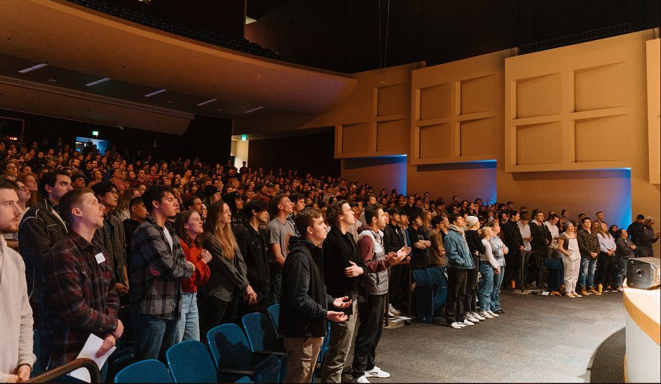
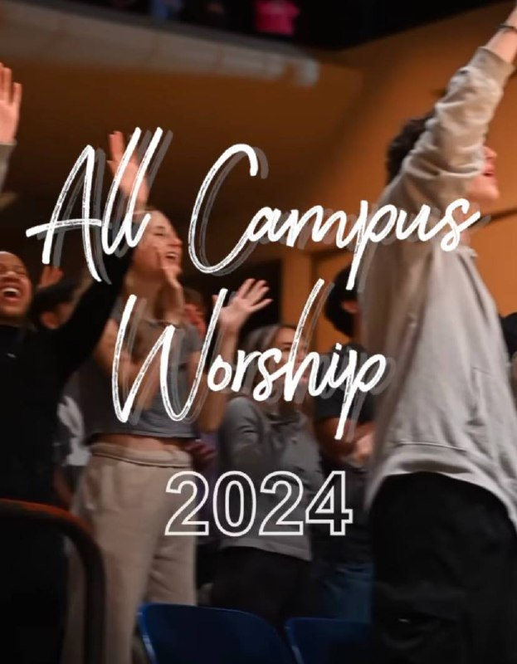
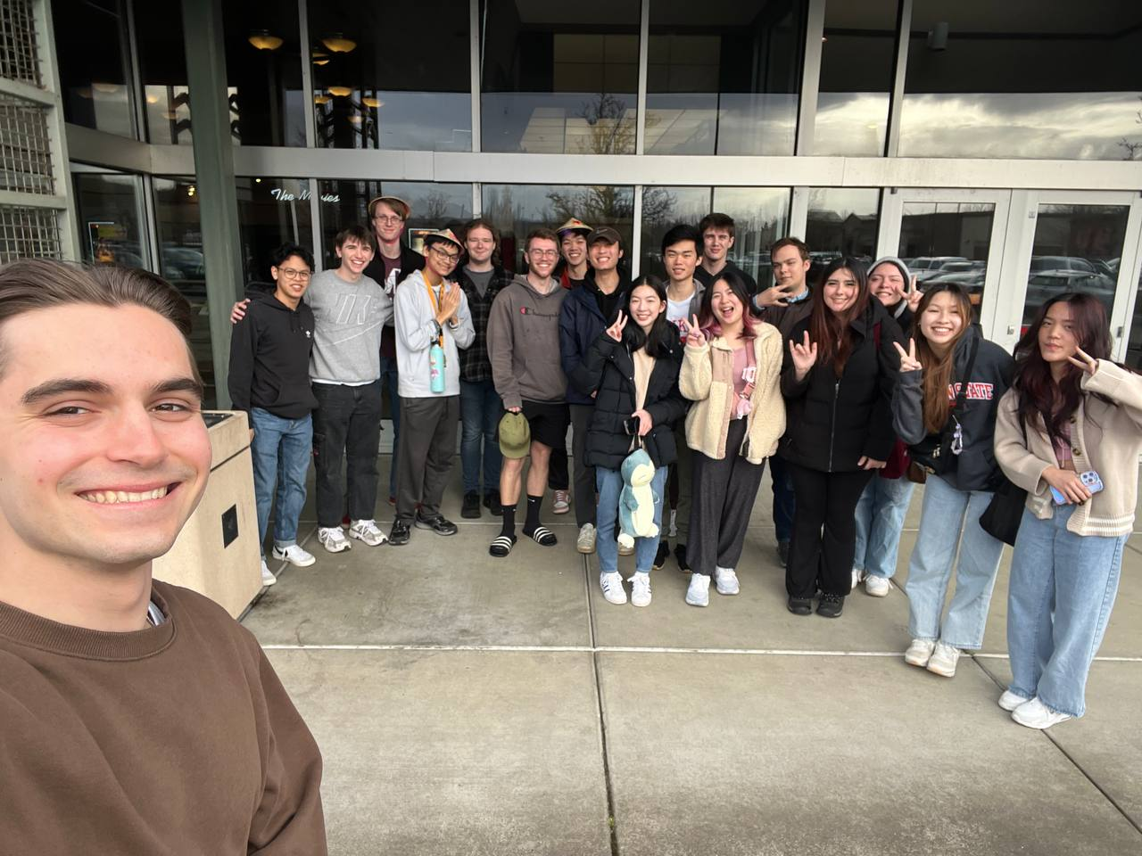
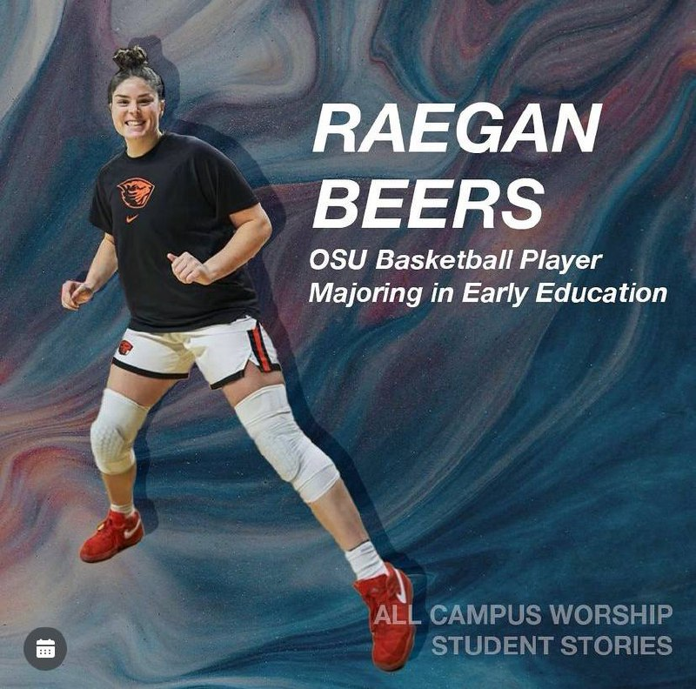
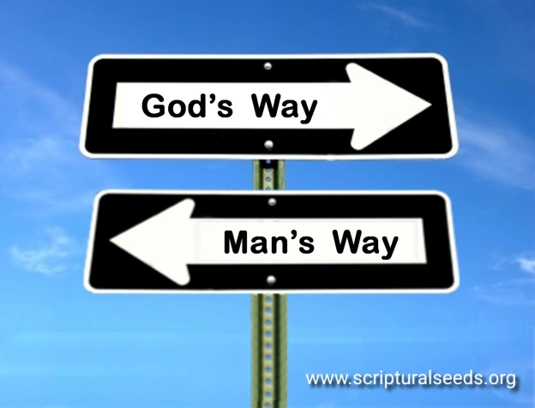
Matthew Oh
Choosing God in a Life you can call your own
Above all, keep loving one another earnestly, since love covers a multitude of
sins. ⁹ Show hospitality to one another without grumbling. ¹⁰ As each has
received a gift, use it to serve one another, as good stewards of God’s varied
grace. 1st Peter 4:8-10

Slide 11

彼得前書 1 Peter 4:8-10
最要緊的是彼此切實相愛，因為愛能遮掩許多的罪。 你們要互相款待，不發怨言。 各人要照所得的恩賜彼此服事，作 神百般恩賜的好管家。
Above all, love each other deeply, because love covers over a multitude of sins. Offer hospitality to one another without grumbling. Each of you should use whatever gift you have received to serve others, as faithful stewards of God’s grace in its various forms.

Slide 12

主日信息
Sunday Sermon

Slide 13
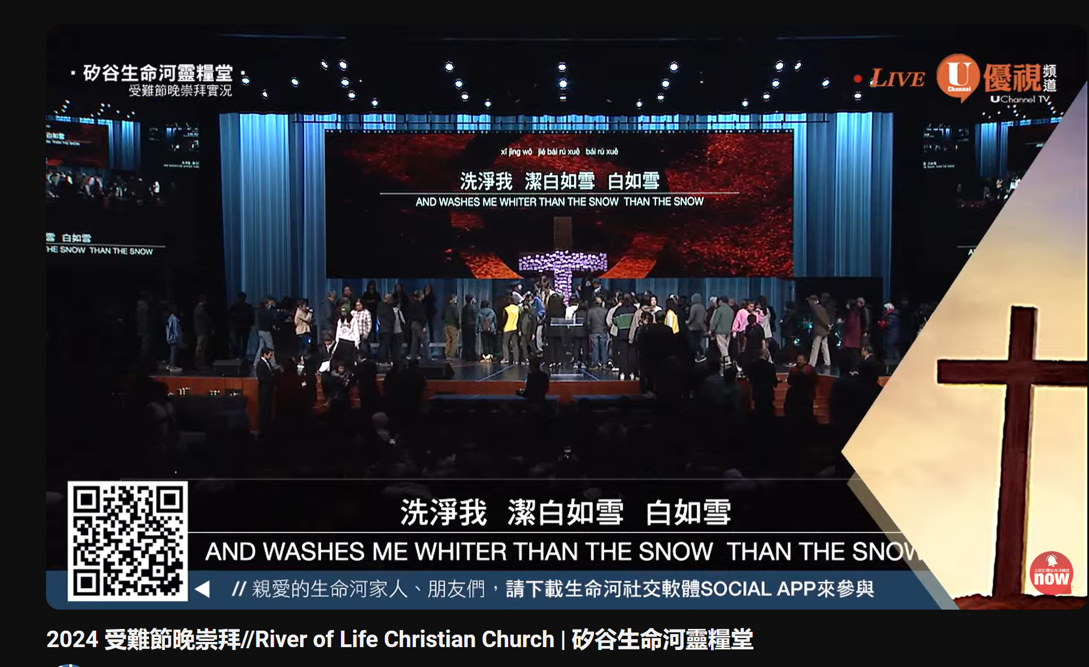

Slide 14
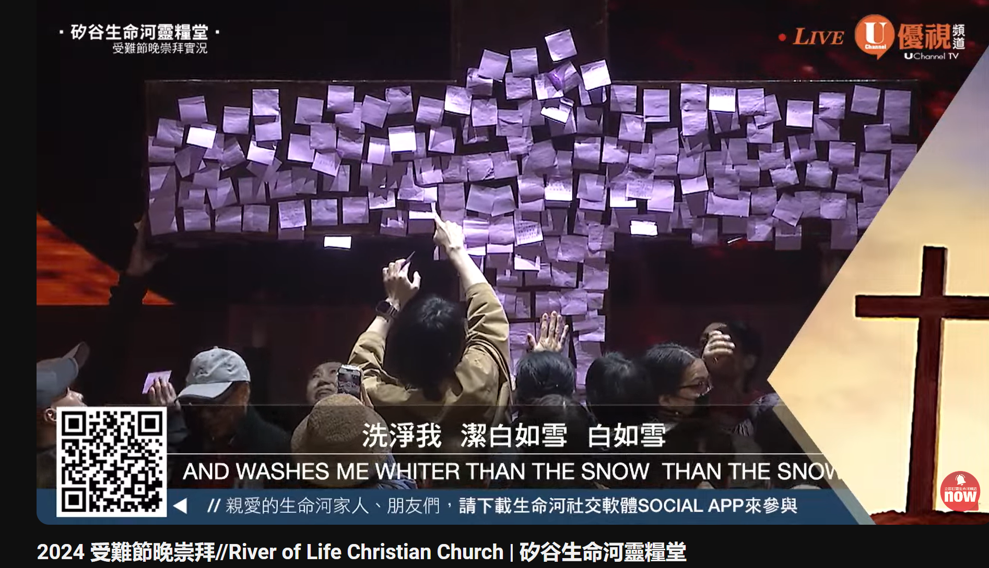

Slide 15
復活真有這麼要緊嗎？
Is Resurrection Truly So Crucial?
波特蘭靈糧堂
March 31, 2024

Slide 16
哥林多前書 1 Corinthians 15:13-15
若沒有死人復活的事，基督也就沒有復活了。 若基督沒有復活，我們所傳的便是枉然，你們所信的也是枉然； 並且明顯我們是為 神妄作見證的，因我們見證 神是叫基督復活了。 若死人真不復活， 神也就沒有叫基督復活了。
If there is no resurrection of the dead, then not even Christ has been raised. And if Christ has not been raised, our preaching is useless and so is your faith. More than that, we are then found to be false witnesses about God, for we have testified about God that he raised Christ from the dead. But he did not raise him if in fact the dead are not raised.

Slide 17
哥林多前書 1 Corinthians 15:16-20
因為死人若不復活，基督也就沒有復活了。 基督若沒有復活，你們的信便是徒然，你們仍在罪裡。 就是在基督裡睡了的人也滅亡了。 我們若靠基督只在今生有指望，就算比眾人更可憐。 但基督已經從死裡復活，成為睡了之人初熟的果子。
For if the dead are not raised, then Christ has not been raised either. And if Christ has not been raised, your faith is futile; you are still in your sins. Then those also who have fallen asleep in Christ are lost. If only for this life we have hope in Christ, we are of all people most to be pitied. But Christ has indeed been raised from the dead, the firstfruits of those who have fallen asleep.

Slide 18


哥林多前書第 15 章的主題
是什麼？
What’s the main theme of 1 Corinthians 15？

Slide 19
哥林多前書 1 Corinthians 15:1-4
弟兄們，我如今把先前所傳給你們的福音告訴你們知道；這福音你們也領受了，又靠著站立得住，並且你們若不是徒然相信，能以持守我所傳給你們的，就必因這福音得救。我當日所領受又傳給你們的：第一，就是基督照聖經所說，為我們的罪死了，而且埋葬了；又照聖經所說，第三天復活了，
Now, brothers and sisters, I want to remind you of the gospel I preached to you, which you received and on which you have taken your stand. By this gospel you are saved, if you hold firmly to the word I preached to you. Otherwise, you have believed in vain.For what I received I passed on to you as of first importance: that Christ died for our sins according to the Scriptures, that he was buried, that he was raised on the third day according to the Scriptures,

Slide 20

哥林多前書第 15 章的主題 ：
The main theme of 1 Corinthians 15：
復活 Resurrection！

Slide 21
哥林多前書 1 Corinthians 15:57-58
感謝 神，使我們藉著我們的主耶穌基督得勝。 所以，我親愛的弟兄們，你們務要堅固，不可搖動，常常竭力多做主工；因為知道，你們的勞苦在主裡面不是徒然的。
But thanks be to God! He gives us the victory through our Lord Jesus Christ. Therefore, my dear brothers and sisters, stand firm. Let nothing move you. Always give yourselves fully to the work of the Lord, because you know that your labor in the Lord is not in vain.

Slide 22
反思 Reflection
我曾經真實的活過嗎？
Have I truly lived before？

Slide 23

回應詩歌 Response Song
「我的救贖者活著
My Redeemer Lives」

